Slide 1
PULLEYS
BY:
DR. DIGVIJAY SHARMA
DIRECTOR
SCHOOL OF HEALTH SCIENCES, CSJMU

Slide 2
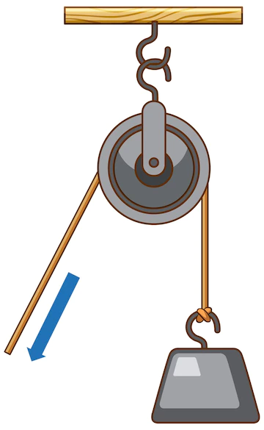
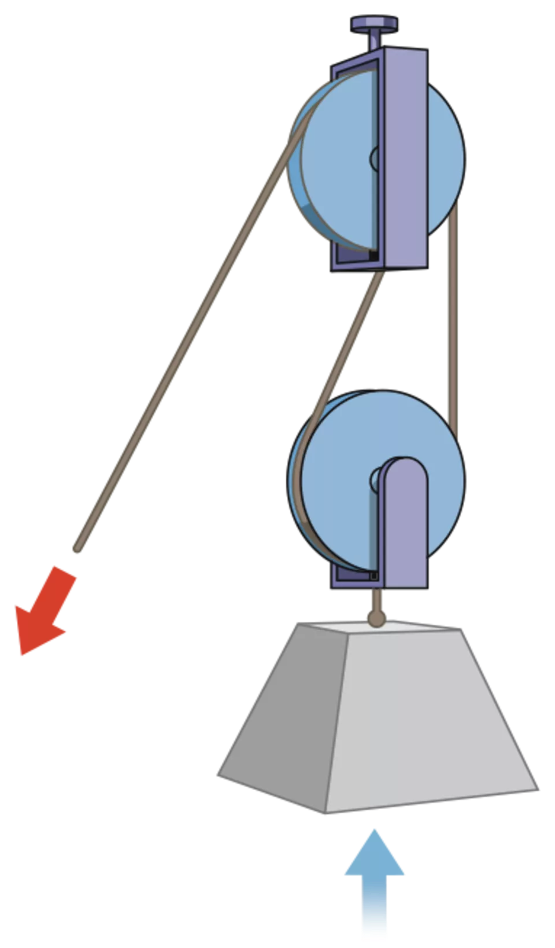
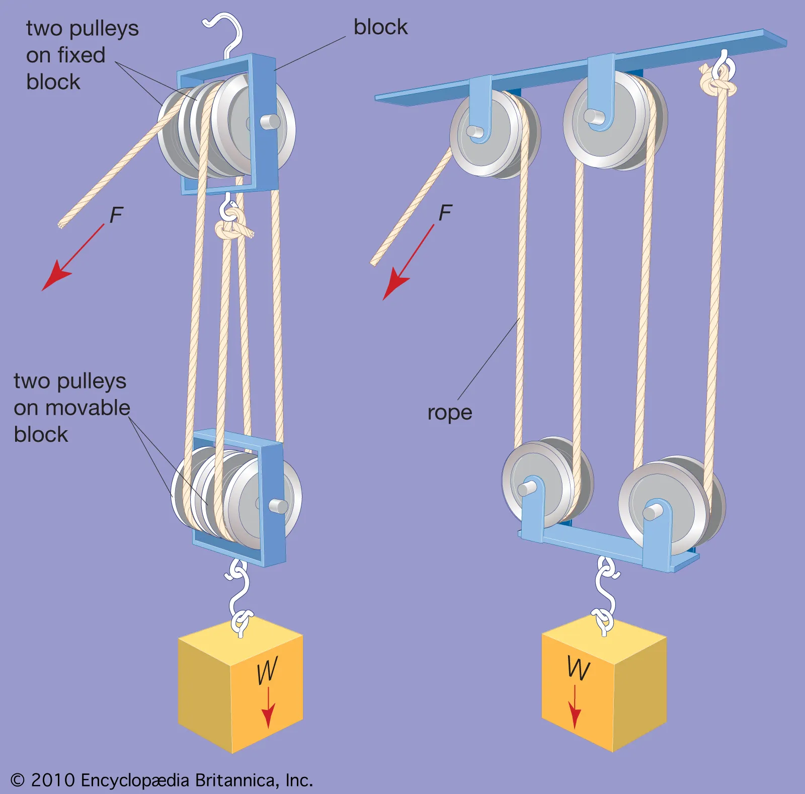
PULLEYS
A Pulley is a grooved wheel which is rotated about a fixed axis by a rope which passes round it
The axis is supported by a framework or block and the whole structure may be used either as a fixed pulley or a movable pulley

Slide 3
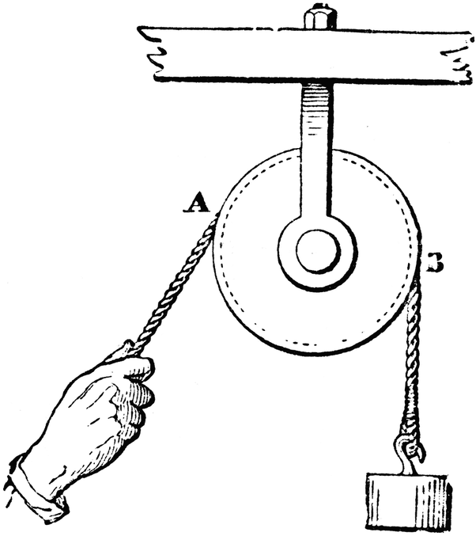
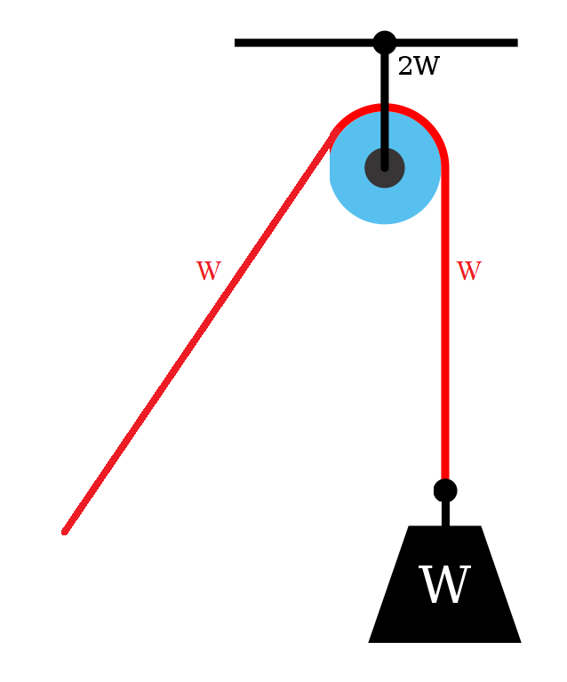
FIXED PULLEYS
This is used to alter the direction of a force and enables traction or weight to be applied at any angle
The pulley block is fixed to some suitable support and the rope which passes round the wheel is attached to the weight at one end and effort on the other

Slide 4
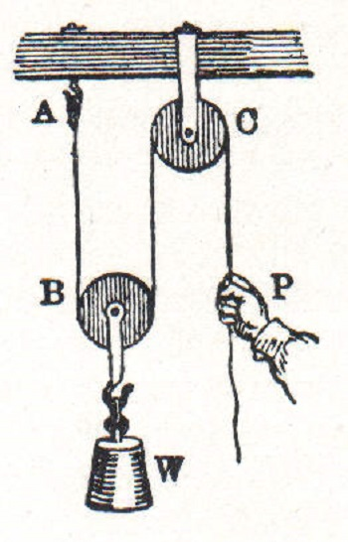
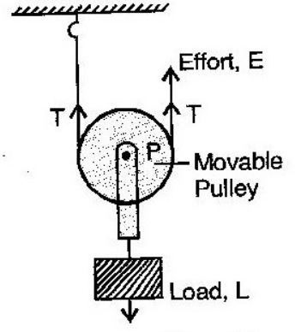
MOVABLE PULLEYS
This is used to gain the Mechanical advantage to lift the heavy weight
The upper pulley is fixed to an overhead support to which the rope is attached
The rope is then wound round the movable pulley, to which the weight is attached
The effort being applied at the free end

Slide 5
EXAMPLE
Example: assume that friction is negligible the tension is same in all parts of the rope then if the weight (W) is 10kg, the tension in each supporting rope will be 5 kg and the effort required will be 5kg. This can be expressed as:
MA= Weight/ Effort
= 10/5= 2
This combination is in common use for lifting the body parts for suspension exercises in Physiotherapy

Slide 6
ANATOMICAL PULLEYS
Something analogous to a fixed pulley system is used in the body by some muscles allow them to be inserted at a more advantageous angle
The main function of pulley system with the body is to change the effective direction of the applied force
When the direction of pull of a muscle is altered the bone or bony prominence causes the deflection forms an anatomical pulley
The pulley changes the direction without changing the magnitude of applied force

Slide 7
Because anatomical pulleys are commonly encountered by muscles in the body, the pull of a muscle (Fms) or muscle segment is considered in such a way that:
The point of application is located on the segment under consideration
At the point of attachment of the muscle on that segment
The muscle action line is in the direction of pull that the fibres or tendons of the muscle create at the point of application
Vectors are straight lines and also must change directions, regardless of any change in direction at the muscle fibre or tendon
Magnitude or length of muscle vector unless given a specific hypothetical value one usually arbitrary because we cant measure the absolute force of a muscle’s pull on bone in most living subjects

Slide 8
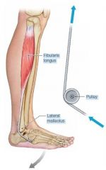
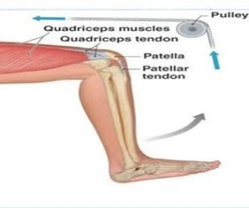

Slide 9
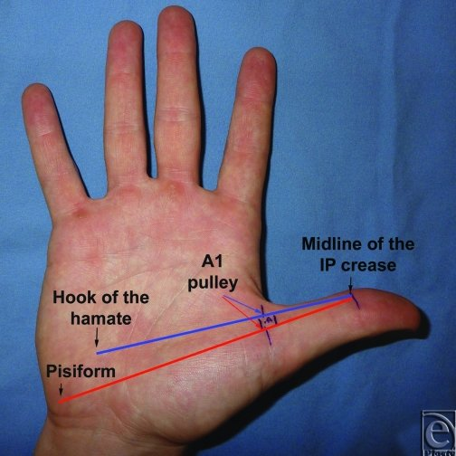
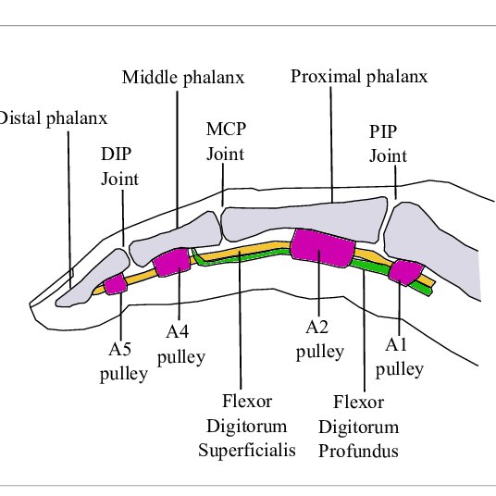
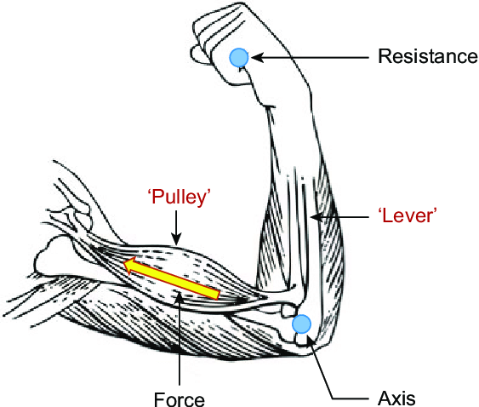
EXAMPLES IN UPPER LIMB
Action line of Deltoid muscle on a schematic representation of the clavicle and humerus
Action line of Deltoid is deflected by the bony contours that form the anatomical pulley

Slide 10
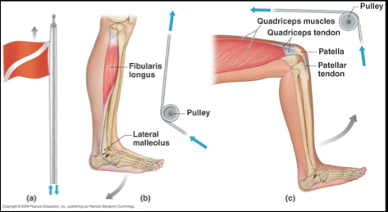
EXAMPLES IN LOWER LIMB
The quadriceps muscle pulls proximally towards their bellies and get the knee action from flexion to extension
The muscular action around the malleolus on the medial and lateral side of the ankle

