Slide 1
PATIENTS
MEDICAL
HISTORY
INTERVIEW

Slide 10
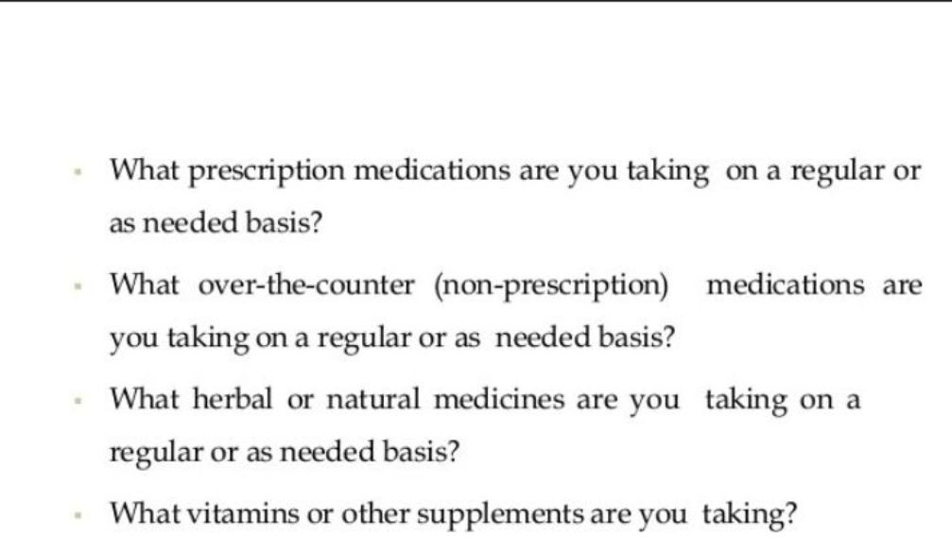

Slide 20
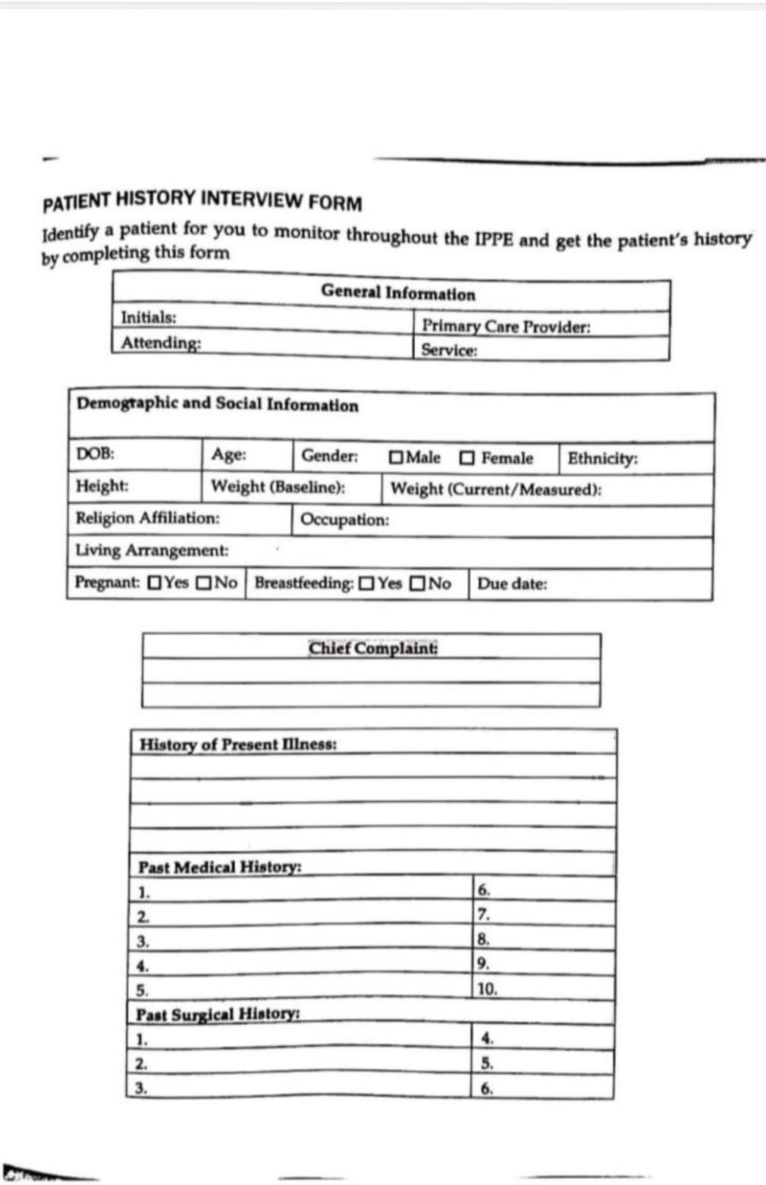

Slide 21
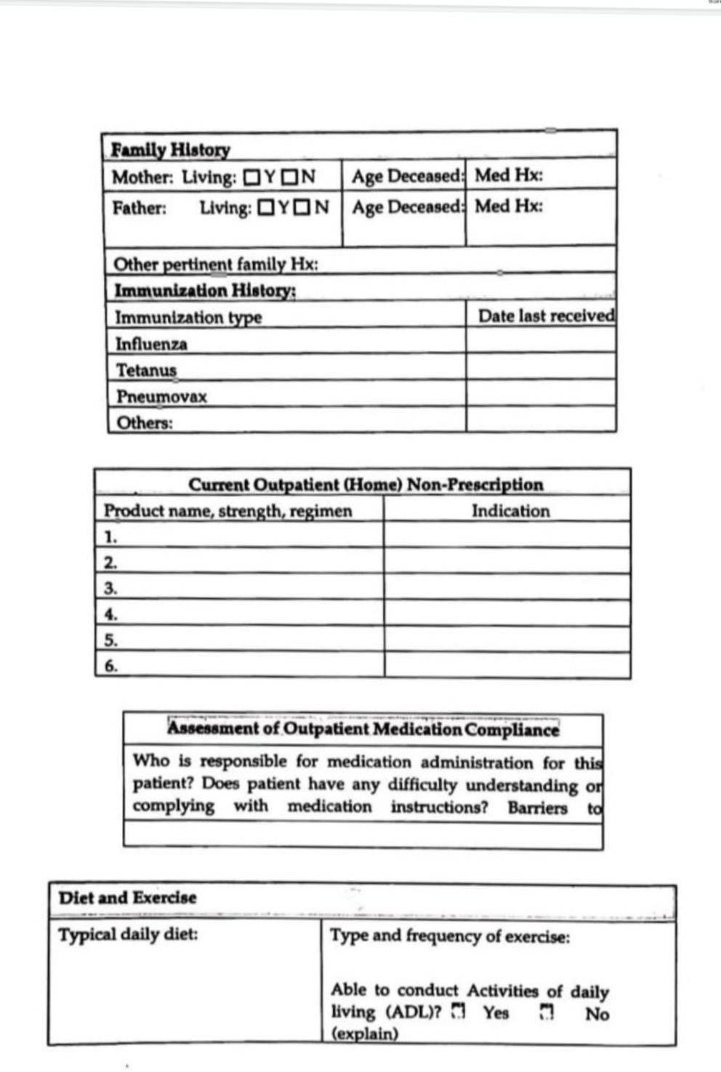

Slide 22
