Slide 1
PERIARTHRITIS SHOULDER
&
ADHESIVE CAPSULITIS/FROZEN SHOULDER

Slide 2
1. Peri-arthritis Is A Common Condition Characterised By Pain And Progressive Limitation Of Abduction & External Rotation Movement Of Shoulder Joint
DEFINITION:-
FROZEN SHOULDER, ALSO CALLED ADHESIVE CAPSULITIS, CAUSES PAIN AND STIFFNESS IN THE SHOULDER. OVER TIME, THE SHOULDER BECOMES VERY HARD TO MOVE.
FROZEN SHOULDER OR ADHESIVE CAPSULITIS DESCRIBES THE COMMON SHOULDER CONDITION CHARACTERIZED BY PAINFUL AND LIMITED BOTH ACTIVE AND PASSIVE RANGE OF MOTION IN ALL PLAINS WITH RADIOGRAPHIC APPEARANCE.

Slide 3
Risk factors for frozen shoulder/PA include:-
Immobilisation Dueto Fracture & Dislocation
The Shoulder Jt.
Bicipital Tendinitis
Rotator Cuff Tendinitis
Stroke,
Lung Disease,
RSD
Thyroid Disease ---- Hyperthyroidism
Heart Disease (CVS) -- Ischemic Heart Diseases
Diabetes Mellitus- insulin dependent diabetes
Tonic Seizures
Strain and Strain and Surgical trauma.
Around

Slide 4
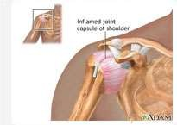
Clinical Feature
YOU SHOULD BE ABLE TO MOVE YOUR SHOULDER IN ALL DIRECTIONS WITHOUT PAIN. TO TEST YOURSELF, DO THESE THINGS:
SHOULDER STIFFNESS INABILITY TO RAISE ARM LIMITED SHOULDER MOBILITY SHOULDER PAIN
SHOULDER IMMOBILITY
RADIATING PAIN DOWN ARM
SHOULDER PAIN; USUALLY A DULL, ACHING PAIN LIMITED MOVEMENT OF THE SHOULDER
DIFFICULTY WITH ACTIVITIES SUCH AS BRUSHING HAIR, PUTTING ON SHIRTS/BRAS PAIN WHEN TRYING TO SLEEP ON THE AFFECTED SHOULDER
IN PA LIMITATION OF ABD. & ER OF GH JOINT.
PAIN FROM FROZEN SHOULDER & PA IS USUALLY DULL OR ACHING. IT IS TYPICALLY WORSE EARLY IN THE COURSE OF THE DISEASE AND WHEN YOU MOVE YOUR ARM. THE PAIN IS USUALLY LOCATED OVER THE OUTER SHOULDER AREA AND SOMETIMES THE UPPER ARM.
TENDERNESS FRONT OF SH. JT.

Slide 5
CLASSIFICATION OF F.A/A.C ADHESIVE CAPSULITIS IS CLASSICALLY
CHARACTERISED BY THREE STAGE:-
FIRST STAGE (STAGE OF PAIN) ---- ( 3 TO 6 MONTH)
SECOND STAGE (STAGE OF STIFFNESS) ---(3 TO 18 MONTH)
THIRD STAGE (STAGE OF RECOVERY )-----(6 MONTH TO 2 YRS.)
FIRST STAGE (STAGE OF PAIN) – IS THE FREEZING STAGE IS CHARACTERISED BY—
*ACHING PAIN IN SHOULDER
*PAIN MORE SEVERE AT NIGHT WITH ACTIVITIES.
*PAIN MAY RADIATES DOWN THE ARM
PATIENTS ADEPT THE ADDUCTION + INTERNAL ROTATION.
DISCOMFORT SHOULDER.
NOTE:- (WHEN IT IS TREATED BY MOBILISATION THEN SYMPTOM BECOME WORSEN THE FREEZING PROCESS).

Slide 6
SECOND STAGE (STAGE OF STIFFNESS) – IT IS ALSO CALLED FROZEN OR PROGRESSIVE STIFFNESS PHASE
PAIN ↓ DURING REST.
*ADL SEVERELY RESTRICTED.
SHOULDER MOTION RESTRICTED
IN ALL PLAIN.
*PATIENT COMPLAIN:-
INABILITY TO REACH IN TO BACK POCKETS.
FASTEN THE BRA.
COMB THE HAIR.
WASH THE OPPOSIT SHOULDER.
PAI AT NIGHT.
STAGE CAN BE LAST FROM 3 TO 18 MONTH
( NOT:- EASILY TREATED WITH MEDICINE AND PHYSICAL THERAPY.)

Slide 7
3) THIRD STAGE (STAGE OF RECOVERY )----
FINAL STAGE IS THROWING OR RESOLUTION PHASE. IT IS CHARACTERISED BY NO PAIN WITH SLOW RECOVERY OF MOTION. LOSS OF EXTERNAL ROTATION WITH ARM AT SIDE OF THE PT. IS HALLMARK OF THIS CONDITION.
(NOTE:- AGGRESSIVE TREATMENT WITH PHYSICAL THERAPY AS CLOSE MANIPULATION AS MAITLAND & MULLIGAN ETC. IF CONSERVATIVE MANAGEMENT IS FAILED THAN SURGICAL RELEASE IS REQUIRED ).

Slide 9
DIAGNOSING OSTEOARTHRITIS:-
X – RAY AP & LATERAL VIEW SHOULDER .
MRI SHOULDER
ORTHROSCOPY OF SHOULDER
ELEVATED ERYTHROCYTE SEDIMENTATION RATE [ESR]
C-REACTIVE PROTEIN [CRP] LEVEL) – INCREASE
ANTI–CYCLIC CITRULLINATED PEPTIDE [ANTI-CCP]
INFLAMMATORY JOINT FLUID WITH A PREDOMINANCE OF
....POLYMORPHONUCLEAR LEUKOCYTES (PMNS)
TLC & DLC , ELEVATED WHITE BLOOD CELL (WBC) COUNT

Slide 10
MANAGEMENT OF PA/FS DRUG MANAGEMENT 1.NSAID:-
ASPIRIN, CELECOXIB (CELEBREX), DICLOFENAC POTASSIUM (CATAFLAM), DICLOFENAC SODIUM (VOLTAREN, VOLTAREN XR), DICLOFENAC SODIUM WITH MISOPROSTOL (ARTHROTEC), IBUPROFEN, INDOMETHACIN (INDOCIN, INDOCIN SR), OXAPROZIN (DAYPRO), PIROXICAM (FELDENE), ROFECOXIB (VIOXX)
MEFENAMIC ACID (PONSTEL), MELOXICAM (MOBIC), NABUMETONE (RELAFEN), NAPROXEN (NAPROSYN, NAPRELAN), NAPROXEN SODIUM, KETOPROFEN

Slide 11
MANAGEMENT :-
THE BASIC AIM OF FROZEN SHOULDER EXERCISES ARE: TO REDUCE PAIN.
TO INCREASE EXTENSIBILITY OF THE THICKENED AND CONTRACTED CAPSULE OF THE JOINT.
TO IMPROVE MOBILITY OF THE SHOULDER.
TO IMPROVE STRENGTH OF THE MUSCLE. HOWEVER IT MAY BE REMEMBERED THAT STRENGTHENING OF MUSCLE IS SECONDARY TO MOBILIZATION.

Slide 12
MANAGEMENT OF PA/F. S. CLASSIFIED INTO THREE STAGE :-
FIRST STAGE (STAGE OF PAIN) ---- ( 3 TO 6 MONTH)
SECOND STAGE (STAGE OF STIFFNESS) ---(3 TO 18 MONTH)
THIRD STAGE (STAGE OF RECOVERY )-----(6 MONTH TO 2 YRS.)
FIRST STAGE (STAGE OF PAIN) ---- ( 3 TO 6 MONTH):-
NSAIDS- FIRST LINE MEDICATION FOR PAIN CONTROL ASSOCIATED WITH ANTACID.
GH JOINT INJECTION: CORTICOSTEROID/LOCAL ANESTHETIC COMBINATION.
ORAL STEROID TAPER- FOR PATIENTS WITH REFRACTIVE OR SYMPTOMATIC FROZEN SHOULDER.
THERAPEUTIC MODALITIES ICE FOR 20 MIN, ULTRASOUND 0.8 TO
1.2 WTTS. FOR 5 TO 7 MINS, HVGS FOR 25 MINS.
APPLY MOIST HEAT BEFORE THERAPY AND ICE PACK AT THE END OF SESSION.

Slide 13
INITIALLY FOCUS ON FORWARD FLEXION AND INTERNAL AND EXTERNAL ROTATION WITH THE ARM AT THE SIDE, AND THE ELBOW AT 90 DEGREES.
ACTIVE ROM EXERCISES.
ACTIVE ASSISTED ROM EXERCISES.
PASSIVE ROM EXERCISES.
A SUSTAINED STRETCH, OF 15-30 SECONDS, AT THE END ROMS SHOULD BE PART OF ALL ROM ROUTINES.
IN HOME THESE FROZEN SHOULDER EXERCISES SHOULD BE PERFORMED 3-5 TIMES PER DAY.
2) SECOND & THIRD STAGE (STAGE OF STIFFNESS & STAGE OF RECOVERY ) ---
CRITERIA FOR PROGRESSION TO STAGE - 2 IMPROVEMENT IN SHOULDER DISCOMFORT. IMPROVEMENT IN SHOULDER MOTION. SATISFACTORY PHYSICAL EXAMINATION.

Slide 14
GOALS
PAIN CONTROL BY SAME MEANS AS USED IN 1ST 8 WEEKS.
IMPROVE SHOULDER MOTION IN ALL PLANE
IMPROVE STRENGTH AND ENDURANCE OF ROTATOR CUFF AND SCAPULAR STABILIZERS.
MOTION: FROZEN SHOULDER EXERCISES
ACTIVE ASSISTED EXERCISES.
PASSIVE RANGE OF MOTION EXERCISES TO OBTAIN
AROUND 140 DEGREE OF
FORWARD FLEXION, 45 DEGREE OF ROTATION.
EXTERNAL ROTATION AND INTERNAL

Slide 15
THERMOTHERAPY
DEEP HEATING MODALITIES SUCH AS SWD, UST, LWD ETC. USING BEFORE PASSIVE MOBILIZATION FOR PROPER RELAXATION OF MUSCLE & LIGAMENT.
GENERAL MOBILIZATION TECHNIQUE:-
*PASSIVE GLIDING WITH LONGITUDINAL TRACTION :- SUPINE, FULL ABDUCTION AND NEUTRAL ROT. WITH ELBOW IN 90°FL. THERAPIST APPLY LONGITUDINAL TRACTION ALONG THE AXIS OF THE HUMERUS, HE CARRIES OUT AP GLIDE & ABD.& ADD GLIDE IN A SLOW RHYTHMIC MANNER. )
* FORWARD STOOPING POSITING:- STABILIZED THE SH. JT. BY ONE HAND & OTHER GRASP THE WRIST THEN SLOW CURCUMDUCTION MOVEMENT IS CARRIED OUT UP TO LIMIT OF PAIN.

Slide 16
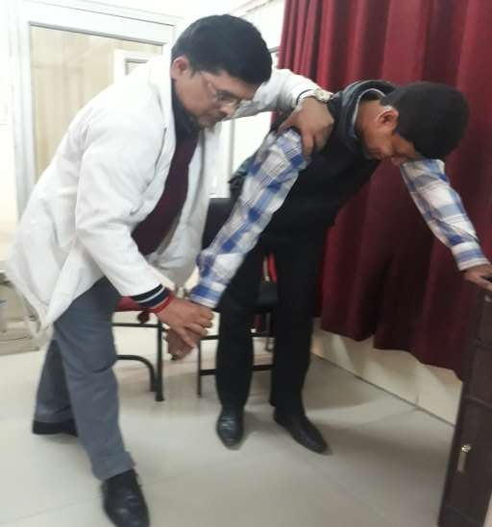
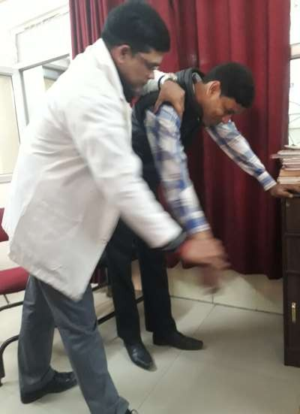
PASSIVE MOBILIZATION OF SH. IN A FORWARD STOOPING POSITING

Slide 17
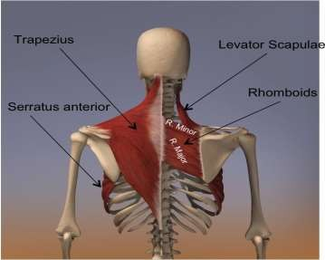
MUSCLE STRENGTHENING
START WITH ROTATOR CUFF STRENGTHENING EXERCISES 3 TIMES/ WEEK, 8-12 REPETITIONS FOR THREE SETS.
CLOSED CHAIN ISOMETRIC STRENGTHENING WITH THE ELBOW FLEXED TO 90 DEGREES AND THE ARM AT THE SIDE. PERFORM INTERNAL ROTATION, EXTERNAL ROTATION, ABDUCTION AND FORWARD FLEXION.
PROGRESS TO OPEN CHAIN STRENGTHENING EXERCISES WITH THERABAND FOR SAME GROUP OF MUSCLES.
PROGRESS TO LIGHT WEIGHT DUMBBELL EXERCISES FOR INTERNAL ROTATORS, EXTERNAL
ROTATORS, ABDUCTORS AND FORWARD FLEXORS.
STRENGTHENING OF SCAPULAR STABILIZERS.
DELTOID STRENGTHENING.

Slide 18
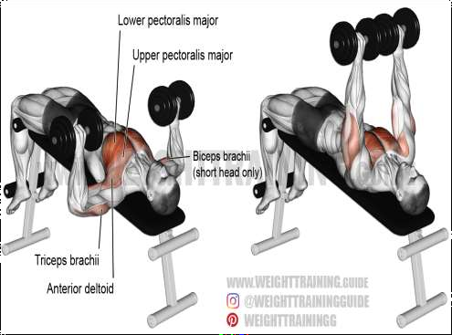
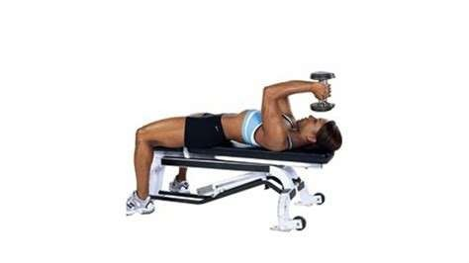
1. LYING DUMBBELL PRESSES
PT. LIE ON SUPINE LYING HOLDING A LIGHT DUMBBELL IN EACH HAND. EXTEND YOUR ARMS VERTICALLY WITH PALMS FACING INWARDS.
NEXT, PUSH YOUR ARMS FURTHER UPWARDS KEEPING THEM PARALLEL TO
EACH OTHER SUCH THAT YOUR SHOULDERS BLADES SEPARATE.
PERFORM BETWEEN 10 AND 20 REPETITIONS OF THE EXERCISE. INCREASE THE NUMBER OF REPETITIONS WITH PRACTICE.

Slide 19
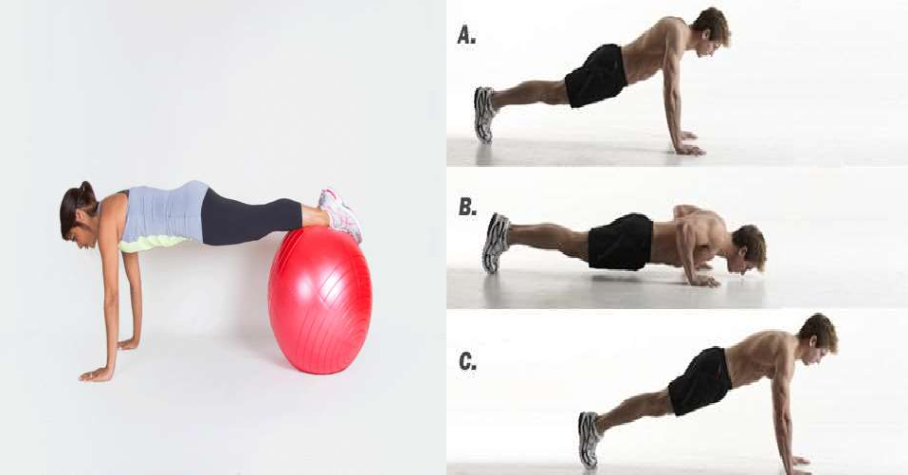
2. PUSH-UP PLUS
HOLD YOURSELF IN A PUSH-UP POSITION: HERE, YOUR BODY IS HORIZONTAL, FACING DOWNWARDS, ARMS EXTENDED WITH YOUR SHOULDERS WIDE APART. KEEP YOUR HEAD IN A STRAIGHT LINE WITH YOUR SPINE.
EXTEND YOUR SHOULDERS TO THE FRONT AND SQUEEZE YOUR SHOULDER BLADES TO BRING YOURSELF UP. KEEPING YOUR ARMS EXTENDED, LET GRAVITY BRING YOU BACK TO THE ORIGINAL POSITION. REPEAT THE WORKOUT 10-20 TIMES DAILY.

Slide 20
3. RHOMBOIDS STRETCH
RHOMBOIDEUS MAJOR AND MINOR ARE TWO IMPORTANT MUSCLES TO KEEP THE SHOULDER GIRDLE IN A FUNCTIONAL STATE.
FIRST PLACE YOUR RIGHT ARM UNDER YOUR LEFT SHOULDER AND THEN PLACE YOUR LEFT ARM OVER YOUR RIGHT SHOULDER AND FEEL THE STRETCH.
HOLD THIS POSITION IN 10 SECONDS AND THEN RELAX. PERFORM 10 REPETITIONS FOR EACH ARM TWICE EACH DAY.

Slide 21
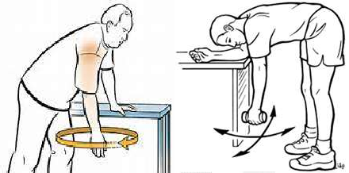
7. PENDULUM EXERCISE
THE PENDULUM EXERCISE IS A PART OF SCAPULAR STABILIZATION EXERCISEIS GREAT FOR WORKING A LARGE NUMBER OF MUSCLES LIKE THE DELTOIDS, SUBSCAPULARIS, ROTATOR CUFFS AND SUPRASPINATUS AND INFRASPINATUS MUSCLES.
LEAN ON A TABLE PLACING ONE OF YOUR HANDS ON THE TABLE FOR SUPPORT. SWING THE OTHER HAND 10-12 TIMES BOTH IN THE BACKWARD-FORWARDS DIRECTION AND LATERALLY. ALSO SWING THE ARM CLOCKWISE AND ANTI- CLOCKWISE.

Slide 22
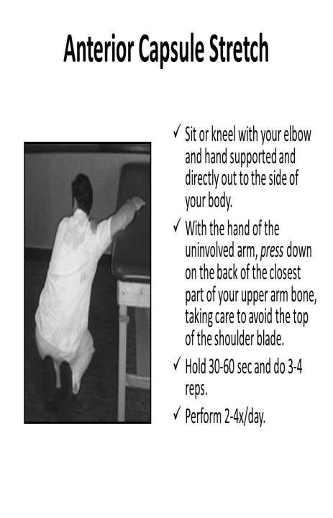
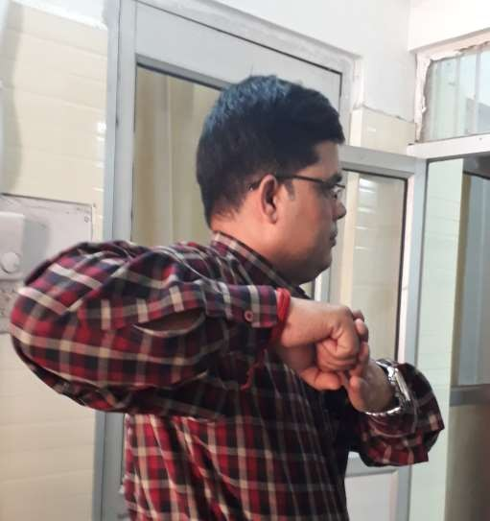
ANTERIOR CAPSULE STRETCHING

Slide 23
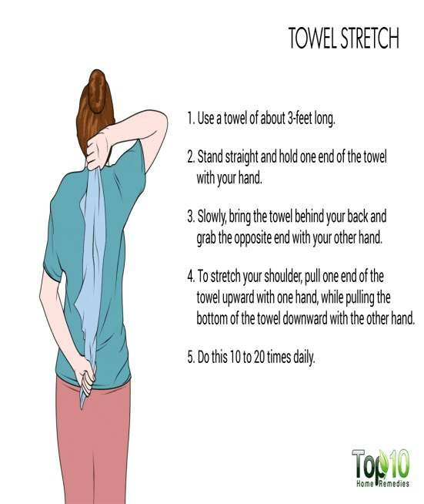
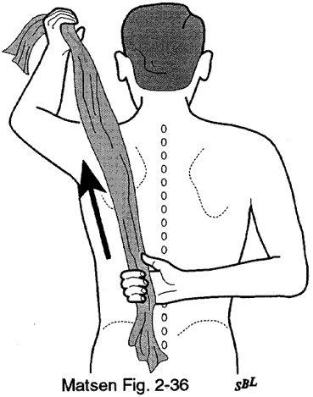
HAND TO BACK POSITION:
TO DECREASE SHOULDER STIFFNESS:-
GRAB YOUR AFFECTED HAND BEHIND YOUR BACK AS FAR AS POSSIBLE. PUSH THE HAND DOWNWARDS INTO THE OPPOSITE HAND AND HOLD FOR 6 SECONDS. RELAX AND SLOWLY BRING THE HAND BACK UP. REPEAT 2 TO 3 TIMES.
Hand to back Sh. Exe.

Slide 24
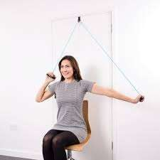
OTHER EXERCISES :
WALL & LADDER EXERCISES EXERCISE.
SHOULDER & WHEEL EXERCISE
FINGER LADDER EXERCISE.
Wall & ladder exe.

