Slide 1
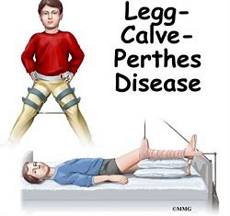
PERTHE’S DISEASE

Slide 2
Other Name
The other name of Perthe’s disease are Legg-Calve , psudocoxalgia, coxa plana .
It is a common pediatric disorder .
It is one of the group of condition called as osteocondroitis of upper femoral epiphysis .
It occurs when the blood supply to the rounded head of the femur is temporarily disrupted.

Slide 3
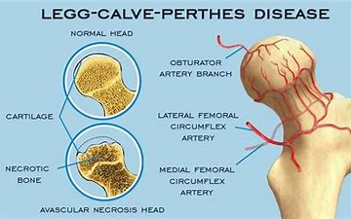
Pathology-

Slide 4
Incidence –
generally male child are affected .
Typically occurs in children who are in between 3-10 years.
Usually effects one hip but can be bilateral.

Slide 5
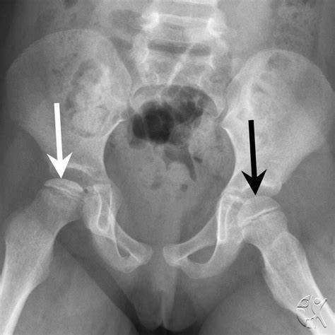
Investigation-
Presentation :- child present with a limb associated with minor degree of pain and variable degree of limitation of movement.

Slide 6
Stages of Perthe’s disease-
There are four stages in perthe’s disease :-
1) initial / necrosis
2) Fragmentation
3) re – ossification
4) remodeling

Slide 7
Pathology-
1) Necrosis :-initial period of ischemia/ loss of blood supply to the femoral head.
2) Fragmentation :- Re-absorption of bone with femoral head collapse .
3) Re- ossification :- new bone re- grows to reshape the femoral head.
4) Remodeling :- femoral head reshapes itself into normal spherical shape.

Slide 8
Clinical Features-
Sign and symptoms of perthe’s disease may include-
Limping
Pain or stiffness in the hip ,groin,thigh or knee
Limited range of motion (ROM) of the hip joint
Pain that worsens with activity and improves with rest .

Slide 9
Non-operative or conservative treatment :-
Rest in the bed with bilateral skin traction this is used in early stages while the diagnosis is being to overcome the muscle spasm.
Activity restrictions
Casting or bracing
Physical theraphy to keep the hip muscles strong and promote hip movements.

Slide 10
Physiotherapy management-
1) Reduction of muscular spasm , pain, and inflammation ,
2) Isometric painless contraction ,
3) intermittent compression of joints ,
4) maintaenance of the range of motion,
5) prevention of contracture ,
6) increase of muscle strength ,
7) Ambulation ,
8) mobilization,
9) strengthening exercises.

Slide 11
Orthosis-
Weight relieving orthosiss – thomas pattern ended caliper with compensatory pattern of normal leg.
The main aim of treatment is to prevent the head from mis-shapening while the bone is in softening phase, is the primary aim of treatment ...whereas, the head is required to be kept inside the acetabulum while the revascularisation takes place ( head containment ) this may be achieved by ( plaster,splints ) conservative method.

Slide 12
Orthosis-
A special brace (scottish –Rite brace ) allows flexion of the hip joint while it is maintained in abduction.
2) The second method is the petrie plaster method .This maintains the hip in 30 degrees of abduction and 20 degrees of internal rotation , with 15 degrees of flexion at the knees.

Slide 13
Management-
The child needs training in balanced standing , weight bearing and ambulatory activities .
On removal of the splint POP cast / brace , active mobilization is to be initiated .
It is progressed from relaxed passive movements to active resisted movements in stages . Hydrotherapeutic pool exercises are very useful at this stage.

