Slide 1
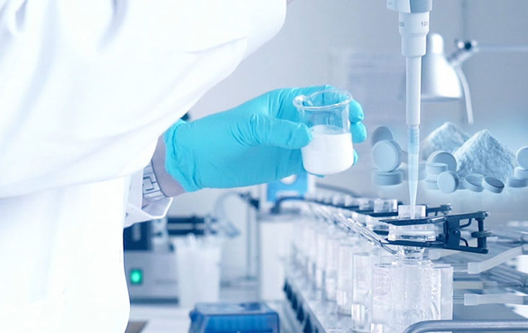
Pre-Formulation Studies
C.S.J.M UNIVERSITY KANPUR
Dr.Kalpana
Part -3

Slide 2
pKa Determination
pKa is the dissociated constant of a drug.
The un-ionized drug is lipid soluble thus permeated through lipid membrane .
The ionized substance is lipid insoluble therefore permeation is slow.
Degree Of ionization depends on PH.

Slide 3
Solubilization
Solubilization is defined as the spontaneous passage of poorly water soluble solute molecules into an aqueous solution of a soap or detergent in which a thermodynamically stable solution is formed

Slide 4
General Method of Increasing the Solubility
Addition of co-solvent
pH change method.
Reduction of Particle size
Temperature change method
Hydro-trophy
Addition of surfactant
Dialectical constant.
Complexation.

Slide 5
Partition Coefficient
A measurement of drug lipophilicity e.g. the ability to cross the cell membrane.

Slide 6
Dissolution
Rate constant of dissolution
Rate constant of absorption
Solid drug in the G.I Fluid
Drug in solution in the G.I fluid
Drug systemic circulation
K d
K a
When kd<< Ka dissolution is significantly slower and the absorption is described as dissolution rate- limited.
The dissolution rate of drug substance in which surface area is constant during dissolution is described by Noyes-Whitney eq.

Slide 7
Noyes-Whitney eq.

Slide 8
Constant surface area is obtained by compressing in to a disc of known area with a die and punch apparatus.
Hydrodynamic condition are maintained with static-disc dissolution apparatus and Rotating disc apparatus.

Slide 9
Stability Analysis
1.Solution stability.
2. Solid State stability.
Solution stability:-The decomposition of drug occurs through hydrolysis,oxidation,Photolysis.
Solid State stability-
Objective :- identification of stable storage conditions.
identification of compatible excipients.
Solid-state stability depend on the tempreture,light,humidty,polymorphic chnages,oxidation.

Slide 10
Chemical Properties
Cyclodextrine molecules have cylindrical shape with central axial cavity and resemble with shape of truncated cone.
The interior cavity is hydrophobic and the out site of the molecule is hydrophilic

Slide 11
Drug Stability
The potency should not fall below 95% under the recommended storage condition and the product should still look and perform as it did when first manufactured.
Drug degradation occurs by four main processes.
Hydrolysis
Oxidation
Photolysis
Trace metal catalysis

Slide 12
Drug - Excipient compatibility
Compatibility test play a very important role in the preformulation studies of oral forms.
An incompatibility in the dosage form can result in any of the following change:-
Change in organoleptic properties.
Physical form conversion
An decrease in potency.

Slide 13
Method

Slide 14
Method Of Analysis
1.Thermal method Of analysis.
DSC
DTA
2.Accelerated Stability study.
3.FTIR Spectroscopy.
4.Chromatography.
TLC, HPLC, Self interactive chromatography.
5.DRS
6.Miscellaneous.
Vapour pressure osmometry
Fluorescence's Spectroscopy
Radio - labelled techniques.

Slide 16
Thank You

