Slide 1
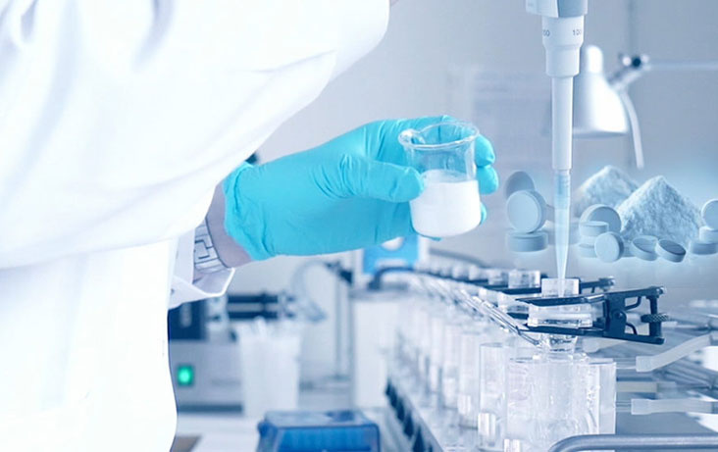
Pre-Formulation Studies
C.S.J.M UNIVERSITY KANPUR
Dr.Kalpana
Part -2

Slide 2
What to consider before starting a preformulation study ?
Scientists must think about a few things before starting preformulation investigations.
Available physicochemical data, such as chemical structure, various salts, potency in comparison to competing products, and dose form, among other things.
The proposed route of drug administration and the expected dose.
Supply situation and development schedule.
Availability indicating assay.

Slide 3
Evaluated Parameters in Preformulation studies
Physical characteristics:-
Organoleptic properties of the candidate drug molecule e.g., colour, odour and taste.
Bulk characterization e.g., particle size and surface area, powder flow properties, density, compressibility, crystalline, polymorphism and hygroscopicity.
Solubility analysis e.g., ionization constant/ drug Pka, partition coefficient, solubilization, thermal effect, common ion effect (Ksp) and dissolution.
Stability analysis e.g., solution-state stability testing, solid-state stability testing, and drug-excipient compatibility studies.

Slide 4
Chemical characteristics
Isomerization
Hydrolysis
Oxidation
Polymerization
Photostability
Racemization

Slide 5
Physical Properties
Organoleptic properties:-
Colour,odour,taste of the new drug must be recorded.
Colour | Odour | Taste
Off-white | Pungent | Acidic
Cream yellow | Sulphourous | Bitter
Itan | Fruity | Bland
Shiny | Aromatic | Intense
 | Odurless | Sweet
 |  | Tasteless

Slide 6
Bulk Characterization
Crystalline:-
Crystal habit is description of outer appurtenance of crystal.
Internal structure is molecules arrangement with in the solid.
Crystal habit & Internal structure of drug can affected bulk & physiological properties of molecules.
Change with internal structure usually alter crystal habit.
Eg:-Conversion of sodium salt to its free acid produce both change in internal structure & crystal habit.

Slide 7
Different shapes Of Crystals
Depending on internal structure compounds is classified as
1.Crysalline.
2.Amorphous.

Slide 8
Polymorphism
It refers to a compound's ability to crystallize as multiple separate crystalline species with differing internal lattices.
Polymorphs are different crystalline forms.
There are two sorts of polymorphs.
1.Enatiotropic.
2.Monotropic.
Enantiotropy polymorph is a type of polymorph that can transform from one state to another by altering temperature or pressure.
for example:- Sulphur
Monotropic polymorphs are polymorphs that are unstable at all temperatures and pressures.
for example:- Glycerl stearate

Slide 9
Polymorphs differ from each other with respect to their physical property such as:-
Solubility
Melting point
Density
Hardness
Compression characteristic.
Eg. Chloromphenicol exist in A.B & C form of these B Form Is more stable & most Preferable

Slide 10
Particle Size
Particle size is characterized using these terms:-
Very coarse, Coarse, Moderately coarse, Fine ,Very fine.
Particle size can influence variety of importance factors
Dissolution rate
Suspend-ability
Uniform distribution
Penetrability
Lack of grittiness.

Slide 11
Method to determine Particle size
Sieving (5u-15u)
Microscopy (0.2u-100u)
Sedimentation rate method (1u-200u)
Light energy diffraction (0.5u-500u)
Lesser holography (1.4u- 100u).

Slide 12
Powder Flow Properties
Powder flow properties can be affected by change particle size, shape & density.
The flow properties depend upon following-
Force of friction.
Cohesion b/w one particle to another.
Fine particle posses poor flow by filling void spaces b/w large particle causing packing & desification of particles.
By Using glident we can alter the flow properties
Eg:- Talc

Slide 13
Determination of powder flow properties
By determining Angle of Repose.
A grater angle of repose indicate poor Flow.
It should be less than 30 degree & can be determined by following equation.

Slide 14
Method to determine angle of Repose
Static angle of repose.
Fixed-funnel method
Fixed-cone method
Kinetic or dynamic method
Rotating Cylinder method.
Tilting box method.

Slide 15
Determination of powder flow properties
Measurement of free flowing powder by compressibility.
Also known as Carr’s index
It is simple. Fast & popular method of predicting powder flow characteristics.

Slide 16
Determination of powder flow Properties

Slide 17
Solubility Studies
Solution phase equilibrium with solid phase at a stated temperature and pressure.
Determination amount of drug dissolved. Amount of drug available for absorption.
Solubility reduction is carried out in certain conditions.
Enhancement of chemical stability.
Taste masking products.
Production of sustained release products.

Slide 18
The equilibrium solubility is based on the phase-solubility technique proposed by Higuchi-Connors.
Method
Drug dispersed in solvent in a closed container.
Agitated at a constant temperature using shakers.
Sample of the slurry are withdrawn as a function of time.
Clarified by centrifugation and assayed by HPLC,UV,GC, etc.

Slide 19
Thank You

