Slide 1
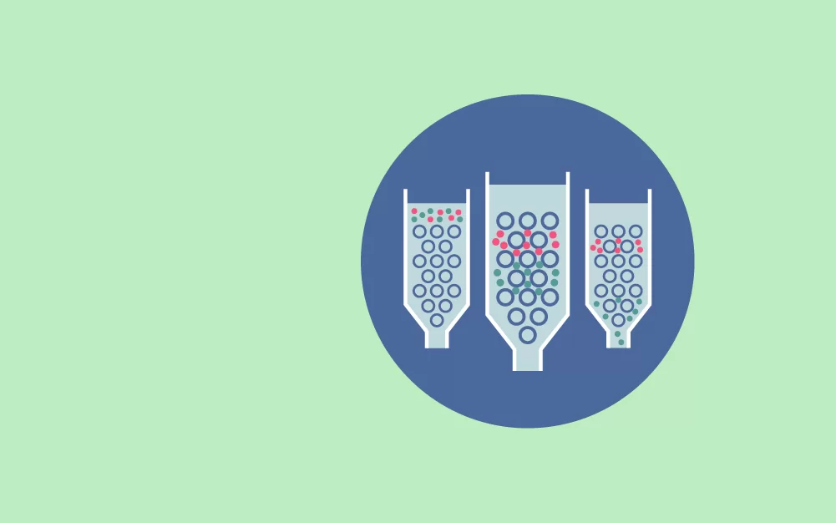
GEL FILTRATION CHROMATOGRAPHY
DR RAJESH KUMAR
Dept. Of Life Sciences,CSJMU

Slide 2
INTRODUCTION
Gel Filtration is a separation technique which is strictly based on molecular size. It is a helpful method to separate the macromolecule of different sizes from one another. It is also known as Gel permeation, molecular, size exclusion or molecular sieve chromatography. Water is a mobile phase in Gel filtration chromatography whereas organic solvent used as a mobile phase in case of Gel permeation Chromatography.

Slide 3
GENERAL PRINCIPLES
Gel filtration chromatography is a special case of partition chromatography because the stationary phase is the same as the mobile phase. The stationary phase is in form of porous
when a sample containing solutes varying from small to large molecules elutes through column. Small molecules penetrate all pores and are retained, thus being eluted later than large molecules, which move only in mobile phase. Molecules of intermediate size penetrate only some pores, thereby being retained to a laser degree than small ones. The elution of the solute is best characterized by a distribution coefficient, Kd.
Kd = Ve – Vo / Vs
Vo = Volume of solvent required to elute an unretained compound; also called " void volume''.
Ve = Volume of the mobile phase required to elute a compound from the chromatographic column.
Vs = Volume of the stationary phase.
The Distribution Coefficient is thus represented as
Kav = Ve –Vo / Vt – Vo
Vt = Volume of the chromatographic column
Whereas ,Kav represents the fraction of the stationary gel volume.(not a true partition coefficient)
Ve –Vo represents the volume of the gel-forming substance.

Slide 6
TYPES OF MEDIA
The best-known media for gel-filtration are based on dextran, a polymer of glucose cross-linked with epichlorohydrin. These are called Sephadex. The degree of swelling is determined by the degree of cross-linking.

Slide 7
(i) Sephadex: The Sephadex types are designated by G, followed by a number which corresponds to ten times the water regains, the number of millimeters of water taken by 1 gm of dry gel matrix. Thus, the commercially available series: Sephadex G-10, G-15, G-25, G-50, G-100, G-200 have fractionation ranges for proteins of molecular weights up to 600,000 Daltons.
Sephadex also swells in organic solvents such as dimethyl sulphoxide, formamide, dimethyl formamide and mixtures of lower alcohols with water. However, the degree of swelling in these organic solvents or their mixtures is less than in water alone. The Sephadex series, LH-20, LH-60 and Sephacryl are suitable for organic solvents. SEPHADEX LH types are specially prepared for gel filtration in organic solvents. These are prepared by the hydroxy- propagation of Sephadex G-50. Which have both hydrophilic and lipophobic properties.

Slide 8
(ii) Sepharose: This gel is based on agarose, it is used mostly for the fractionation of large molecules. The agarose base is obtained by the purification of agar devoid of charged polysaccharides. The polysaccharide chains in agarose consist of D-galactose and 3,6 anhydro-L-galactose forming double helices like DNA which aggregate on ageing to form bundles. These bundles are mechanically strong with pore size capable of fractionating macromolecules of different molecular weight.
(iii) Sephacryl: This is an example of a mixed gel, (agarose and poly- acrylamide). The agarose forms a support frame for the polyacrylamide gel. It is prepared by covalently cross-linking allyl dextron with N' N' - methylene bis acrylamide to give a rigid gel with a carefully controlled range of pore size.

Slide 9
S No. | Types of Sephadex | Fractionation range for Peptides and globular proteins, MW(Daltons) | Water Regain Gm Water/gm Dry Gel | Bed Volume Cm./gm. Dry Gel | Types of Bio-gel | Fractionation Range (Dalton)
1 | G-10 | Up to 700 | 1.0 | 2.0 | P -2 | 100-1800
2 | G-15 | Up to 1500 | 1.5 | 3.0 | P -4 | 800-4000
3 | G-25 | 1000-5000 | 2.5 | 5.0 | P -6 | 1000-6000
4 | G-50 | 1500-30000 | 5.0 | 10.0 | P -10 | 1500-20000
5 | G-75 | 3000-70000 | 7.5 | 12-15 | P -30 | 2500-40000
6 | G-100 | 4000-150000 | 10.0 | 15-20 | P -60 | 3000-60000
7 | G-150 | 5000-450000 | 15.0 | 12-30 | P- 100 | 5000-100000
8 | G-200 | 5000-800000 | 20.0 | 30-40 | P- 150 | 15000-150000

Slide 10
Type | Approximate Agarose Concentration In %(w/v) | Approximate Exclusion Mol. Wt.(Daltons)
Sepharrose-2B | 2 | Polysaccharides 20 X 10⁶ | Protein 40 X 10⁶
Sepharrose-4B | 4 | 5 X 10⁶ | 20 X 10⁶
Sepharrose-6B | 6 | 1 X 10⁶ | 4 X 10⁶

Slide 11
CHARACTERISTICS OF GEL MATRIX
The characteristics of such gels are enumerated below:
(a) Chemically inert: The gel matrix should be inert. Any chemical interaction between the matrix and solutes may lead to irreversible binding to the gel material and chemical alterations of labile substances.
(b) Stability: The matrix must be stable over a wide range of pH and temperature.
(c) Controlled particle size and size distribution: The particle-size must possess good flow rate characteristics. Therefore, it is essential that the particle size distribution be as narrow as possible.
(d) Mechanically rigid: This is essential for the gel particles, so as to prevent deformation by the forces caused by the flow of liquid (solvent)

Slide 12
APPLICATIONS OF GEL FILTRATION CHROMATOGRAPHY
There are many different applications of gel permeation chromatography. These have been employed in biomedical research problems and clinical laboratory. These include:
(i) Separation of polysaccharides, enzymes, antibodies and other proteins.
(ii) Separation of nonpolar species such as triglycerides in non-aqueous mobile phases.
(iii) Desalting process i.e., removal of salt and buffer ions from protein solutions as an alternative to dialysis.
(iv) Phenol removal from nucleic acid preparations.
(v) Removal of products, viz., co-tactors and inhibitors from enzymes.

Slide 13
bibliography
Textbook of Analytical Chemistry by G.D. Christian
J.A. Dean ,Chemical Separation Methods , New York
Textbook of current status of Chromatography by K.P. Hupe

