Slide 1
Compression and compaction Unit IV MPH: 103 T (Modern Pharmaceutics)
(Dr.) Anupriya Kapoor
Assistant Professor
School of Pharmaceutical sciences, CSJMU, Kanpur
In-Campus

Slide 2
Learning Objective
After going trough the slides, students would be able to understand
Physics of tablet making
Force involved in tablet making
Compaction profile
Effects of friction

Slide 3
Learning outcome
Students would be able to understand
The basic of tablet making and knowledge of Compression, compaction and consolidation
The type of forces involved in tablet compression
Distribution of forces in tablet press

Slide 4
Tablets
Tablets are defined as the solid unit dosage form of medicament or medicaments with suitable excipients. It comprises a mixture of active substances and excipients, usually in powder form, pressed or compacted from a powder into a solid dose.

Slide 5
Definitions
Compression: the reduction in bulk volume of material on application of external mechanical forces.
Consolidation: it is the increase in mechanical strength of material due to particle – particle interaction.
Compaction: it is a term that indicates compression and compaction of two phase system due to application of applied forces.

Slide 6
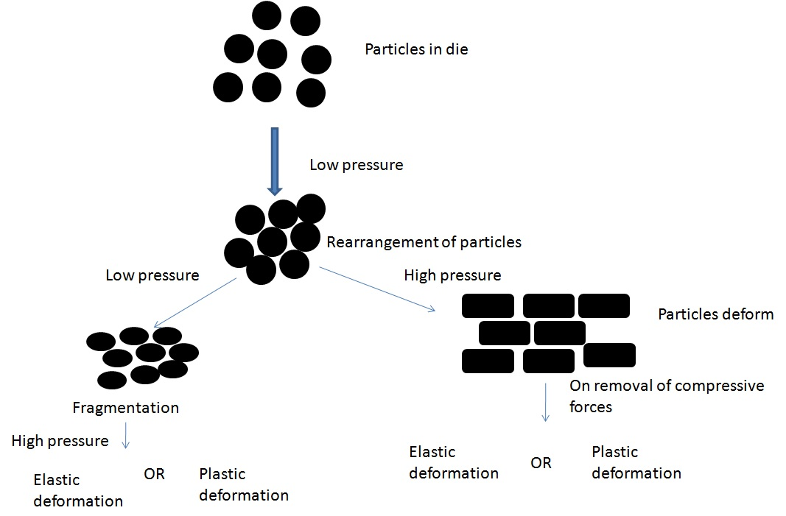
Particle rearrangement during compression

Slide 7
Consolidation
The phenomena of consolidation is observed when two particles approach each other and the inter-particle distance between them in 50nm or less
Factors governing consolidation
The chemical nature of the materials
The extent of the available surface
The presence of surface contaminants
The inter-surface distances

Slide 8
Types of consolidation
Types
Cold welding
Fusion bonding
Cold welding: when two surfaces approach each other and are close enough, their free surface energies result in strong attractive forces. The phenomena is referred as cold welding.
Fusion bonding: when load is applied to the bed of particle the heat is generated due to friction, if the heat is not dissipated their is local rise in temperature that causes the melting of contact area, the melt solidifies giving rise to fusion bonding

Slide 9
Compaction profiles
It is the hysteresis curves that establish the relationship between axial pressure and radial pressure
The compaction cycle consist of two types of forces
Axial force
Radial force
Axial force: vertical component that is applied by the upper punch during compression
Radial force: horizontal component observed in the die wall, when the powder mass attempt to expand in the die

Slide 11
Compression Phase
OA - Represents repacking of granules or powders.
AB - Represents elastic deformation which continues up to B (elastic limit)
BC - Represents plastic deformation and brittle fracture. Point C indicates the maximum compression force.
Decompression phase:
CD - Represents elastic recovery on the removal of applied force.
DE - Represents recovery from plastic deformation
E - Represents residual force, which holds the compact in the sides of the die.
Ejection force must be greater than residual force

Slide 12
Effect of friction
Frictional forces are interparticulate friction & die wall friction.
Interparticulate friction forces occur due to particle-particle contact & it is more significant at low applied load . These forces are reduced by using glidants e.g. colloidal silica .
Die wall friction forces occur from material pressed against die wall & moved it is dominant at high applied load These forces are reduced using lubricants e.g. magnesium stearate

Slide 13
Components of frictional forces
Interparticulate friction
Die-wall friction
Interparticulate friction: The type of friction arises at particle /particle contacts and can be expressed in terms of coefficient of interparticulate friction.
interparticulate friction = µ_{i}
Die-wall friction: The friction originates as a result of material being pressed against the die wall and moved down it. The effect is predominating at high applied forces when the particle rearrangement has ceased.
Die-wall friction = µ_{W}

Slide 14
Distribution of forces
The fundamentals of tabletting have been carried out on single-station press or even on isolated punch & punches with hydraulic press.
When force is being applied to top of a cylindric powder mass, the following basic relationship applies, since there must be an axial (vertical) balance of forces.
F_{A} = F_{L} + F_{D}

Slide 15
F_{A} = force applied on the upper punch
F_{L} = proportion of force transmitted to the lower punch
F_{D} = is the reaction at the die wall due to friction at this surface
Since there exist an inherent difference between the force applied on the upper punch and that affecting material close to lower punch, a mean compaction force F_{M} is experienced
F_{M} = (F_{A} + F_{L})/2

Slide 16
Since there is an exponential decay of applied transmission force, the most appropriate equation can be expressed in terms of geometric mean force, F_{G}
F_{G} = (F_{A} . F_{L})^{0.5}

