Slide 1
Promotion
Dr Digvijay Sharma
School of health Sciences

Slide 2
Definition
In marketing, promotion refers to any type of marketing communication used to inform target audiences of the relative merits of a product, service, brand or issue, most of the time persuasive in nature. It helps marketers to create a distinctive place in customers' mind, it can be either a cognitive or emotional route. The aim of promotion is to increase brand awareness, create interest, generate sales or create brand loyalty. It is one of the basic elements of the market mix, which includes the four Ps, i.e., product, price, place, and promotion.^{[1]}
Promotion is also one of the elements in the promotional mix or promotional plan. These are personal selling, advertising, sales promotion, direct marketing publicity, word of mouth and may also include event marketing, exhibitions and trade shows.^{[2]} A promotional plan specifies how much attention to pay to each of the elements in the promotional mix, and what proportion of the budget should be allocated to each element.

Slide 3
Objective
There are three objectives of promotion. These are:^{[6]}
To present information to consumers and others.
To increase demand.^{[7]}
To differentiate a product.

Slide 4
Promotions mix
The promotions mix (the marketing communications mix) is the specific blend of promotion tools that the company uses to persuasively communicate customer value and build customer relationships.”
-Philip Kotler

Slide 5
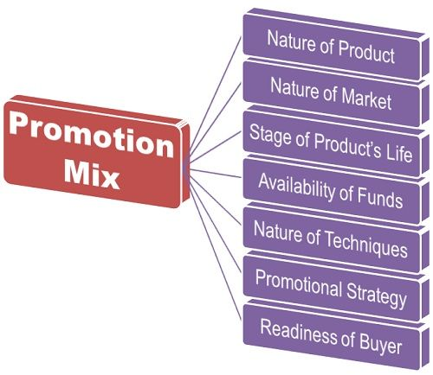
Promotion Mix
.

Slide 6
Purpose
The main purpose of promotion is to educate your audience regarding your products or service. Imagine if nobody knows about your products or services about how they can buy your products or services.
Some people think Promotion is only used for an increase in sales but that’s not true it is one aspect of Promotion.
Promotion plays different roles in Your Company’s marketing Plan i.e, Recall your brand value in Target audience, increase brand awareness or introduce your brand to a new audience.
The Promotion mix is a blend of different promotional tools used by businesses to create brand awareness and sales.

Slide 7
Types of Marketing Promotion
There are the following types of promotion in the marketing mix.

Slide 8
1. Personal Selling
The first type of Promotion is Personal selling in which an individual is involved in an interaction with customers with objective sales. It is an effective way to manage personal customer relationships.
In Personal selling, an individual called a salesman acts on behalf of the organization. A salesman is a trained person in approaches and techniques of direct selling. These salespersons are very expansive and only used where the product margin is so high.

Slide 9
2. Sales Promotion
Sales promotions tend to be thought of as being all promotions apart from advertising, personal selling, and public relations. It includes free coupons, limited time off, free accessories.
The main objective of sales promotion is to attract customers whether its new customers or existing customers. It is a very effective promotional tool that is used by several big companies to increase their sales.

Slide 10
3. Public Relation
Public Relations is a mutual understanding between the organization and its customers, investor there and other stakeholders. Public Relation is a very important tool for an organization which aims to maintain a particular image in the minds of customers, investors, and stakeholders.

Slide 11
4. Direct Marketing
Direct Marketing is a form of communication between an organization and its customers in which the company directly communicates with its customers.

Slide 12
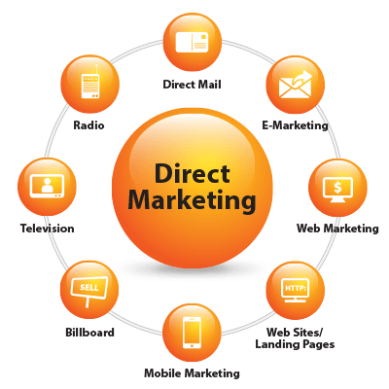
Direct marketing
.

Slide 13
Examlpe
Harpic which is sold on almost every shop but if a salesman from a company directly goes to their pre-defined customers to sell their products its called Direct Marketing. We can also say that direct marketing is any marketing undertaken without an intermediator.

Slide 14
5. Advertising
Advertising is a paid way to communicate with the audience. Advertising is an effective tool for promotion which also helps in increasing brand awareness and increase sales.
There are a lot of paid ways i.e, Newspapers, Television, cinema and outdoor advertising. Nowadays Digital Advertising is also trending which one we will cover later.

Slide 15
6. Sponsorship
Sponsorship is a way whereas an organization pays to feature in a particular event and cause. Nowadays companies sponsor Events, movies, and crickets.
Sponsorship is also an effective tool for Promotion in marketing. For Example, you have sponsors A IPL league, a lot of People watch IPL every Now Your Brand name will be shown to this person which indirectly markets your brand to this audience.

Slide 16
7. Trade Fair & Exhibition
Trade Fair & Exhibition is another effective tool that is mostly used by B2b business for making new business Contacts. Trade Fair Provides a great opportunity to both buyers and customers.

Slide 17
8. Online Promotion
Online Promotion is a Digital way to promote your products and service. All the tools we have discussed yet are offline. Online Promotion is now in trend and saves a lot of marketing costs. In Online promotion, we use Social Media Advertising and Pay Per Click advertising to promote products or services.

Slide 18
Importance of promotion
Increase Brand Awareness- The first big advantage of Promotion is Promotion increases your brand awareness. Brand Awareness means How much people know about the brand. If nobody knows about your product or service then how they can buy your product or Service. So the first thing you need for sales is to increase brand awareness. If a lot of people will know about your product or service there are high chances that some people from them will buy your products.

Slide 19
Recall Brand value- The other big advantage of Promotion is its Recall your Brand among your targeted audience. Let’s understand it with an example You Know Dettol Handwash And Almost everyone knows about Dettol Handwash and the reason behind we know about Dettol is called brand awareness.
We are aware of Dettol Handwash, still, Dettol advertises brand a lot the reason behind this Brand Recall. As we saw their advertising, again and again, we will remember their brand and ultimately buy their brand.

Slide 20
Increase Customer Traffic- Promotion Also Increase traffic. As we have discussed earlier Promotion increase brand awareness and Recall brand Value, Its quite simple its increase customer traffic.
Increase Sales And Profit- Promotion increase sales because Sales is proportionate to brand awareness and brand recall value. If Sales increases then it ultimately increases your Profit.

Slide 21
Refrences
McCarthy, Jerome E. (1964). Basic Marketing. A Managerial Approach. Homewood, Illinois: Irwin. pp. 769. ISBN 0256025339.
^ Jump up to:ª ^{b} Rajagopal (2007). Marketing dynamics theory and practice. New Delhi: New Age International. ISBN 978-81-224-2712-7.
^ Online Etymology Encyclopedia, <Online: "Archived copy". Archived from the original on 2018-01-08. Retrieved 2018-01-07.>
^ Online Etymology Encyclopedia, <Online: "Archived copy". Archived from the original on 2018-01-08. Retrieved 2018-01-07.>
^ Pickton, D. and Broderick, A. Integrated Marketing Communications, Harlow, Essex, Pearson, 2005, pp 4–5
^ Boone, Louis; Kurtz, David (1974). Contemporary marketing. Hinsdale, Illinois: Dryden Press. ISBN 978-0-03-088518-1.
^ instead of spending on free samples, giving a larger amount to a paying customer to whom an expiration date matching that of the small size promotes self-medicating Christina Thompson (December 13, 2015). "Philadelphia Lawyer Finds His True Passion In Technology". CBS. Why is the 100-count Advil only 25% more than the 50-count?
https://lapaas.com/what-is-marketing-promotion-complete-guide/

