Slide 1
Recruitment and selection
Dr. Digvijay Sharma

Slide 2
Definition
Recruitment involves actively seeking out and advertising to potential candidates and obtaining their interest in the position. Selection refers to the process of determining the best candidate from the pool of applicants.
Recruitment is the process of attracting qualified candidates for a job role and Selection is the process of identifying and selecting the right candidate for that job.

Slide 3
WHAT IS THE DIFFERENCE IN RECRUITMENT AND SELECTION?
RECRUITMENT AND SELECTION ARE DISTINCT PHASES FOR HIRING PROFESSIONALS.
When it comes to recruitment, the focus is on attracting, selecting, and designing the appropriate candidates for one or more positions within an organization, permanent or temporary.
The selection process aims at conducting interviews and evaluating candidates for a specific job, defined at recruitment, selecting. Finally, an individual for the vacancy, based on predefined criteria.

Slide 4
TYPES OF RECRUITMENT AND SELECTION?
INTERNAL RECRUITMENT
EXTERNAL RECRUITMENT
MIXED RECRUITMENT

Slide 5
WHICH COMES RECRUITMENT OR SELECTION FIRST?
Recruitment and selection are different processes. First is the recruitment that has as its premise: Attraction, selection and design of the appropriate candidates for the selection phase.
Then the selection is made, which aims to conduct the interviews and evaluate the candidates, in order to select an individual for the job.

Slide 6
INTERNAL RECRUITMENT
Internal recruitment methods include opening position changes, distributing announcements within the organization, searching the organizational database for the relationship of skills required to perform the job, to match the competencies held by current employees. This recruitment and selection method explores internal sources, filling positions and encouraging promotions.

Slide 7
EXTERNAL RECRUITMENT
External recruitment is when an organization looks to fill vacancies from applicants outside of the company.

Slide 8
MIXED RECRUITMENT
Mixed recruitment is the combination of external and internal procedures. It is made in a way that can reconcile the interest in filling the vacancy and the appreciation of the company’s talents.

Slide 9
RECRUITMENT PROCESS
Who Conduct the Stages of Recruitment Process?
Within the small companies, it's usually a department head or managers who have the responsibility for the full recruitment life cycle.
Large organizations often put in charge of people from the HR department. Thus, some world-renewed corporations have independent HR divisions that take care of each stage of the recruitment process.

Slide 10
The Stages of Recruitment Process
Here are the 7 recruitment stages that are the primary reason for successful hiring.
1.Understanding and analyzing the requirements
2.Preparing the job description
3.Sourcing
4. Application screening
5.Selection
6.Hiring
7.Onboarding

Slide 11
Understanding and analyzing the requirements
It is to gather the requirements from the client or hiring manager and conduct an examination (e.g., gap analysis) to identify what's the best way to meet their job position-related expectations and needs.
If you want to ensure that you are on the right path, consider what kind of experience, qualifications, and education should that employee have.
Thus, think about whether they should be flexible and open to remote work, how much will they receive as compensation, and what will they get by working in your company.

Slide 12
Preparing the job description
It's time to create an engaging and accurate job description that will attract the candidate you need.
Preparing the job description is another stage of the recruitment process. Once you discover all the requirements of an ideal employee such as qualification, experience, skills, etc., forming a good job description for potential candidates is not a hassle.

Slide 13
The checklist of the perfect job description:
Company name and detail
Type of job/ job title
Number of the open position
Salary structure
Location
Duties' description
Specific skill, knowledge and experience
Additional skills and knowledge that will add advantages
Benefit offers

Slide 14
Sourcing
After creating a compelling and all-encompassing job ad, it's time to start sharing and advertising the job position. Another recruitment step of the full recruitment life cycle process. There are various ways and places for attracting the right candidate, but these are the most frequent forms:

Slide 15
Searching the web
You don't have to wait for the candidates to come to you. The internet is full of talented people that could fit in your organization. Seek them and try to identify those that reflect similar values and set of skills. Most people would be happy to receive an unexpected job offer. Hence, if you find someone promising, reach out and ask them to apply.

Slide 16
Social media recruiting
These are the most frequent forms and the best platforms to target millennial and generation Z. Share the job ad and additional material on LinkedIn, Facebook, and Instagram.

Slide 17
Job boards
One of the safest and most traditional routes is to share the vacancy on job boards and career websites.

Slide 18
Referrals
Another trusted method is to encourage employee referrals because they are the ones who know the best what the company needs and which profiles to target.

Slide 19
In-house recruiting
Re-evaluate all the current job positions and employees. The right talent might already be in front of you, but working in a different job position or department. Consider whether training and transfer could be your answer.

Slide 20
Application screening
One of the most time-consuming and demanding stages, screening stands for going through and evaluating all the job applications. While it's challenging, this step is also critical to identifying the best talent, and you need to analyze each resume and cover letter carefully, paying attention to the detail. However, you can also consider using software that will speed up the recruitment process.
As you seek a resume that points to a candidate who would be a perfect fit for the job role, you can also conduct a brief phone interview to weed out incompatible job applicants. That's also a great way to get more insights into who are the persons behind the resumes.

Slide 21
Selection
Another critical stage of the recruitment process, the selection includes conducting thorough interviews with the best talents who passed the screening phase. By now, you should be sure what you are looking for to fill the position and what kind of a candidate will feel the most comfortable in your company, and in return, give the best results.
Ensure that you are ready for this stage of the full recruitment life cycle, that you have prepared questions and that you have a method of getting the answer to all you need to know.

Slide 22
Hiring
Hiring is another stage of the recruitment process. As you finalize the selection phase, you will probably already have an idea of who is the ideal employee. The final decision comes after going again through all the insights and data. It's recommendable to talk about the decision with other team members and departments. Once you have the decision, it's time to invite the candidate and give an official job offer.
Include all the terms of hiring, including the salary, schedule, working hours, and potential deal-breakers. Be aware that you might have to negotiate these terms, which is why you need to determine beforehand what is non-negotiable.

Slide 23
On boarding
Make sure that you have a good onboarding strategy because this is a crucial stage, and it might affect whether the employee will want to continue working in the company. Create an engaging and detailed onboarding, with a welcome pack and team introduction.
The outcome of your full recruitment life cycle process should be an employee who feels ready to start working because they have all the necessary information about their job position and the company.

Slide 24
Selection Process
Every organization creates a selection process because they have their own requirements. Although, the main steps remain the same. So, let’s understand in brief how the selection process works.

Slide 25
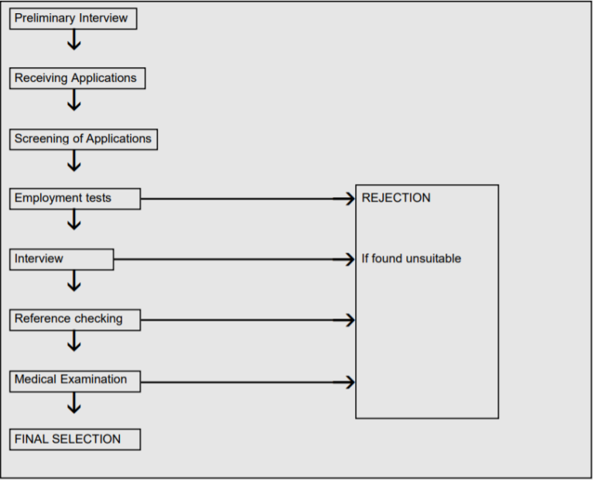
Selection Process

Slide 26
Preliminary Interview
This is a very general and basic interview conducted so as to eliminate the candidates who are completely unfit to work in the organization. This leaves the organization with a pool of potentially fit employees to fill their vacancies

Slide 27
Receiving Applications
Potential employees apply for a job by sending applications to the organization. The application gives the interviewers information about the candidates like their bio-data, work experience, hobbies and interests.

Slide 28
Screening Applications
Once the applications are received, they are screened by a special screening committee who choose candidates from the applications to call for an interview. Applicants may be selected on special criteria like qualifications, work experience etc.

Slide 29
Employment Tests
Before an organisation decides a suitable job for any individual, they have to gauge their talents and skills. This is done through various employment tests like intelligence tests, aptitude tests, proficiency tests, personality tests etc.

Slide 30
Employment Interview
The next step in the selection process is the employee interview. Employment interviews are done to identify a candidate’s skill set and ability to work in an organization in detail. Purpose of an employment interview is to find out the suitability of the candidate and to give him an idea about the work profile and what is expected of the potential employee. An employment interview is critical for the selection of the right people for the right jobs.

Slide 31
Checking References
The person who gives the reference of a potential employee is also a very important source of information. The referee can provide info about the person’s capabilities, experience in the previous companies and leadership and managerial skills. The information provided by the referee is meant to kept confidential with the HR department.

Slide 32
Medical Examination
The medical exam is also a very important step in the selection process. Medical exams help the employers know if any of the potential candidates are physically and mentally fit to perform their duties in their jobs. A good system of medical checkups ensures that the employee standards of health are higher and there are fewer cases of absenteeism, accidents and employee turnover.

Slide 33
Final Selection and Appointment Letter
This is the final step in the selection process. After the candidate has successfully passed all written tests, interviews and medical examination, the employee is sent or emailed an appointment letter, confirming his selection to the job. The appointment letter contains all the details of the job like working hours, salary, leave allowance etc. Often, employees are hired on a conditional basis where they are hired permanently after the employees are satisfied with their performance.

Slide 34
Importance of the Selection Process
Proper selection and placement of employees lead to growth and development of the company. The company can similarly, only be as good as the capabilities of its employees.
The hiring of talented and skilled employees results in the swift achievement of company goals.
Industrial accidents will drastically reduce in numbers when the right technical staff is employed for the right jobs.
When people get jobs they are good at, it creates a sense of satisfaction with them and thus their work efficiency and quality improves.
People who are satisfied with their jobs often tend to have high morale and motivation to perform better.

Slide 35
Refrences
Amit Ghodasara, Full Recruitment Life Cycle: 7 Stages of Recruitment Process. https://www.ismartrecruit.com/
Tanya Lesiuk, Recruitment & Selection: Optimize Your Hiring Process. November 17, 2021
RECRUITMENT AND SELECTION: WHAT IT IS, STEPS, STRATEGIES, AND TECHNIQUES. https://articles.jobconvo.com/Não categorizado
Recruitment and selection – The most important HR function. empxtrack.com/blog. June 11, 2013
Selection Process. https://www.toppr.com/guides

Slide 36
Thank You

