Slide 1
ROLE OF ENERGY IN LIVING SYSTEM
COMPILED BY Prof. Sudhir Kumar Awasthi
Dept. Of Life Sciences
CSJMU

Slide 2
Energy flow through living systems
Interactions that occur between matter and energy can be examined by using a variety of models. The flow of energy through living systems can be modeled as food chains, food webs, or energy pyramids.
Food chains diagram the transformation of energy is it flows from the sun to producers (plants) to primary consumers (herbivores), to secondary consumers (carnivores that eat herbivores) to tertiary consumers (carnivores that eat carnivores).

Slide 3
Food webs diagram the complex relationship of energy flow in an ecosystem containing a variety of producers and consumers.
Energy pyramids diagram the decreasing amount of available energy as it flows from one trophic level to the next. Energy transfer from one trophic level to the next is not efficient because some of the energy transforms into heat and is therefore unavailable to the next level on the pyramid.

Slide 4
Energy pyramid
Tertiary Consumers
(carnivores that eat carnivores)
heterotrophs
Secondary Consumers
(carnivores that eat herbivores)
heterotrophs
Primary Consumers (herbivores)
heterotrophs
Producers (plants)
autotrophs

Slide 5
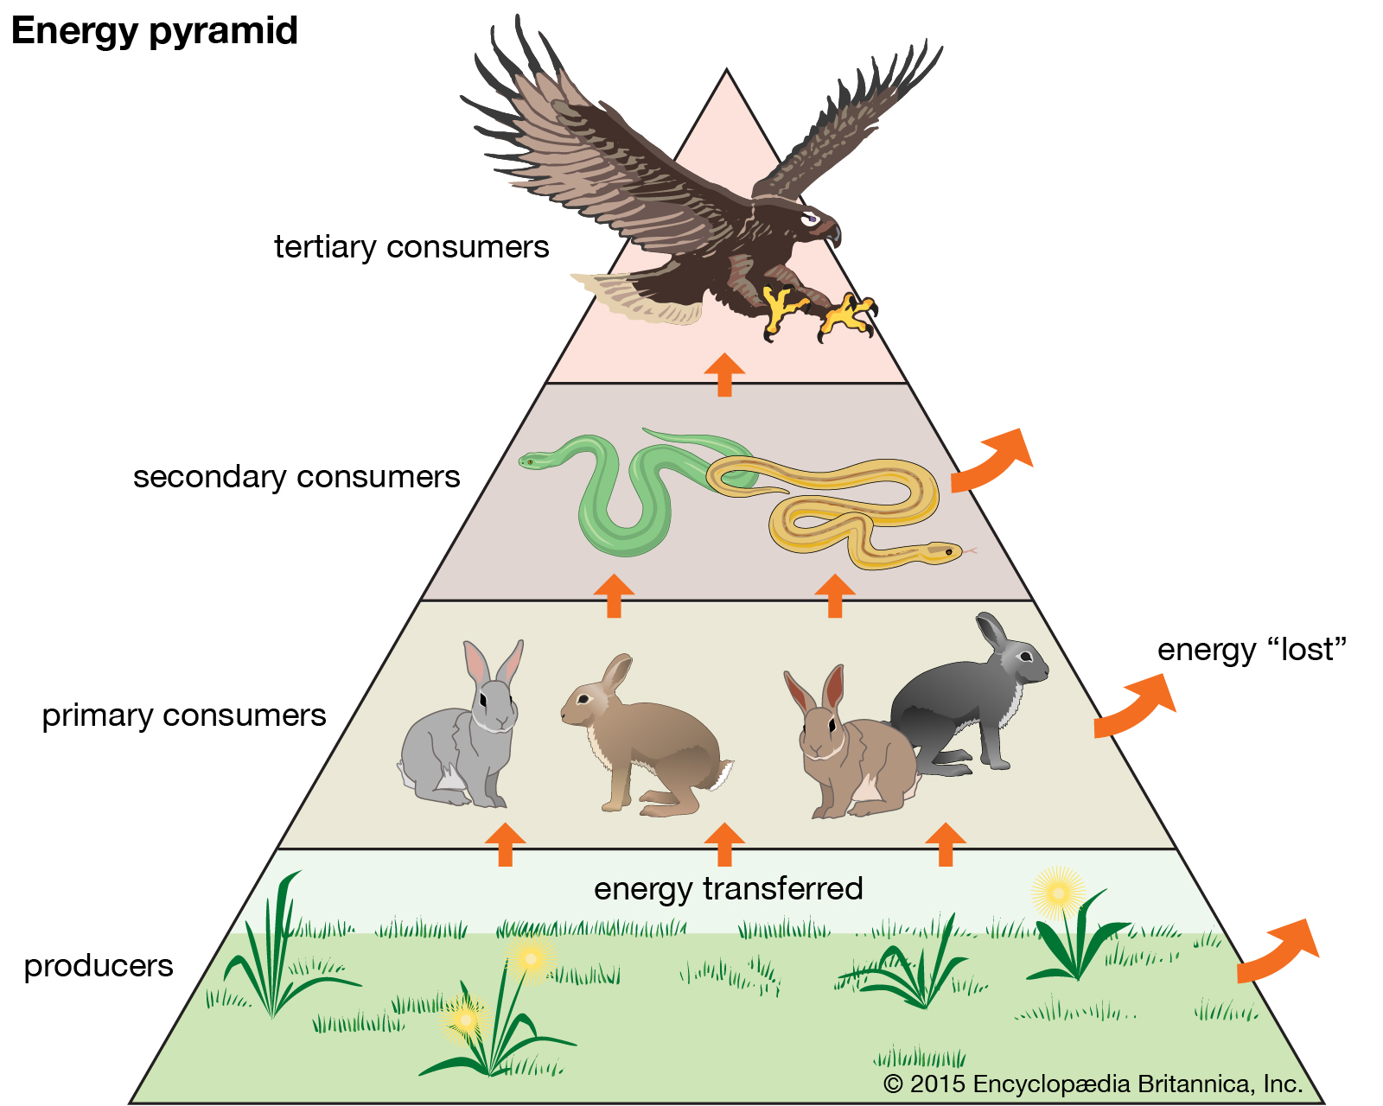

Slide 6
Ten percent rule
Only 10% of the energy transfers
from each Trophic level.
1 / 10 = 0.1%
10 / 10 = 1%
100 / 10 = 10%
100%

Slide 7
FOOD CHAIN
Food chain, in ecology, the sequence of transfers of matter and energy in the form of food from organism to organism. Food chains intertwine locally into a food web because most organisms consume more than one type of animal or plant.
Plants, which convert solar energy to food by photosynthesis, are the primary food source.
In a predator chain, a plant-eating animal is eaten by a flesh-eating animal.
In a parasite chain, a smaller organism consumes part of a larger host and may itself be parasitized by even smaller organisms.
In a saprophytic chain, microorganisms live on dead organic matter.

Slide 8
Because energy, in the form of heat, is lost at each step, or trophic level, chains do not normally encompass more than four or five trophic levels.
People can increase the total food supply by cutting out one step in the food chain: instead of consuming animals that eat cereal grains, the people themselves consume the grains.
Because the food chain is made shorter, the total amount of energy available to the final consumers is increased.

Slide 9
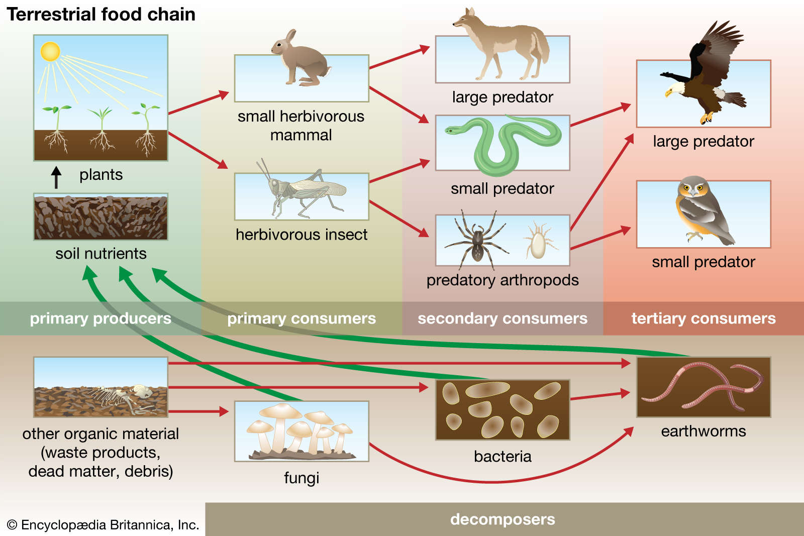

Slide 10
FOOD WEB
Food web is an important ecological concept. Basically, food web represents feeding relationships within a community .
It also implies the transfer of food energy from its source in plants through herbivores to carnivores (. Normally, food webs consist of a number of food chains meshed together.
Each food chain is a descriptive diagram including a series of arrows, each pointing from one species to another, representing the flow of food energy from one feeding group of organisms to another.
There are two types of food chains:
the grazing food chain, beginning with autotrophs, and the detrital food chain, beginning with dead organic matter
In a grazing food chain, energy and nutrients move from plants to the herbivores consuming them, and to the carnivores or omnivores preying upon the herbivores. I
In a detrital food chain, dead organic matter of plants and animals is broken down by decomposers, e.g., bacteria and fungi, and moves to detritivores and then carnivores.

Slide 11
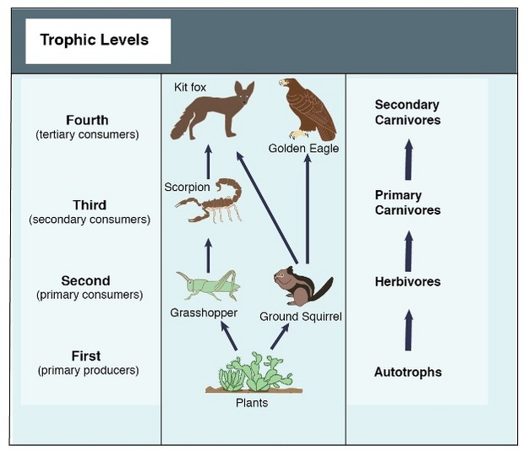
Food web offers an important tool for investigating the ecological interactions that define energy flows and predator-prey relationship .
Figure shows a simplified food web in a desert ecosystem. In this food web, grasshoppers feed on plants; scorpions prey on grasshoppers; kit foxes prey on scorpions.
While the food web showed here is a simple one, most feed webs are complex and involve many species with both strong and weak interactions among them
For example, the predators of a scorpion in a desert ecosystem might be a golden eagle, an owl, a roadrunner, or a fox.

Slide 12
REFERENCES
Introduction to Energy and Climate by Jullie A, Kerr (2017)
Principles of Biology by Lisa Bartee, Walter Shriner , Catherine Creech (2012)
Concept of Biology by Open Stax (2016)

