Slide 1
SOFTWARE PROCESS MODEL
.There are various software development life cycle models defined and designed which are followed during the software development process.
.These models are also referred as Software Development Process Models". Each process model follows a Series of steps unique to its type to ensure success in the process of software development.
Following are the most important and popular SDLC models followed in the industry −
Waterfall Model
Iterative Model
Spiral Model

Slide 2
WATERFALL METHOD
The Waterfall Model was the first Process Model to be introduced. It is also referred to as a linear-sequential life cycle model
The Waterfall model is the earliest SDLC approach that was used for software development.
In this Waterfall model, typically, the outcome of one phase acts as the input for the next phase sequentially.

Slide 3
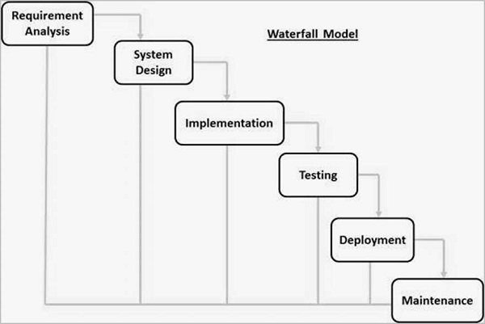

Slide 4
The sequential phases in Waterfall model are −
Requirement Gathering and analysis − All possible requirements of the system to be developed are captured in this phase and documented in a requirement specification document.
System Design − The requirement specifications from first phase are studied in this phase and the system design is prepared. This system design helps in specifying hardware and system requirements and helps in defining the overall system architecture.
Implementation − With inputs from the system design, the system is first developed in small programs called units, which are integrated in the next phase. Each unit is developed and tested for its functionality, which is referred to as Unit Testing.
Integration and Testing − All the units developed in the implementation phase are integrated into a system after testing of each unit. Post integration the entire system is tested for any faults and failures.
Deployment of system − Once the functional and non-functional testing is done; the product is deployed in the customer environment or released into the market.
Maintenance − There are some issues which come up in the client environment. To fix those issues, patches are released. Also to enhance the product some better versions are released. Maintenance is done to deliver these changes in the customer environment.

Slide 5
ADVANTAGES OF WATERFALL METHOD
Some of the major advantages of the Waterfall Model are as follows −
Simple and easy to understand and use
Easy to manage due to the rigidity of the model. Each phase has specific deliverables and a review process.
Phases are processed and completed one at a time.
Works well for smaller projects where requirements are very well understood.
Clearly defined stages.
Well understood milestones.
Easy to arrange tasks.

Slide 6
Waterfall Model - Disadvantages
The major disadvantages of the Waterfall Model are as follows −
No working software is produced until late during the life cycle.
High amounts of risk and uncertainty.
Not a good model for complex and object-oriented projects.
Poor model for long and ongoing projects.
Not suitable for the projects where requirements are at a moderate to high risk of changing. So, risk and uncertainty is high with this process model.
It is difficult to measure progress within stages.
Cannot accommodate changing requirements.

Slide 7
ITERATIVE MODEL
Iterative process starts with a simple implementation of a subset of the software requirements and iteratively enhances the evolving versions until the full system is implemented.
At each iteration, design modifications are made and new functional capabilities are added.
The basic idea behind this method is to develop a system through repeated cycles (iterative) and in smaller portions at a time (incremental).

Slide 8
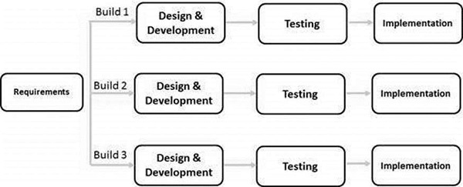

Slide 9
Iterative Model - Application
Like other SDLC models, Iterative and incremental development has some specific applications in the software industry. This model is most often used in the following scenarios −
Requirements of the complete system are clearly defined and understood.
Major requirements must be defined; however, some functionalities or requested enhancements may evolve with time.
There is a time to the market constraint.
A new technology is being used and is being learnt by the development team while working on the project.

Slide 10
SPIRAL MODEL
The spiral model combines the idea of iterative development with the systematic, controlled aspects of the waterfall model.
This Spiral model is a combination of iterative development process model and sequential linear development model i.e. the waterfall model with a very high emphasis on risk analysis.
It allows incremental releases of the product or incremental refinement through each iteration around the spiral.

Slide 11
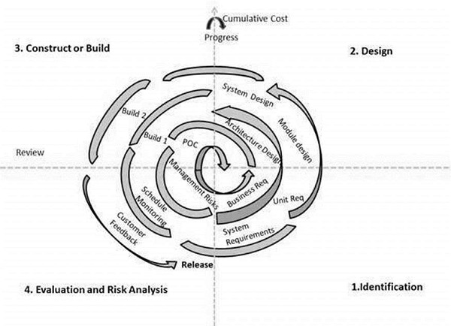

Slide 12
Spiral Model - Design
The spiral model has four phases. A software project repeatedly passes through these phases in iterations called Spirals.
Identification
This phase starts with gathering the business requirements in the baseline spiral. In the subsequent spirals as the product matures, identification of system requirements, subsystem requirements and unit requirements are all done in this phase.
This phase also includes understanding the system requirements by continuous communication between the customer and the system analyst. At the end of the spiral, the product is deployed in the identified market.
Design
The Design phase starts with the conceptual design in the baseline spiral and involves architectural design, logical design of modules, physical product design and the final design in the subsequent spirals.

Slide 13
Construct or Build
The Construct phase refers to production of the actual software product at every spiral. In the baseline spiral, when the product is just thought of and the design is being developed a POC (Proof of Concept) is developed in this phase to get customer feedback.
Then in the subsequent spirals with higher clarity on requirements and design details a working model of the software called build is produced with a version number. These builds are sent to the customer for feedback.
Evaluation and Risk Analysis
Risk Analysis includes identifying, estimating and monitoring the technical feasibility and management risks, such as schedule slippage and cost overrun. After testing the build, at the end of first iteration, the customer evaluates the software and provides feedback.

Slide 14
Spiral Model Application
The Spiral Model is widely used in the software industry as it is in sync with the natural development process of any product, i.e. learning with maturity which involves minimum risk for the customer as well as the development firms.
The following pointers explain the typical uses of a Spiral Model −
When there is a budget constraint and risk evaluation is important.
For medium to high-risk projects.
Long-term project commitment because of potential changes to economic priorities as the requirements change with time.
Customer is not sure of their requirements which is usually the case.
Requirements are complex and need evaluation to get clarity.
New product line which should be released in phases to get enough customer feedback.
Significant changes are expected in the product during the development cycle.

