Slide 1
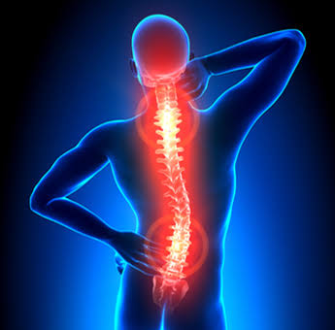
SPINAL CANAL STENOSIS

Slide 2
Spinal canal stenosis
STENOSIS- Constriction of a tube.
Spinal canal stenosis is defined as an abnormal narrowing of Osteoligamentous vertebral canal / or the intervertebral foramina, causing direct compression or compromise of the dural sac / caudal nerve root or their vasculature. Producing symptom of rediculopathy or claudication.
Refers to narrowing of the spinal canal, nerve root canals or intervertebral foramina due to spondylosis & degenerative disc disease.
Usually occurs in cervical & lumbar spine.

Slide 3
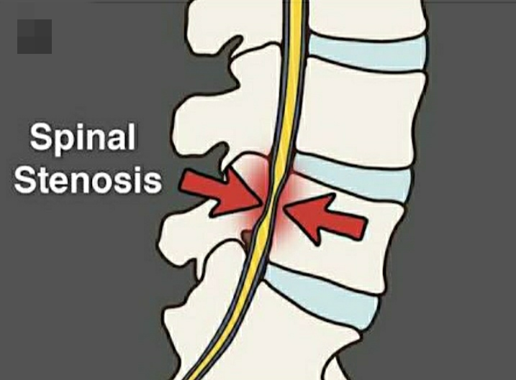
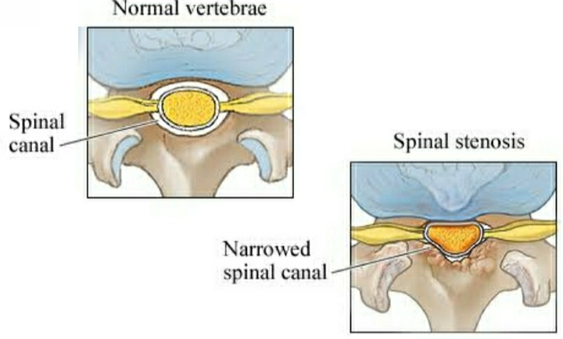

Slide 4
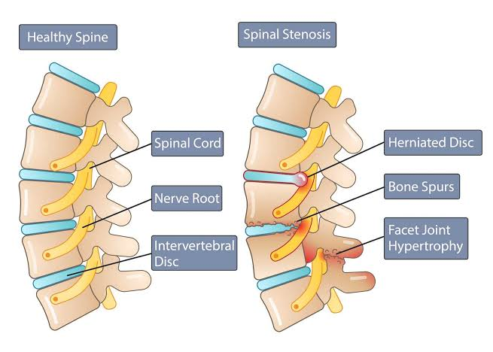

Slide 5
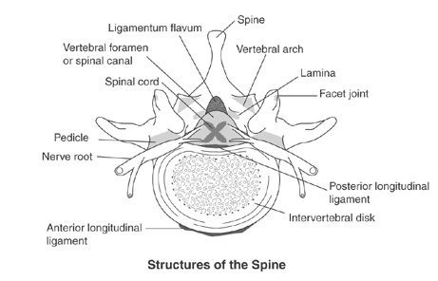

Slide 6
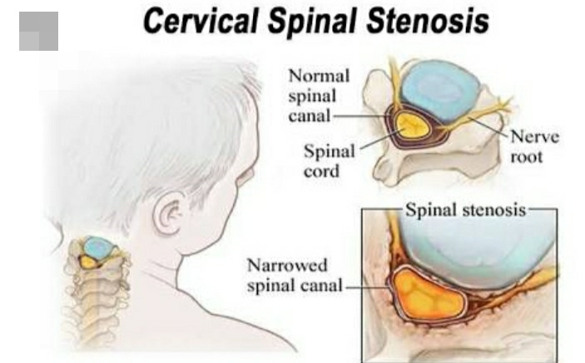
CERVICAL STENOSIS
Usually present with cervical radiculopathy: radiating arm pain with numbness and paresthesia and occasionally, associated weakness.

Slide 7
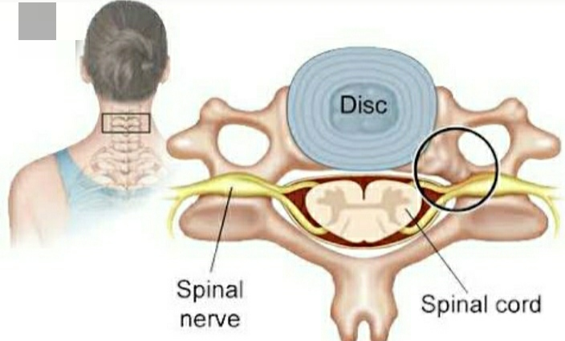
If the stenosis is severe enough or if it is positioned centrally in the spine, patients may present with signs and symptoms of myelopathy ( Spinal cord dysfunction): Finger numbness, clumsiness and
difficulty walking due to spasticity and loss of position sense.
In more severe cases, the patient can have bowel and bladder control dysfunction. Upon examination, these patient have ‘long tract signs’ such as hyper-reflexia and clonus.

Slide 8
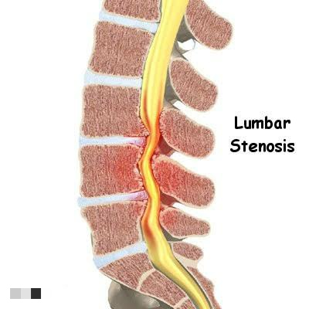
Lumbar stenosis
The further narrowing of the anatomically narrower spinal canal in the lower lumbar region due to a structural abnormality is termed as Spinal stenosis. Since this occurs most commonly in the lumbar spine, it is known as Lumbar stenosis.
It present as backache with radicular pain in the legs, brought on by exercise or walking for a perticular distance

Slide 10
CLASSIFICSATION-
1) Congenital or developmental stenosis- The lower lumbar canal become narrow due to laminar thickening of the developmental origin or congenital as seen in achondroplastic dwarfs.
2) Acquired stenosis- The canal become narrow over a period of time due to various causes-
Degenerative disease- Osteophytes encroach upon the space of the lumbar canal & cause compression.

Slide 11
Degenerative spondylolisthesis- The canal become narrow due to slip of the vertebrae, perticularly at L4-L5 level.
Miscellaneous- conditions such as fluorosis and paget’s disease are associated with narrow lumbar canal.
CLINICAL FEATURES-
The patients classically present with symptoms of intermittent claudication. He develops pain heaviness or parasthesia in the lower limb after walking for a certain distance.
The symptom become so severe that he has to take rest immediately for a few minutes. The symptoms settle down temporarily & allow him to walk further the same distance.

Slide 13
NEUROLOGICAL EXAMINATION-
Neurological examination of the lower limb may be normal or may be bizarre neurological deficit.
In severe cases, there may be signs of cauda equina compression with loss of bladder & bowel control.
INVESTIGATIONS-
Plain radiograph of the spine- Measurement of the lumbar canal will show decreased anteroposterior diameter of the canal or narrowing of the interlaminar space.

Slide 14
Myelography- is useful in the diagnosis . It shows multiple indentations in the dye column.
CT Scan & MRI are also helpful in the diagnosis.
TREATMENT-
The treatment could be-
Conservative
Surgical
1) Conservative treatment- The conservative treatment approach is basically to emphasize flexion exercises & generalized flexion attitudes, avoiding extension.

Slide 16
Drug to control pain & inflammation.
Improve strength endurance & tone of the abdominal muscle- This greatly helps in the maintenance of the flexed posture, which provides comfort to these patients.
Back ergonomics, avoiding extension attitudes are taught.
Lumbar traction may be beneficial if comfortable.
Lumbar corset should be used during strenuous activities.
Gentle passive manipulation technique is effective.

Slide 17
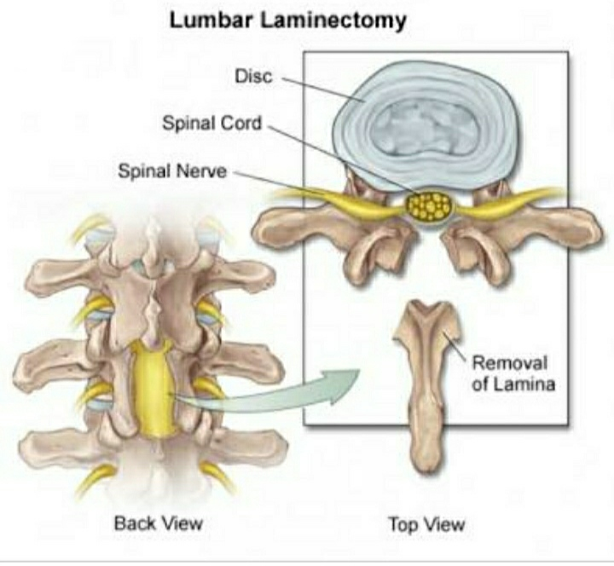
SURGICAL TREATMENT-
The aim of surgery is to decompress the cord by performing laminectomy.

Slide 18
THANK YOU

