Slide 1
SPINAL ORTHOSIS
By:
Dr. Digvijay Sharma
Director & Professor
School of Health Sciences, CSJMU

Slide 2
Contents
Spinal Orthosis
Functions of Spinal Orthosis
Types of spinal orthosis
Head- Cervical Orthosis
Cervical Orthosis
Head- Cervical- Thoracic Orthosis
Thoraco- Lumbo- Sacral Orthosis
Lumbo- Sacral Orthosis
Sacral Orthosis
Other Orthosis

Slide 3
Spinal Orthosis
Any orthosis which provides support to the spinal musculature and alignment of the spinal column is termed as spinal orthosis.
These work on the principle of three point force control system of Jordan with respect to pelvic positioning.
Pelvis acts as the base of support for spinal column alignment.
Longitudinal forces are handled by the anterior abdominal compression.
Counter pressure is provided by rigid posterior positioning system.
Forces are distributed over a wide area which makes it comfortable.
The patient must be comfortable, able to sit and stand without hindrance from the orthosis.

Slide 4
Functions of Spinal Orthosis
Prevent spinal deformities
Correction of acute deformations from kyphosis and scoliosis
Provide stability to patients with Spondylolisthesis
Relieves chronic pain
Relieves muscle spasm due to faulty axial loading
Prevents movement post surgical intervention
Protects against spinal injuries
Indicated in post surgical interventions after vertebral fracture

Slide 6
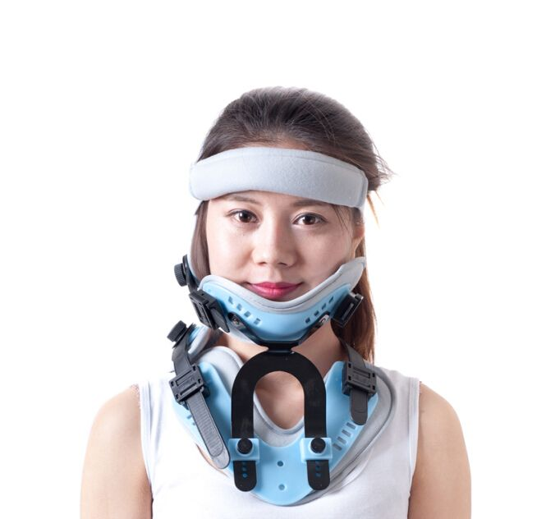
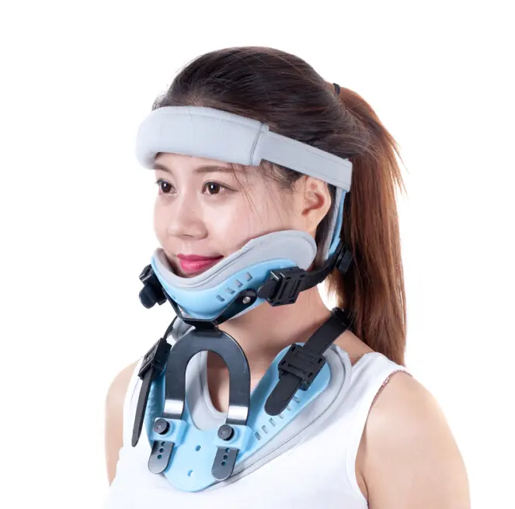
Head- Cervical Orthosis
Incorporates the head and cervical region
Provides support from the base of the skull eliminating minor movements from the cervical and head.
Prevents cervical injuries from worsening

Slide 7
Cervical Orthosis
Surrounds and protects the cervical spine.
Made up of foam plastic
Surround the neck from lower jaw to the occiput with rigid anterior and posterior struts.
Restrict neck flexion completely and to some extent neck extension as well.
They may be soft, hard or medium depending upon the indication.
It reduces stress over the damaged cervical tissue
Immobilizes spine wherever necessary
Prescribed only if neck movement causes severe pain, giddiness or prone to injure anatomical structures.
Long term use only when there is extreme instability of the neck.

Slide 8
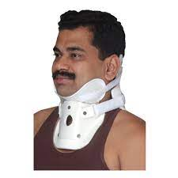
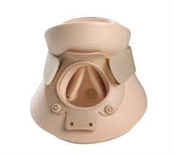
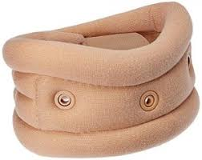
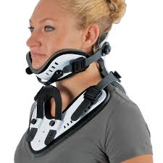
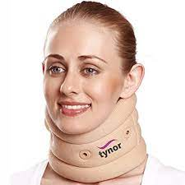
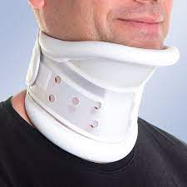
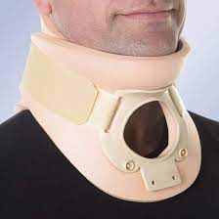
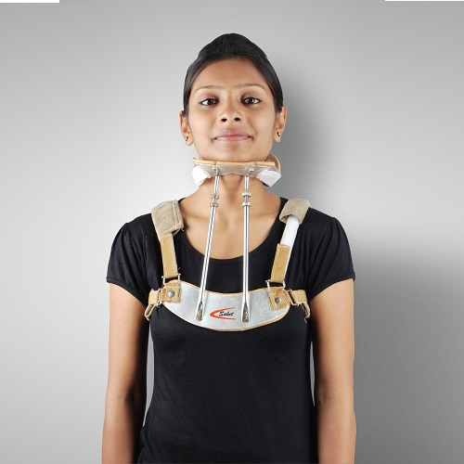
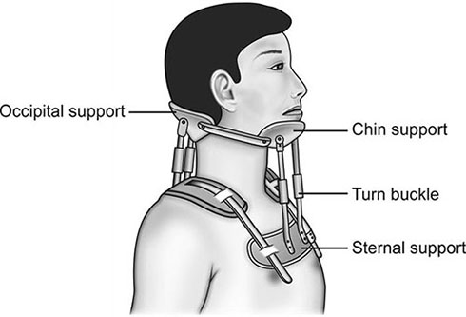
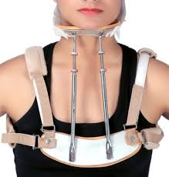
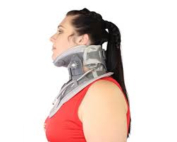
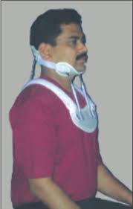
SOFT CERVICAL COLLAR
SEMIRIGID COLLAR
SEMIRIGID THERMOPLASTIC COLLAR
FOUR POSTER COLLAR

Slide 9
Indications of Cervical Orthosis
Cervical Crush Injuries
Hyperextension injuries to cervical
Whiplash Injuries
Sprains and strains of neck
Degenerative diseases like cervical spondylosis

Slide 10
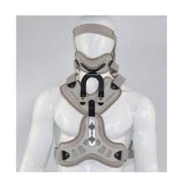
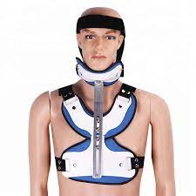
Head- Cervical- Thoracic Orthosis
Also called as Halo orthosis
Stabilized with external fixation of the skull with reference to chest.
This orthosis is uncomfortable during exercise.
Aluminium turnbuckles connecting the jacket ring are adjustable to provide variable traction, flexion or extension.
Used in patients with paralysis with or without cervical fracture and dislocations post cervical spine fractures.

Slide 11
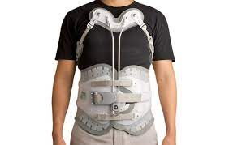
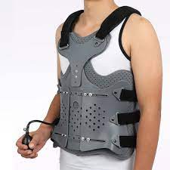
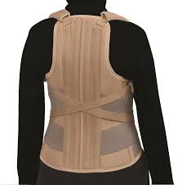
Thoraco- Lumbar- Sacral Orthosis
These fix the pelvis and shoulder to prevent spinal movements.
They are classified on the basis of the movements they restrict.
Hyperextension braces like Jewett and ASH control rotatory movement.
They are attached to a pelvic band inferiorly.
Used efficiently to restrict flexion, extension and lateral flexion of the thoracolumbar spine.
Indicated in compression fracture of vertebrae, dessication of IVD and prolapse, non-operative and post operative immobilization of spine.

Slide 12
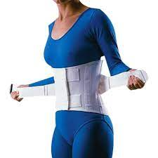
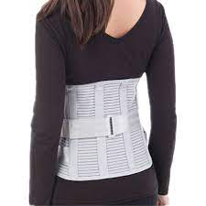
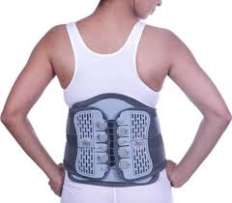
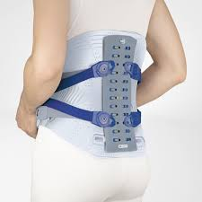
Lumbo- Sacral Orthosis
These orthosis are used in conditions like low back pain, spondylolisthesis and intervertebral disc diseases.
This type of orthosis avoids abrupt motion.
The restricting force is also supported by abdominal pressure.
They are often of two distinct types Knight brace and Boston Brace.
In cases where there is need of a routine usage Lumbosacral corsets are used.

Slide 13
Sacral Orthosis
These are the least restrictive spinal orthosis.
In this type of orthosis, pelvis control is achieved using the pelvis as base of support and thus provides the spinal column the stability needed.
Used widely to heal pelvic fractures and relieving the pain in conditions like sacroilitis.

Slide 14
Other Spinal Orthosis

Slide 15
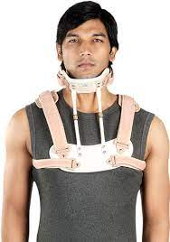
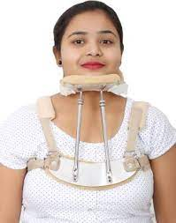
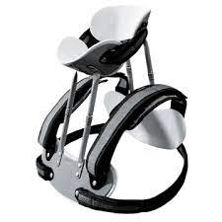
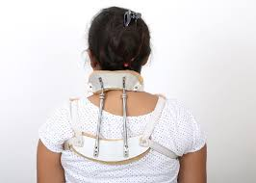
Four Poster Cervical Orthosis
It is a type of cervical orthosis.
It has padded mandibular and occipital support attached to anterior and posterior plates by four rigid adjustable uprights.
Leather straps laterally connect mandibular and occipital supports.
Provides greater restriction of flexion, extension, lateral bending and rotation than ordinary collar.

Slide 16
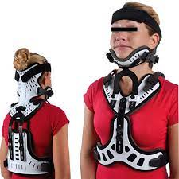
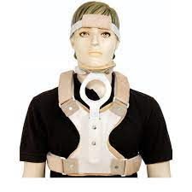
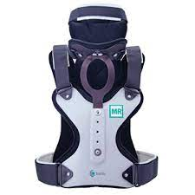
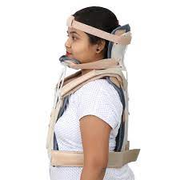
Minerva Jacket
A type of cervical orthosis.
Suitable modified jacket.
Anteriorly it has forehead straps securing upper posterior shell and a rigid mandibular plate.
Provides excellent motion restriction in all directions.
It provides the facility of selecting the optimal alignment of the head on neck.

Slide 17
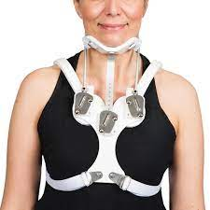
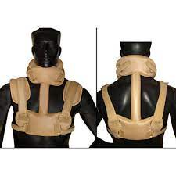
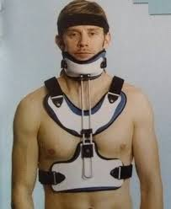
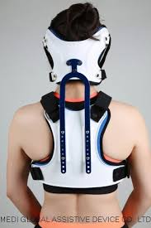
SOMI Brace
Stands for Sterno Occipito Mandibular Immobilization Brace.
Its point of attachments are sternum, occiput and mandible.
It is a type of Halo Orthosis.
It restricts flexion, extension, rotation and lateral bending.
Used in conditions like cervical vertebral fracture and conditions where immobilization of spine becomes necessary.

Slide 18
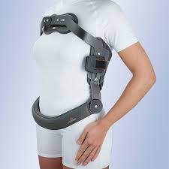
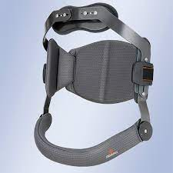
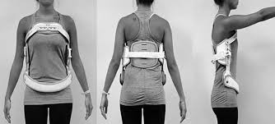
Jewett Orthosis
It is an anterior hyperextension orthosis.
It is a type of TLSO
It has rectangular frame exerting pressure over the pubis and upper thorax.
The counter support is exerted by the fulcrum maintained by a thoracic strap attached to the sides of the frame.

Slide 19
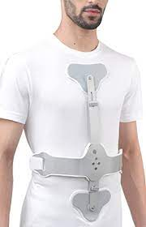
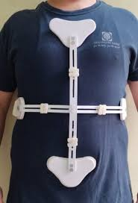
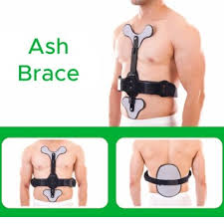
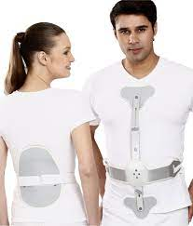
ASH Brace
It is a type of TLSO.
It is more comfortable than the Jewett brace
It has a cross like frame anteriorly fixed with pads on the sternum and pubic symphysis.
Posteriorly a padded support in thoraco lumbar region maintains spinal extension by the principle of Jordon.

Slide 20
Milwaukee Brace
It is a type of TLSO
It is the choice of orthosis given for growing children with dynamic scoliosis.
Directs longitudinal and transverse forces actively and passively.
It is a dynamic spinal brace which can grow along with the children.
The pelvis band fixes the pelvis and decreases lordosis.
Collar head band applies distracting forces that elongates the spine.
There are buckles which are used to distract the brace according to the height of the child.
Used in any lateral curvature of the spine whether kyphoscoliosis or scoliosis.

Slide 21
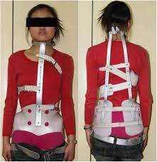
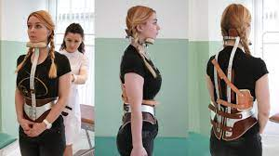
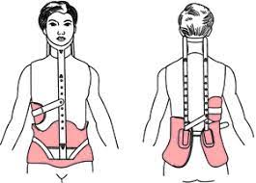
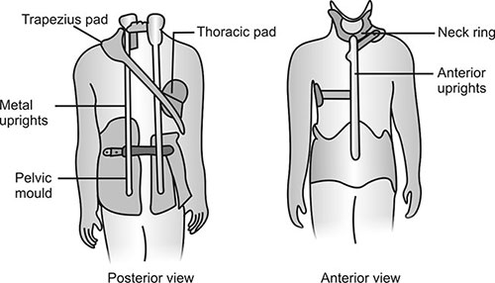

Slide 22
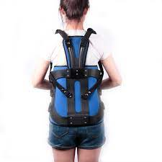
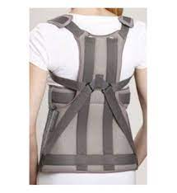
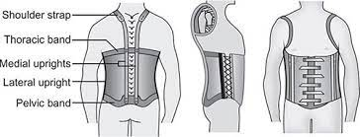
Knight Brace
It is a type of lumbosacral orthosis
It is a short spinal brace consisting of a pelvic band and a thoracic band joined by 2 posterior and 2 lateral metal uprights providing more rigidity than corsets.

Slide 23
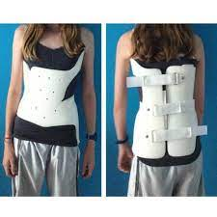
Boston Brace
It is a type of Lumbosacral orthosis
It is an example of modular orthosis that provides varying control and is useful for the treatment of scoliosis.
Made up of semi rigid plastic and supports the lower trunk by controlling the lumbosacral motion.

Slide 24
Lumbosacral Corset
Very commonly and routinely used corsets.
May vary in rigidity and material used.
Extensive spinal problems are dealt with longer length corsets.
It is frequently used in many painful low back conditions associated with osteoporosis, lumbar spondylosis, malignancy, bad posture, spondylolisthesis, lumbosacral strain, sciatica, etc.
Reduces pain by avoiding the movement and contraction of erector spinae
Also used in reducing pain related to the compression of the intervertebral discs.

Slide 26
Sacro-iliac Corset
It is prefabricated device that can be adjusted anteriorly, posteriorly or laterally with laces or hooks.
Superior border lies at the iliac crest.
Posterior border extends to gluteal fold
It is thought to act by elevation of the intra-abdominal pressure and stabilization of the sacro-iliac joint and pubis symphysis.

