Slide 1
SPLINTS
BY:
Dr. Digvijay Sharma
Director & Professor
School of Health Sciences, CSJM University

Slide 2
Contents
Introduction to Splints
Functions of Splints
Types of Splints
Various splints

Slide 3
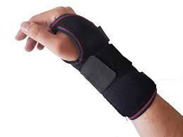
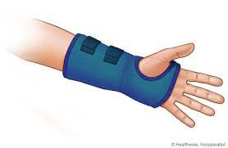
Introduction
Splints are the technical and temporary devices that are used to provide assistance to an injured body part.
These are most commonly applied at the upper extremity.
Earlier these splints were only used to stabilize the structures and thus were used efficiently in cases of fractures and other acute traumas.
These days there are variety of splints which also allow movement along with the function of stabilization.

Slide 4
Functions
Prevention of Undesirable movements
Maintain the structure in functional position
Reduce pain
Provide stability and support
Maintains a position which is reduced by physiotherapy treatment
Strengthen musculature
Promote grip and pinch
Reduce muscle spasm

Slide 5
Types of Splints
Static Splints
These are immobile.
Prevent motion across a joint.
Used to provide rest and stability to the injured part.
Used to stretch joint contractures, used to align the structures whether reduced or not.
Must only be applied to the joint being treated.
Should be removed immediately after serving the purpose.
Its disadvantage include the development of atrophy and muscle stiffness in various cases.
Dynamic Splints
These are mobile in nature.
They not only provide support but also provide, control and strengthen the movements.
The power of movement can be intrinsically triggered or through other body part or by electrical stimulation of patient’s muscles.
Extrinsically the power of movement comes from the pulley system and harnesses tied with the splints.
Used effectively to provide prehension along with static positioning of the part in functional position after its use.

Slide 6
Aeroplane Splint
Maintains the shoulder in abduction and external rotation.
Also known as Shoulder arm Orthosis or Shoulder- elbow- wrist- hand orthosis.
Consists of chest, arm, forearm and wrist joint at almost right angles.
Keeps the joint in optimal position.
Sometimes it is highly inconvenient for patients to maintain belt at the torso.
Modifications include Functional arm orthosis, Gun slinger, Deltoid aid, etc.

Slide 7
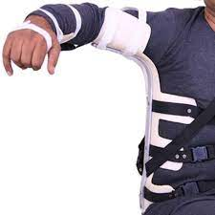
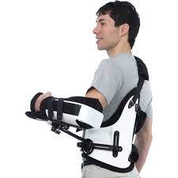
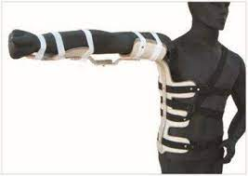
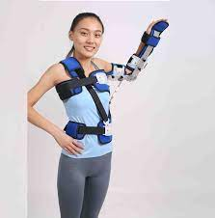
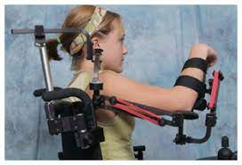
IGR AEROPLANE SPLINT
GUN SLINGER
AEROPLANE SPLINT
DELTOID AID
FUNCTIONAL ARM ORTHOSIS

Slide 8
Indications
Erb’s palsy
Avulsion of greater tuberosity of humerus
Deltoid paralysis
Supraspinatus tendon rupture
Tubercular arthritis of Shoulder joint
Abduction # of neck of humerus

Slide 9
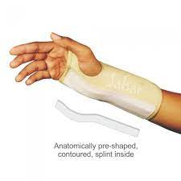
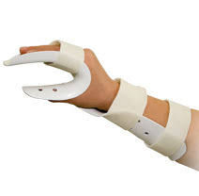
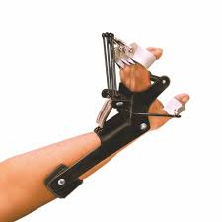
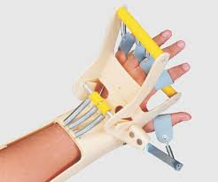
Cock-up Splint
Also called Wrist- hand orthosis.
Immobilizes the wrist in dorsiflexion with dorsal support.
Can be transformed into dynamic splint.
Allows full metacarpophalangeal flexion and carpometacarpal function of the thumb.
Can be worn anytime except for exercise and bath.
Used extensively in cases of Wrist drop or Radial nerve Injury, hemiplegia, etc.

Slide 10
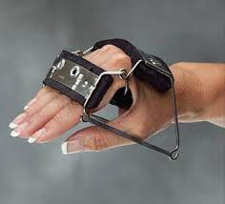
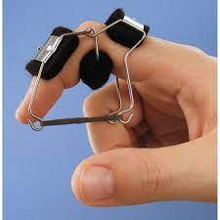
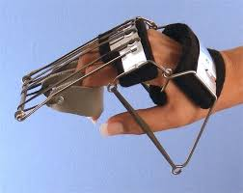
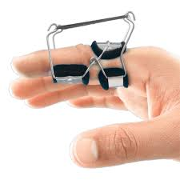
Knuckle Bender Splint
Stabilizes the metacarpophalangeal joint in 90 degree flexion and interphalangeal joint in extension.
It serves the basic function of immobilizing the fingers, support and stabilization to the wrist in extension, maintains transverse palmer arch and assists in prehension.
This splint is a typical example of 3- point principle.
Used extensively in cases of Median and ulnar nerve palsy or Total claw hand, Hansen’s disease and Ulnar claw hand.
BUNNELL FINGER
BUNNELL REVERSE FINGER
BUNNELL KNUCKLE BENDER SPLINT

Slide 11
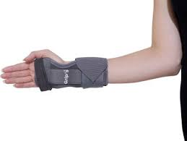
C- Splint
Stabilizes the thumb in abduction and partial rotation under the second metacarpal and supports it.
Stretches the first web space.
Indications include median nerve injury, contractures, burns, etc.

Slide 12
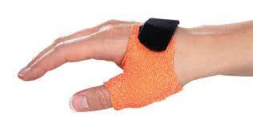
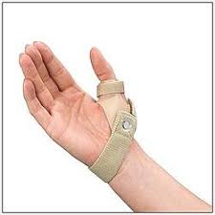
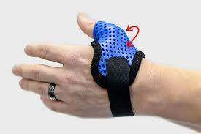
Short Opponens Splint
Maintains the thumb in abduction and partial rotation under second metacarpal.
Wrist and fingers are set free.
Also called Wrist hand Orthosis
Indicated in cases like low median nerve injury and opponens transfer.

Slide 13
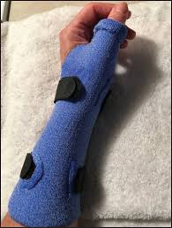
Long Opponens Splint
Thumb is stabilized in abduction and partial rotation under second metacarpal with additional support to the dorsal wrist in functional position.
Wrist in 20-30 degree dorsiflexion, metacarpophalangeal joint in 0-5 degrees flexion.
Other fingers are set free
Stabilizes the thumb
Used extensively in cases of scaphoid fracture, bennet’s fracture and de Quervains tenosynovitis.
Also called wrist- hand- forearm orthosis or thumb spica.

Slide 14
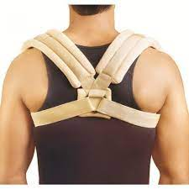
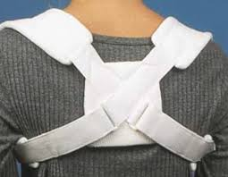
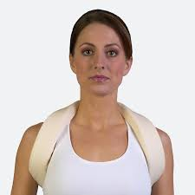
Clavicular Orthosis
Also known as Shoulder Orthosis, Clavicular Harness or Figure of four harness.
Used extensively in Clavicular fractures, TOS, rounded shoulders, pectoral contractures, etc.
Improves posture, range of motion, tissue healing and reduces pain.
Inhibits clavicular movements and scapular protraction with no hindrance to movements of GH joint.

Slide 15
Arm Slings
Also called figure of 8 harness, orthopaedic sling, universal sling, glenohumeral support, hook hemiharness, etc.
Used in cases of rotator cuff injuries, bicipital tendonitis, brachial plexus lesion, AC joint injury, hemiparesis with subluxation, scapular and humeral fractures.
Prevents overstretching of GH musculature and ligaments.
Reduces oedema by elevating the hand and forearm.
Roylan Hemiharness sling supports humerus but allows movement at the elbow and forearm.
Studies have shown that use of slings should be discouraged in patients with UMN lesions because it tends to increase the flexion synergy thus enhancing incidences of development of contractures.
Roylan Hemiharness are however difficult to use in bulky patients.

Slide 16
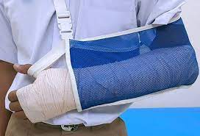
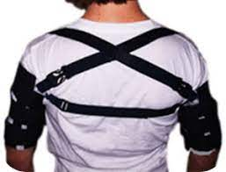
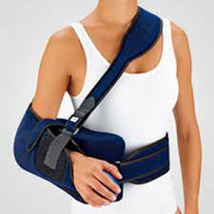
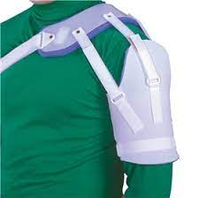
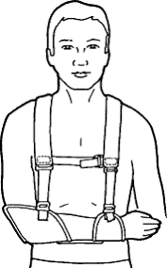

Slide 17
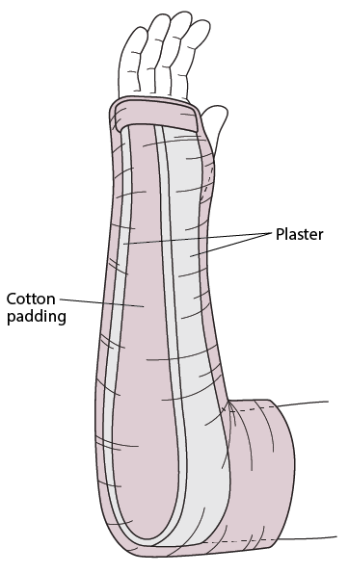
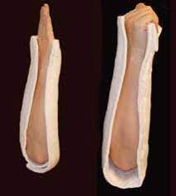
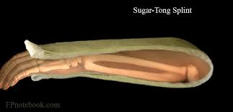
Sugar Tong Splint
Also called elbow- wrist- hand orthosis.
Places the elbow in 90 degree of flexion and forearm and wrist in neutral position.
Used in CTDs of elbow, forearm fractures, ulnar nerve transposition, etc.
Basically used to inhibit movements at the elbow joint and promote healing of the tissues.

Slide 18
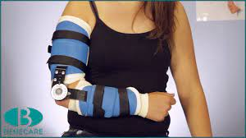
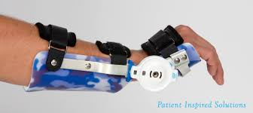
Ultraflex Splint
Also called elbow orthosis or wrist elbow, turn buckle splint, dynasplint, pheonix wrist hinge, etc.
Indicated in conditions like contracture, burns, fractures, scar lesions, polio, spinal cord injury, brachial plexus lesion, radial nerve injury, etc.
Used to increase soft tissue for tissue elongation.
This orthosis provides traction which may cause skin breakdowns.
Traction may also increase muscle tone.

Slide 19
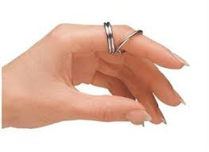
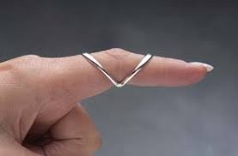
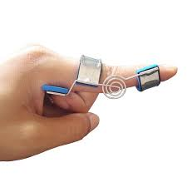
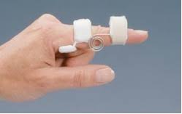
Ring Orthosis
Also called finger orthosis, swan neck splint, pulley ring, Boutonniere splint, Murphy ring splint, etc.
Indicated in conditions like swan neck deformity, arthritis, boutonniere deformity, etc.
Blocks the PIP or DIP hyperextension.
Prevents hypermobilization, overstretching and deformity.
Swan neck splint allows IP flexion and boutonniere's splint allows IP extension.
MURPHY
SWAN NECK SPLINT
DYNAMIC
BOUTONNIERE SPLINT

