Slide 1
SURGICAL INCISIONS USED IN CARDIO-THORACIC SURGERY

Slide 2
Thoracotomy

Slide 21
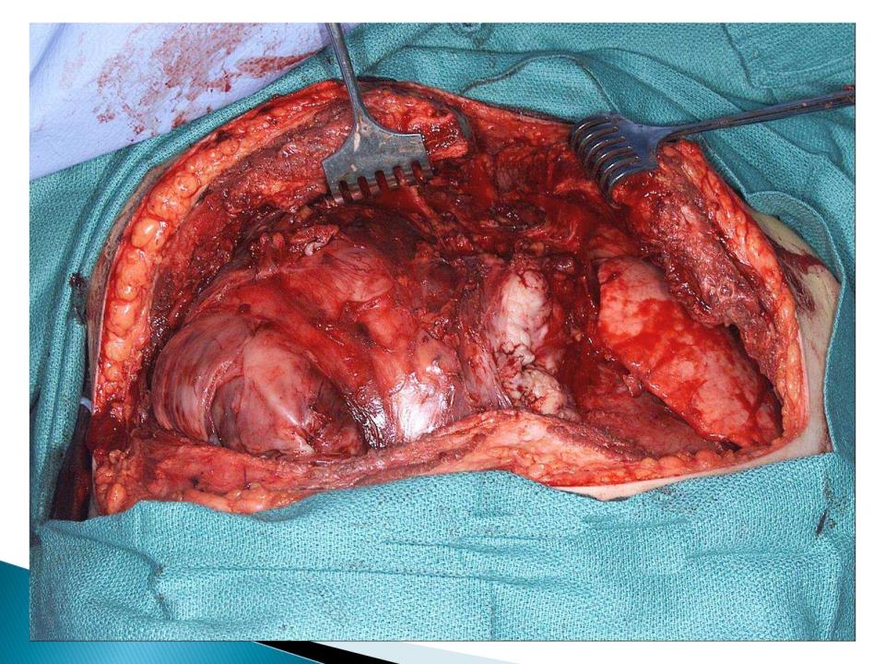

Slide 27
‘L’ shaped skin incision for ant. approach

Slide 29
Location of osteotomy for transclavicular approach

