Slide 1
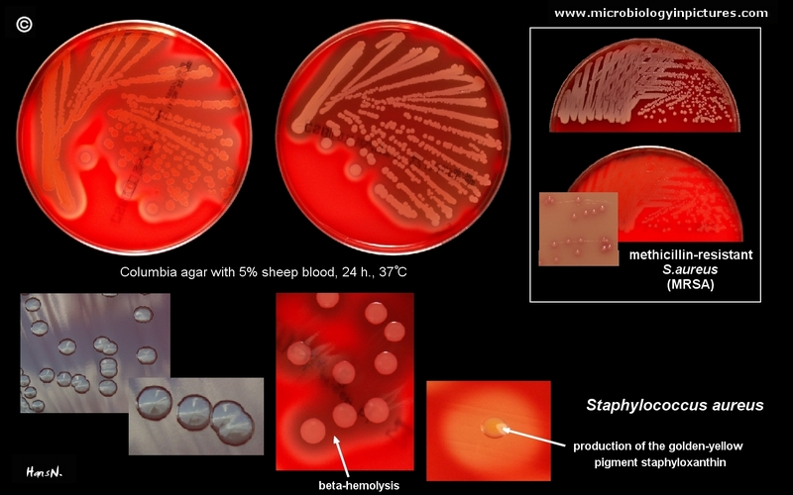
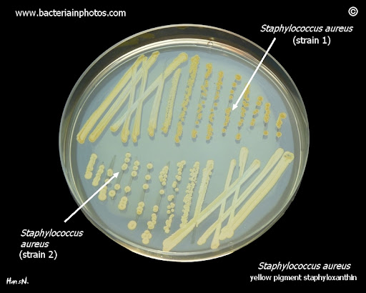
Staphylococcus aureus

Slide 2
General Features
Gram positive cocci in grape-like clusters
Catalase positive

Slide 3
Cell wall associated factors
Cell wall associated factors
Peptidoglycan | Rigidity, Endotoxin
Teichoic acid | Adhesion, Inhibit opsonisation
Cell surface adhesins-Clumping factor | Adhesion, Clumping
Protein A | Anti-complementary Chemotactic, Mitogenic, Inhibit opsonisation Induction of platelet damage IgG Fc →Co-agglutination
Capsule | Inhibit phagocytosis

Slide 4
Toxins
Toxins
Membrane active toxins Hemolysins-α,β,γ,δ
Leucocidin | F & S toxins + γ hemolysin →hemolytic and leucocidal (Synergohymenotropy)
Epidermolytic toxin | Staphylococcal scalded-skin syndrome
Enterotoxins | Serotype A- MC, Superantigen Self limiting food poisoning IP<6 Hrs Preformed toxin →vagus stimulation
Toxic shock syndrome toxin | Super antigen Risk - abscesses, osteomyelitis, post-surgical wound infection

Slide 5
Virulence Factors
αhemolysin | Inactivated at 70°C reactivated at 100°C Lethal, leucocidal, dermonecrotic, cytotoxic and neurotoxic Lyses rabbit RBCs, but less active against sheep and human RBCs.
βhemolysin | Sphingomyelinase Lyses sheep RBC, but not human or rabbit RBC Exhibits hot-cold phenomenon
γhemolysin | Act together with leucocidin for hemolytic activity. Lyses rabbit, sheep and human RBCs
δhemolysin | Surfactant action Lyses rabbit, sheep, horse & human RBCs Lethal, leucocidal and dermonecrotic

Slide 6
Enzymes
Extracellular Enzymes
Coagulase | + CRF →prothrombin to thrombin Tube coagulase test
Heat stable thermonuclease | specific to S.aureus
Deoxyribonuclease | specific to S.aureus
Lipase
Protease
Staphylokinase(fibrinolysin)
Hyaluronidase

Slide 7
Pathogenesis
Colonization-anterior nares, axilla and perineal skin
Introduction into the tissue- minor abrasions or instrumentation→ adhere to tissue
Invasion- with help of enzymes
Evasion of host defence mechanisms
- Anti-phagocytic -microcapsule and Protein A
- Inhibition of leukocyte migration
- -formation of small colony variants
Metastatic spread- hematogenous

Slide 8
Clinical Manifestations
Skin & Soft tissue infections
Folliculitis, Furuncle
Carbuncle, Impetigo
Mastitis and breast abscess
Surgical site wound infections
Cellulitis →
Hidradenitis suppurativa

Slide 9
Clinical Manifestations...
Musculoskeletal Infections
Respiratory Tract Infections
Septic arthritis
Osteomyelitis
Pyomyositis in HIV
Psoas abscess
Epidural abscess
Ventilator associated pneumonia in adults
Septic pulmonary emboli
Post viral pneumonia
Empyema and Pneumothorax
Pneumatocele in neonates

Slide 10
Bacteremia and its Complications
Sepsis, septic shock
Central line associated blood stream infection
Metastasis - kidney, joints, bone and lung
Native-valve endocarditis
Prosthetic-valve endocarditis
Intravenous drug use associated endocarditis

Slide 11
Clinical Manifestations
Toxin-Mediated Illnesses
Toxic shock syndrome
Food poisoning
Staphylococcal scalded-skin syndrome
Infections Associated with MRSA
Necrotizing pneumonia
Necrotizing fasciitis

Slide 12
Staphylococcal Gastroenteritis
Enterotoxin - expressed by 50% of S.aureus
preformed heat stable toxin and resistant to gastric juice
Serotypes(A–E, G–I, R-T and V). Type A – Most common
Site of action- Stimulates the vagus nerve and the vomiting center. Stimulation of intestinal peristaltic activity

Slide 13
Staphylococcal Gastroenteritis
incubation period – 16 Hrs
Symptom- nausea, vomiting and occasionally diarrhea, hypotension, and dehydration. No fever. Selflimiting within 8–10 hour.
Source - food handler
Food items - milk products, bakery food,custards, potato salad, or processed meats.

Slide 14
Staphylococcal scalded-skin syndrome (SSSS)
Epidermolytic/exfoliative toxin –
Two proteins- ET-A (chromosomal and heat stable), ET- B (plasmid coded, heat labile).
More common in newborns and children
- May vary from localized tender blisters& bullae formation to exfoliation & separation of outer epidermal layer leaving denuded underlying skin (Nikolsky's sign).

Slide 15
Staphylococcal scalded-skin syndrome (SSSS)
Milder form - pemphigus neonatorum and bullous impetigo
Ritter’s syndrome - Severe form in newborns
Fever, lethargy, and irritability with poor feeding.
S.aureus bacteriophage group II

Slide 16
TOXIC SHOCK SYNDROME
Toxic shock syndrome toxin (TSST)- Enterotoxin F, a superantigen
Risk factors- vaginal tampons, abscesses, osteomyelitis and post-surgical wound infection.
Pathogenesis- TSST absorbed into circulation - non-specific T cells stimulation - excessive cytokine production -multisystem disease.

Slide 17
TOXIC SHOCK SYNDROME
Clinical features- Fever, hypotension, mucosal hyperemia, vomiting, diarrhea, confusion, myalgia, abdominal pain and erythematous rashes → rapid involvement of liver, kidneys, GIT and/or CNS.
Diagnosis-
- Detection of TSST - latex agglutination test and ELISA
- TSST genes 1 and 2 - PCR
Treatment- Clindamycin (MSSA), vancomycin (MRSA)

Slide 18
LABORATORY DIAGNOSIS..
Infection | Specimen
Suppurative lesion | Pus, wound swab
Respiratory Infections | Sputum
Urinary tract infection | Mid ­stream urine
PUO, Bacteremia | Blood
Food poisoning | Feces, vomitus, food
Carriers | Nasal & perianal swab

Slide 19
LABORATORY DIAGNOSIS..
MICROSCOPY
Gram staining -Gram positive cocci in clusters

Slide 20
LABORATORY DIAGNOSIS- CULTURE
Aerobe, facultative anaerobe, Non-fastdious
Nutrient agar – Golden yellow
Blood agar – beta hemolytic

Slide 21
LABORATORY DIAGNOSIS- Biochemical Tests
Coagulase test
Tube coagulase
Clumping factor
Heat stable thermo nuclease test
DNase test
Phosphatase (also produced by S.epidermidis)
Golden yellow pigmentation
Hemolysis on blood agar
Mannitol fermentation
Black coloured colonies on potassiumtellurite agar
Gelatin liquefaction
Protein A detection
S.aureus positive and CoNS mostly negative

Slide 22
Typing of S.aureus
Phenotypic methods
Bacteriophage typing
Antibiogram typing.
Genotypic methods - PCR-RFLP

Slide 23
CONTROL MEASURES
Proper hand washing
Screening of MRSA carriers
Treatment of carriers
Stoppage of antibiotic misuse

Slide 24
References
Textbook of Medical Microbiology by Ananthnarayan and Paniker
Textbook of Medical Microbiology by D.R Arora

