Slide 1
TABLETS

Slide 2
TABLETS
A tablet is a pharmaceutical dosage form. It comprises a mixture of active substances and excipients, usually in powder form, pressed or compacted into a solid.
The excipients can include binders, glidants (flow aids) and lubricants to ensure efficient tabletting; disintegrants to promote tablet break-up in the digestive tract; sweeteners or flavours to enhance taste; and pigments to make the tablets visually attractive.
A polymer coating is often applied to make the tablet smoother and easier to swallow, to control the release rate of the active ingredient, to make it more resistant to the environment (extending its shelf life), or to enhance the tablet's appearance.

Slide 3
ADVANTAGES
They are unit dosage form and offer the greatest capabilities of all oral dosage form for the greatest dose precision and the least content variability.
Cost is lowest of all oral dosage form.
Lighter and compact.
Easiest and cheapest to package and strip.
Easy to swallowing with least tendency for hang‐up.
Sustained release product is possible by enteric coating.
Objectionable odour and bitter taste can be masked by coating technique.
Suitable for large scale production.
Greatest chemical and microbial stability over all oral dosage form.
Product identification is easy and rapid requiring no additional steps when employing an embossed and/or monogrammed punch face.

Slide 4
DISADVANTAGES
Difficult to swallow in case of children and unconscious patients.
Some drugs resist compression into dense compacts, owing to amorphous nature, low density character.
Drugs with poor wetting, slow dissolution properties, optimum absorption high in GIT may be difficult to formulate or manufacture as a tablet that will still provide adequate or full drug bioavailability.
Bitter testing drugs, drugs with an objectionable odor or drugs that are sensitive to oxygen may require encapsulation or coating. In such cases, capsule may offer the best and lowest cost.

Slide 5
General properties of Tablet
A tablet should have elegant product identity while free of defects like chips, cracks, discoloration, and contamination.
Should have sufficient strength to withstand mechanical shock during its production packaging, shipping and dispensing.
Should have the chemical and physical stability to maintain its physical attributes over time
The tablet must be able to release the medicinal agents in a predictable and reproducible manner.
Must have a chemical stability over time so as not to follow alteration of the medicinal agents

Slide 6
Different types of Tablets
(A) Tablets ingested orally:
1. Compressed tablet, e.g. Paracetamol tablet
2. Multiple compressed tablet
3. Repeat action tablet
4. Delayed release tablet, e.g. Enteric coated Bisacodyl tablet
5. Sugar coated tablet, e.g. Multivitamin tablet
6. Film coated tablet, e.g. Metronidazole tablet
7. Chewable tablet, e.g. Antacid tablet
(B) Tablets used in oral cavity:
1. Buccal tablet, e.g. Vitamin‐c tablet
2. Sublingual tablet, e.g. Vicks Menthol tablet
3. Troches or lozenges
4. Dental cone

Slide 7
CONT.
(c) Tablets administered by other route:
1. Implantation tablet
2. Vaginal tablet, e.g. Clotrimazole tablet
(D) Tablets used to prepare solution:
1. Effervescent tablet, e.g. Dispirin tablet (Aspirin)
2. Dispensing tablet, e.g. Enzyme tablet (Digiplex)
3. Hypodermic tablet
4. Tablet triturates e.g. Enzyme tablet (Digiplex)

Slide 8
Tablet Ingredients
In addition to active ingredients, tablet contains a number of inert materials known as additives or excipients.
Different excipients are:
Diluent
Binder and adhesive
Disintegrents
Lubricants and glidants
Colouring agents
Flavoring agents
Sweetening agents

Slide 9
Diluent: Diluents are fillers used to make required bulk of the tablet when the drug dosage itself is inadequate to produce the bulk.
Secondary reason is to provide better tablet properties such as improve cohesion, to permit use of direct compression manufacturing or to promote flow.
A diluent should have following properties:
They must be non toxic
They must be commercially available in acceptable grade
There cost must be low
They must be physiologically inert
They must be physically & chemically stable by themselves & in combination with the drugs.
They must be free from all microbial contamination.
They do not alter the bioavailability of drug.
They must be color compatible.

Slide 10
Commonly used tablet diluents
Lactose‐anhydrous and spray dried lactose
Directly compressed starch‐Sta Rx 1500
Hydrolyzed starch‐Emdex and Celutab
Microcrystalline cellulose‐Avicel (PH 101and PH 102)
Dibasic calcium phosphate dehydrate
Calcium sulphate dihydrate
Mannitol
Sorbitol
Sucrose‐ Sugartab, DiPac, Nutab
Dextrose

Slide 11
2. Binders and Adhesives: These materials are added either dry or in wet‐ form to form granules or to form cohesive compacts for directly compressed tablet.
Example: Acacia, tragacanth‐ Solution for 10‐25% Conc.
Cellulose derivatives‐ Methyl cellulose, Hydroxy propyl methyl cellulose, Hydroxy propyl cellulose
Gelatin‐ 10‐20% solution
Glucose‐ 50% solution
Polyvinylpyrrolidone (PVP)‐ 2% conc.
Starch paste‐10‐20% solution
Sodium alginate
Sorbitol
3. Disintegrants: Added to a tablet formulation to facilitate its breaking or disintegration when it contact in water in the GIT.
Example: Starch‐ 5‐20% of tablet weight.
Starch derivative – Primogel and Explotab (1‐8%)
Clays‐ Veegum HV, bentonite 10% level in colored tablet only
Cellulose
Cellulose derivatives‐ Ac‐ Di‐Sol (sodium carboxy methyl cellulose)
Alginate
PVP (Polyvinylpyrrolidone), cross‐linked

Slide 12
Superdisintegrants: Swells up to ten fold within 30 seconds when contact water. Example: Crosscarmellose‐ cross‐linked cellulose, Crosspovidone‐ cross‐linked povidone (polymer), Sodium starch glycolate‐ cross‐linked starch. These cross‐ linked products swell upto 10n fold with in 30 seconds when in contact with water. A portion of disintegrant is added before granulation and a portion before compression, which serve as glidants or lubricant. Evaluation of carbon dioxide in effervescent tablets is also one way of disintegration
4. Lubricant and Glidants: Lubricants are intended to prevent adhesion of the tablet materials to the surface of dies and punches, reduce inter particle friction and may improve the rate of flow of the tablet granulation.
Glidants are intended to promote flow of granules or powder material by reducing the friction between the particles.
Example: Lubricants‐ Stearic acid, Stearic acid salt ‐ Stearic acid, Magnesium stearate, Talc, PEG (Polyethylene glycols), Surfactants
Glidants‐ Corn Starch – 5‐10% conc., Talc‐5% conc., Silica derivative ‐ Colloidal silicas such as Cab‐O‐Sil, Syloid, Aerosil in 0.25‐3% conc.

Slide 13
5. Coloring agent: The use of colors and dyes in a tablet has three purposes:
Masking of off color drugs
Product Identification
Production of more elegant product
All coloring agents must be approved and certified by FDA. Two forms of colors are used in tablet preparation – FD &C and D & C dyes. These dyes are applied as solution in the granulating agent or Lake form of these dyes. Lakes are dyes absorbed on hydrous oxide and employed as dry powder coloring.
Example: FD & C yellow 6‐sunset yellow
FD & C yellow 5‐ Tartrazine
FD & C green 3‐ Fast Green
FD & C blue 1‐ Brilliant Blue
FD & C blue 2 ‐ Indigo carmine
D & C red 3‐ Erythrosine.
D & C red 22 – Eosin Y

Slide 14
6. Flavoring agents: For chewable tablet‐ flavor oil are used
7. Sweetening agents: For chewable tablets: Sugar, mannitol.
Saccharine (artificial): 500 time’s sweeter than sucrose
Disadvantage: Bitter aftertaste and carcinogenic
Aspartame (artificial)
Disadvantage: Lack of stability in presence of moisture.

Slide 15
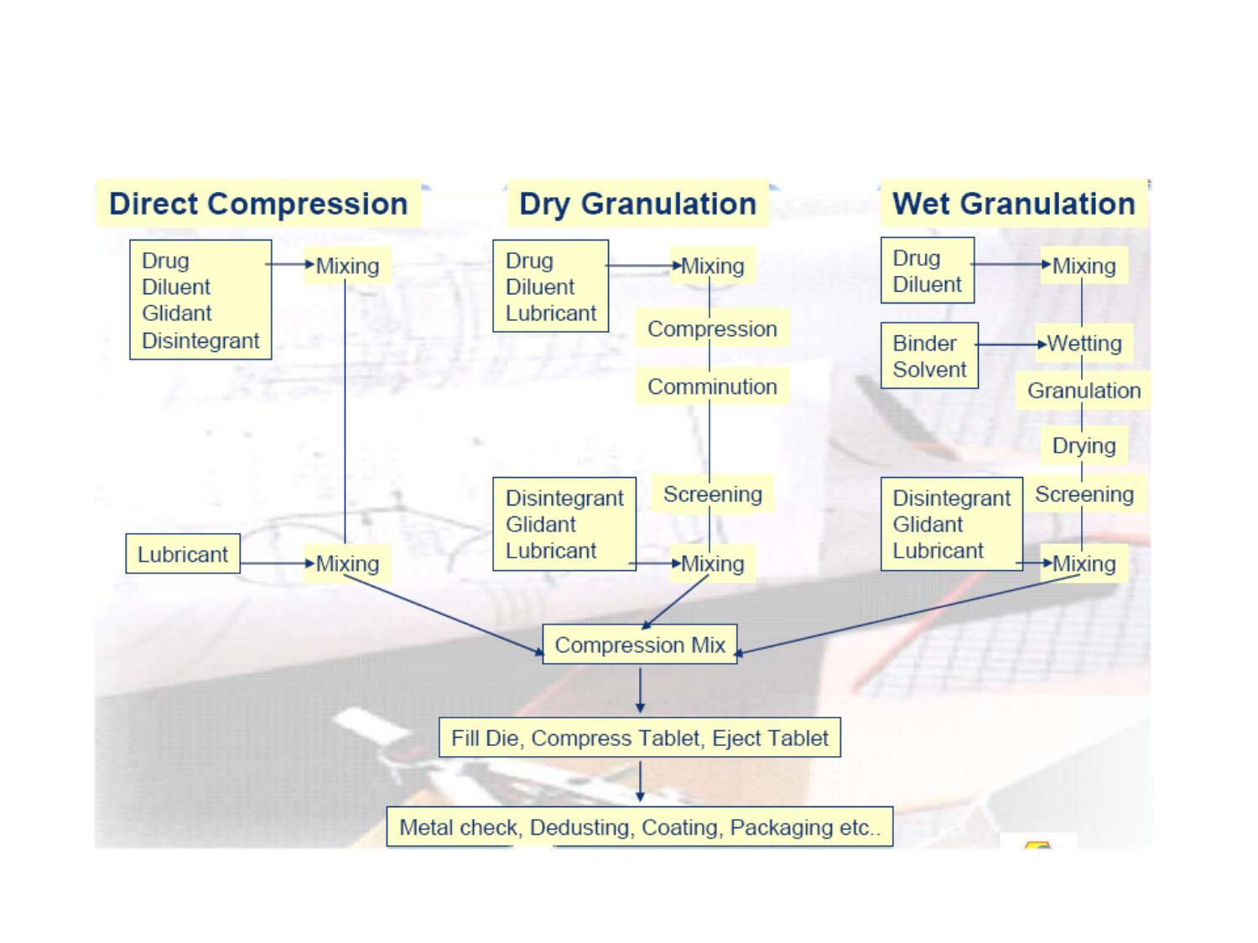
Tablet Manufacturing

Slide 16
UNCOATED TABLETS
Uncoated tablets are generally single-layer tablets prepared by a single compression of granules or multi-layer tablets consisting of parallel layers prepared by compression of granules of different compositions. No treatment is given to such tablets after compression. Any added substances are not specifically intended to modify the release of their active ingredients.
The addition of flavors to uncoated tablets other than multi-layer tablets is not official unless permitted in the individual monograph. Uncoated Tablets have the general characteristics of tablets.

Slide 17
COATED TABLETS
Coated tablets are tablets covered with one or more layers of mixtures of various substances such as resins, gums, inactive and insoluble fillers, sugars, plasticisers, polyhydric alcohols, waxes, etc. The coating may also contain active ingredients.
In compression-coated tablets, the coating is applied by compressing around the tablets granules prepared from tablet excipients such as lactose, calcium phosphate, etc.
Substances used as coatings are usually applied as a solution or suspension in conditions in which evaporation of the vehicle occurs.
When the coating is thin, the tablets are described as film-coated.
Coated tablets may contain flavoring agents. Coated tablets have a smooth, usually polished and often colored, surface; a broken section examined under a lens shows a core surrounded by one or more continuous layers of a different texture.

Slide 18
Film-Coated Tablets
Film-coated tablets are conventional tablets coated with a thin layer of polymer (e.g., hydroxypropyl methylcellulose, hydroxypropyl cellulose) or a mixture of polymers (e.g., Eudragit E100) capable of forming a skin-like film.
The film is usually coloured and also impacts the same general characteristics as sugar coating with the added advantage of being more durable, less bulky, and less time-consuming to apply.
By its composition, the coating is designed to break and expose the core tablet at the desired location in the gastrointestinal tract.

Slide 19
Sugar-coated Tablets
These are compressed tablets that have been coated with concentrated sugar solution to improve patient’s compliance, increase aesthetic appeal, mask objectionable tastes or odours, increase stability and/or modify the release of therapeutic agent(s).
Sugarcoating was once quite common but lost commercial appeal due to the time and expertise required in the coating process, the increase in size and weight of coated tablets, high cost of process validation and shipping.

Slide 20
Enteric-coated Tablets
Enteric-coated tablets are compressed tablets that have delayed-release properties. They are coated with polymeric substances (such as cellulose acetate phthalate/cellulose acetate butyrate; hydroxypropylmethylcellulose succinate; and methacrylic acid copolymers) that resist solution in gastric fluid but disintegrate and allow drug dissolution and absorption in the intestine.
Enteric coatings are primarily employed when the drug substance is inactivated or destroyed by gastric acid (e.g., erythromycin) or is particularly irritating to the gastric mucosa (e.g., non-steroidal anti-inflammatory drugs) or when bypass of the stomach substantially enhances drug absorption.

Slide 21
Effervescent Tablets
Effervescent tablets are uncoated tablets that generally contain organic acids (such as tartaric or citric acid) and sodium bicarbonate in addition to the medicinal substance or API.
They react rapidly in the presence of water by releasing carbon dioxide which acts as a disintegrator to produce either a drug suspension or an aqueous solution.
These tablets are prepared by compressing granular effervescent salts (organic acid and bicarbonate) with the medicinal substances

Slide 22
Chewable Tablets
Chewable tablets are big sized tablets which are difficult to swallow and thus, are chewed within the buccal cavity prior to swallowing.
They are especially useful for administration of large tablets to children and adults who have difficulty swallowing conventional tablets or antacid formulations in which the size of the tablet is normally large and the neutralisation efficacy of the tablet is related to particle size within the stomach.
Chewable tablets are not conventionally used if the drug has issues regarding taste acceptability.

Slide 23
Buccal and Sublingual Tablets
Buccal and sublingual tablets are small, flat, oval tablets that are intended to be dissolved in the buccal pouch (buccal tablets) or beneath the tongue (sublingual tablets) for absorption through the oral mucosa to produce a systemic effect.
These tablets are employed to achieve either rapid absorption into the systemic circulation e.g. glyceryl trinitrate sublingual tablets or, alternatively, to enable oral absorption of drugs that are destroyed by the gastric juice and/or are poorly absorbed from the gastrointestinal tract.

Slide 24
Lozenges or Troches
These are disc-shaped solid preparations containing medicinal agents and generally a flavouring substance in a hard candy or sugar base. They are intended to be slowly dissolved in the oral cavity, usually for local effects.

Slide 25
Hypodermic Tablets
Hypodermic tablets are soft, readily soluble tablets that were originally used by physicians in extemporaneous preparation of parenteral solutions. These tablets are dissolved in a suitable vehicle (water for injections) and administered by parenteral route.
Hypodermic tablets are no longer used in most countries due to the difficulty in achieving sterility. Also, the availability of stable parenteral solutions and prefabricated injectable products, some in disposable syringes have also discouraged their use in recent times.

Slide 26
Gelatin-Coated Tablets
Gelatin-coated tablets are compressed tablets coated with either one or two-toned colour gelatin. The gelatin coating impacts the same general characteristics as sugar coating and film coating with the added advantage of improving the stability of photosensitive APIs.
The gelatin coating also facilitates swallowing, enables custom branding, and prevents counterfeit since they are more tamper-evident than unsealed capsules. Gelatin-coated tablets are also ideal for double-blind clinical studies, or for drug substances that can irritate the oesophagal mucosa when they are incorporated in an immediate-release tablet such as bisphosphonates

Slide 27
Extended-Release Tablets
Extended-release tablets sometimes called controlled-release tablets, prolonged-release, delayed release or sustained release tablets are tablets designed to release their medication in a predetermined manner over a prolonged period of time.
These tablet types are categorized into
Those that respond to some physiological condition to release the drug, such as enteric coatings;
Those that release the drug in a relatively steady, controlled manner; and
Those that combine combinations of mechanisms to release pulses of drug such as repeat action tablets.

Slide 28
Advantages of Extended-Release tablets
It reduces the dosing frequency of drugs.
It may maintain therapeutic concentrations.
Reduce the toxicity by slowing drug absorption.
Minimize the local and systemic side effects.
Use of these formulation avoids the high blood concentration.
Improvement in treatment efficacy.
Minimizes drug accumulation.
Improve bioavailability of some drugs.
They have the potential to improve the patient compliance and convenience.

Slide 29
Disadvantages of Extended-Release Tablets
It contains a higher drug load and thus any loss of integrity of the release characteristics of the dosage form.
High cost of preparation.
The larger size of extended release products may cause difficulties in ingestion or transit through gut.
Sometimes the target tissue will expose to constant amount of drug over extended period results in drug tolerance.
The release rates are affected by various factors such as food and the rate of transit through the gut.

Slide 30
Sustain Release Tablet
Sustained release tablets are in a form of dosage where a drug is administered to a patient at a given or calculated rate with the aim of maintaining a certain concentration of the administered drug over a specific period of time into the patient's system while reducing possible side effects.
Sustained release tablets are often time-release drugs, they can either be released immediately or in small amounts after administration. They include pills and capsules. Time and rate of administration of the formulations are predetermined so as to reduce the effect on blood levels or reduce effects on the intestinal tract and even extend the drugs half life.

Slide 31
Advantages of Sustain Release Tablets
As the rate of recurrence of drug administered is reduced, patient compliance can be enhanced.
Better drug absorption can be achieved.
Occurrence of side effects can be reduced.
It allow to improved consistency of treatment.

Slide 32
Disadvantages of Sustain Release Tablets
Expensive
Toxicity due to dose dumping
Bigger possible for first-pass clearance.
Require for extra patient learning and counselling.

Slide 33
Fast Dissolving Tablet
Fast dissolving tablets are uncoated tablets intended to be placed in the mouth where they disperse rapidly before being swallowed
These tablets are designed for the patients who have difficulty in swallowing tablets.
These are also known as orodispersible tablets, fast disintegrating tablets, mouth dissolving tablets and rapid dissolving tablets.
These tablets disintegrate rapidly, usually within a matter of seconds, when placed upon the tongue. These tablets liquefy on the tongue, and the patient swallows the liquid.

Slide 34
Advantages of Fast Dissolving Tablets
It facilitate drug administration to the patients who have difficulties in swallowing.
It achieves increased bioavailability/rapid absorption of a drug.
It increases patient compliance and convenience.
No need of water to swallow.
It provide good mouth feel property.
The risk of chocking or suffocation during oral administration is avoided.
It leaves negligible or no residue in the mouth after ingestion.

Slide 35
Disadvantages of Fast Dissolving Tablets
Mechanical strength is less as compared to other tablets.
Drug with higher dose can not be formulated as fast dissolving tablet.
Sweeteners are required in sufficient quantity otherwise the tablet will possess a bitter taste.
Tablet show grittiness if not formulated properly.
More fragile and porous.
These are hygroscopic in nature and have to be stored in cool dry place.
It has physical stability issue.
Special packaging is required to maintain stability of these tablets.

Slide 36
Multi Layered Tablets
These tablets are used as a means of administering one or more than one drug in one tablet to achieve immediate and prolonged drug delivery.
When these tablets are prepared by subjecting the fill material to more than a single compression, they are known as multiple compressed tablets. Multiple compressed tablets are tablet within a tablet and layered tablets.
When the coating material, in the form of a granulation or powder, is compressed onto a preformed tablet core of drug, the tablet is known as compression coated tablet.
Immediate release layered tablets are made to separate incompatible drugs from each other in a single tablet.
A modified release bi-layer tablet may contain immediate and sustained release layers. The immediate release layer delivers the initial dose af a drug upon reaching the gastrointestinal fluids. The sustained release layer releases the drug in a sustained manner for a prolonged period of time.
The drugs in the two layers may be same or different. If the drug in both the layers of the tablet is same, the tablet may also be called as Repeat Action tablet.

Slide 37
Advantages of Multi Layered Tablet
Increased patient compliance.
They can be used to deliver two incompatible drugs having different release profiles.
They can be used to formulate gastro-retentive tablets.
They can be used with two or more delivery mechanism.
Reduction in cost of medication.
They are elegant products and provide brand recognition.
Unpleasant odor and bitter taste can be masked by coating technique.
The tablet can be easily used for combination therapy.

Slide 38
Disadvantages of Multi Layered Tablet
Higher chances of lamination and capping.
Lack of sufficient bonding and adhesion at the interface between the adjacent compacted layers which is often the result of an interfacial crack and layer separation.
They are complicated to manufacture.
There are chances of cross contamination between the layers.

