Slide 1
TELEVISION COMMERCIAL PRODUCTION Advertising Management
Dr. Sudesh Srivastava
Associate Professor - Marketing Area
Institute of Business Management
CSJM University, Kanpur

Slide 2
What is a TVC?
A television commercial (TVC) is a form of advertising where goods, services, organizations, ideas, etc. are promoted through television broadcast.
Usual duration of a TVC in India :
3 minutes
60 seconds
45 seconds
30 seconds
15 seconds
10 seconds

Slide 3
Objectives of a TVC
A Television commercial helps a marketer to
Launch a new product
Launch a modified product
Extend the Product Life Cycle
Convince the customers to switch brand/product
Remind the consumer etc..

Slide 4
Steps in the TVC Production Process
Pre-Production
Production
Post-Production

Slide 5
Pre-Production
Pre-production is a general term that refers to the various tasks undertaken before the production begins. The tasks included in this stage depend upon the medium and situation.
For an advertising agency creative team, pre-production may refer to everything that happens before the photography/shooting begins, e.g., meeting with the client, research, storyboarding, location planning, etc.

Slide 6
Pre-Production…..contd.
Pre-production includes:
Location search
Props and wardrobe identification and preparation
Special effects (SFX) identification and preparation
Scheduling production
Set construction
Locking the script (semi-finalisation of the script)
Script read-through with cast, director and other related parties

Slide 7
Production
Production is that part of the process where the footage is shot/recorded. This is what laymen imagine when they think of a film being made — actors on sets, cameras rolling, etc. The production phase is also known as principal photography.
In full length feature films the beginning of the production phase marks the "point of no return", i.e. the point at which it is no longer financially viable to cancel the project. At this point it is almost always cheaper to continue until the project is finished than to deal with the financial losses incurred upon cancelling the shoot.

Slide 8
Production ……..contd.
Thus, the main objective of principal photography is to record all required shots (however it is fairly common to shoot "pick-up" shots in post-production).
Pick-up shots are required when a mistake is noticed, a script change is made (not often), or when a performance is deemed to be unsatisfactory.

Slide 9
Post-Production
Post-production is the third and final stepof the TVC production process. In the parlance of the advertising world, it is often referred to simply as post, ("We can sort that out in post“)
Common tasks in Post-Production include, but not limited to:
Editing the video footage
Editing the soundtrack, adding sound effects, music, etc.
Adding titles and graphics
Colour and exposure correction
Adding special effects
Re-shooting certain scenes if required ("pick-up" shots)

Slide 10
Post-Production …… contd.
Sometimes, the post-production is comparatively simple, consisting of just selecting and arranging footage in the desired sequence. In most cases, however, post-production involves time-consuming tasks, often taking longer than the actual production phase.

Slide 11
Some Tips for Creating Effective TV Commercials
Begin at the finish.
– one should focus on the final impression the commercial will.
The opening should grasp the attention of the audience
– An opening that is visually surprising or full of action, drama, humor or human interest sets the context and allows a smooth transition to the rest of the commercial.
• One should use a situation that grows naturally out of the sales story.
– Avoid distracting gimmicks. Make it easy for viewers to identify with the characters.

Slide 12
Some Tips for Creating Effective TV Commercials contd.
Characters personify the product.
– They should be appealing, believable, non-distracting and relevant.
• One should try to keep it simple.
– The sequence of ideas should be easy to follow. Keep the number of elements in the commercial to a minimum.
• Write concise audio copy.
– The video should carry most of the weight. Fewer than 2 WPS is effective for demonstrations. For TVCs, 101-110 words is most effective. More than 170 words is too talky.

Slide 13
Some Tips for Creating Effective TV Commercials contd.
• Demonstrations should be dramatic but believable.
– They should always be true to life and avoid the appearance of camera tricks.
• Let the words interpret the picture and prepare viewers for the next scene.
– Use conversational language; avoid “ad” talk.
• Run scenes five or six seconds on average.
– Rarely should a scene run less than 3 seconds. Offer a variety of movement-filled scenes without “jumping”. dairymilkold.mp4

Slide 14
Filming techniques
• SHOT
– Basic visual element in a film
– Continuous view made by one camera without interruption
– Each shot is a take. A number of takes may be required to make one acceptable shot
– A scene may consist of one or more shots taken from different angles and distances

Slide 15
Three Important Considerations
1. Area included in the shot
2. The viewpoint
3. Camera angle

Slide 16
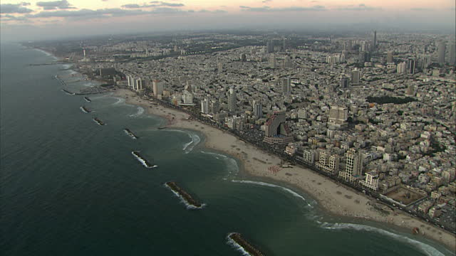
The area included in the shot
Extreme Long Shot (ELS)
Panoramic shot that shows a great area seen from a distance
Establishes geographical setting or scenic beauty

Slide 17
The area included in the shot
Long Shot (LS)
– Less panoramic and a little more specific than the ELS.
– Setting could be established but the viewer will be better able to pick out and relate to specific individuals within the shot
– Used to establish all elements in the scene, so that viewers will know who is involved, their location, etc

Slide 18
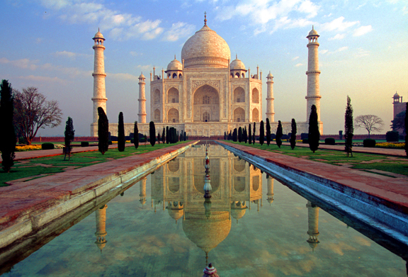
The area included in the shot

Slide 19
The area included in the shot
Medium Shot (MS or MED)
– People are filmed about waist high.
– Camera is close enough to capture gestures, expressions and movements
– Most common type of MS is two-shot, in which 2 characters exchange dialogues
– MS are good re-establishing shots after series of close-ups to help reorient viewer to the larger scene, action or setting

Slide 20
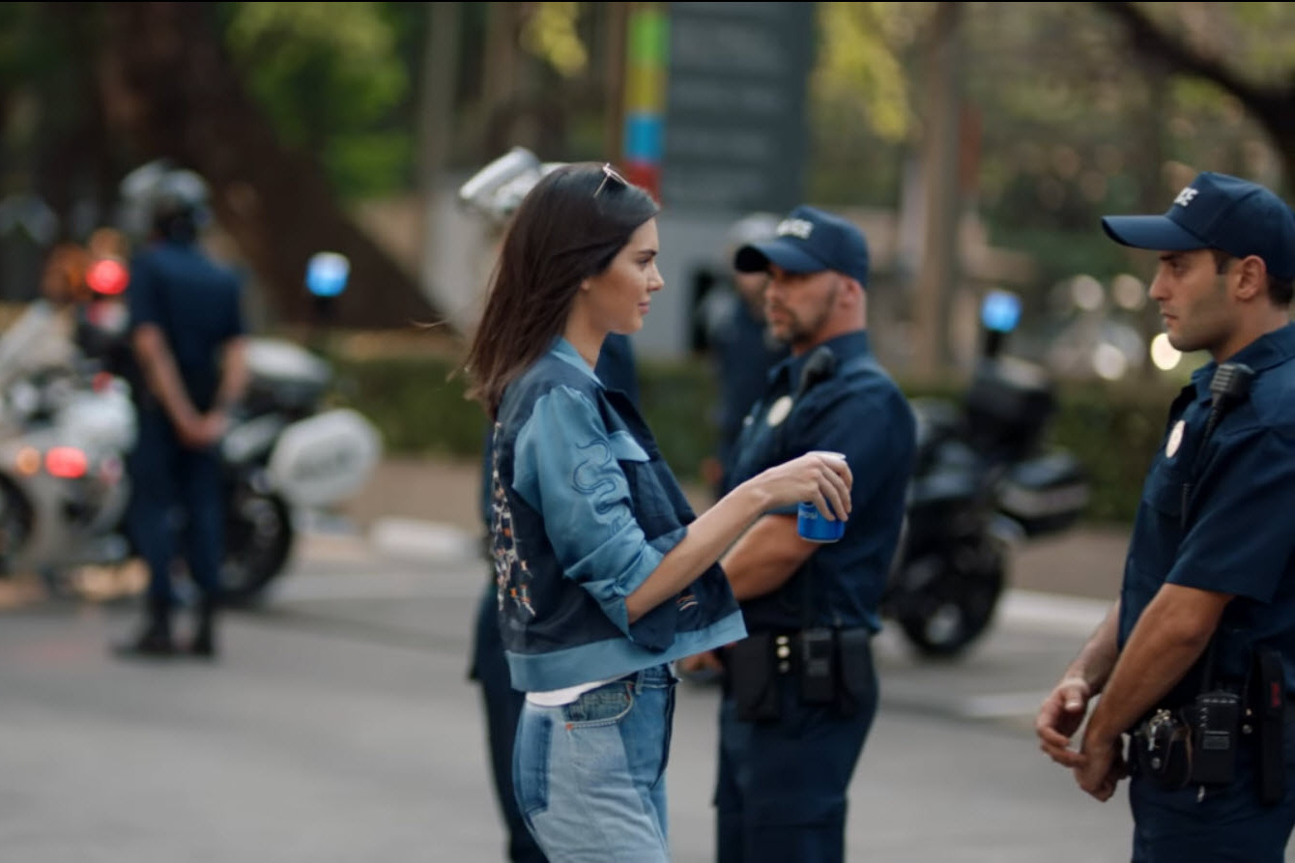
The area included in the shot (Kendall Jenner Pepsi)

Slide 21
The area included in the shot
Close Up (CU)
– CU of a person includes head and shoulders. Variations include: medium CU (between waist and shoulders to above the head), head CU (head only), and choker CU (below lips to above the eyes)
– Basic use of CU is draw attention to a significant detail such as unique product feature or the emotional reactions of an actor. – Backgrounds should be kept simple or simply out of focus
– 2 basic editing uses of CU: Cut-in CU is a CU of a preceding larger shot to heighten dramatic dialogue, isolate significant detail, magnify small-scale action, etc. Cut-away CU is a CU related to but not part of the previous scene. It depicts action simultaneously happening elsewhere.

Slide 22
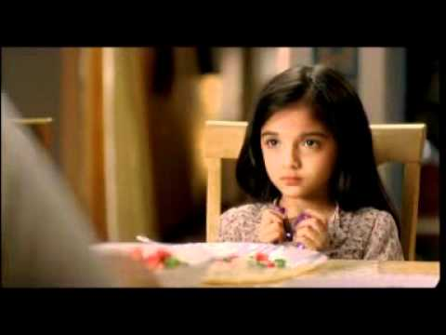
Close Up (CU)

Slide 23
The area included in the shot
Extreme Close Up (ECU)
– Focus attention on detail of a detail. Tiny objects or areas, small portions can be magnified.

Slide 24
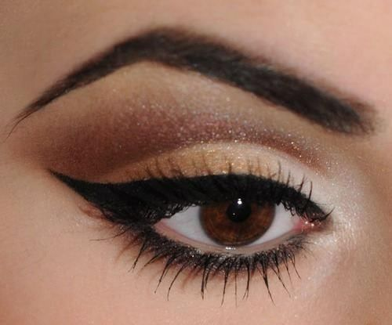
Extreme Close Up (ECU)

Slide 25
Different Shots.
Amity Ad Amityuniversity.mp4

Slide 26
The Viewpoint
Objective-impersonal.
Viewpoint of a sideline observer. Characters do not look at the camera.

Slide 27
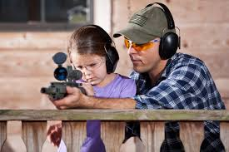
Objective Viewpoint

Slide 28
The Viewpoint
Subjective-Personal
Involved viewpoint (audience or one of the characters). Characters look directly at camera.

Slide 29
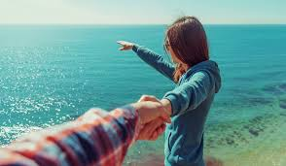
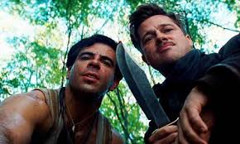
Subjective Viewpoint

Slide 30
Camera Angle
Eye Level:
sense of equality, attainable

Slide 31
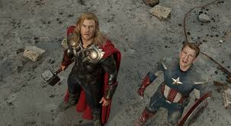
Camera Angle
Looking down (high angle):
Gives viewer a sense of superiority on the subject. Makes subject appear inferior

Slide 32
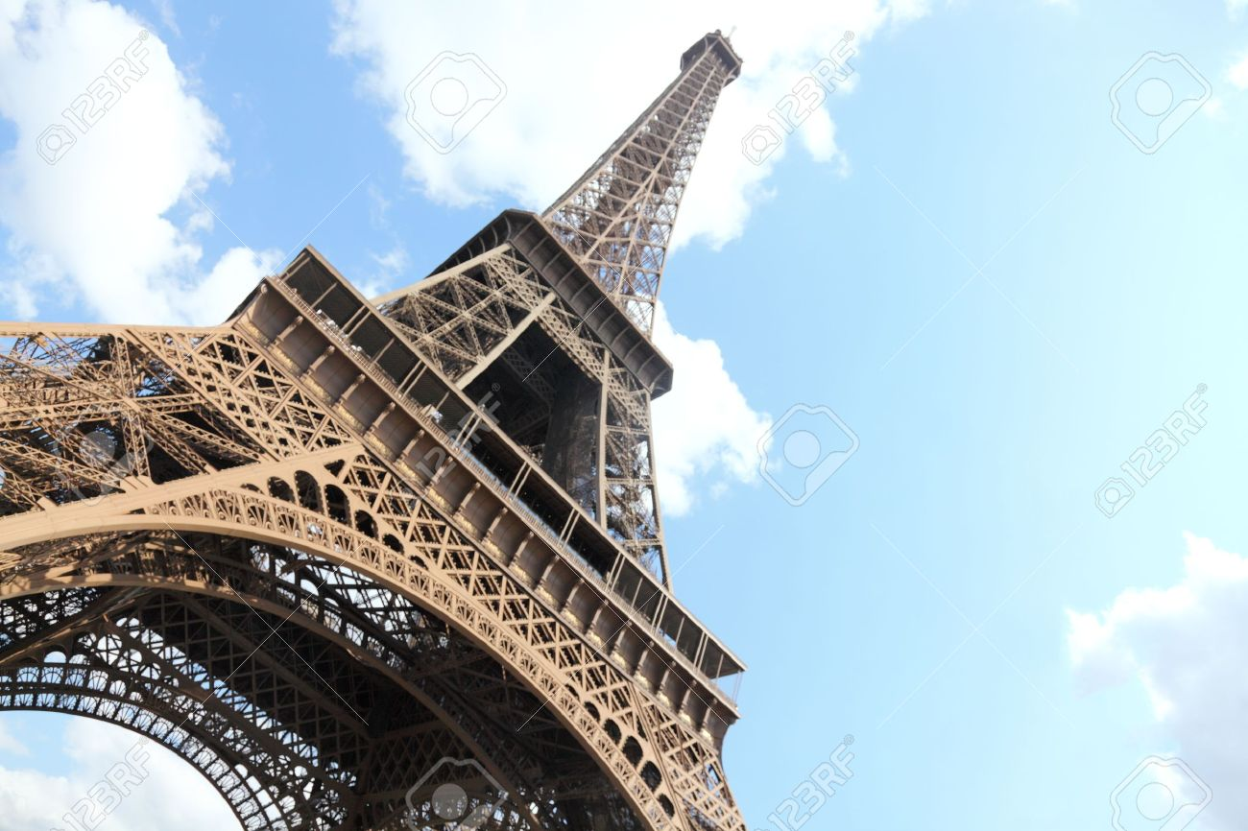
Camera Angle
Looking up (low angle):
Gives a sense of height or superiority to the subject.

Slide 33
Production of advertisements
Amul Ad making
making of amul ad.mp4

Slide 34
Thank You

