Slide 1
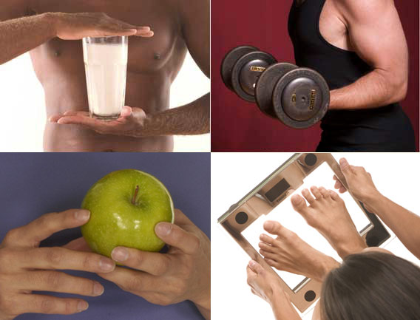
THE ROLE OF NUTRITION IN SPORTS PERFORMANCE
Deepali Nigam
Asstt. Professor, Dept. of Physical Education,
Mahila Mahavidyalaya P.G.College, Kanpur, U.P.

Slide 2
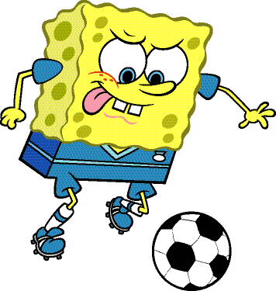
INTRODUCTION
Nutrition is the science that deals with food and its uses by the body. The relationship between nutrition and athletic performance is as certain as the connection between physical training and athletic success.

Slide 3
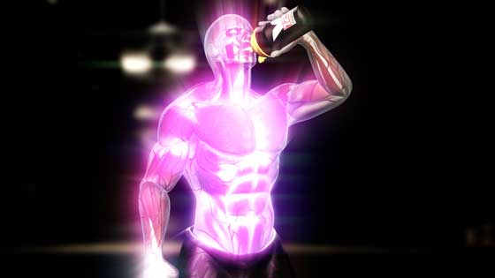
Purpose of Sports Nutrition
Sports nutrition has several purposes:
To prepare athletes before performance or training.
To maintain an acceptable level of performance during competition or training.
To help the athlete's body recover after training or athletic competition.
To provide sound information about healthy dietary practices and use of supplements.
To monitor athletes for signs of eating disorders, doping, supplement abuse, or other unhealthful nutritional practices.
To provide specialized nutritional advice to athletes following vegetarian, vegan, or other special diets.
To monitor the special nutritional needs of persons with disabilities who participate in athletic activities and programs.

Slide 4
NUTRIENT BALANCE
Carbohydrates
Protein
Fats
Vitamins and Minerals
Fluids
Calories
Consumed
Calories
Expended

Slide 5
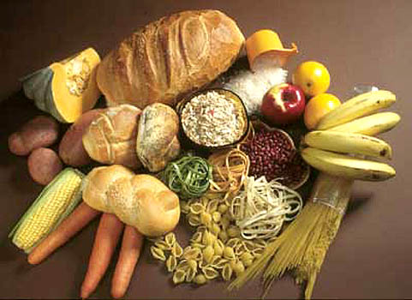
Carbohydrates
They provide quick energy to the body and are not stored in body for long.
it enhances energy and fuels the muscle constructions in the body.
it breaks down into smaller sugars such as glucose, fructose, and galactose which are absorbed by the body to release energy.
Carbohydrate recommendations for athletes range from 6 to 10 g/kg body weight.
The main source of carbohydrate are sugar, cereals, grains, dried fruits etc.

Slide 6
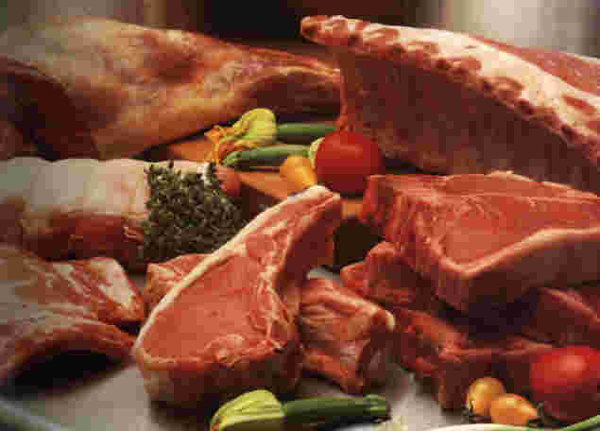
Protein
Proteins are the basic structure of all living cells.
Proteins is a chain of amino acids that contain carbon, oxygen, hydrogen and nitrogen.
It is constantly being synthesized and degraded.
Resulting in the maintenance of muscle and lean tissue mass.
The best sources of complete proteins are eggs, milk, meat, poultry, beef and milk products.
Protein recommendations for endurance and strength-trained athletes range from 1.2 to 1.7 g/kg body weight.

Slide 7
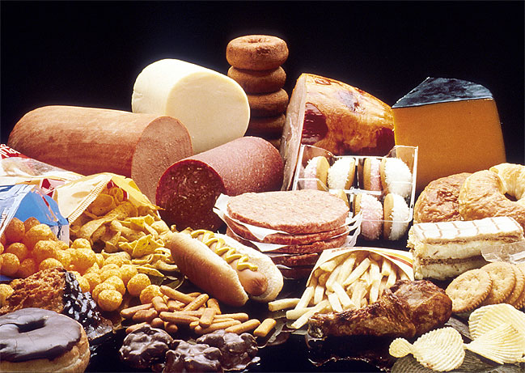
Fat
Fat also contain carbon, hydrogen and oxygen. They are most concentrated source of energy in foods.
Fat provides energy, protects the body's organs and helps with the absorption of some vitamins.
Good choices include the fats from nuts, seeds, vegetable oils (canola, olive, peanut), and avocados. Fat intake should range from 20% to 35% of total energy intake.

Slide 8
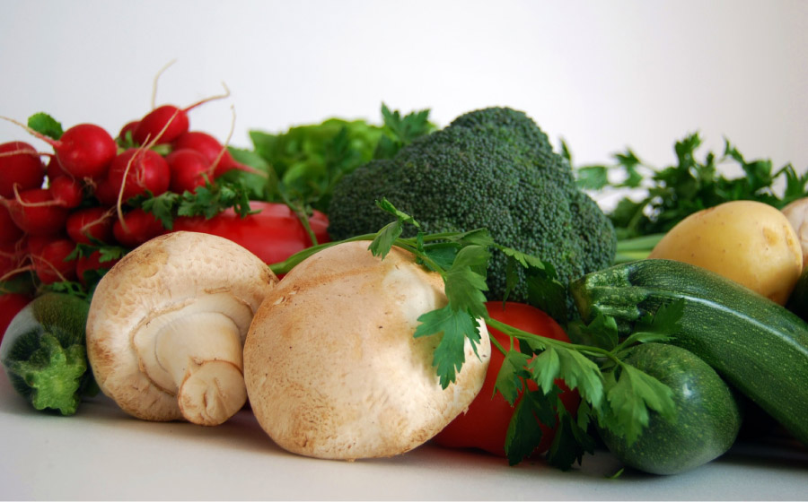
Vitamins and Minerals
These are also called MICRONUTRIENTS which plays a vital role in energy production, hemoglobin synthesis, maintenance of bone health, adequate immune function and protection of body oxidative damage.
The most common vitamins and minerals found to be of concern in athletes' diets are calcium and vitamin D, the B vitamins, iron, zinc, magnesium.

Slide 9
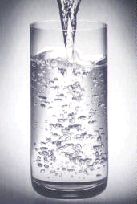
Fluids
Water makes up about 60 percent of a person's body weight.
Water helps move nutrients throughout the body and helps remove waste from the body.
It is preventing from dehydration and avoiding injury. Even mild dehydration can cause muscle and body fatigue, which will reduce athletic performance.
Dehydration increases the risk of potentially life-threatening heat injury such as heat stroke.

Slide 10
Fluid intake guidelines
WHEN TO DRINK AMOUNT OF FLUID
2 hr before exercise 2-3+ cups
15 minutes before 1-2+ cups
Every 15 minutes DURING 1-1.5 cups
After 1 hour of Activity Drink Freely

Slide 11
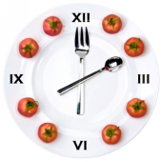
The Timing of Meals
The importance of what foods are eaten is matched only by when they are eaten.
Several Hours before You Workout
Thirty Minutes before You Workout
During Your Workout
Hydration after Your Workout
Eating After Your Workout

Slide 12
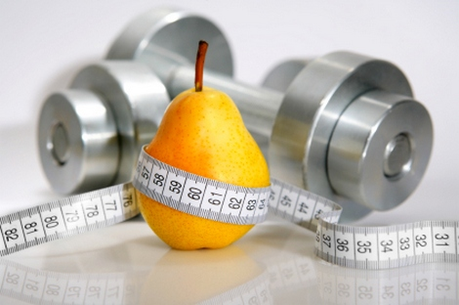
Several Hours before You Workout
Depending upon your exercise style.
Include easily digestible foods
Experiment with what works best for you

Slide 13
Thirty Minutes before You Workout
Depending upon the type and duration of workout
Hard work out
Shorter workout
Drink 6-12 ounces in the hour before your workout.

Slide 14
During Workout
Proper hydration during exercise depends upon the intensity and duration of exercise, the fitness of the athlete, and weather conditions.
Exercising for more than about 90 minutes usually requires that you replenish lost carbohydrates. If your workout is less than an hour, then you don't need to consume anything extra.

Slide 15
Hydration after Workout
After your workout, drink enough water to replace water lost through sweat. The best way to determine this is by weighing yourself before and after exercise.
Another way to determine how much liquid to consume is to check the color of your urine.

Slide 16
Eating After Workout
The post-exercise meal should be eaten within two hours of a long or intense workout in order to replenish glycogen stores for continued exercise.
Studies have found that a 4:1 ratio of carbohydrate to protein seems to the ideal combination of nutrition.
Solid foods can work just as well as a sports drink, a drink may be easier to digest make it easier to get the right ratio and meet the 2-hour window.

Slide 17
