Slide 1
TYPES OF ORTHOSIS
By:
Dr. Digvijay Sharma
Director & Ass. Professor
School of Health Sciences, CSJMU

Slide 2
Contents
Patient- Orthosis interface
Classification of Orthosis
According to Basic Functions
According to Regions
Spinal Orthosis

Slide 3
Patient- Orthosis Interface
It is the junction between the body and the tissues and orthosis.
It is the transient support surface.
All the forces acting upon or through the body or the orthosis is transmitted through this interface.
On application of force, there occurs some deformation within both the surfaces.
Deformation of structures on force leads to progressive breakdown of the tissues which may further lead to abnormal functioning or degradation of tissue concerned.
Thus, it becomes important to evaluate the thickness, relative shape of structures and the amount as well the level at which force will be assertive.
S Sunder; Textbook of Rehabilitation; Jaypee Brothers; Third Edition
Patzkowski, Jeanne C., et al. "Comparative effect of orthosis design on functional performance." JBJS 94.6 (2012): 507-515.
Root, M. L. "Development of the functional orthosis." Clinics in podiatric medicine and surgery 11.2 (1994): 183-210.
Bregman, D. J. J., et al. "A new method for evaluating ankle foot orthosis characteristics: BRUCE." Gait & posture 30.2 (2009): 144-149.

Slide 4
Classification
Classification of Orthosis
According to Basic Function
According to Region
According to Specific Condition
According to Special Functions
S Sunder; Textbook of Rehabilitation; Jaypee Brothers; Third Edition
Patzkowski, Jeanne C., et al. "Comparative effect of orthosis design on functional performance." JBJS 94.6 (2012): 507-515.
Root, M. L. "Development of the functional orthosis." Clinics in podiatric medicine and surgery 11.2 (1994): 183-210.
Bregman, D. J. J., et al. "A new method for evaluating ankle foot orthosis characteristics: BRUCE." Gait & posture 30.2 (2009): 144-149.

Slide 5
According to Basic Functions

Slide 6
Basic Functions
Support
Function
Correction
Protection
De-substitution
Strengthening
Pain relief
Weight distribution
S Sunder; Textbook of Rehabilitation; Jaypee Brothers; Third Edition
Patzkowski, Jeanne C., et al. "Comparative effect of orthosis design on functional performance." JBJS 94.6 (2012): 507-515.
Root, M. L. "Development of the functional orthosis." Clinics in podiatric medicine and surgery 11.2 (1994): 183-210.
Bregman, D. J. J., et al. "A new method for evaluating ankle foot orthosis characteristics: BRUCE." Gait & posture 30.2 (2009): 144-149.

Slide 7
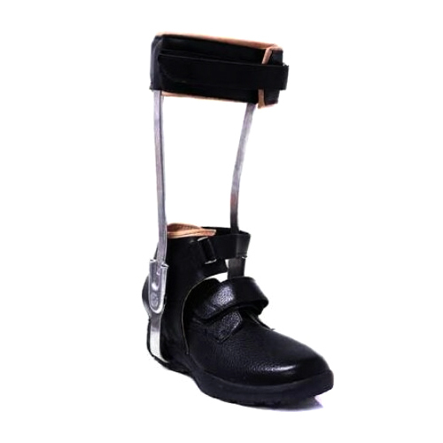
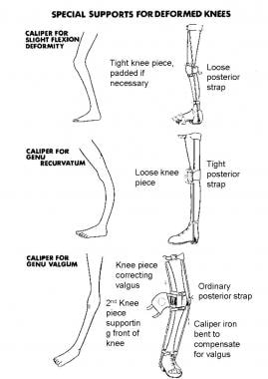
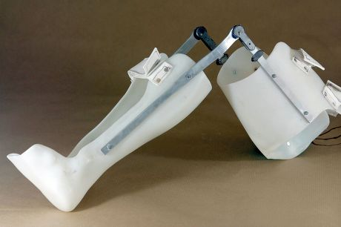
Supportive Orthosis
As the name suggests, they are meant for supporting the concerned limb or structure.
It stabilizes the joints and muscles around
Adequate support is provided in anatomical position.
For ex: Calipers, gaiters, etc.
Below knee Caliper
K.A.F.O
S Sunder; Textbook of Rehabilitation; Jaypee Brothers; Third Edition
Patzkowski, Jeanne C., et al. "Comparative effect of orthosis design on functional performance." JBJS 94.6 (2012): 507-515.
Root, M. L. "Development of the functional orthosis." Clinics in podiatric medicine and surgery 11.2 (1994): 183-210.
Bregman, D. J. J., et al. "A new method for evaluating ankle foot orthosis characteristics: BRUCE." Gait & posture 30.2 (2009): 144-149.

Slide 8
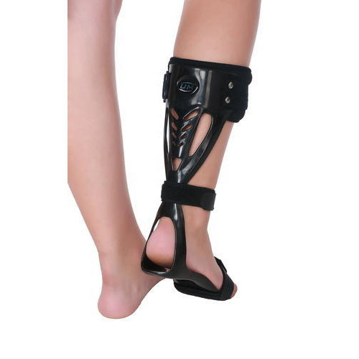
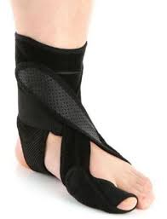
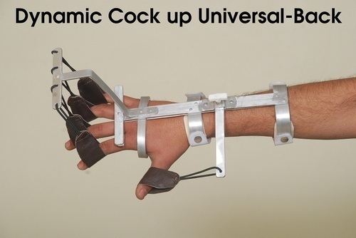
Functional Orthosis
As the name suggests, it is meant for maintaining the functional activities.
It also gives stabilization but with ability to perform concerning function.
For ex: Dynamic cock-up splint, Foot Drop splint, etc.
S Sunder; Textbook of Rehabilitation; Jaypee Brothers; Third Edition
Patzkowski, Jeanne C., et al. "Comparative effect of orthosis design on functional performance." JBJS 94.6 (2012): 507-515.
Root, M. L. "Development of the functional orthosis." Clinics in podiatric medicine and surgery 11.2 (1994): 183-210.
Bregman, D. J. J., et al. "A new method for evaluating ankle foot orthosis characteristics: BRUCE." Gait & posture 30.2 (2009): 144-149.

Slide 9
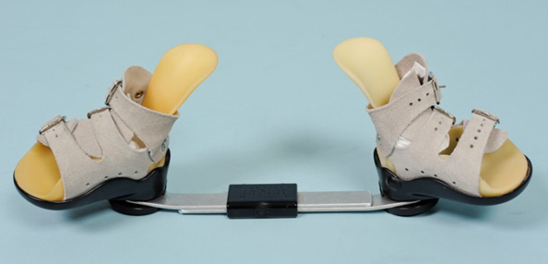
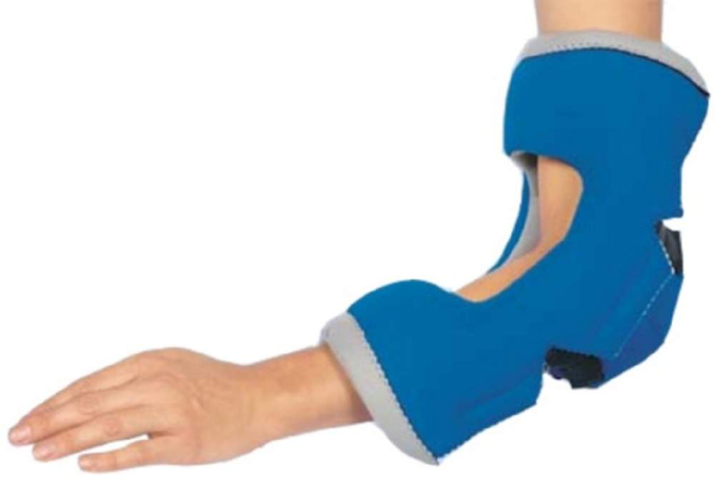
Corrective Orthosis
As the name suggests, it is meant for correction of deformities.
It is used to provide an extra force to the body structures to correct the alignment and to counter the deforming forces acting on the structures.
For ex: Club Foot boot, etc.
S Sunder; Textbook of Rehabilitation; Jaypee Brothers; Third Edition
Patzkowski, Jeanne C., et al. "Comparative effect of orthosis design on functional performance." JBJS 94.6 (2012): 507-515.
Root, M. L. "Development of the functional orthosis." Clinics in podiatric medicine and surgery 11.2 (1994): 183-210.
Bregman, D. J. J., et al. "A new method for evaluating ankle foot orthosis characteristics: BRUCE." Gait & posture 30.2 (2009): 144-149.

Slide 10
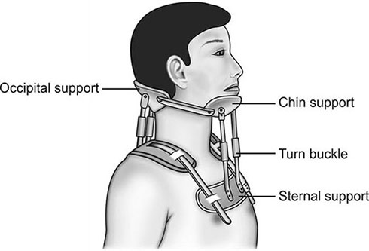
Protective Orthosis
The orthosis meant for providing protection.
This means that the orthosis supporting the healing process.
For ex: Rigid four post collar, etc.
S Sunder; Textbook of Rehabilitation; Jaypee Brothers; Third Edition
Patzkowski, Jeanne C., et al. "Comparative effect of orthosis design on functional performance." JBJS 94.6 (2012): 507-515.
Root, M. L. "Development of the functional orthosis." Clinics in podiatric medicine and surgery 11.2 (1994): 183-210.
Bregman, D. J. J., et al. "A new method for evaluating ankle foot orthosis characteristics: BRUCE." Gait & posture 30.2 (2009): 144-149.

Slide 11
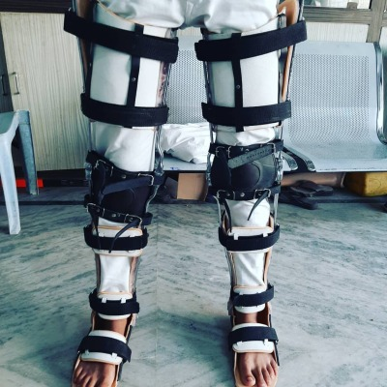
De- substitution of Functions
These orthosis not only support the limb or body structure but also help restrain a faulty or incorrect movement which the body might generally adapt in absence of a limiting support.
For ex: full length Caliper, etc.
S Sunder; Textbook of Rehabilitation; Jaypee Brothers; Third Edition
Patzkowski, Jeanne C., et al. "Comparative effect of orthosis design on functional performance." JBJS 94.6 (2012): 507-515.
Root, M. L. "Development of the functional orthosis." Clinics in podiatric medicine and surgery 11.2 (1994): 183-210.
Bregman, D. J. J., et al. "A new method for evaluating ankle foot orthosis characteristics: BRUCE." Gait & posture 30.2 (2009): 144-149.

Slide 12
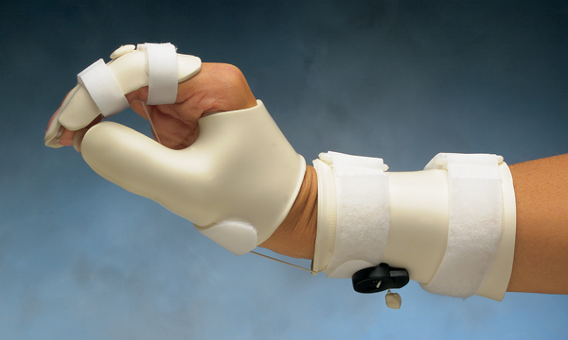
Strengthening Orthosis
These orthosis provide stability and also provide support and strength to the concerning musculature.
For ex: Tenodesis splint
S Sunder; Textbook of Rehabilitation; Jaypee Brothers; Third Edition
Patzkowski, Jeanne C., et al. "Comparative effect of orthosis design on functional performance." JBJS 94.6 (2012): 507-515.
Root, M. L. "Development of the functional orthosis." Clinics in podiatric medicine and surgery 11.2 (1994): 183-210.
Bregman, D. J. J., et al. "A new method for evaluating ankle foot orthosis characteristics: BRUCE." Gait & posture 30.2 (2009): 144-149.

Slide 13
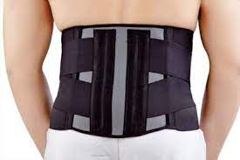
Pain Relieving Orthosis
This type of orthosis prevents the pain from increasing and supports the musculature around
This type of orthosis may be used with adjoining physiotherapy treatment protocols for chronic pains.
For ex: Lumbosacral corset, etc.
S Sunder; Textbook of Rehabilitation; Jaypee Brothers; Third Edition
Patzkowski, Jeanne C., et al. "Comparative effect of orthosis design on functional performance." JBJS 94.6 (2012): 507-515.
Root, M. L. "Development of the functional orthosis." Clinics in podiatric medicine and surgery 11.2 (1994): 183-210.
Bregman, D. J. J., et al. "A new method for evaluating ankle foot orthosis characteristics: BRUCE." Gait & posture 30.2 (2009): 144-149.

Slide 14
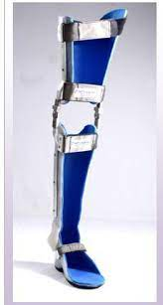
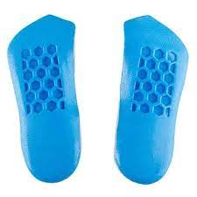
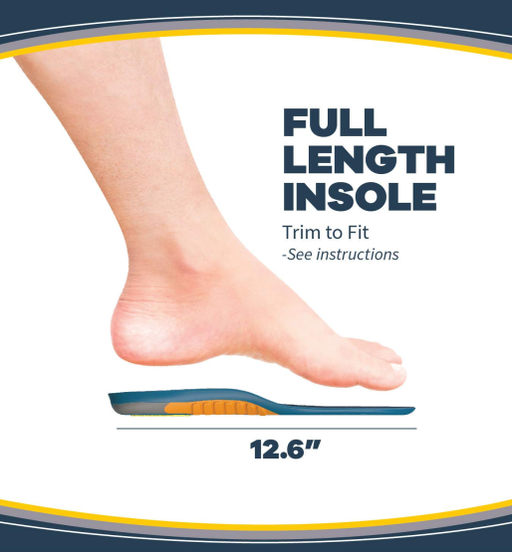
Weight distributing Orthosis
This type of orthosis is used for preventing weight bearing.
These weight relieving orthosis not only provide relief from pain or weight bearing but also provide the body structures with appropriate support.
Used in conditions where there is strict non- weight bearing.
S Sunder; Textbook of Rehabilitation; Jaypee Brothers; Third Edition
Patzkowski, Jeanne C., et al. "Comparative effect of orthosis design on functional performance." JBJS 94.6 (2012): 507-515.
Root, M. L. "Development of the functional orthosis." Clinics in podiatric medicine and surgery 11.2 (1994): 183-210.
Bregman, D. J. J., et al. "A new method for evaluating ankle foot orthosis characteristics: BRUCE." Gait & posture 30.2 (2009): 144-149.

Slide 15
According to Regional Classification

Slide 16
Classification
Spinal Orthosis
Upper Extremity Orthosis
Lower Extremity Orthosis or Calipers
S Sunder; Textbook of Rehabilitation; Jaypee Brothers; Third Edition
Patzkowski, Jeanne C., et al. "Comparative effect of orthosis design on functional performance." JBJS 94.6 (2012): 507-515.
Root, M. L. "Development of the functional orthosis." Clinics in podiatric medicine and surgery 11.2 (1994): 183-210.
Bregman, D. J. J., et al. "A new method for evaluating ankle foot orthosis characteristics: BRUCE." Gait & posture 30.2 (2009): 144-149.

Slide 17
Types of Spinal Orthosis
Head- Cervical Orthosis (HCO)
Cervical Orthosis
Head- Cervical –Thoracic Orthosis (HCTO)
Thoraco- Lumbar- Sacral Orthosis (TLSO)
Lumbo- Sacral Orthosis
Sacral Orthosis
S Sunder; Textbook of Rehabilitation; Jaypee Brothers; Third Edition
Patzkowski, Jeanne C., et al. "Comparative effect of orthosis design on functional performance." JBJS 94.6 (2012): 507-515.
Root, M. L. "Development of the functional orthosis." Clinics in podiatric medicine and surgery 11.2 (1994): 183-210.
Bregman, D. J. J., et al. "A new method for evaluating ankle foot orthosis characteristics: BRUCE." Gait & posture 30.2 (2009): 144-149.

Slide 18
Types of Upper Extremity Orthosis
Shoulder and Arm Orthosis
Elbow Orthosis
Wrist Orthosis
Hand Orthosis
S Sunder; Textbook of Rehabilitation; Jaypee Brothers; Third Edition
Patzkowski, Jeanne C., et al. "Comparative effect of orthosis design on functional performance." JBJS 94.6 (2012): 507-515.
Root, M. L. "Development of the functional orthosis." Clinics in podiatric medicine and surgery 11.2 (1994): 183-210.
Bregman, D. J. J., et al. "A new method for evaluating ankle foot orthosis characteristics: BRUCE." Gait & posture 30.2 (2009): 144-149.

Slide 19
Types of Lower Extremity Orthosis
Foot Orthosis (FO)
Ankle- Foot Orthosis (AFO)
Knee- Ankle- Foot Orthosis (KAFO)
Hip- Knee- Ankle- Foot Orthosis (HKAFO)
S Sunder; Textbook of Rehabilitation; Jaypee Brothers; Third Edition
Patzkowski, Jeanne C., et al. "Comparative effect of orthosis design on functional performance." JBJS 94.6 (2012): 507-515.
Root, M. L. "Development of the functional orthosis." Clinics in podiatric medicine and surgery 11.2 (1994): 183-210.
Bregman, D. J. J., et al. "A new method for evaluating ankle foot orthosis characteristics: BRUCE." Gait & posture 30.2 (2009): 144-149.

Slide 20
According to Special Functions

Slide 21
Specialized Orthosis
Swedish Knee cage- a knee orthosis used to control minor or moderate genu recurvatum.
Pediatric Orthosis- Also called Standing Frame, used for toddlers with spina bifida or spinal lession or cerebral palsy.
Parapodium- Also called Swivel Orthosis, used for leg length discrepancy with wide abdominal support to assist weight bearing.
Reciprocating Gait Orthosis (RGO)- bilateral hip, knee, ankle and foot orthosis to provide contralateral hip flexion along with ipsilateral hip extension and vice- versa.
Twister- prescribed for lack of control of internal or external rotation or torsion of lower limb.
S Sunder; Textbook of Rehabilitation; Jaypee Brothers; Third Edition
Patzkowski, Jeanne C., et al. "Comparative effect of orthosis design on functional performance." JBJS 94.6 (2012): 507-515.
Root, M. L. "Development of the functional orthosis." Clinics in podiatric medicine and surgery 11.2 (1994): 183-210.
Bregman, D. J. J., et al. "A new method for evaluating ankle foot orthosis characteristics: BRUCE." Gait & posture 30.2 (2009): 144-149.

Slide 22
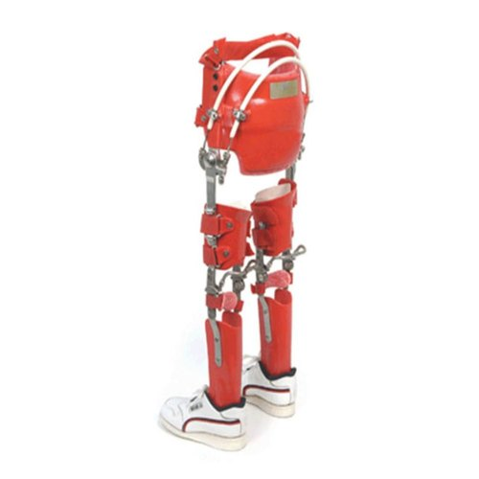
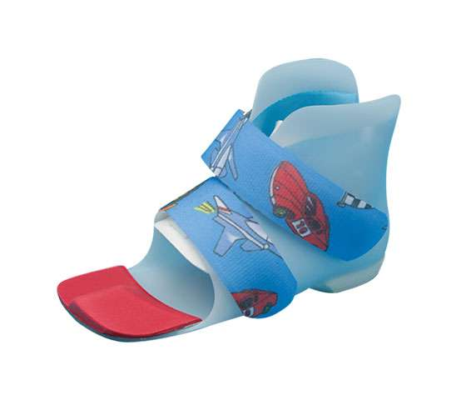
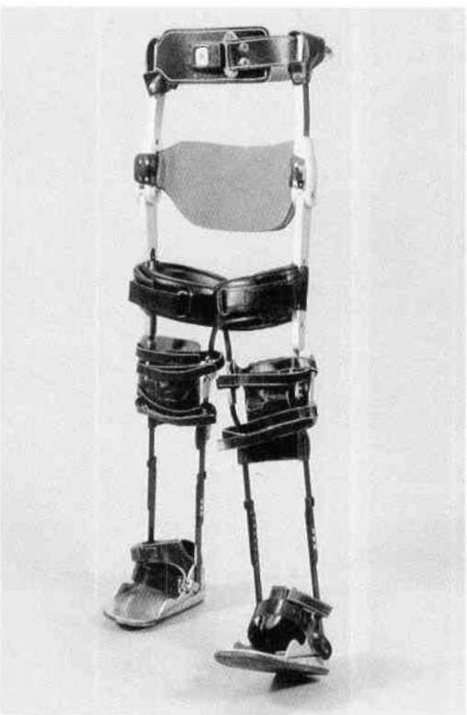
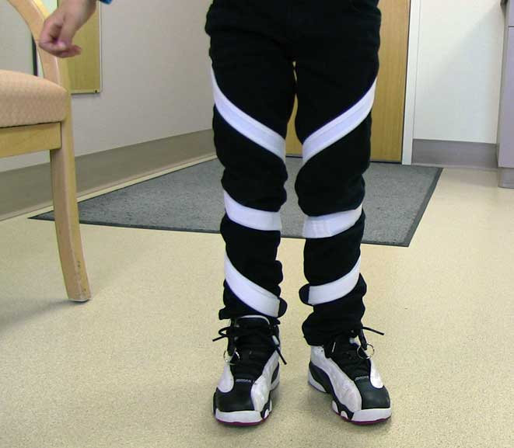
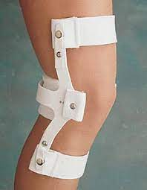
PEDIATRIC ORTHOSIS
R G ORTHOSIS
SWIVEL ORTHOSIS
TWISTER
SWEDISH KNEE CAGE

Slide 23
According to Specific Conditions

Slide 24
Orthosis for Neural injury
Radial nerve injury- a radial nerve glove to keep wrist in extended position or a wrist drop splint is given.
Ulnar nerve injury- Splints maintaining the flexion of metacarpophalangeal joints and extension at the interphalangial joints. For ex: Knuckle bender splint
Median nerve injury- the thumb is to be maintained in abducted and opposed position. For ex: Opponens Splint.
S Sunder; Textbook of Rehabilitation; Jaypee Brothers; Third Edition
Patzkowski, Jeanne C., et al. "Comparative effect of orthosis design on functional performance." JBJS 94.6 (2012): 507-515.
Root, M. L. "Development of the functional orthosis." Clinics in podiatric medicine and surgery 11.2 (1994): 183-210.
Bregman, D. J. J., et al. "A new method for evaluating ankle foot orthosis characteristics: BRUCE." Gait & posture 30.2 (2009): 144-149.

Slide 25
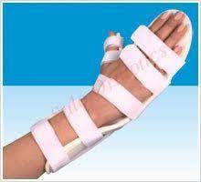
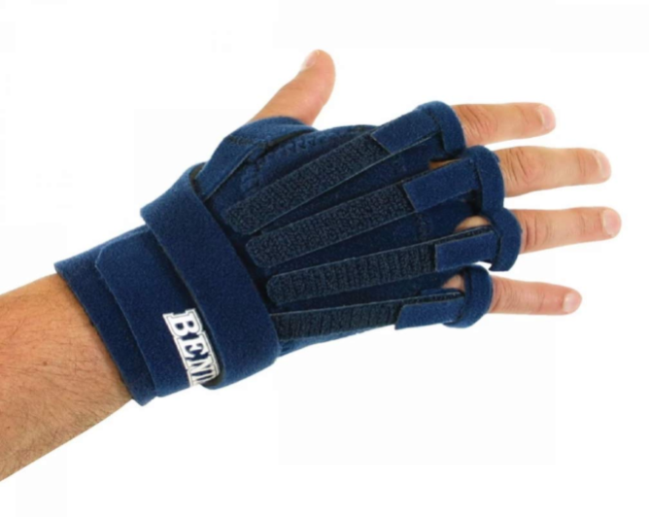
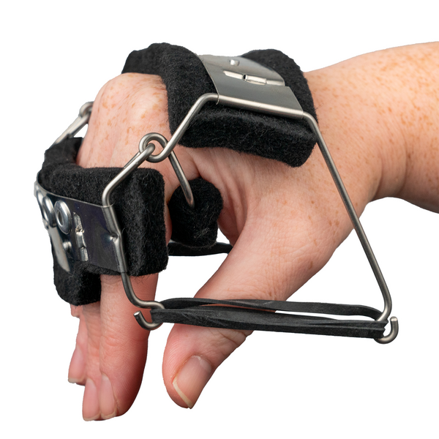
RADIAL GLOVE
STATIC COCK UP SPLINT
THUMB SPICA
KNUCKLE BENDER SPLINT

Slide 26
Inflammation of joints and tendons
Orthosis used for inflammed joints work as a part of healing mechanism.
In acute cases these orthosis or splints work as preventive measure to inhibit degradation or worsening of the condition.
For example: Static thumb spica to keep proximal interphalangeal joint free, etc.
THUMB SPICA
S Sunder; Textbook of Rehabilitation; Jaypee Brothers; Third Edition
Patzkowski, Jeanne C., et al. "Comparative effect of orthosis design on functional performance." JBJS 94.6 (2012): 507-515.
Root, M. L. "Development of the functional orthosis." Clinics in podiatric medicine and surgery 11.2 (1994): 183-210.
Bregman, D. J. J., et al. "A new method for evaluating ankle foot orthosis characteristics: BRUCE." Gait & posture 30.2 (2009): 144-149.

Slide 27
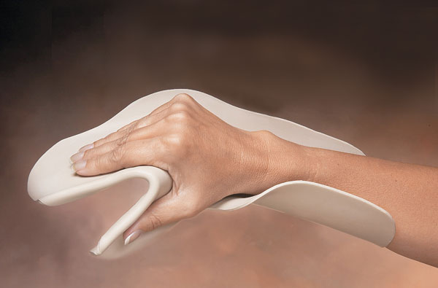
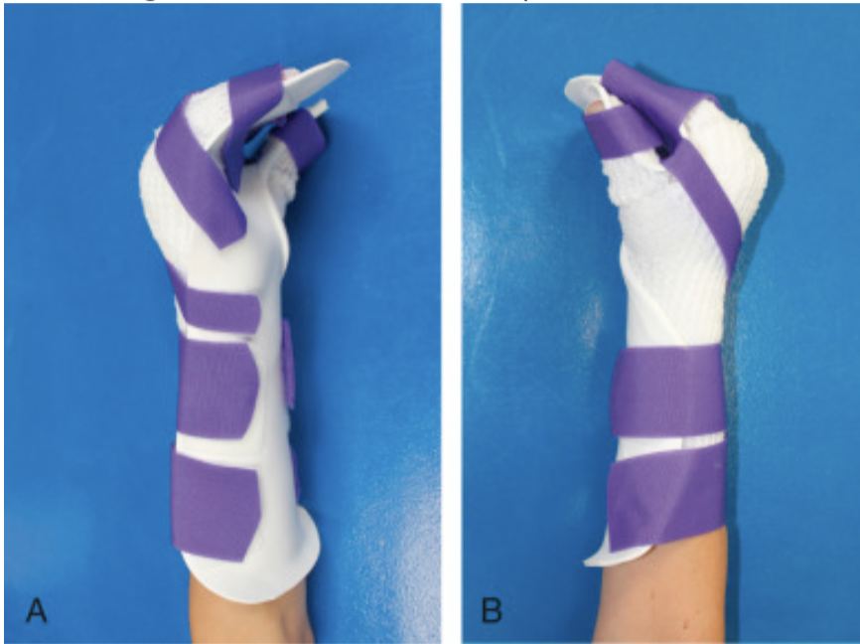
Burns
Orthosis are also used in cases of burns.
Mostly splints are used to keep the burnt area or region into neutral position preventing stiffening of the structures near by thus at times preventing development of contractures.
For ex: to prevent stiffness at the metacarpophalangeal joints.
S Sunder; Textbook of Rehabilitation; Jaypee Brothers; Third Edition
Patzkowski, Jeanne C., et al. "Comparative effect of orthosis design on functional performance." JBJS 94.6 (2012): 507-515.
Root, M. L. "Development of the functional orthosis." Clinics in podiatric medicine and surgery 11.2 (1994): 183-210.
Bregman, D. J. J., et al. "A new method for evaluating ankle foot orthosis characteristics: BRUCE." Gait & posture 30.2 (2009): 144-149.

Slide 28
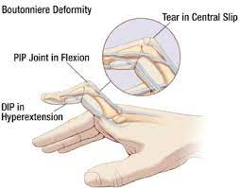
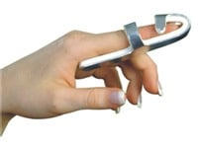
Rheumatoid Arthritis
Orthosis used in cases of RA are generally for the purpose of maintaining joints into neutral working positions.
Any joint left untreated in RA gives rise to deformities which is prevented by the use of splints or orthosis in the initial stages.
For ex: Static three point proximal interphalangeal orthosis for Boutonniere deformity.
S Sunder; Textbook of Rehabilitation; Jaypee Brothers; Third Edition
Patzkowski, Jeanne C., et al. "Comparative effect of orthosis design on functional performance." JBJS 94.6 (2012): 507-515.
Root, M. L. "Development of the functional orthosis." Clinics in podiatric medicine and surgery 11.2 (1994): 183-210.
Bregman, D. J. J., et al. "A new method for evaluating ankle foot orthosis characteristics: BRUCE." Gait & posture 30.2 (2009): 144-149.

Slide 29
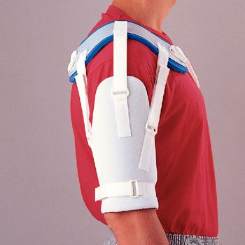
Neurological Impairment
Orthosis are vastly used for conditions post stroke, traumatic brain injury, etc.
There are many external physical comorbidities attached to neurological impairments which need a thorough treatment protocol devised using physiotherapy, medications, nursing care and externally applied orthosis.
For ex: Arm slings preventing subluxation of the shoulder joint post stroke.
S Sunder; Textbook of Rehabilitation; Jaypee Brothers; Third Edition
Patzkowski, Jeanne C., et al. "Comparative effect of orthosis design on functional performance." JBJS 94.6 (2012): 507-515.
Root, M. L. "Development of the functional orthosis." Clinics in podiatric medicine and surgery 11.2 (1994): 183-210.
Bregman, D. J. J., et al. "A new method for evaluating ankle foot orthosis characteristics: BRUCE." Gait & posture 30.2 (2009): 144-149.

