Slide 1
TRANSFER TECHNOLOGY PROCESS
Dr. Shashi Kiran Misra
Assistant Process
School of Pharmaceutical Sciences
CSJM University Kanpur

Slide 2
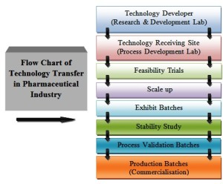
TRANSFER TECHNOLOGY PROCESS

Slide 3
Production Technology Transfer
Receiving unit and sending unit both should develop the product transfer protocol jointly to transfer the product related information. Information should be transferred according to the technical expertness of the staff and the manufacturing site capabilities to run the process smoothly.

Slide 4
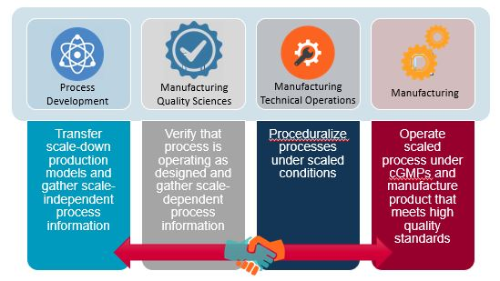
INDUSTRIAL- INSTITUTIONAL INTERACTIONS

Slide 5
2)Active Pharmaceutical Ingredients (API):
Sending unit should provide the drug master file (DMF) and other related information of the active materials. It may include the following information .
Flowchart of the manufacturing process of the drug material
Physical properties including bulk and tap density
Moisture content including water activity
Bioburden, endotoxin and sterility as required
Solubility and pH of solution
Particle size distribution and its dissolution profile
Manufacturer and the supply chain of the material
Other information like heat, light and moisture sensitivity
1.Raw Materials:
The material used for manufacturing on receiving unit should have consistency with the material used at the sending unit. The properties of the raw material those can alter the quality of the product should be identified.

Slide 6
3)Excipients
Excipients also have the considerable effect on the final product so their detailed information should also be provided by the sending unit to receiving unit. It may include the following information:
Viscosity of material
Flowchart of the manufacturing process of the drug material
Physical properties including bulk and tap density
Moisture content range
Melting range
Bioburden, endotoxin and sterility as required Ion strength of material
Solubility and pH of solution
Specific gravity
Particle size distribution and its dissolution profile
Manufacturer and the supply chain of the material
Compliance with TSE and BSE requirements
MSDS and heat, light and moisture sensitivity

Slide 7
In-process Materials and Finished Products
Sending unit should provide the detailed information of manufacturing process, physical description, specification and in-process controls.
History of the development of the product should also be provided for the further development or process optimization after the successful technology transfer.
Information regarding the environment, health and safety should also be provided to the receiving unit. It should also include the information on product quality review, validation, stability and environmental conditions for manufacturing.
Generally, trial batches are taken at the receiving unit to test the manufacturing parameters and capability of the manufacturing process before running the validation batch.

Slide 8
4.Packing Process and Cleaning Process
All the information regarding the packing should be transferred as the manufacturing process. It includes the specification of foils or containers and closures, and other related information as design labelling, artwork and drawings.
To prevent the contamination in the pharmaceutical products, it is essential the follow the adequate cleaning procedure. It can minimize the risk of cross-contamination during manufacturing. Receiving unit should validate the cleaning procedure and sending unit should provide the required information such as existing cleaning procedure, the solubility of all materials, therapeutic dose, the toxicity of the API, cleaning agents and recovery studies.

