Slide 1
Elbow complex
DR. DIGVIJAY SHARMA
DEPARTMENT OF PHYSIOTHERAPY
U.I.H.S
KANPUR

Slide 2
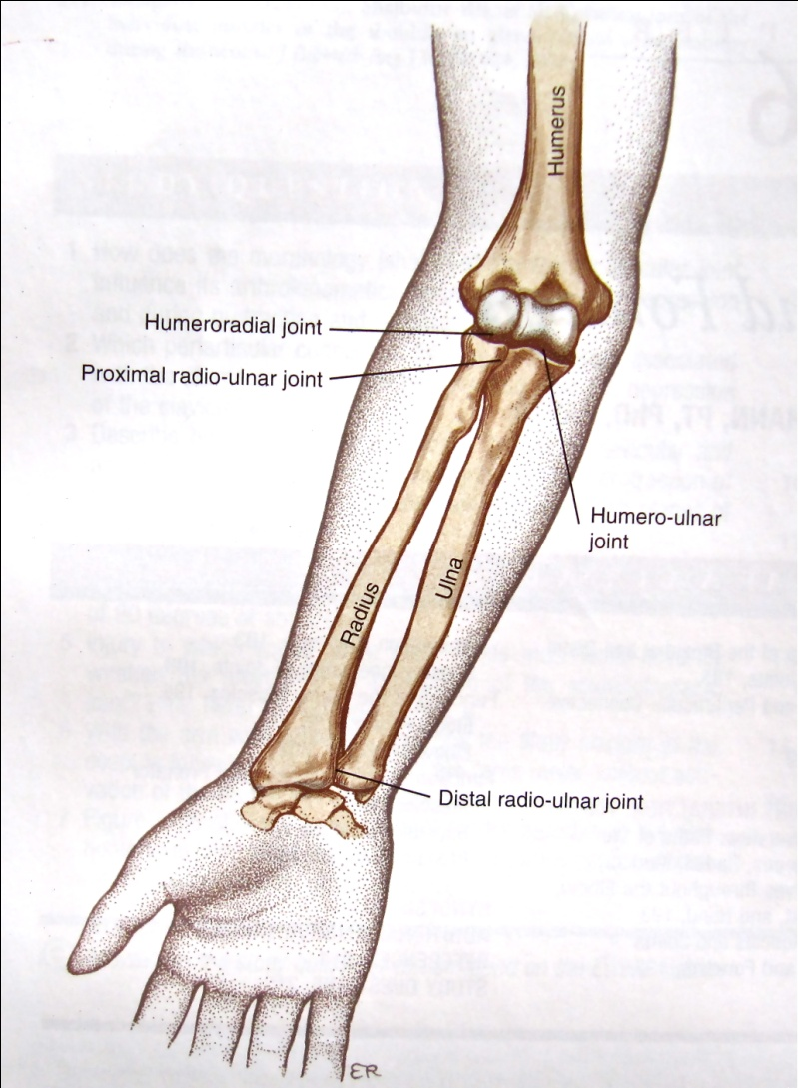
Elbow complex
It consist of
  Elbow joint (humero-ulnar and humero-radial articulation)
  Proxiomal and distal radio-ulnar joints.
It is a compound joint of hinge variety.
Uniaxial diarthrodial joint .

Slide 3
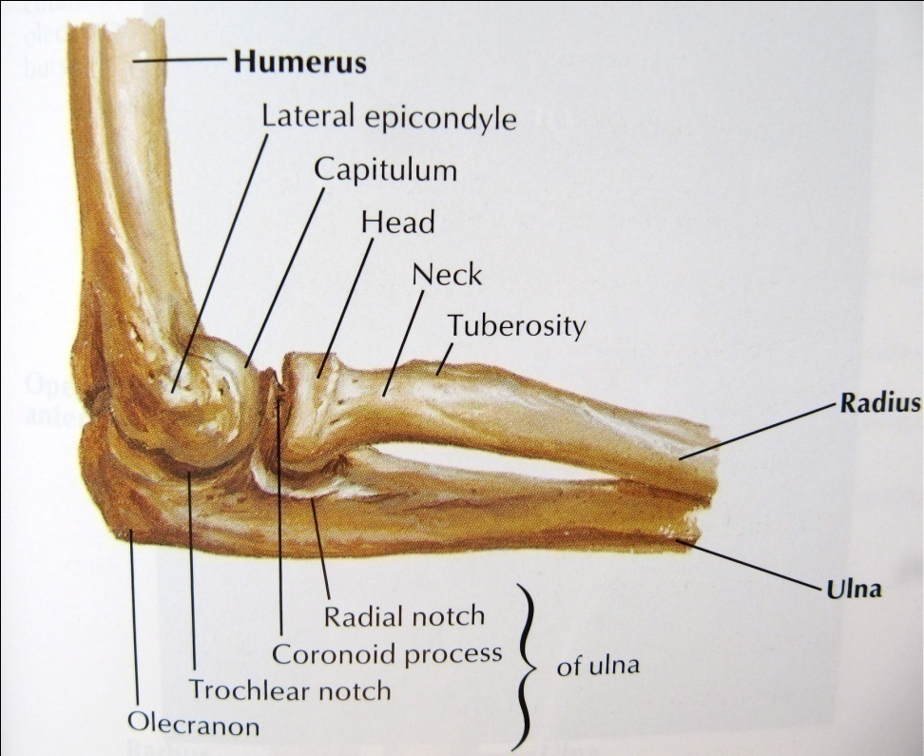
Structure:Elbow joint
Articulating surfaces on Humerus
Pulley or glass-hour shaped trochlea and spherical shaped capitulum
A groove called trochlear groove divides the trochlea in middle and lateral portion.
Capitulo trochlear groove seprates the trochlea from capitulum
A fossa located above the trochlea is known as the coronoid while fossa above the capitulum is known as radial.
Posteriorly on the distal aspect a deep fossa is called as olecranon fossa

Slide 4
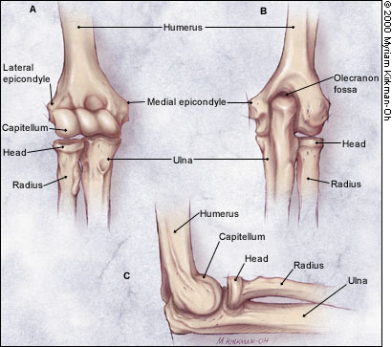
Ariculating surfaces of Radius and Ulna
Ulnar articulating surface is concave semilunar shaped called as Trochlear notch.
Radial articulating surface is head of the radius which is slightly cup-shaped concave sourrded by a rim.

Slide 5
Articulations
Between ulna and humerus occurs primarly as a sliding motion of the trochlear notch of the ulna on the trochlea .
In extension sliding continues untill the olecranon process enters the olecranon fossa
In flexion ulna slides until the conoid process enters the coniod fossa in full flexion.
Between the radius and humerus involves sliding of the concave radial head over the capitulum
In full extension there is no contact but in flexion the rim of the radius in the capitulo-trochlear groove and enters the radial fossa at the end of flexion.

Slide 6
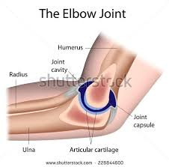
Joint capsule
The humero-ulnar humero-radial and superior radio ulnar joints are enclosed in a single joint capsule
Attachments:-
antero-superiorly above the coronoid and radial fossa
Antero-inferiorly on the margin of coronoid process and the annular ligament
Medially-blend with the medial collateral ligament
Laterallly-blend with lateral collateral ligament
Posteriorly-along with the upper edge of olecranon fossa
Capsule is large,loose and weak anteriorly and posteriorly
It is reinforced side by side by the ligaments, fat pads are located between the capsule and the synovial membrane justabove to olecranon,coronoid and radil fossa.

Slide 7
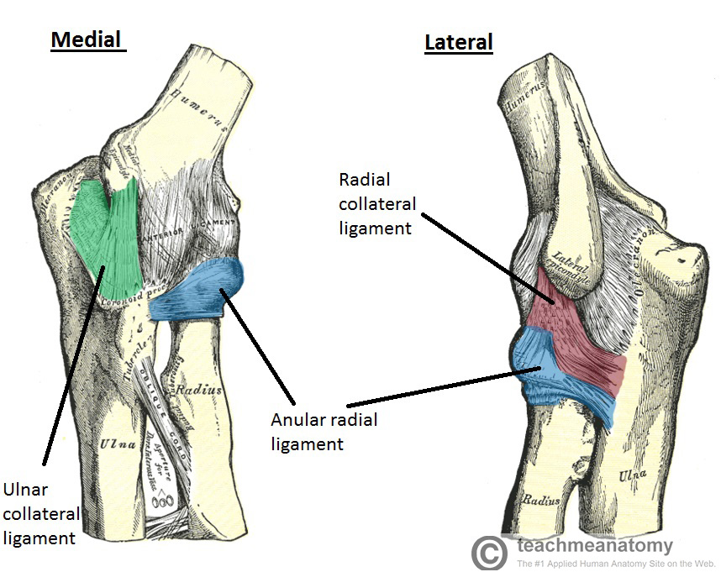
Ligaments
Two main ligaments of the elbow joint
  Medial collateral ligament
  Lateral collateral ligament

Slide 8
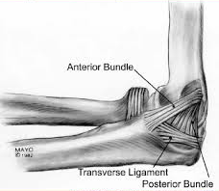
Medial collateral ligament
It consist of 3 parts
  Anterior
  posterior and
  oblique /transverse

Slide 9
Anterior: extends from anterior aspect, tip and medial edge of the medial epicondyle of the humerus to attach to the ulnar coronoid process.
It has 3 fibres
  fibres arising from anterior surface of medial epicondyle
  fibres arising below the tip of medial condyle
  fibres arising from the inferior edge of the medial epicondyle
These fibres resist the valgus stress and limits extension
Posterior-It extend from the posterior aspect of medial epicondyle of the humerus to the ulnar coronoid and olecranon process.It limits extension.
Oblique-It extends between olecranon and ulnar coronoid process this assist in providing valgus stability and helps in joint approximation

Slide 10
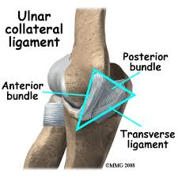
Lateral collateral ligament
The LCL is a fan-shaped poorly demarcated structure
Extends from the inferior lateral epicondyle of the humerus and to the annular ligament.
It is an important stabilizer of humero-radial joint it in force varus.
It prevents posterior translation of the radial head

Slide 11
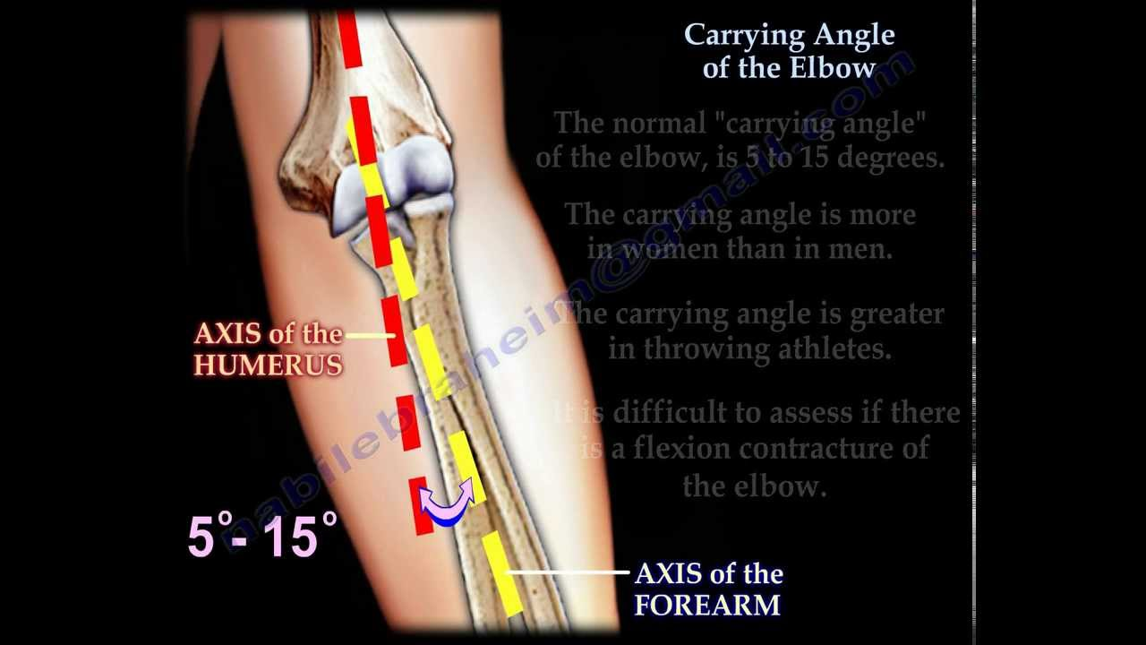
Axis of Motion
For flexion and extension the axsis passes through the center of trochlea and the capitulum bisecting the logitudnal axis of the shaft of the humerus .
Carrying angle- The long axis of the humerus and the long axis of the forearm form an acute angle medially when they meet at the elbow. This angulation is due to the configuration of the articulating surfaces results in a normal valgus angulation of the forearm in relation to the humerus .This angle is known as the carrying angle .

Slide 12
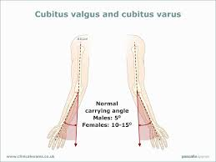
Carrying Angle
Carrying angle is slightly greater in women than men.
The average angle in men is about 5 ° whereas in women it is about 10-15°
When the angle increases beyond the average it is called cubitus valgus

Slide 13
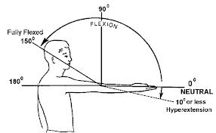
Range of Motion
factors determine the ROM at the elbow joint are
  Types of motion
  Position of Forearm
  Position of shoulder
  Configuration of joint surfaces
  Ligaments and joint capsules

Slide 14
Conti..
The range of active flexion is usually less than passive because of the bulk of the contracting flexors on the anterior surface of the humerus interferes with the approximation of the forearm with the humerus.
The active ROM is 135-145 ° and passive range 150-160 ° for flexsion
Position of the forearm –when the forearm is in pronation or in neutral position the ROM is less than when it is in supination.
Position of shoulder- Two joint muscles such as biceps and triceps that crosses both the shoulder and elbow jts may become actively or passively insufficient when full ROM is attempted at both jts.

Slide 15
Configuration of joint surfaces:-
  The elbow has inherent articular stability at the extremes of extension and flexion.
  In full Extension the humero-ulnar joint is in closed- packed position .
  In this position bony contact of the olecranon process in the olecranon fossa limits the end of extension.
  Configuration of joint structure helps to provide valgus and varus stability.

Slide 16
Ligaments and joint capsule
MCL and anterior part of capsule resist the valgus stress in full flexsion.
The lateral collateral ligament and joint capsule provides half resistance in full extension.
The anterior part of capsule provides majority of resistance to anterior displacement of the distal humerus out of the olecranon fossa.
In 90°flexsion anterior part of MCL provides primary resistance to both distraction and varus stress.

Slide 17
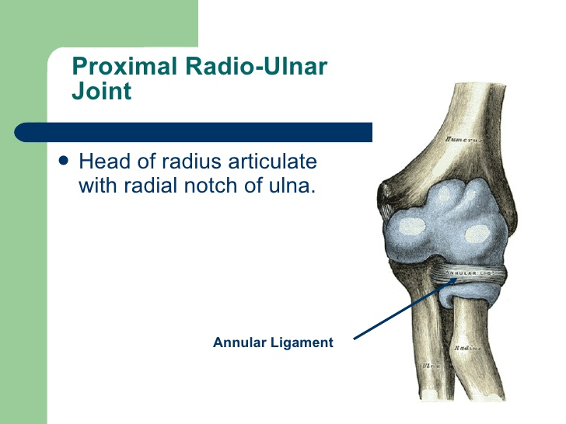
Superior Radio –Ulnar joints
Articulating surfaces-It includes the radial notch of ulna ,annular ligament, head of radius .
The radial notch is concave and covered with articular cartilage .
The annular ligament is circular in shape attached to the anterior and posterior edges of the notch.

Slide 18
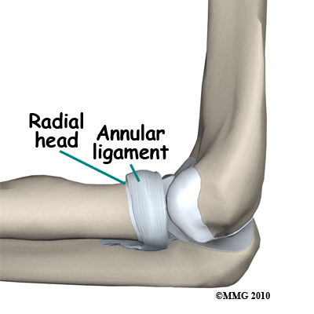
Ligaments
There are 3 ligaments-
Annular ligament-It encircles the radial head and attached to the anterior and posterior edges of the radial notch
It also limits the spin of the radial head in the supination and pronation

Slide 19
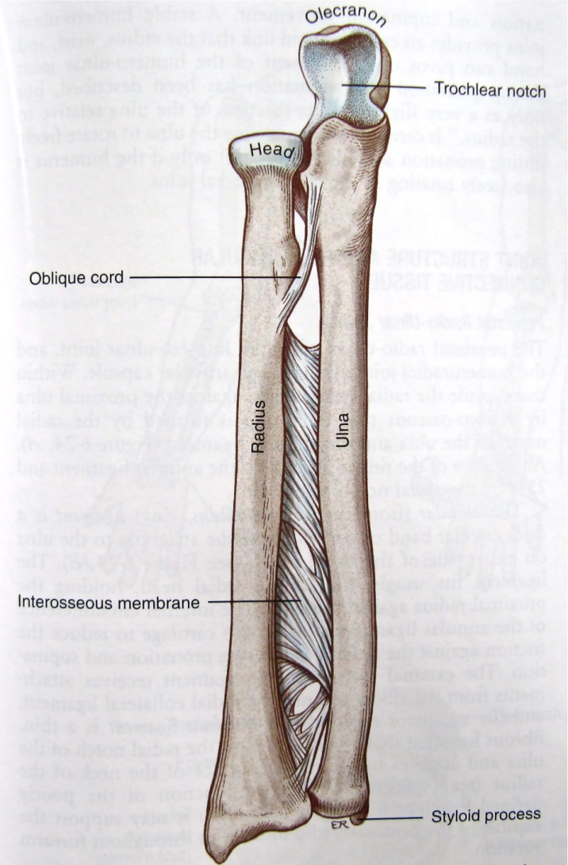
Oblique chord-It is a facial band extending from below the radial notch to just below the radial tuberosity

Slide 20
Interosseous Membrane
Interosseous membrane-It is a broad collaenous sheet that runs between the radius and ulnar . It provides stability for both superior and inferior radio-ulnar joints.
It also reinforces inferior radio-ulnar joint.

Slide 21
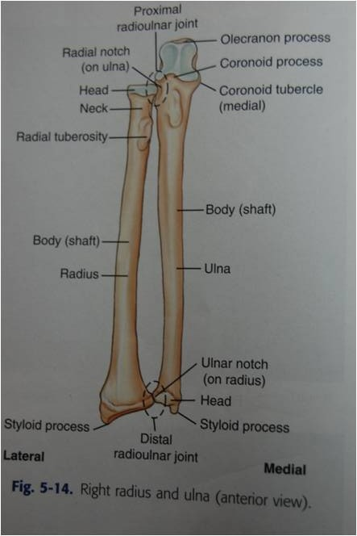
Inferior radio-ulnar joint
Articulating surfaces-It include the ulnar notch of the radius the articulating disc and the head of the ulna.
The ariculating disc is triangular in shape and fibro cartilaganeous in nature.

Slide 22
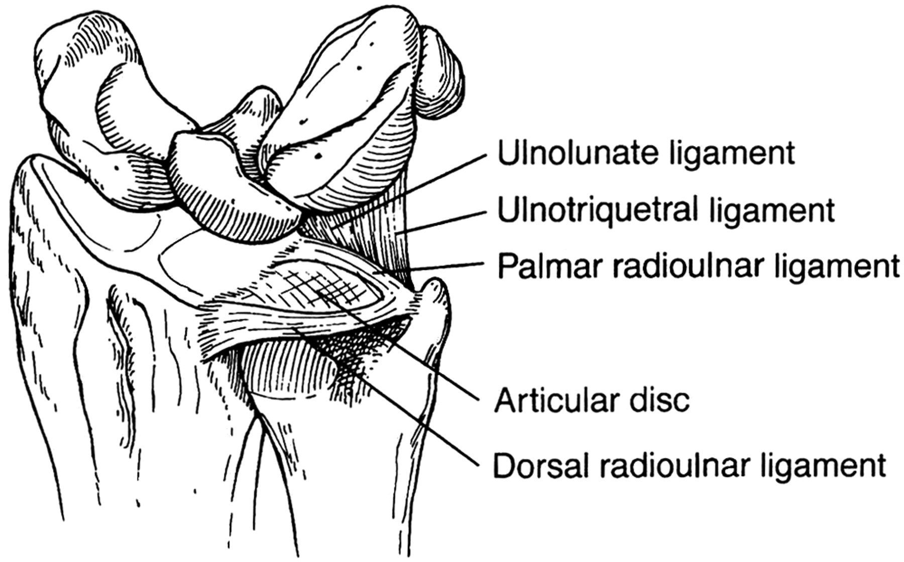
Ligaments
Dorsal radio –ulnar ligament
Palmar radio -ulnar ligament
Interosseous ligament
The palmar and dorsal ligament originates from the dorsal and palmar aspects of ulnar notch extends the ulnar fovea and the base of the styloid process.

Slide 23
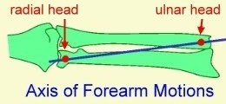
Axis of motion
Proximal and distal joints are mechanically linked therefore motion in one joint is always accompanied by the motion of the other joint.
Distal joint also considered to be functionally linked to the to the wrist .
Compressive loads are transmitted through the distal radio –ulnar joints to the hands

Slide 24
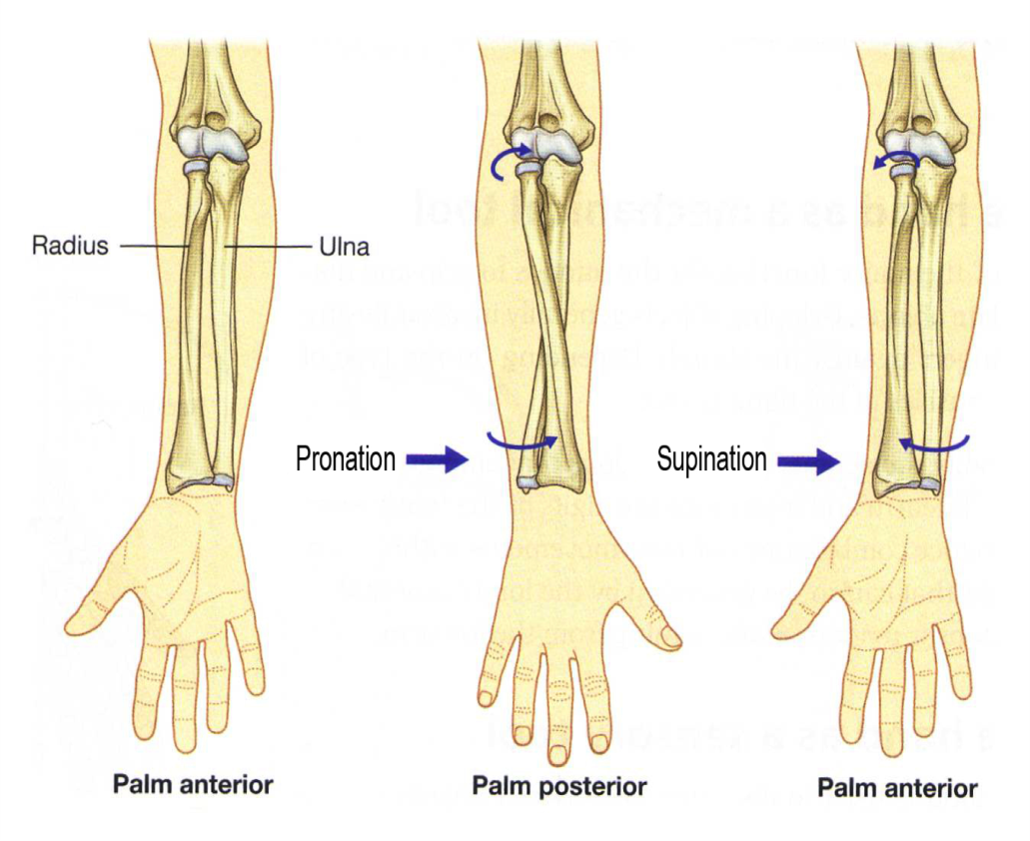
conti
The radius carry 80% and ulna carry 20% compressive loads .
The axis of supination and pronation is longitudnal axis extending from the centre of the ulnar head.
The radius and ulna are parallel to each other in supinated position whereas in pronation the radius crosses the ulna there is very little motion of ulna.

Slide 25
Range of Motion
When the elbow is in 90° flexion a total ROM of 150 ° is possible at radio ulnar joints.
The 90° position stablises the humerus so there is no rotation at shoulder joint.

Slide 26
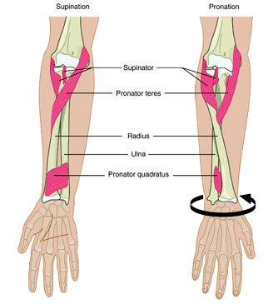
Pronation in all position of elbow is limited by bony approximation while supination is by passive tension in palmar ligament and oblique chord .
The quadrate ligament limits both supination and pronation and annular ligament maintains the stability.

Slide 27
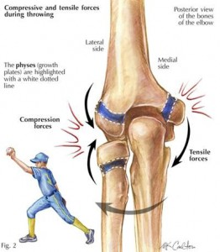
Applied anatomy
Compression injuries-Resistance to longitudnal compression forces at the elbow is provided for mainly by the contact of bony components.
Excessive compression forces at the elbow often result in bony failure

Slide 28
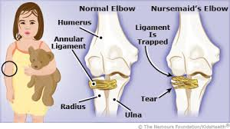
Distraction injuries
A distraction force of sufficient magnitude exerted on the radius may cause the radius to slip out of the annular ligament.
Ex-Nursemaid’s Elbow-lifting a small child up into the air by one or both hand or yanking a child by the hand is the usual causative mechanism and therefore the injury is referred to as nursemald’s elbow

Slide 29
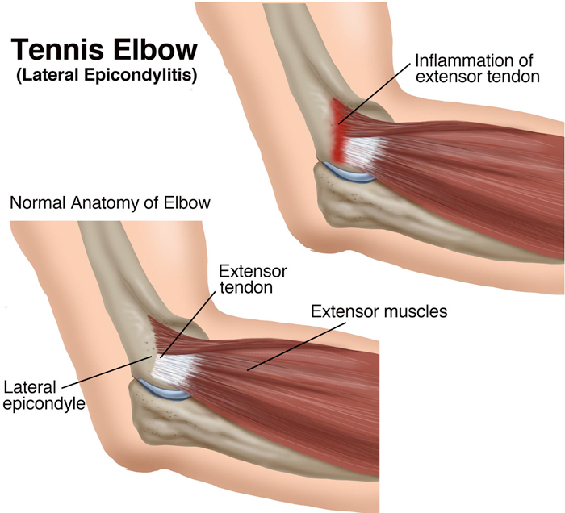
Tennis Elbow
The classic tennis elbow (epicondylitis of lateral epicondyle) is caused by repeated forceful contraction of the wrist extendons , primarily the extensor carpi radialis brevis.
Repeated tensile stress on the inelastic tendon may result in microscopic tears at the musculatendinous junction an d result in tendinitis.

