Slide 1
THE HIP COMPLEX
DR. DIGVIJAY SHARMA
DEPARTMENT OF PHYSIOTHERAPY
U.I.H.S
KANPUR

Slide 2
Hip Complex
It also known as coxofemoral joint.
It is the articulation between the acetabulum of the pelvis and the head of the femur.

Slide 3
Proximal Articular Surface
The Cup-like concave socket of the hip joint is called the acetabulum and is Located on the lateral aspect of the pelvic bone.
Three bones form the pelvis-
The ilium
The ishchium
The pubis

Slide 4
Acetabulum
It is formed by the-
2/5 ilium
2/5 ishchium
1/5 pubis
Only a Horse-shoe shaped portion of the periphery of acetabulum is covered with hyaline cartilage and articulates with the head of femur, is called lunate surface.
The Inferior aspect of the lunate surface is interrupted by a deep notch called the acetabular notch.

Slide 5
Acetabular Notch and Fossa
The Acetabular notch is spanned by a fibrous band, the Transverse acetabular ligament ,that connects the two ends of horseshoe.
The transverse acetabular ligament also spans the acetabular notch to create a fibro-osseus tunnel beneath the ligament through which blood vessels may pass into the central deepest portion of the acetabulum called ,the acetabular fossa.
The acetabular fossa is non articular,
The femoral head does not contact this surface.
The acetabular fossa contains fibroelastic fat covered with synovial membrane.

Slide 6
Central Edge Angle
The centre age angle of the acetabulum if formed by a vertical line through the centre of the femoral head and a line connecting the centre of the femoral head and the bony edge of the acetabulum.
An average it is 38°in men and 35° in women
It may vary between 22° to 42° regardless of sex

Slide 7
Acetabular Anteversion
The acetabulam not only faces somewhat anteriorly but also inferiorly.
The magnitude of orientation of the acetabulum may be referred as the angle of actabular anteversion.
The average value-
Men-18.5°
Women-21.5°
Pathologic increases are associated with decrease joint stability and increased tendency of anterior dislocation of head of the femur

Slide 8
Acetabular Labrum
Entire periphery of the acetabulum is rimed by a fibro cartilage called the acetabular labrum.
It is wedge shaped
It increases the concavity of the acetabulum.

Slide 9
Distal Articular Surface
Head of femur may slightly larger than a hemisphere.
Femoral head is attached to the femoral neck .
Femoral neck attached to the femoral shaft of the femur between greater and lesser trochanter.

Slide 10
Femoral neck is angulated and most commonly faces-
Medialy
Superiorly
Anteriorly
Just inferior to the medial point on the head a small rough pit called the fovea capitis

Slide 11
Angle of Inclination
It is the axis of the femoral head and neck form an angle with the axis of the femoral shaft.
Normally it is 125° in adults

Slide 12
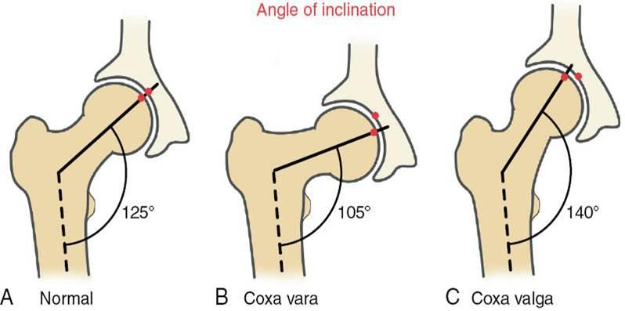
Coxavalga And Coxavara
Pathological increase in angle of inclination is known as coxavalga.
Decrease in the angle is angle of inclination is known as coxavara

Slide 13
Hip Joint Capsule
Capsule of the hip joint is strong and dense.
Capsule is attached proximally to the entire periphery of the acetabulum.
It covers femoral head and neck like a sleeves and attaches to the base of the neck.

Slide 14
Hip Joint Ligaments
It is reinforced by 3 ligaments 2anteriorly and 1 posteriorly
Iliofemoral
Pubofemoral
Ishchiofemoral
Iliofemoral and pubofemoral anteriorly.
Ishchiofemoral ligament posteriorly.

Slide 15
Iliofemoral Ligament
It is a fan-shaped ligament.
It resembles an inverted letter of Y and often referred as Y-ligament biglow.
The apex of the ligament is attached to the anterior inferior iliac spine the two arms attached to the intertrochantric line of femur.

Slide 16
Pubofemoral Ligament
It is also located anteriorly
It extends from the anterior aspect of pubic ramus and passing to the anterior surface of the intertrochanteric fossa.

Slide 17
Ishchiofemoral Ligament
It is located posteriorly
Ligament attaches to the posterior surface of the acetabular labrum.
Some of its fibres spiral around the femoral neck and blend with the fibers of Zonaarbicularis.

Slide 18
Ligament Teres
The ligament is a triangular shaped band with its base on the sides of the peripheral edge of the acetabular notch from there it attaches to the fovea of the femur.

Slide 19
Arthrokinematic Movement
In non-weight bearing there will be gliding of femoral head with in acetabulum in opposite direction of movement of distal end of femur.
There will be spin of head of femur posteriorly during flexion and anterior during extension.
In abduction and adduction and rotation both gliding and spining occurs but in opposite direction of movement of distal end of femur.

Slide 20
Arthrokinematic Movement
In non-weight bearing there will be gliding of femoral head with in acetabulum in opposite direction of movement of distal end of femur.
There will be spin of head of femur posteriorly during flexsion and anterior during extension.

Slide 21
In abduction and adduction and rotation both gliding and spining occurs but in opposite direction of movement of distal end of femur.
In weight bearing,the pelvis moves over the femur and the acetabulum moves according to the movment.

Slide 22
Osteokinematics
The ROM available at hip joint is most commonly described by movement of the femur.
The ROM is influenced by the wheather the motion is performed actively or passively
Flexon-0°to120°
Extension-0°-30° to40°
Abduction-0°-45° to 60
Adduction-0°-20°to 25°
Medial Rotation-0°-45°
Lateral Rotation-0°-45°to60°

Slide 23
Anterior and Posterior Pelvic Tilt
In anterior pelvic tilt the ASIS moves anteriorly and downward and pubic symphysis moves posteriorly and downward,closer to femur.
In posterior pelvic tilt the PSIS moves posteriorly and downward and pubic symphysis moves anteriorly and upwards.

Slide 24
Lateral Pelvic Tilt
Lateral pelvic tilt occur as pelvic hike or pelvic drop.
Whenever there is hiking of pelvis the supporting or opposite limb will go for abduction as the pubis symphysis is moving away from the supporting limb.

Slide 25
Pelvic Drop
In pelvic drop their will be adduction of the supporting or the opposite limb as pubis symphysis is moving toward it

Slide 26
Pelvic Rotation
Whenever the ilium of one side move anteriorly around the fixed or supporting limb there will be pelvic rotation.
The forward rotation may cause medial rotation of opposite side.
The backward rotation of pelvis of one side will cause rotation of other side.

Slide 27
Lumbar-Pelvic Motion
It is analog to the scapulo-humero rthym.
These gives the ROM for functional activities.

Slide 28
Thank You

