Slide 1
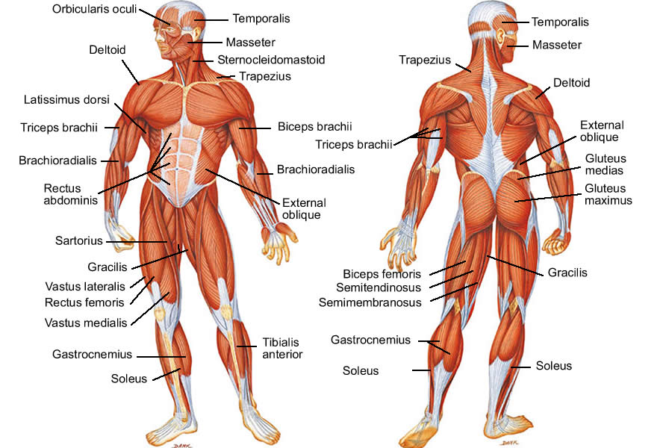
The muscular system
By
Dr. Deepali nigam Assistant Professor Department of Physical Education, Mahila Mahavidyalaya (P. G.) Kidwai Nagar, Kanpur

Slide 2
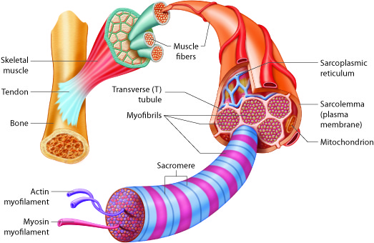
What is Muscles?
A muscle is a soft tissue found in human body. The muscles are attached by tough fibrous structure called tendons. These attachments bridge one or more joints and the result of muscle contraction is movement of these joints.
Muscle cells contain protein filaments of actin and myosin that slide past one another, producing a contraction that changes both the length and the shape of the cell.
The primary function of the muscle is to produce force and motion so we can say that a muscle function is to provide movement to the body. More than 600 muscles are there in human body and they are around 40% of our body weight.

Slide 3
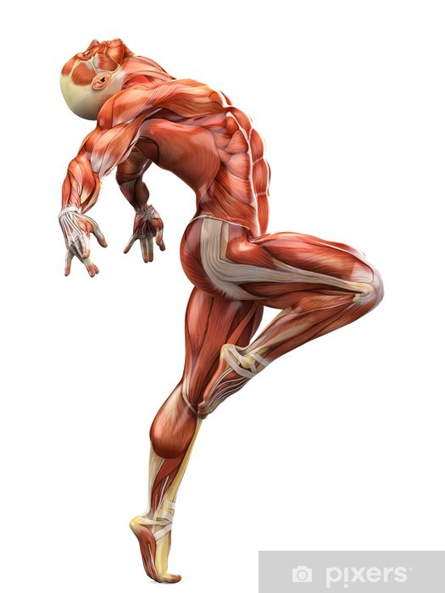
Muscular system
The muscular system is an organ system consisting of skeletal, smooth skeletal and cardiac muscles It permits movement of the body, maintains posture and circulates blood throughout the body.
The muscular systems in vertebrates are controlled through the nervous system although some muscles (such as the cardiac muscle) can be completely autonomous.
Together with the skeletal system, it forms the musculoskeletal system, which is responsible for movement of the human body.

Slide 4
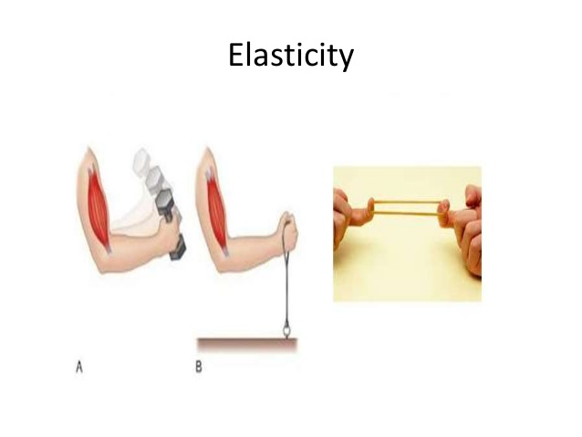
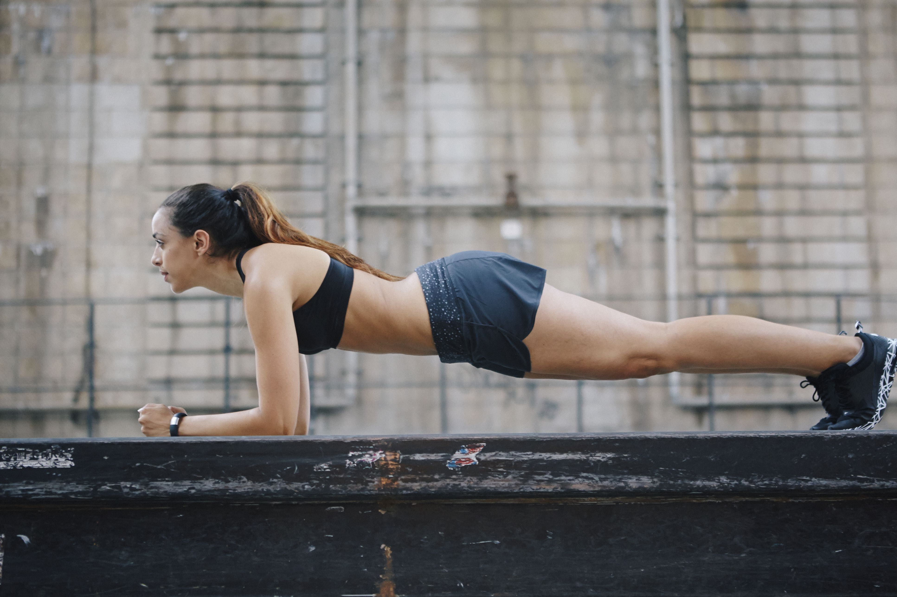
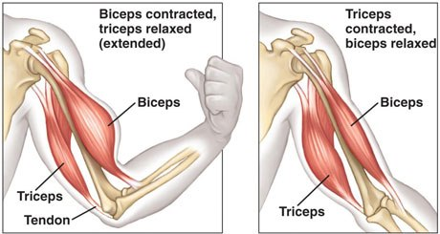
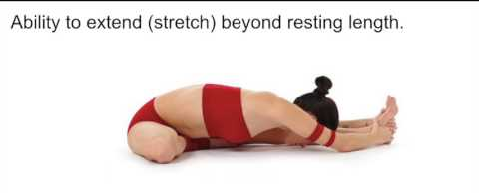
Properties of muscles
There are 5 major properties to the muscular system
Excitable or Irritable: Muscles are Excitable or Irritable. This means that they are capable of receiving stimulation and responding to stimulation from the nerves.
Contractible: They are contractible. After receiving stimulation, they are capable of contracting, or shortening.
Adaptability: The muscular system is adaptable in that it can be changed in response to how it is used. For example, a muscle will enlarge, or undergo hypertrophy with increased work; but on the other hand it can go in atrophy, or waste away if deprived of work.
Extensible: Being extensible means a muscle can be stretched without damage by the application of force
Elasticity: With elasticity, a muscle is able to return to its original resting shape and length after being extended or contracted.

Slide 5
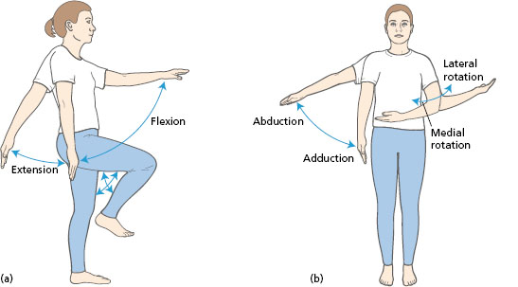
Types of Muscle Movements
Adduction...is the moving of a body part toward the mid-line of the body.
Abduction…is moving a body part away from the body.
Flexion…Flexion means bending a joint to decrease the angle between two bones or two body parts.
Extension…extension is straightening and extending of the joint to increase the angle between two bones or body parts.
Rotation… and last, rotation involves move a body part around an axis.

Slide 6
Types of muscles
There are three kinds of muscles

Slide 7
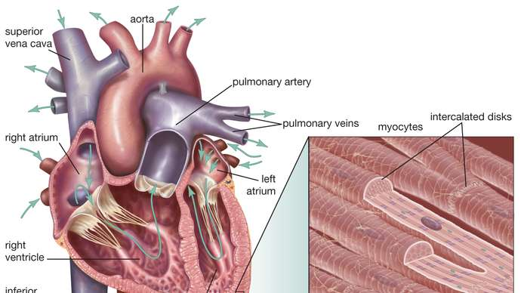
1. Cardiac Muscle
The cardiac muscle (the muscle of the heart), is an involuntary muscle; meaning it operates without any conscious control.

Slide 8
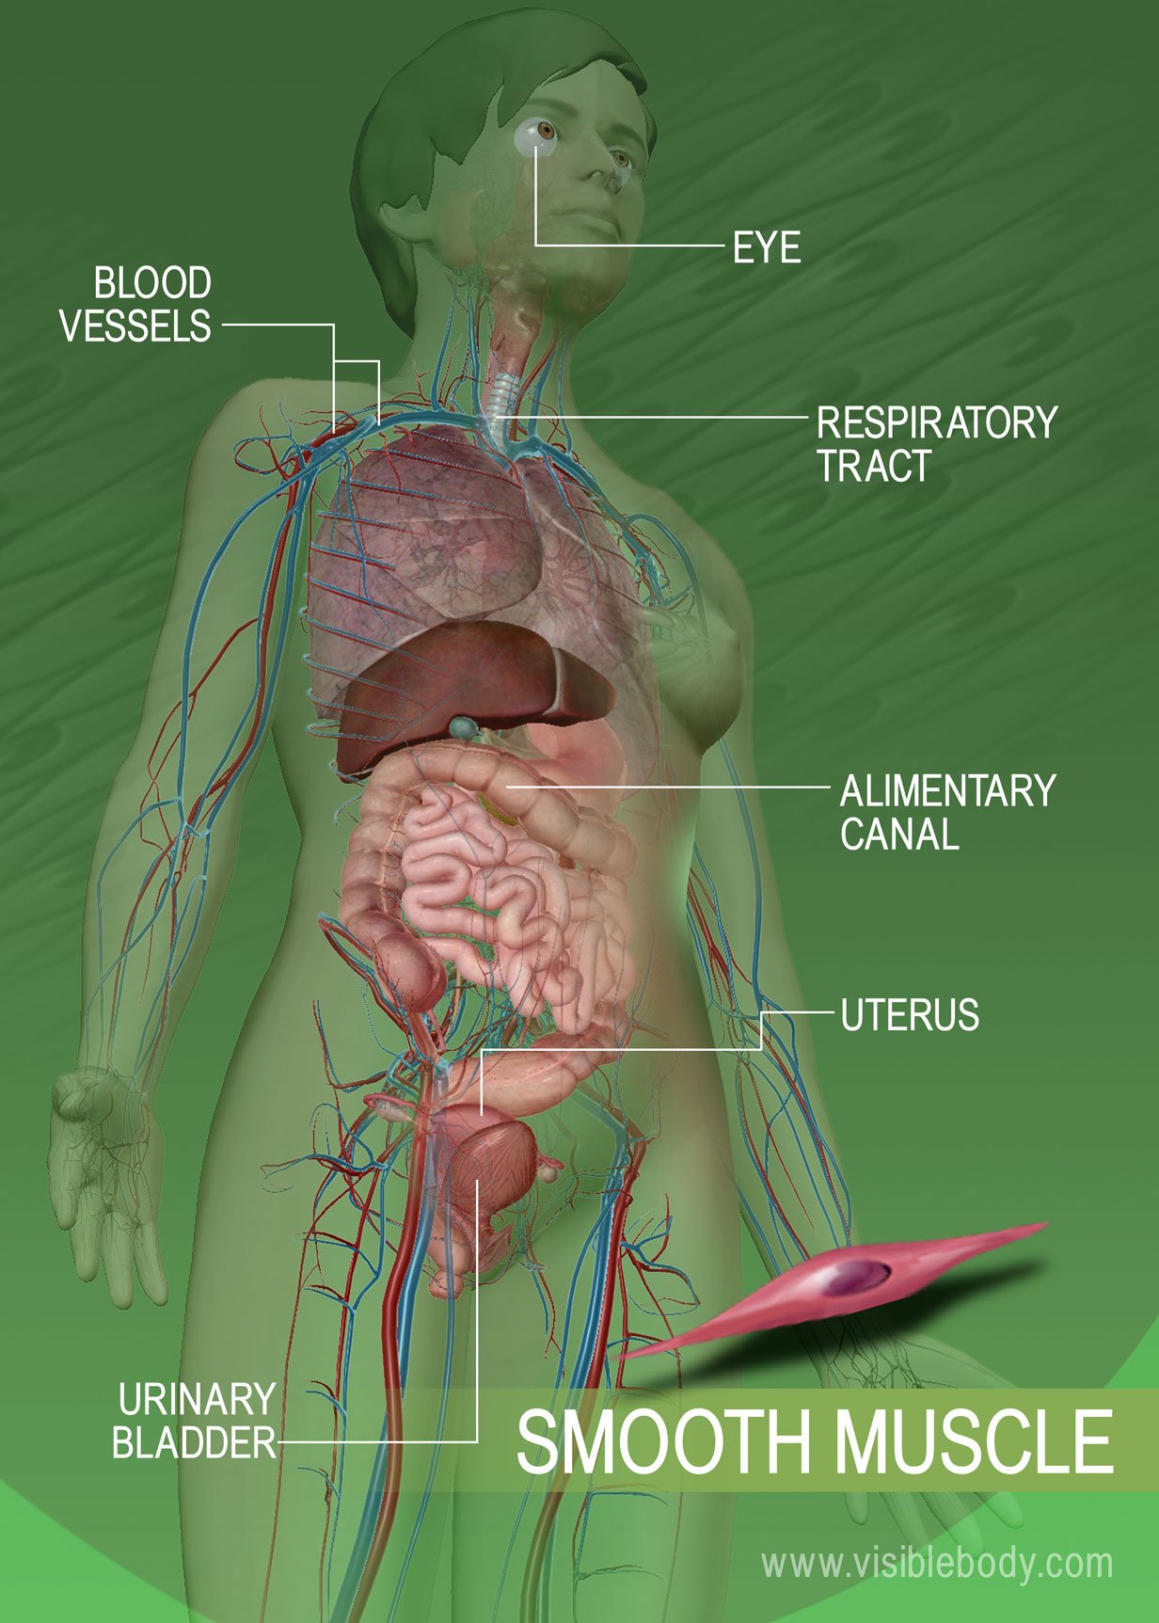
2. Smooth Muscles
The Visceral or smooth muscles, are also considered involuntary (the muscle in blood vessels and the bladder) – these muscles are found in organs or organs systems such as the digestive or respiratory system.

Slide 9
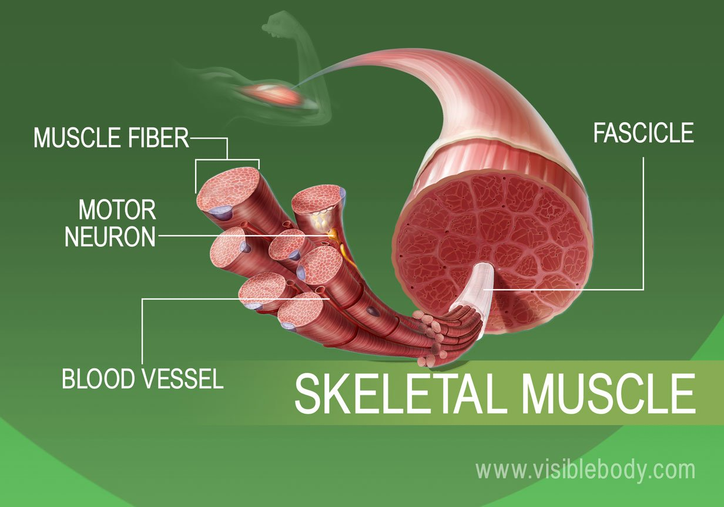
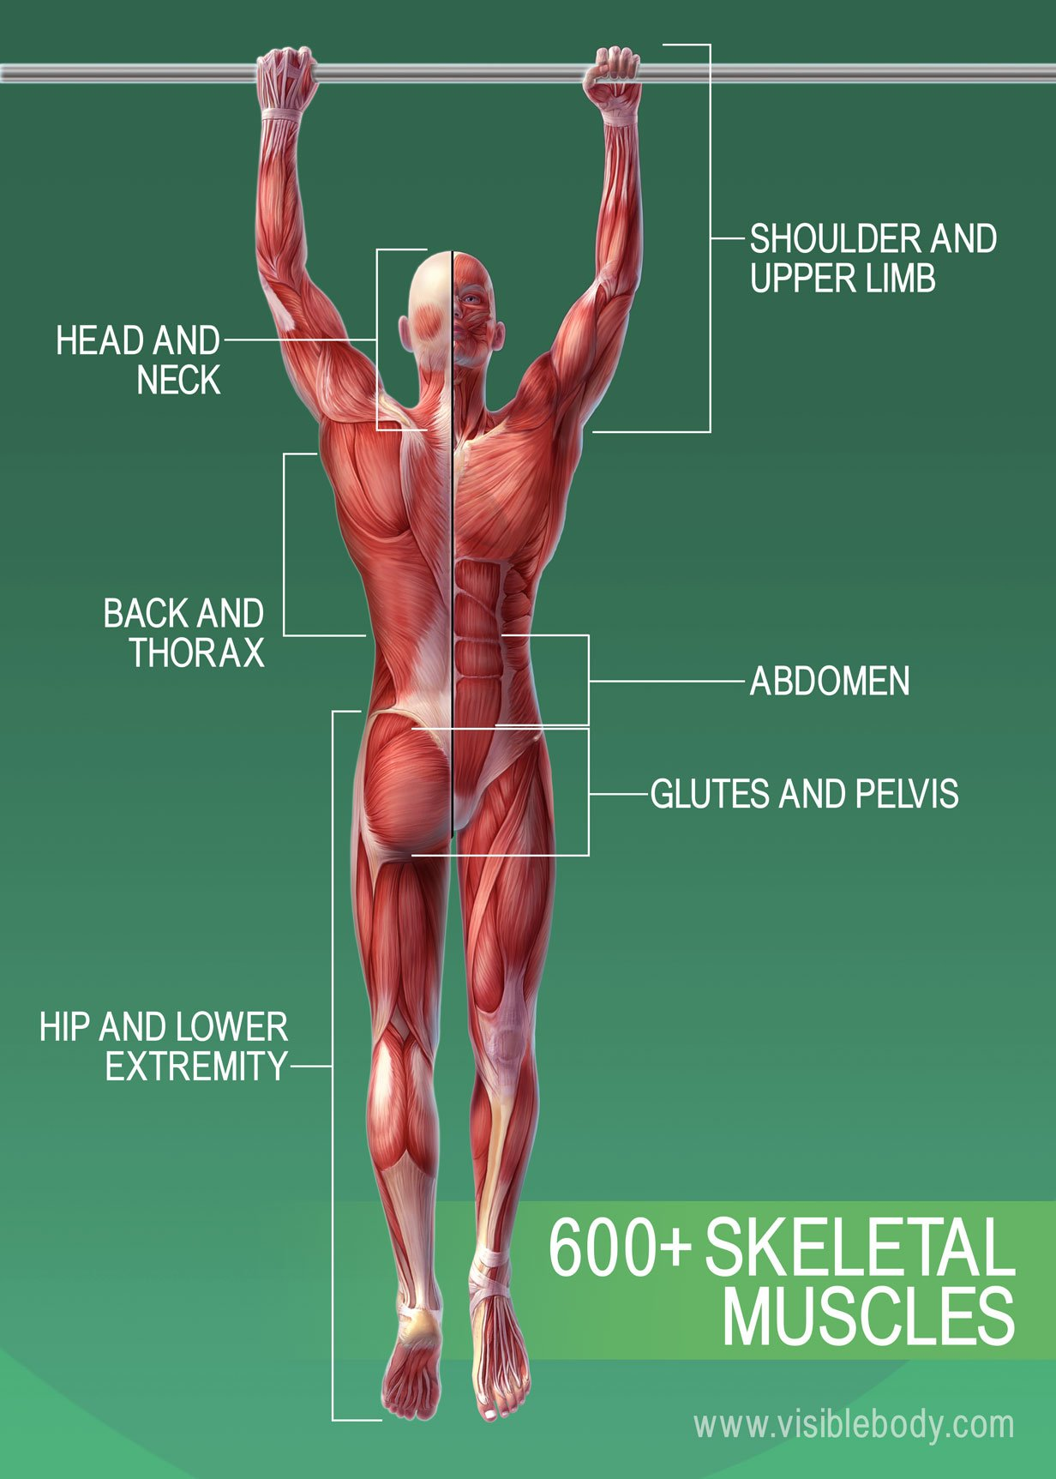
3. Skeletal muscle
These Muscles are what we would typically think of when talking about muscles. These muscles attach to bones. They pull on bones to make movements. The Skeletal Muscles are classified as voluntary. This is because we have to make a conscious effort or decision to make them move.

Slide 11
Thank you

