Slide 1
Types of corrosion

Slide 2
TYPES OF CORROSION
In atmospheric corrosion the metals tend to revert to the states in which they occur in nature.
Types of corrosion are basically :
1. Chemical corrosion or Dry corrosion
2. Electrochemical corrosion or Wet corrosion

Slide 3
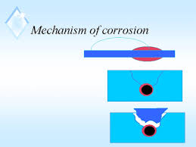
Dry corrosion or Chemical corrosion
The direct chemical reaction of environment/atmospheric gases or inorganic liquids with metal surfaces .
There are three types of chemical corrosion
Oxidation corrosion
Corrosion by other gases
Liquid metal corrosion

Slide 4
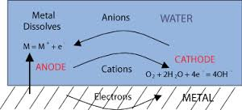
(1.) Oxidation Corrosion: This is carried out by the direct action of oxygen low or high temperatures on metals in absence of moisture. Alkali metals and Alkaline earth metals are rapidly oxidized at low temperatures. At high temperature all metals are oxidized (except Ag, Au, Pt).
M → M₂⁺ + 2e⁻ (Oxidation)
O₂ + 2e ⁻ → 2O₂⁻ (Reduction)
M + O₂ → M₂⁺ + 2O²⁻ (Metal oxide)

Slide 5
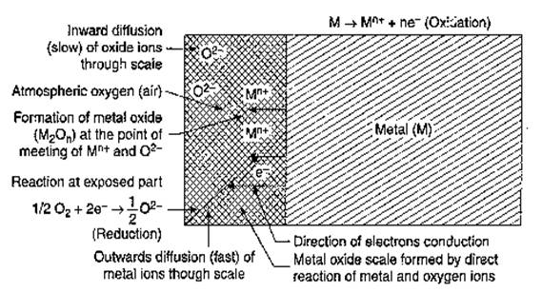
Mechanism:-
1. When temp increases the metal undergoes oxidation and losses e⁻
2M → 2M^{+n} + 2ne⁻
Metal Ion
2. Electron are gained by the oxygen molecules forms oxide ions
nO₂ + 4ne⁻ → 2n O²⁻
Oxide Ion
3. Scale of metal oxide formed 2M + nO₂ → 2M + 2n O²⁻
Metal Oxide

Slide 6
2.) Corrosion due to other gases: This type of corrosion is due to gases like SO₂, CO₂, Cl₂, H₂S, F₂ etc. In this corrosion, the extent of corrosive effect depends mainly on the chemical affinity between the metal and the gas involved. The degree of attack depends on the formation of protective or non protective films on the metal surface which is explained on the basis of Pilling Bedworth rule.
(i) If the volume of the corrosion film formed is more than the underlying metal, it is strongly adherent, non-porous does not allow the penetration of corrosive gases.
Ag + Cl₂ → 2AgCl (protective film)

Slide 7
(ii) If the volume of the corrosion film formed is less than the underlying metal, it forms pores/cracks and allow the penetration of corrosive gases leading to corrosion of the underlying metal.
Ex. In petroleum industry, H₂S gas at high temperature reacts with steel forming a FeS scale. Fe (steel) + H₂S FeS (porous)
3.) Liquid metal corrosion: This corrosion is due to chemical action of flowing liquid metal at high temperatures on solid metal or alloy. The corrosion reaction involves either dissolution of a solid metal by a liquid metal or internal penetration of the liquid metal into the solid metal.
Eg. Coolant (sodium metal) leads to corrosion of cadmium in nuclear reactors.

Slide 8
Wet or Electrochemical corrosion
The electrochemical corrosion occurs when
i) a conducting liquid is in contact with a metal.
ii) when two dissimilar metals or alloys are immersed partially in the solution.
Corrosion occurs due to the presence of anodic and cathodic areas.
At anode oxidation reactions takes place
At cathode reduction reactions takes place

Slide 9
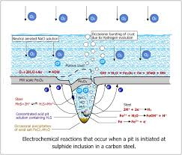
Occurs when aqueous solution or liquid electrolytes are present
Wet corrosion takes place in environments where the relative humidity exceeds 60 %.
Wet corrosion is most efficient in waters containing salts, such as NaCl (e.g. marine conditions), due to the high conductivity of the solution.

Slide 10
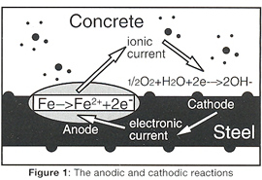
Mechanism Of Electrochemical Corrosion
Mechanism Of Electrochemical Corrosion
Anodic Reaction:
Dissolution of metal takes place.
As result metal ions are formed with the liberation of free electrons.
M ↔ M^{+n} + e⁻
Metal Ion

Slide 11
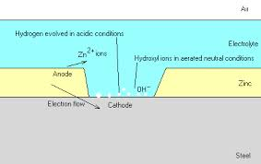
Cathodic Reaction
Hydrogen Evolution :- Occurs usually in acidic medium
2H⁺ + 2e⁻ ↔ H₂ (g)
(ii) Oxygen Absorption :- occurs when solution is aerated sufficiently.
O₂+ 4H⁺ + 4e⁻ ↔ 2H₂O (In acidic medium)
O₂+ 4H⁺ + 4e⁻ ↔ 4OH⁻ (In basic medium)

Slide 12
Wet corrosion takes by the following ways.
Hydrogen gas evolution
Oxygen gas absorption

Slide 13
This type of corrosion occurs in acidic medium.
E.g. Considering the metal Fe, anodic reaction is dissolution of iron as ferrous ions with liberation of electrons. Anode: Fe----→ Fe₂⁺ + 2e⁻ (Oxidation)
The electrons released flow through the metal from anode to cathode, whereas H+ ions of acidic solution are eliminated as hydrogen gas.
Cathode: 2H⁺ + 2e⁻ ----→H₂ (Reduction)
The overall reaction is: Fe + 2H⁺ -----→Fe₂⁺ +H₂
All metals above hydrogen in electrochemical series have a tendency to get dissolved in acidic solution with simultaneous evolution of H₂ gas.

Slide 14
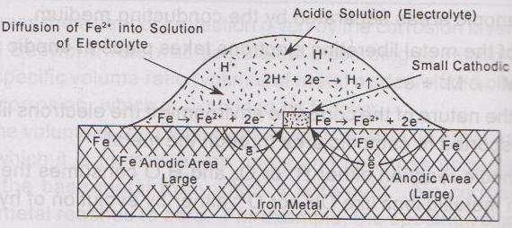
Mechanism of wet corrosion by hydrogen evolution

Slide 15
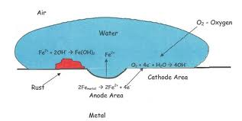
Absorption of oxygen
Absorption of oxygen: For example, rusting of iron in neutral aqueous solution of electrolytes in presence of atmospheric oxygen.
Usually the surface of iron is coated with a thin film of iron oxide.
If the film develops cracks, anodic areas are created on the surface.
While the metal parts act as cathodes. It shows that anodes are small areas, while the rest metallic part forms large cathodes.
The released electrons flow from anode to cathode through iron metal.
.

Slide 16
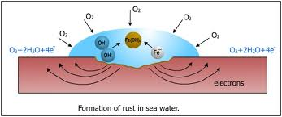
At anode: Fe ----→Fe₂⁺ + 2e⁻ (Oxidation)
At cathode: ½ O₂ + H₂O + 2e⁻ ---→2OH⁻ (Reduction)
Overall reaction: Fe₂⁺ + 2OH⁻ -----→ Fe (OH)₂
The product called yellow rust corresponds to Fe₂O₃. 3H₂O

