Slide 1
Types of research and defining a research problem
Prof A. K. Sharma (Retd.)
HSS Department
IIT Kanpur

Slide 2
This lecture
Is designed for PhD students in social sciences
It sensitizes scholars/ researchers to different methodologies/ perspectives and sources of data
Illustrates approaches with examples based on researches in India
Assumes no specific technical/ mathematical training

Slide 3
Before defining a problem
Let us understand the meaning of research
Nature of research
The context of research
The purpose
Structural influences
Alternative ways of conducting research

Slide 4
What is research?
Research is the process of discovering new theories/ laws/ facts
Confirming/rejecting theories
Assisting planners and service providers with data – monitoring and evaluation
A tool of management decisions (operations research)
Modeling and prediction
System simulation

Slide 5
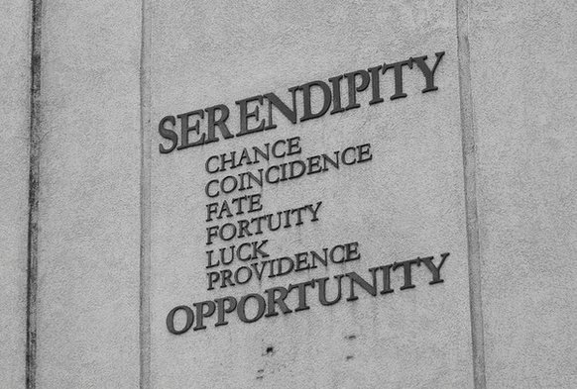
Discovering new facts!
Research is organized search for new facts and not serendipitous
What are facts?
What are new “social facts”?
Who is authorised to produce new facts?
Organized search needs men, money and material (and time)
Somebody to spend that money (sponsors)
Possible conflict between interest of the sponsors and the discovery of Truth

Slide 6
Not serendipity but organized search?
Serendipity refers to unplanned, sudden discoveries
For example, Daniel David Palmer (1845-1913) discovered chiropractic in 1895
Found that through realignment of displaced vertebrae he could treat a chronic case of deafness and a case of heart problems
Theories of Marx and Weber are not serendipitous but the outcome of sustained studies, hard work and observations
Social science research is planned and organized by individuals like you and organizations

Slide 7
Seven components of research
Questions to explore
Existing literature
Theories
Data/ field observations
Logical/ statistical ways to organize and analyse data
Findings related to original questions
Communication to peer groups through journal publications and research reports

Slide 8
You have NOT done any research
If you have not published any paper in a peer reviewed journal (nowadays in an A category journal)
If your work does not have credibility
If you refuse to share your data
If you did not use the scientific/ community norms of doing research
If it was not approved by an ETHICAL REVIEW BOARD/ COMMITTEE

Slide 9
Examples of new facts
After independence the government, NGOs and academicians required demographic facts for planning, interventions and monitoring of programmes
Population size, growth rate, composition, structure, distribution and vital rates
Census was the only source of information
New institutions were developed for collection of facts, e.g. NSSO, SRS, IIPS, etc.
ORG was the first NGO to collect facts about knowledge, attitude and practice of family planning
The latest source on health data is NFHS-5
Today we have surplus data collected by both GOs and NGOs
We need more analysis

Slide 10
AIM I: Confirming/rejecting a theory
Academic researchers work with theories - explanations of a given behaviour
In each field of sociology and other social sciences there are multiple theories
Then the question: which one is correct?
Does conflict theory explain the problem of poverty better than functional theory?
Does the “theory of underdevelopment” more adequately explain development in the Asian countries than the theory of stages of growth?
Does Lee’s theory of migration reject the push-pull theory of migration?

Slide 11
AIM II: Assisting planners, service providers and managers
Examples:
What is the present level of poverty?
Is poverty declining? At what rate?
Conceptual, definitional, and data based issues
Employment rates in formal and informal sectors – separately for men and women, GN, OBC and SC/ST, and by educational level
The condition of the disabled
Mental disorders and facilities in the country/ States

Slide 12
Contd.
A tool of management decisions, e.g., does brand value matter?
How many service centres (e.g., ticket windows) are optimum in order to reduce waiting time by half?
Has Janani Suraksha Yojna helped in reducing maternal mortality rate?
Is MGNREGA able to create sustainable assets in rural areas?
Is it worth spending resources on family planning programme?

Slide 13
AIM III: Modeling and prediction
Extrapolating/ Predicting population of India
Predicting short term and long term economic consequences of fertility decline
Industrialization and sustainable development – impact of urbanization, carbon emission, over crowding …
Modelling the impact of urban renewal on employment

Slide 14
AIM IV: System simulation
Club of Rome study on world system
A form of modelling to study something for which data may not be available or situation in which complex/ probabilistic relationships are involved
Simulation of neighbourhood relations, method use and number of children
Approaches to Naxalite violence requires the modelling of all aspects and perspectives on violence – hard data, major actors and their perspectives, cost of violence, efficiency of administration, collusion between companies, contractors and vested interests, class and agrarian conflicts, history of conversion and castes …

Slide 15
Thus
Research is not the same thing as the armchair philosophy
Uses empirical method
Is based on comparisons and generalizations
Is linked with social development
Is worth spending money and time
Should sustain researcher’s interest for prolonged time
Does not violate ethical principles and does not deprive the subjects of their rights

Slide 16
Types of
Theoretical
- Sociological research is often of the form of scholarly commentary on theories and is based on sound analysis of literature and available facts
- Testing theories with empirical data
- Empirical research may be divided into three categories:
exploratory, descriptive, inferential
Applied

Slide 17
Theoretical research
Raises new issues or deals with controversial theoretical issues – what is postmodern view of consumption/ consumerism?
Is of interest to the academic community –universities and research centers
Findings are disseminated through peer reviewed journals and books
Fills up the gap in knowledge
Is based on the norms of scientific rigor

Slide 18
Examples of theoretical research
Louis Wirth’s theory of urbanism, published in the American Journal of Sociology, 1938
Urbanism is much larger than as shown by the statistics of size, density and heterogeneity
It produces new social conditions and institutions
Everett S. Lee’s theory of migration, published in Demography, 1966
A comprehensive theory combining factors at POO, POD, intervening obstacles and personality factors

Slide 19
Theoretical writings
In September 1998 issue of Sociological Bulletin
Reviewing works of Durkheim, Weber, Radcliffe-Brown and Mauss, Andre Beteille showed how sociology may be influenced by nationalistic values and how it can be made value-neutral by recognizing the sacred character of human person

Slide 20
Another example
In the same issue of Sociological Bulletin, Yogendra Singh showed that traditions “pass into the realm of rational and instrumental values as they seek to become more existentially rooted”
He concluded that we need an “interactive relationship between modernity and tradition within the framework of pluralism”

Slide 21
Applied research
Involves generation of new facts or solves a practical problem
Often sponsored by planners/donors
Conducted by consultants, research organizations (including market research organizations)
The findings are submitted to the donor in the form of reports and executive summaries and are confidential
International NGOs like Population Council have their own journals which publish applied research

Slide 22
Example of applied research
The effect of retirement on self-reported health: a gender comparison in Italy
Published in Vienna Yearbook of Population Research, 2014
Data: EU-SILC longitudinal data
Methods: logistic regression and propensity score matching
Finding: “the self-reported health of men worsens shortly after retirement, while the self-reported health of women does not change.”
UNICEF promoted DSAs of HIV and AIDS
Methods: mixed methods
Findings: Identifying the most vulnerable villages, hotspots and vulnerable communities; sensitizing district authorities, NGOs and village panchayats
TNA

Slide 23
Identifying a research problem
You want to explore an interesting research problem in your study
Certainly, interesting for you
But is it interesting for the international community of researchers also?
Your research problem determines research design, timeline, sample size, type of analysis required

Slide 24
CAN YOU THINK OF A RESEARCH PROBLEM?

Slide 25
If not, go for the following options
Discussion with experts/ supervisors (for PhD students)
Discussion with donors
Ethnographic/exploratory work
Academic/ Research journals (look at the sections on problem(s) for future research)
Go to conferences/ workshops in your broad field of study

Slide 26
Discussion with experts
My Ph.D. problem was suggested by my supervisor who had conducted a large survey (jointly with Michigan University) on fertility and family planning in and around Kanpur in 1972.
He wanted me to conduct a longitudinal study in 1979 in a sub-sample of the respondents of the previous study to study the change in preferences and whether desires expressed in the 1972 study were actualized.
This is how my problem was selected.

Slide 27
Discussion with donors
We conducted “A Base Line Study to Estimate Critical Parameters for Intervention in Maternal Mortality through Reducing PPH in Udaipur District of Rajasthan.” This problem was given to us by Pathfinders International, New Delhi in February, 2010
“A Base Line Study to Assess Training Needs of PRIs in Himachal Pradesh”, was given to us by Deutsche Gesellschaft fuer Technische Zusammenarbeit (GTZ) GmbH, New Shimla, June 2009

Slide 28
Ethnographic work
I did a qualitative study of Muslim fertility in Kanpur to explore if the Muslims want a higher fertility due to religious influence
One of my Ph.D. students did an ethnographic study of Maoist violence in the state of Jharkhand
He spent more than two years in the field

Slide 29
Journals and research papers
At the end of a study “Exploring the paradox of intimate partner violence and increased contraceptive use in sub-Saharan Africa, published in Studies in Family Planning, 46(2), 2015, the authors right:
“… gender inequality at the community level has a larger effect on women’s use of maternal health services than gender inequality within the household. Future research should examine how cultural norms influence the relationship between IPV and contraceptive use.”
Here is a research problem.

Slide 30
Attend conferences/workshops
I developed a desire to work on measurement of urbanization after presenting a paper on prediction of urban population for Maharashtra in the first conference of IASP, held in IIPS, Mumbai, 1976
I and Prof. P. C. Saxena developed a new measure based on Arriaga’s probabilistic approach to measure population concentration
The paper was included in a volume subsequently published by IIPS

Slide 31
Some reflections on sociology of research
Paradigmatic nature of research – positivistic/Durkheimian and post-positivistic/critical realism
Importance/rationale of a problem depends on socio-political and cultural context; a problem which was important in 1950s is not interesting anymore
In social sciences, policy implications are often the guiding force

Slide 32
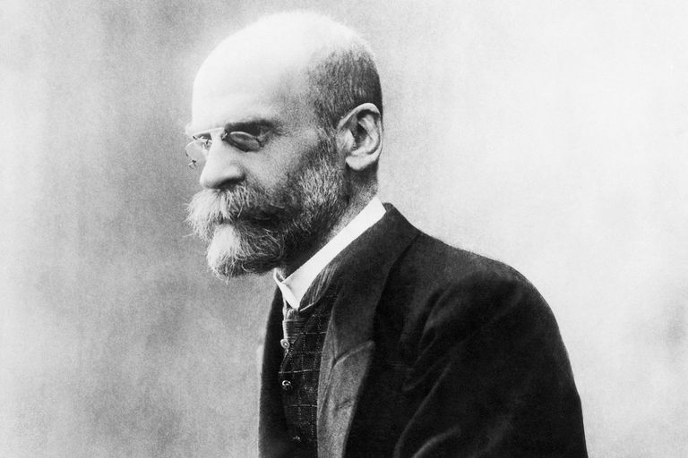
Emile Durkheim
Developed the framework of scientific research in sociology
By dealing with macro level facts, e.g. suicide rates on the one hand and religion, gender, occupation … on the other
Using Durkheim’s work, you may study suicide/ homicide/ crime rate, percent deaths due to neoplasm, unemployment rate, agricultural losses etc. by using secondary data and sophisticated statistical models with independent variables of your choice

Slide 33
George Kingsley Zipf
In American Sociological Review, 12 (6), 1947, presented and validated his law (mathematical law of migration
Tested and validated it on the basis of data on different modes of transportation

Slide 34
Cont.
The Journal of Mathematical Sociology published papers based on application of mathematics to solve sociological problems, e.g., homophily (gays), labor market, and impact of age structure on rationality
American sociology is highly mathematical; European sociology is theoretical

Slide 35
Critique of positivism
Symbolic interactionist theory of deviance
Women’s standpoint theory – gender, race, class, culture
Michel Foucault’s disciplinary society – power and knowledge; power is exercised through disciplinary means in schools, hospitals, prisons and militaries
Linguistic turn - the power of language and rhetorical tropes/ metaphors
Discursive nature of theory

Slide 36
Nelson Phillips and Cynthia Hardy in Discourse Analysis
RESEARCHERS FACE A FEW QUESTIONS
What research philosophy underpins your research?
What is your object of study?
Upon which theoretical influence(s) are you drawing?
What contribution do you hope to make?
What are your research questions?

Slide 37
More on methodology in the next lecture
More on methodology in the next lecture

Slide 38
Common mistakes in research
Insufficiently motivated research questions
Pursuing research fads – limited shelf life
Unresearchable problems - there are so many important social questions but all are not researchable
Favoured research methods
Blind data mining – collect the data first/ abundance of data is not a substitute of planning in research
From: Anol Bhattacharjee, Social Science Research, University of Florida, Scholar commons, 2012.

Slide 39
Feel free to ask questions
Thank you!

