Slide 1
Types of tdds
(Dr.) Pranati Srivastava
Asst. Professor
School of Pharmaceutical Sciences, CSJMU, Kanpur

Slide 2
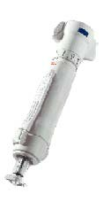
Needle-free Jet Injectors

Slide 3
Pain-free delivery — particles are too small to trigger pain
receptors on the skin.
Improved efficacy and bioavailability.
Targeting to a specific tissue, such as a vaccine delivered to epidermal cells.
Accurate dosing and Overcomes needle phobia.
Safety — the device avoids skin damage or infection from needles or splash back of body fluids.
The PowderJect system fires solid particles (20–100µm) through stratum corneum into lower skin layers, using a supersonic shock wave of helium gas.
Intraject is a development of the vaccine gun designed to deliver liquids through skin without using needles.

Slide 4
A substance that will increase the permeability of the epithelial barrier by modifying its structure also termed as accelerants or sorption promoters-can enhance drug flux.
Ideal Penetration Enhancer
Non-toxic, non-irritating, non-allergenic.
Immediate onset of increased permeability.
Immediate recovery of normal barrier properties upon removal (reversible).
Physically and Chemically compatible with a wide range of drugs.

Slide 5
Solvents
- Ethanol, acetone, polyethylene glycol, glycerol, propylene glycol, dimethyl
sulfoxide
Surfactants
- Brij30, brij72, Pluronic, Sodium lauryl sulphate, Span 20, Tween 80.
Azones
- N- Acyl hexahydro-2-oxo-1H-azepines, N-Alkylmorpholine-2,3-diones.
Terpenes
- Limonene, Carvone
Fatty alcohols fatty acids
- Lauryl alcohol, linolenyl alcohol, oleic and acid and lauric acid.
Miscellaneous
- Lecithin, sodium deoxycholate, L-amino acid, acid phosphatase,phospholipase & calonase

Slide 6
1.Ultrasound (Phonophoresis / Sonophoresis)
Used originally in physiotherapy and sports medicine, applies a preparation topically and massages the site with an ultrasound source.
The ultrasonic energy (at low frequency) disturbs the lipid packing in stratum corneum by cavitation.
Sonicators operating at frequencies in the range of 20kHz to 3MHz are available commercially and can be used for Sonophoresis.
◻ Therapeutic ultrasound (1–3MHz) - for massage,
◻ Low-frequency ultrasound (23-40kHz) - in dentistry,
◻ High-frequency ultrasound (3–10 MHz) - diagnostic purposes.

Slide 7
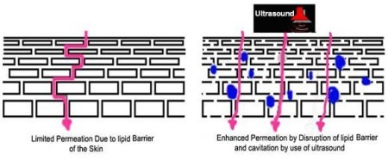

Slide 8
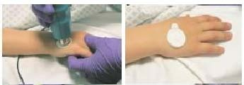
Ultrasound to Enhance Skin Permeability

Slide 9
The electrical driving of charged molecules into tissue, passes a small direct current (approximately 0.5 mA/cm²) through a drug containing electrode in contact with the skin. The most popular electrodes are based on the silver/silver chloride redox couple.
Three main mechanisms enhance molecular transport:
Charged species are driven primarily by electrical repulsion from the driving electrode.
Flow of electric current may increase the permeability of skin and
Electroosmosis may affect uncharged molecules and large polar peptides.
Limitations: Hair follicle damage is possible.

Slide 10
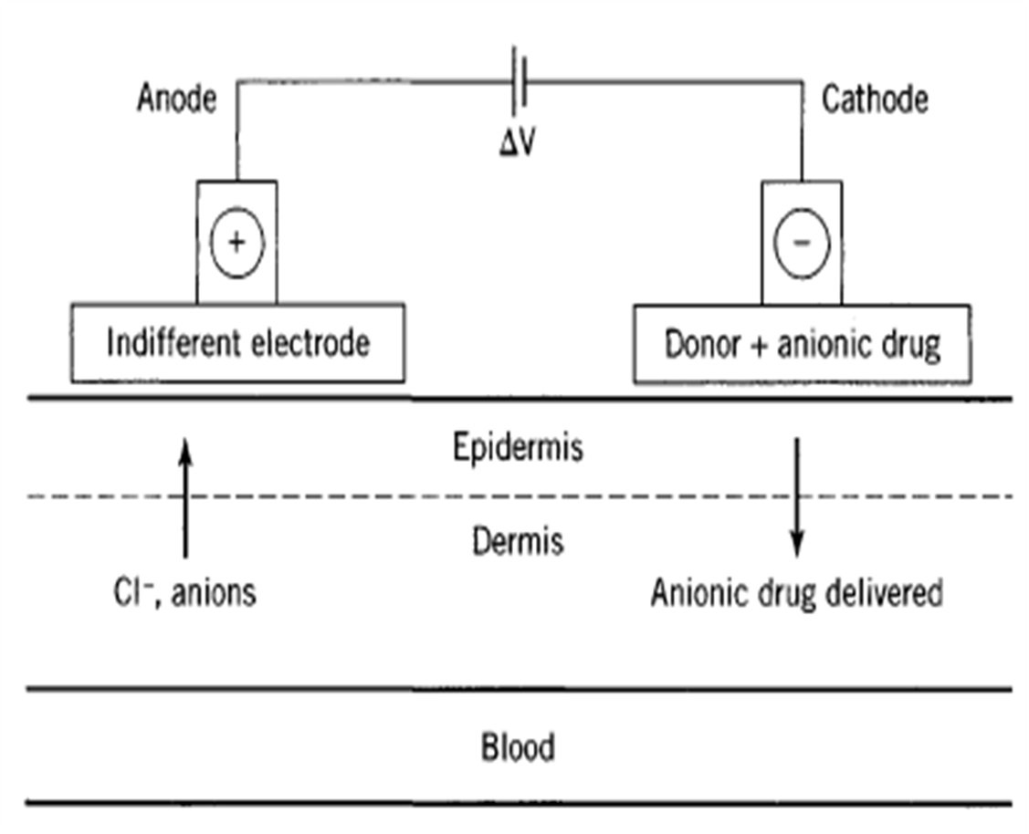

Slide 11
Skin electroporation (electropermeabilization) creates transient aqueous pores in the lipid by application of high voltage of electrical pulses of approximately 100–1000 V/Cm for short time(milliseconds). These pores provide pathways for drug penetration that travel straight through the horny layer.
This technology has been successfully used to enhance the skin permeability of molecules with differing lipophilicity and size including biopharmaceuticals with molecular weights greater that 7kDA..

