Slide 1
Universal Precautions
Dr. VERSHA PRASAD

Slide 2
Why it needed
The Center for Diseases Control and Prevention (CDC) Designed “UNIVERSAL PRECAUTIONS to help n protect people who are providing first aid or health care from the spread of Human Immunodeficiency Virus (HIV) , and other blood borne pathogens.
.

Slide 3
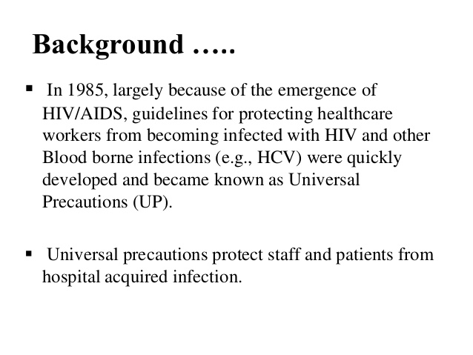

Slide 4
Principle
Using the “better safe than sorry” principle universal precautions are based on the assumption that blood and certain body fluids of all people carry HIV, HBV and other blood borne pathogens.
By 1987 CDC recommended that to prevent transmission of HIV, precautions for handling blood and body fluids apply to all patients regardless of diagnosis. This system has been called “Universal Precautions”

Slide 5


Slide 6
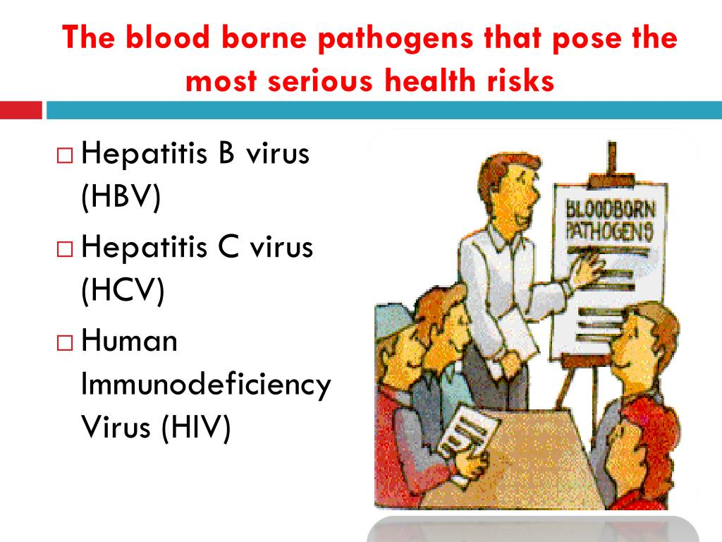

Slide 7
Modes of Specific protections
Barrier protection.
Hand washing.
Handling instrument with caution.

Slide 8
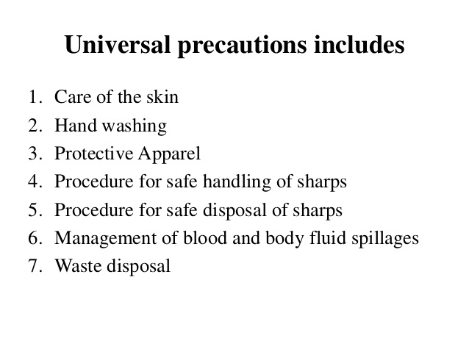

Slide 9
Prevention and control A two-tiered approach
A two-tiered approach to precautions is used to interrupt the mode of transmission of infections agents.
Standard precautions:
These refer to work practices that are applied to all patients receiving care in health facilities, regardless of their diagnosis or presumed infectious status so as to minimize the risk of transmission of infectious agents in all situations.
Standard precautions minimize the likelihood of transmission of infectious agents between HCWs and patients, and from patient to patient.

Slide 10
Transmission-based precautions:
Transmission-based precautions are precautions required to be taken based on the route of transmission of organisms like contact precautions, airborne precautions, etc.
If successfully implemented, standard and transmission based precautions prevent any infection from being transmitted.

Slide 11
1. Barrier protection
Incudes disposable lab coats, gloves and eye and face protection
Use barrier protection at all times to prevent skin and mucus membrane contamination with blood , body fluids containing visible blood, or any other body fluids.
The type of barrier protection used should be appropriate for the type of procedures being performed and the type of exposure anticipated

Slide 12
1. Barrier protection
Wear gloves when there is potential for hand and skin contact with blood ,other potentially infectious material, or items and surfaces contaminated with these materials.
Wear face protection (face shield) during procedures that are likely to generate droplets of blood or body fluids to prevent exposure to mucus membranes of the mouth, nose and eyes

Slide 13
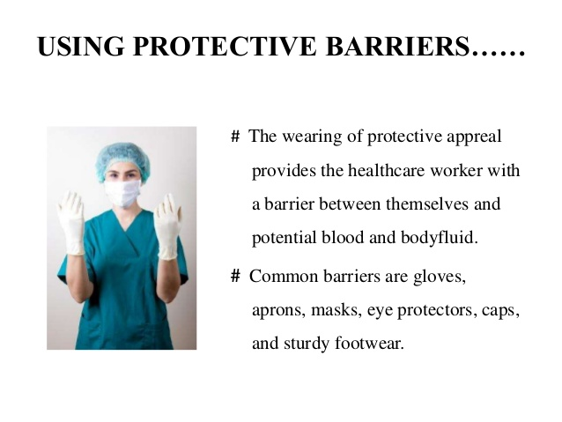

Slide 14
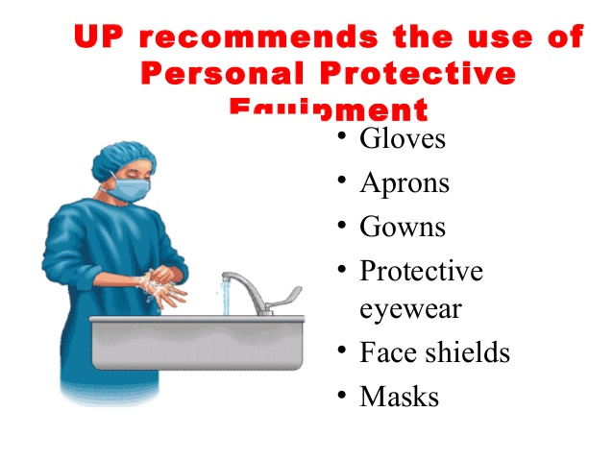

Slide 15
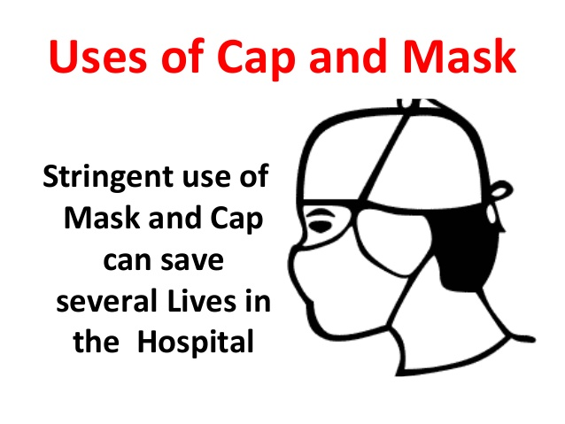

Slide 16
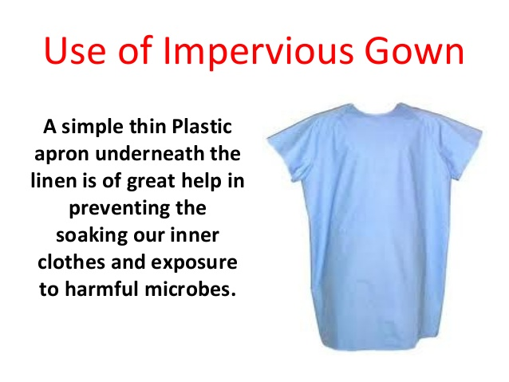

Slide 17
Barrier protection
Wear protective body clothing(disposable lab coat or PPE KIT) when there is a potential for splashing of blood or body fluids
Change gloves and other protective clothings when moving from one patient to other. And always remember that WASH HANDS THOROUGHLY BEFORE PUTTING ON A NEW PAIR OF GLOVES.

Slide 18
2. Hand washing
Thorough and frequent hand washing is essential
Wash hands or other skin surfaces thoroughly and immediately if contaminated with blood, body fluids containing visible blood, or other body fluids to which universal precautions apply.
Wash hands immediately after gloves are removed.

Slide 19
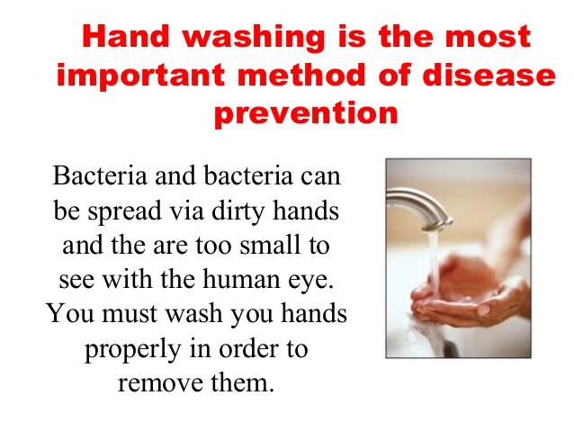

Slide 20
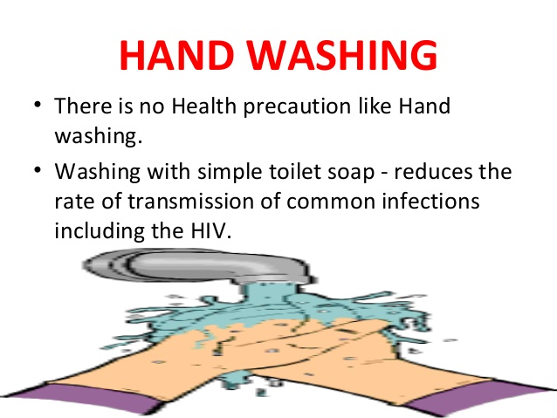

Slide 21
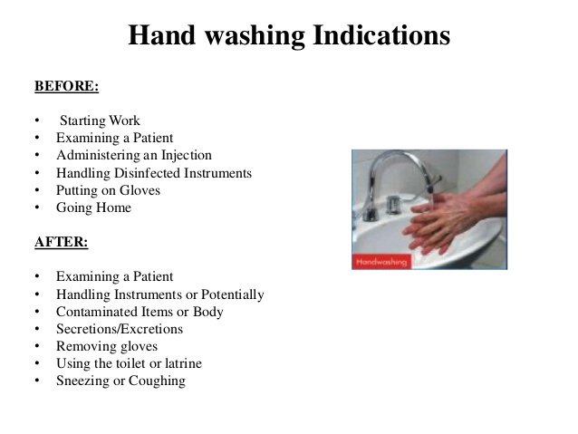

Slide 22
3.Handle instruments with caution
Avoid accidental injuries that can be caused by needles, scalpel blades, laboratory instruments, etc. When performing procedures, cleaning instruments, handling sharp instruments and disposing of used needles, pipettes, etc.
Always placed used needles, disposable syringes, scalpal blades, pipettes and other sharp items in puncture resistant containers marked with biohazard disposal.

Slide 23
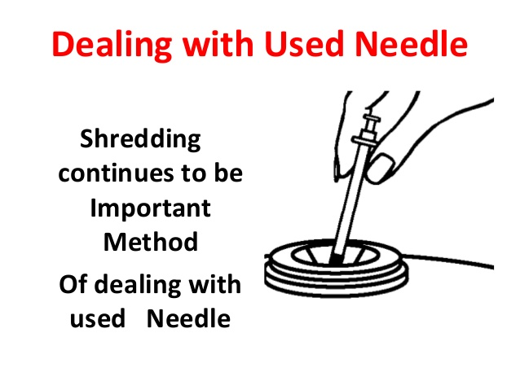

Slide 24
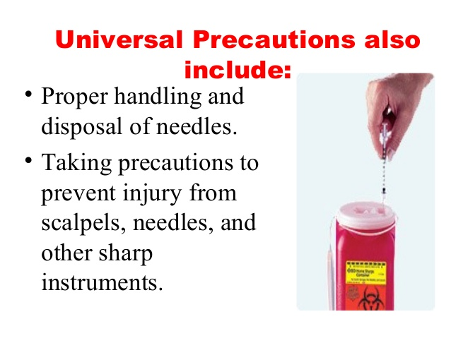

Slide 25
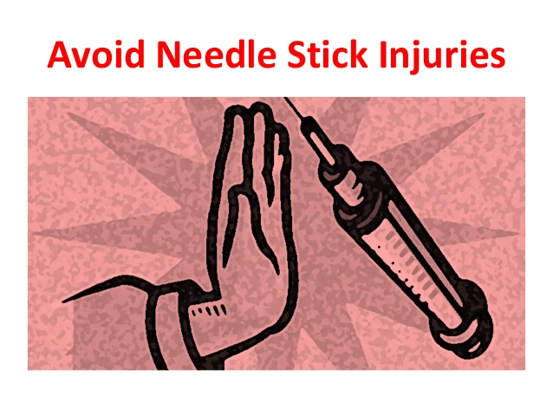

Slide 26
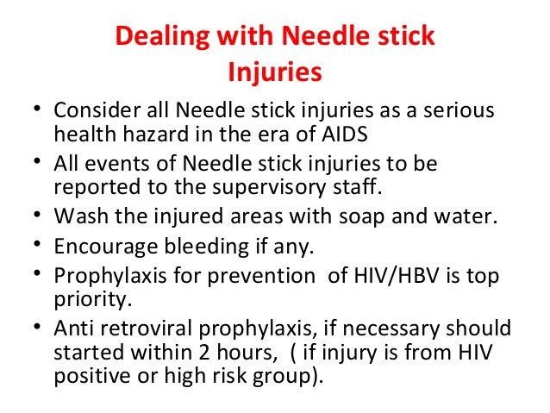

Slide 27
Example of specific precautions include –
All blood and body fluids and material contaminated are treated as infectious for HIV,HBV,HCV and other blood pathogens
Gloves should be used when handling all potentially infectious material
Protective garments should be worn and removed before leaving the work area
Handle all linen soiled with blood or body fluidsas potentially infectious.

Slide 28
Example of specific precautions include –
Mask and eye protections should be worn whenever splashes or dropletsfrim infectious material pose a risk.
Only disposable needles should be used
Needle should be discarded directly into special containers without recapping.

Slide 29
Example of specific precautions include –
Work surfaces should be decontaminated using a bleach solution.
Laboratory personal should refrain from mouth pipetting, eating ,drinking and smoking in the work area.
All metal objects and instruments can be disinfected by AUTOCLAVING or by exposure to ethylene oxide Gas.
Frequent Hand Washing is an important safety precaution and should be carried out whenever there is visible contamination with blood or body fluid ,when changing glove ,after work has been completed, before leaving laboratory, eating, drinking, smoking, changing contact lenses and using washroom facilities.

Slide 30
Example of specific precautions include –
When specimens are obtained from patients they should be placed into leak proof primary container with secure closure. When being transported to the laboratory, the primary specimen container should be placed into secondary container that would contain the specimen in any case if the primary container is broken or leaked in transportation.

Slide 31
Unfortunately :
Exposure
Source HIV Testing: Available source with confirmed HIV:
Current viral load.
Resistance test result.
Current antiretroviral therapy (ART) regimen.
Previous regimens.
Contact information for prescriber (s.)
Do not delay PEP initiation while waiting for test results.

Slide 32
Available source with unknown HIV status
Inform the source of the exposure incident.
Perform HIV test.
Assess the source patient for risk of HIV acquisition within the past 4 weeks acute HIV infection).

Slide 33
Unknown unavailable source
Assess the exposure to identify the exposed individuals risk of HIV infection.
Assume the source has HIV until proven otherwise.

Slide 34
Notification of health care worker who are exposed accidentally:
1. Exposed area must be washed with soap and water. Blood and other body fluid must be removed and clean under running tap water with soap.
2.Notify the accident to hospital authority and
3. and exposed person is evaluated for serological evidence of HIV infection as soon as possible after accident. If found positive immediately after infection, it can be concluded that the accident is not a cause of seropositive result as it takes minimum 2 weeks for seroconversion.
If found negative then evaluation is repeated after ½ month, 3 months,6 months and 12 months after exposure.
If still negative it can be concluded that HIV transmission did not occur. If found positive after 2 weeks, the opinion of expert to be sought.

Slide 35
Information and Training-
In order to protect Hospital workers , the hospital authorities must provide general information about the danger to be faced in practices, the ways in which AIDS and Hepatitis are transmitted and must give general training with mass awareness to the hospital staff.
It can be concluded that hospital staff and authorities other are equally responsible and accountable for transmission of these hospital-acquired information. Legally hospital is bound to provide such facilities to its staff, which prevent the transmission, but morally staff is also equally responsible if the staff does not fallow STANDAED PRACTICES--
Professional risk liability and compensation is another controversial issue ,which is very difficult to prove in the event of detecting positive casas as attributability is not actually established.

Slide 36
The only answer of many question is Adapt
UNIVERSAL PRECAUTIONS

Slide 37
Thank you

