Slide 1
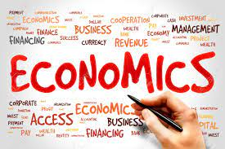
Dr. Pooja Singh Assistant Professor, Department of Economics, School of Arts Humanities And Social Science, Chhatrapati Shahu Ji Maharaj University, Kanpur
Utility- Meaning, Concept
And
Law of Diminishing Marginal Utility

Slide 2
Utility- Meaning
Utility- Meaning, Concept And Law of Diminishing Marginal Utility
From Commodity Point of View:
From Consumer’s Point of View:
Want satisfying power of a commodity.
Psychological felling of satisfaction, pleasure, happiness or well- being which a consumer derives from the consumption of a commodity

Slide 3
Utility- Meaning, Concept And Law of Diminishing Marginal Utility
Total Utility-
Marginal Utility-
Where, TU= total utility, $Δ$Q= change in quantity consumed per unit
Sum of the utilities derived by consumer from the various units of goods and services.
${TU}_{n }$= $U_{1}$+ $U_{2}+ U_{3}+ U_{4}………+U_{n}$
Addition to the total utility resulting from the consumption of one additional unit.
$$MU=\frac{ΔTU}{ΔQ}$$

Slide 4
Measurement of Utility-
Utility- Meaning, Concept And Law of Diminishing Marginal Utility
Measurement 0f Utility
Cardinal
Ordinal
Utility can be measured and quantified.
Utility derived from the consumption of goods or services cannot be measured numerically but can only be ranked in order of preferences.
Utility derived from a particular product is independent i.e consumption of one product is not dependent on utility derived from other products.
Consumer is consistent in ranking
Law Of Diminishing Marginal Utility and Law Of Equi-Marginal Utility derived from cardinal utility.
The preferences of the consumer is based on the choice of thev products available.
Propounded by J.R Hicks and P.G.D Allen and can be explained with the help of Indifference Curve .
Based on the Marshallian School of thoughts.

Slide 5
Utility- Meaning, Concept And Law of Diminishing Marginal Utility

Slide 6
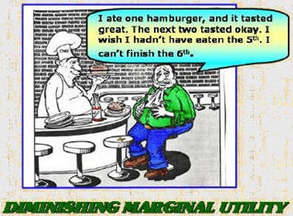
Law of Diminishing Marginal Utility
Utility- Meaning, Concept And Law of Diminishing Marginal Utility
The law of diminishing marginal utility says that the marginal utility from each additional unit declines as consumption increases.
The marginal utility can decline into negative utility, as it may become entirely unfavorable to consume another unit of any product.
This law applies to all kinds of consumer goods- durable and non-durable sooner or later.

Slide 7
Assumptions of Law:
Utility- Meaning, Concept And Law of Diminishing Marginal Utility
Unit of the consumer good must be a standard one. e.g.- A cup of tea, a bottle of water (Same Shape & Size)
The quality of the successive units of goods should remain the same, changes in the quality of the product may not be helpful in proving the law.
Consumer’s taste and preference must remain the same during the point of consumption
Consumption of goods should be continuous, any long gap in the consumption will alter the law.
Mental condition of the consumer must remain normal during the period of consumption
The taste and preference of the consumer should remain unchanged during the period of purchases.

Slide 8
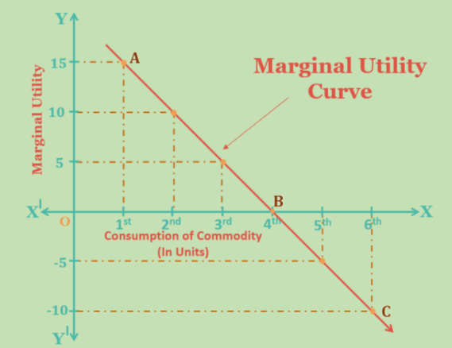
Utility- Meaning, Concept And Law of Diminishing Marginal Utility
Units of Pizza | T. U. | M. U.
1st | 15 | 15(15-0)
2nd | 25 | 10(25-15)
3rd | 30 | 5 (30-25)
4th | 30 | 0 (30-30)
5th | 25 | -5(25-30)
6th | 15 | – 10(15-25)

Slide 9
References
Utility- Meaning, Concept And Law of Diminishing Marginal Utility
Dwivedi D N, Managerial Economics, Vikas Publishing House Pvt. Ltd, 2006
https://quizizz.com/admin/quiz/5d70a2e771623c001e9da20f/unit-2-economics
https://www.amyglenn.com/ECON/econ2302micro1.htm
https://quizizz.com/admin/quiz/5d70a2e771623c001e9da20f/unit-2-economics

