Slide 1
VOCATIONAL REHABILITATION

Slide 2
CONTENTS
Introduction
Planning of Vocational Rehabilitation
Hand functions
Functional position
PT management of disabled hand
Vocational Rehabilitation
Procedure of Rehabilitation
Examples

Slide 3
INTRODUCTION
“ It is a process that assists individuals with impairments to overcome their handicap and try to reintegrate them into society in to a job or vocation using their residual physical and intellectual capacities^{.1 ”}
^{Or}
“Vocational rehabilitation is by definition a multidisciplinary intervention in a process linked to the facilitation of return to work or to the prevention of loss of the work.^{2”}
Usually done by a Vocational therapist, a member of socio-vocational team.
Identification of right job for individuals with respect to their residual abilities.
Vocational evaluation requires knowledge of condition of patient, their medical history, observations, inventories and checklists where required.
S. Sunder; Textbook of Rehabilitation; 3rd edition
Gobelet C, Luthi F, Al-Khodairy AT, Chamberlain MA. Vocational rehabilitation: a multidisciplinary intervention. Disabil Rehabil. 2007;29(17):1405-1410. doi:10.1080/09638280701315060

Slide 4
REHAB PLANNING
Vocational rehab cannot be completed without assessment of hand functions.
Cortical and sensory areas of brain reveals a quite sizeable area for the hand.
Major share of thumb is represented in the brain.
Assessment for a successful vocational rehabilitation requires careful observation of achievements, personality of individuals, intelligence, aptitudes and personal interests of various differently abled patients.
S. Sunder; Textbook of Rehabilitation; 3rd edition
Gobelet C, Luthi F, Al-Khodairy AT, Chamberlain MA. Vocational rehabilitation: a multidisciplinary intervention. Disabil Rehabil. 2007;29(17):1405-1410. doi:10.1080/09638280701315060

Slide 5
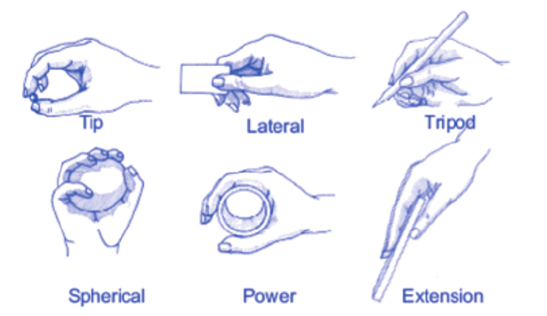
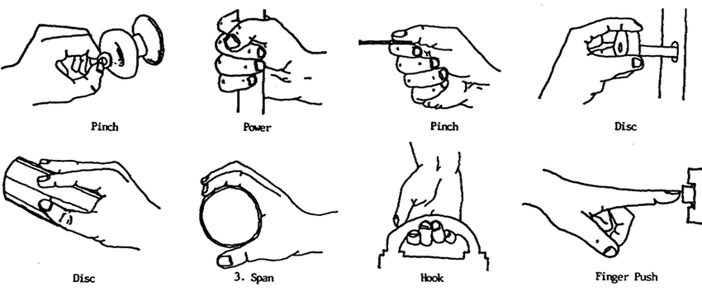
HAND FUNCTIONS
S. Sunder; Textbook of Rehabilitation; 3rd edition
Gobelet C, Luthi F, Al-Khodairy AT, Chamberlain MA. Vocational rehabilitation: a multidisciplinary intervention. Disabil Rehabil. 2007;29(17):1405-1410. doi:10.1080/09638280701315060

Slide 6
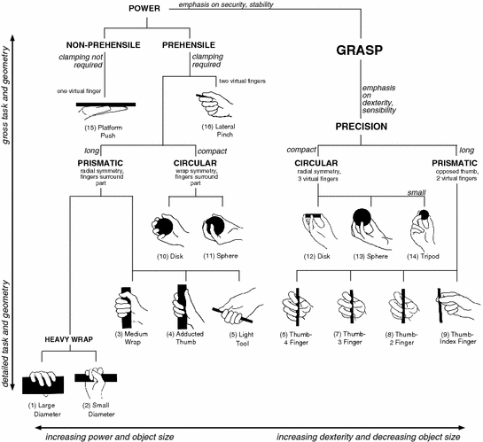
S. Sunder; Textbook of Rehabilitation; 3rd edition
Gobelet C, Luthi F, Al-Khodairy AT, Chamberlain MA. Vocational rehabilitation: a multidisciplinary intervention. Disabil Rehabil. 2007;29(17):1405-1410. doi:10.1080/09638280701315060

Slide 7
Release
Manipulation
Stabilization
Sensation
Expression
Daily living tool
Protection
Support
Basic hand movements involved in the functions are:
S. Sunder; Textbook of Rehabilitation; 3rd edition
Gobelet C, Luthi F, Al-Khodairy AT, Chamberlain MA. Vocational rehabilitation: a multidisciplinary intervention. Disabil Rehabil. 2007;29(17):1405-1410. doi:10.1080/09638280701315060

Slide 8
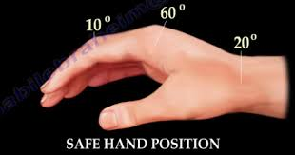
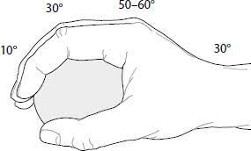
FUNCTIONAL POSITION
Best position of hand movement.
Wrist in 20 degree extension and 10 degree of ulnar deviation
45 degree flexion at metacarpophalangeal joint
30 degree flexion at proximal and interphalangeal joint.
Thumb in midway opposition.
Preservation of normal transverse and longitudinal arches.
S. Sunder; Textbook of Rehabilitation; 3rd edition
Gobelet C, Luthi F, Al-Khodairy AT, Chamberlain MA. Vocational rehabilitation: a multidisciplinary intervention. Disabil Rehabil. 2007;29(17):1405-1410. doi:10.1080/09638280701315060

Slide 9
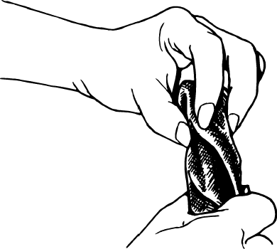
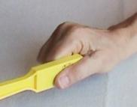
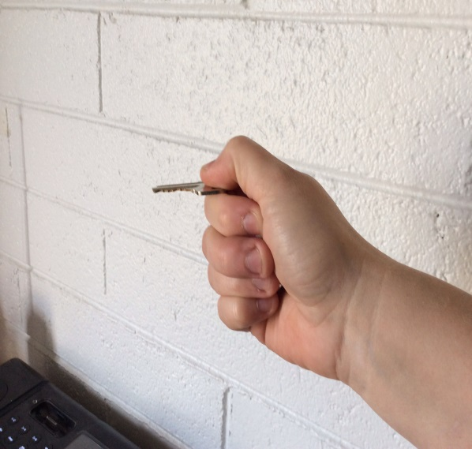
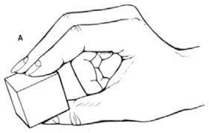
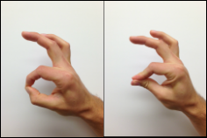
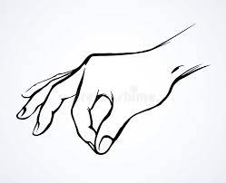
PINCHES/ PRECISION
THREE JAW CHUCK PINCH
LATERAL PINCH
TIP PINCH / TIP TO TIP PINCH
S. Sunder; Textbook of Rehabilitation; 3rd edition
Gobelet C, Luthi F, Al-Khodairy AT, Chamberlain MA. Vocational rehabilitation: a multidisciplinary intervention. Disabil Rehabil. 2007;29(17):1405-1410. doi:10.1080/09638280701315060

Slide 10
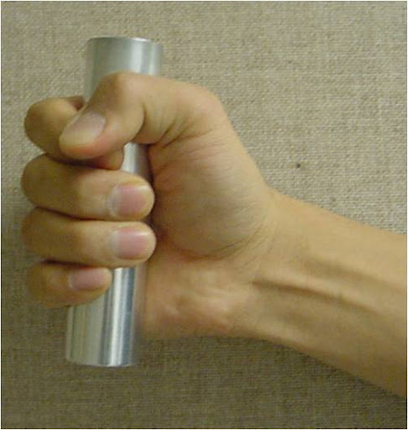
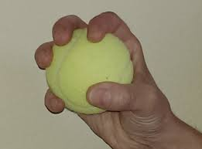
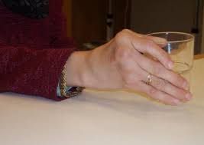
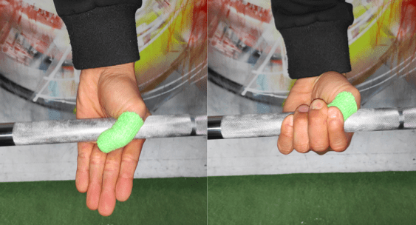
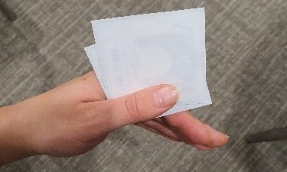
GRIPS OR GRASPS
CYLINDRICAL
SPHERICAL
INTRINSIC PLUS
HOOK
LATERAL PREHENSION
S. Sunder; Textbook of Rehabilitation; 3rd edition
Gobelet C, Luthi F, Al-Khodairy AT, Chamberlain MA. Vocational rehabilitation: a multidisciplinary intervention. Disabil Rehabil. 2007;29(17):1405-1410. doi:10.1080/09638280701315060

Slide 11
PT MANAGEMENT OF DISABLED HAND
1. Sensory re-education technique, by using similar materials used by patients priory in life and making them guess the material with eyes closed with repetitions.
S. Sunder; Textbook of Rehabilitation; 3rd edition
Gobelet C, Luthi F, Al-Khodairy AT, Chamberlain MA. Vocational rehabilitation: a multidisciplinary intervention. Disabil Rehabil. 2007;29(17):1405-1410. doi:10.1080/09638280701315060

Slide 12
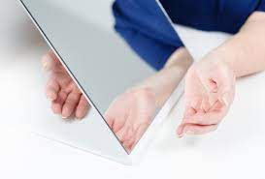
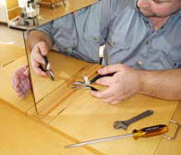
PT MANAGEMENT OF DISABLED HAND
2. Mirror therapy widely used these days to improve hand functions
Patients with hemiplegia or hemiparesis are often rendered with this therapy in which normal limb is placed in-front of mirror and disabled limb at the back and is asked to perform the same function as being performed by the sound limb.
S. Sunder; Textbook of Rehabilitation; 3rd edition
Gobelet C, Luthi F, Al-Khodairy AT, Chamberlain MA. Vocational rehabilitation: a multidisciplinary intervention. Disabil Rehabil. 2007;29(17):1405-1410. doi:10.1080/09638280701315060

Slide 13
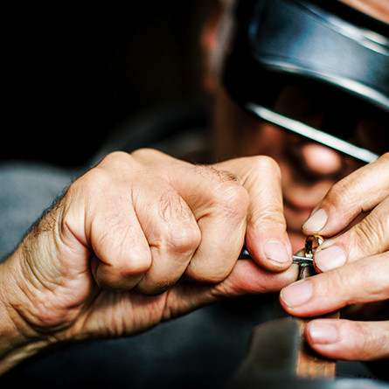
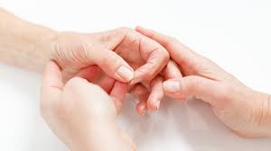
PT MANAGEMENT OF DISABLED HAND
3. Motor re-education by planning of activities for patients and asking them to perform independently. This may also include passive ROM exercises, active- assisted ROM exercises and various task dependent regimes to be followed.
S. Sunder; Textbook of Rehabilitation; 3rd edition
Gobelet C, Luthi F, Al-Khodairy AT, Chamberlain MA. Vocational rehabilitation: a multidisciplinary intervention. Disabil Rehabil. 2007;29(17):1405-1410. doi:10.1080/09638280701315060

Slide 14
VOCATIONAL REHABILITATION
Basic principles of vocational rehabilitation include:
counselling by a professional counsellor
providing empathy to patients
allocation of work on the basis of individual’s ability, aptitude, skills, interest and needs.
home based employment for patients who are home bound
assistance to be provided to patients who are looking for self employment.
S. Sunder; Textbook of Rehabilitation; 3rd edition
Gobelet C, Luthi F, Al-Khodairy AT, Chamberlain MA. Vocational rehabilitation: a multidisciplinary intervention. Disabil Rehabil. 2007;29(17):1405-1410. doi:10.1080/09638280701315060

Slide 15
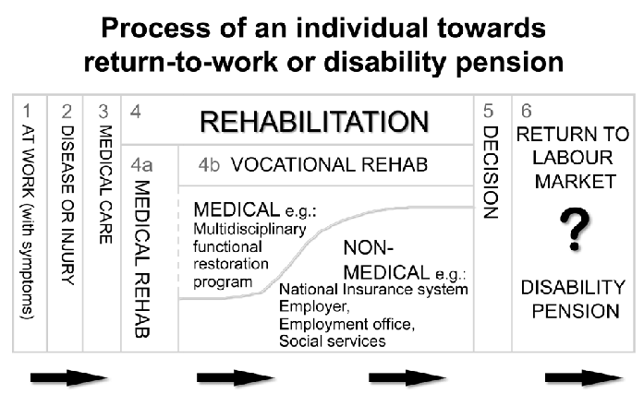
VOCATIONAL REHABILITATION
S. Sunder; Textbook of Rehabilitation; 3rd edition
Gobelet C, Luthi F, Al-Khodairy AT, Chamberlain MA. Vocational rehabilitation: a multidisciplinary intervention. Disabil Rehabil. 2007;29(17):1405-1410. doi:10.1080/09638280701315060

Slide 16
PROCEDURE OF REHABILITATION
Disability evaluation by Vocational Rehabilitation Team
Counselling and Mental preparation of patient for job
Training of patients for job selected
Analysis of job on the basis of patient’s capabilities
Placement and modifications of job area and house
Timely review of job and individual’s satisfaction and needs

Slide 17
EXAMPLES
Vocational rehabilitation centres in India are working continuously with patients of:
Cerebral Palsy
Autism
Stroke
Motor Neuron Disease
Chronic arthritis
Rheumatoid Arthritis
Neurodevelopmental Disorders
Spinal Cord Injury
Blind, Deaf or Differently abled children
S. Sunder; Textbook of Rehabilitation; 3rd edition
Gobelet C, Luthi F, Al-Khodairy AT, Chamberlain MA. Vocational rehabilitation: a multidisciplinary intervention. Disabil Rehabil. 2007;29(17):1405-1410. doi:10.1080/09638280701315060

Slide 18
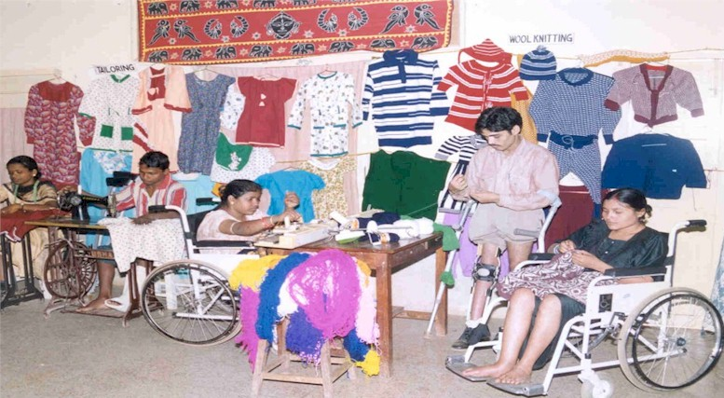
Vocational rehabilitation of individuals suffering from paraplegia rendered with a work of stitching with training by Indian NGOs.

Slide 19
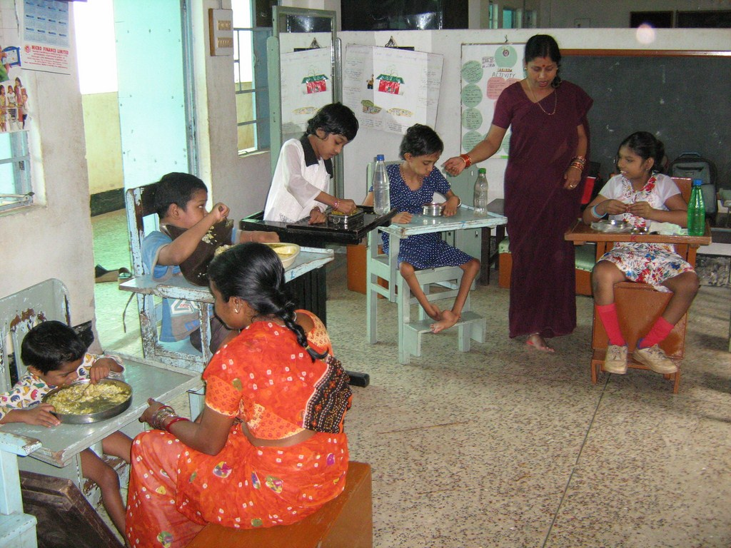
Vocational rehabilitation centre in India for CP and Autistic Children for vocational training.

Slide 20
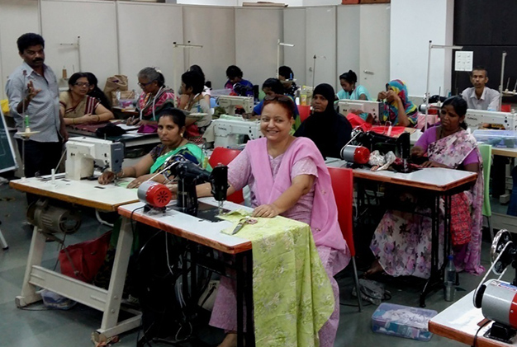
Vocational rehabilitation of Cancer survivors in India

Slide 21
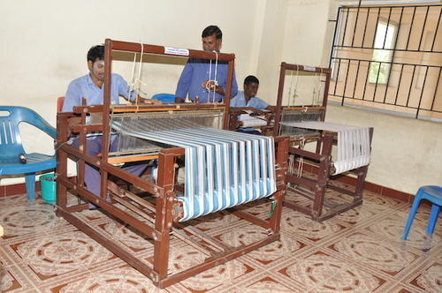
A vocational training centre in Chennai training individuals with lower limb paralysis to weave clothes for small scale industries

