Slide 1
WORK & TORQUE
BY:
DR. DIGVIJAY SHARMA
DIRECTOR
SCHOOL OF HEALTH SCIENCES, CSJMU

Slide 2
WORK
Work is defined as the product of applied forces and to the magnitude of displacement of the object to which force is applied.
Work = Force/ Displacement
or
W = F/d

Slide 3
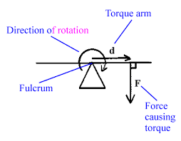
TORQUE
The ability of any force to cause rotation of the lever is known as Torque or Moment of Force
Torque (T) is a product of magnitude of applied force (F) and the distance (d) that force lies from the axis of rotation
The distance (d) in the shortest distance between the action line of the applied force and the axis of lever

Slide 4
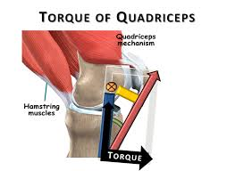
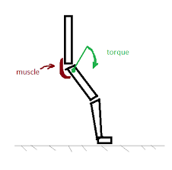

Slide 5
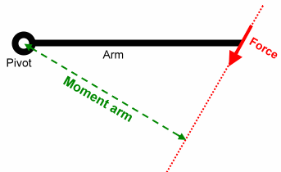
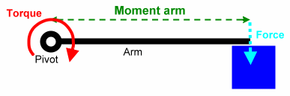
MOMENT ARM
It is always the shortest distance between the action line and the joint axis
It is found by measuring the length of a line drawn perpendicular to the force vector intersecting the joint axis
Hence, Mechanical Advantage is directly perpendicular to the distance

Slide 6
MOMENT ARM of a muscle force
The force applied to a lever has a constant magnitude, but is changing its angle of application to the lever and consequently Mechanical advantage length
The angle of application of a force is the angle between the action line and the lever on the side of the joint axis
However, lever arm is the distance from the point of application of the force to the joint axis
For example in case of elbow flexion Biceps Brachii applies a force to the forearm with the elbow joint. When a force is applied at 90 degree to a segment, the Mechanical advantage and lever arm are equivalent and minimum but for other angle Mechanical advantage will be smaller than lever arm
When a force is applied to its lever at an angle greater than 90 degrees the Mechanical advantage is found by extending the vector

Slide 7
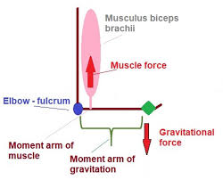
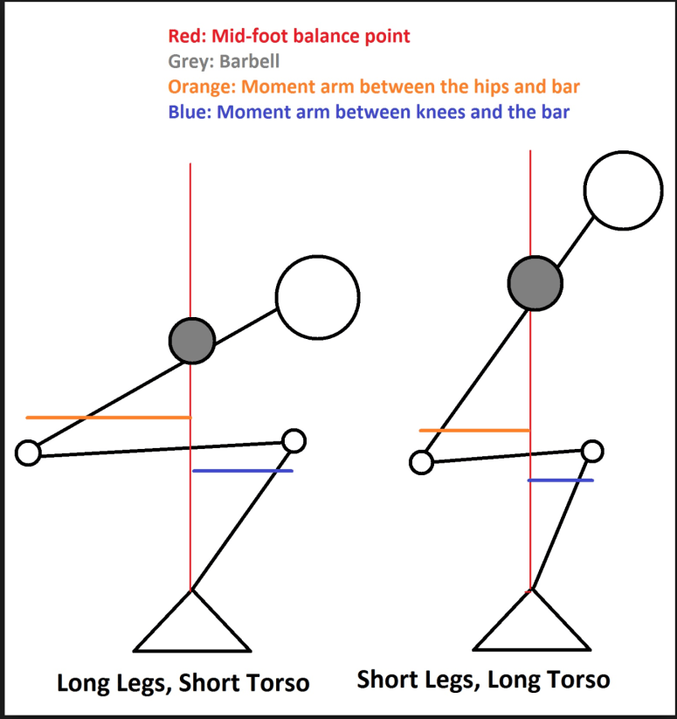
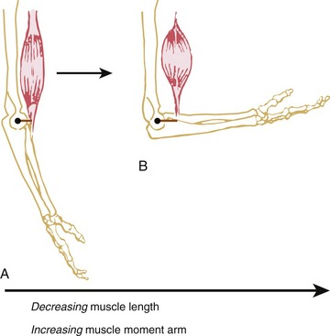
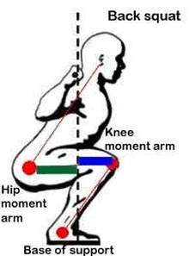
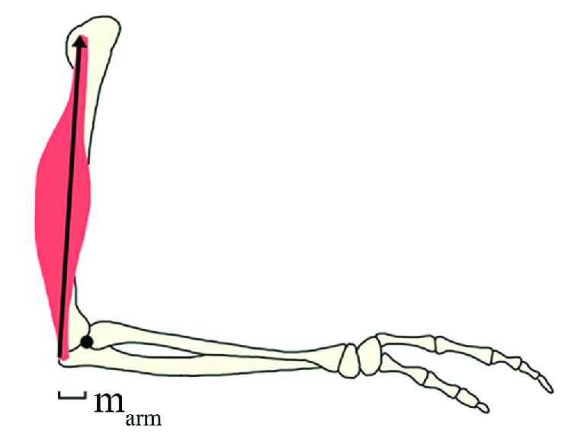

Slide 8
MOMENT ARM of GRAVITY
The change in angle of application with result in an increase or decrease in MA of that force
As the angle of application of the LOG changes, so does the length of MA
Like all other forces, the MA of Gravity is greatest when the force is applied at 90 degrees to the lever
However, the LOG is always vertical and is completely independent of joint position

