Slide 1
WRIST COMPLEX
DR. DIGVIJAY SHARMA
DEPARTMENT OF PHYSIOTHERAPY
U.I.H.S
KANPUR

Slide 2
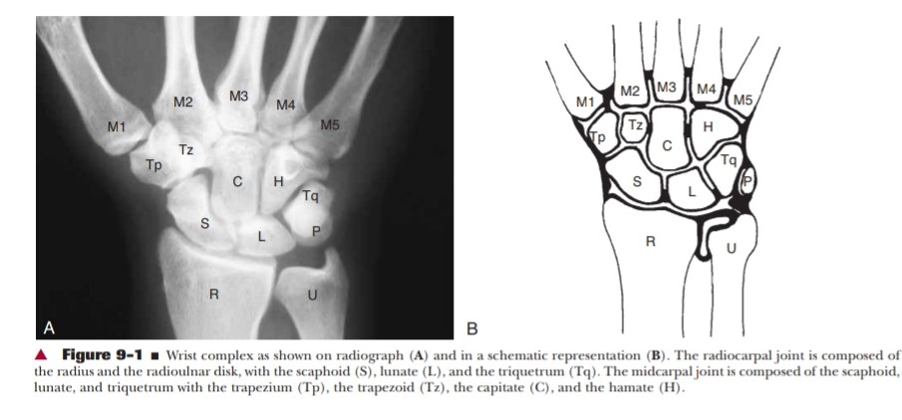
It consist of 2 compound joints-
Radiocarpal joint
Midcarpal joint

Slide 3
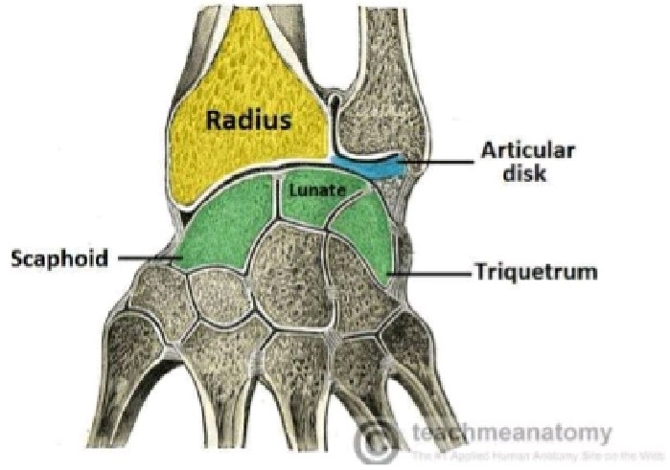
STRUCTURE-
RADIOCARPAL JOINTS-
This joint is formed by radius and radioulnar disc proximally and by the scaphoid, lunate and triquetral distally.
The proximal joint surface is composed of
Lateral radial facet which articulate with scaphoid.
Medial Radial facet articulates with lunate
The triangular fibro cartilage complex that articulate with triquetrum predominantly and lunate with up to some extent .

Slide 4
When the wrist is in neutral position ulna does not participate as the part of the radiocarpal joint Other than an attachment site for the TFCC(triangular fibro cartilage complex).

Slide 5
MIDCARPAL JOINT
It is the articulation between a scaphoid, lunate and triquetrum proximally and distal carpal row composed of the trapezium, trapezoid , capitate and hamate.
The mid carpal joint surfaces are complex with an overall reciprocally concavo-convex configuration.
Functionally the distal carpal row moves as an almost fix unit. The capitate and hamate are most strongly bound together, So only small amount of play is possible between them. The union of distal carpal also results in nearly equal distribution of load across -

Slide 6
A scaphoid – trapezium- trapezoid,
Scaphoid-capitate, lunate-capitate , the triquetrum- hamate articulations. Together the bones of the distal carpal row contribute 2⁰ of freedom of wrist complex with varying amounts of radial/ulnar deviation and flexion/extension credited to the joint .

Slide 7
LIGAMENTS-
The ligaments of the wrist complex are divided into-
Extrinsic ligaments
Intrinsic ligaments

Slide 8
The extrinsic ligaments connect the carpals to the radius or ulna proximally and to the metacarpals distally.
The intrinsic ligaments interconnect the carpals also known as intercarpal or interosseous ligaments.
The intrinsic ligaments lie within the synovial lining and therefore rely on the synovial fluid for nutrition rather than contiguous vascularized tissue as do the extrinsic ligaments.

Slide 9
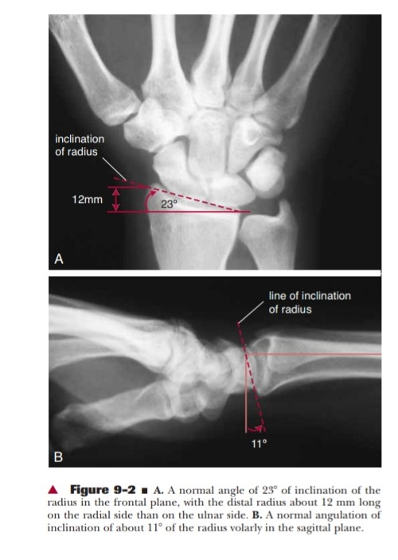
FUNCTION
The ROM of the entire complex are variable and depends upon the factors like ligamentous laxity , shape of articular surface and muscular force.
Normal Range Are :-
Flexion 80⁰- 85⁰
Extension 80⁰ – 90⁰
Radial Deviation 15⁰ – 20⁰
Ulnar Deviation 40⁰ – 45⁰

Slide 10
Motion at the radiocarpal and midcarpal joint are caused by the combination of active muscular and passive ligamentous and joint reaction force.
Although there are several passive forces applied on the proximal carpal rows but there is no direct muscular force are applied.
Therefore the proximal carpal row is a mechanical link between the radius and distal carpals and metacarpals to which direct muscular forces are applied.
Hence this row is also called as intercalated segment a relatively unattached middle segment of a three segment linkages.
When compressive forces are applied across the intercalated segment, the middle segment tends to collapse and moves in opposite direction.

Slide 11
Example-
Application of compressive forces towards extension of wrist complex would cause collapse of mid carpel row in flexion. An intercalated segment require some type of stabilizing mechanisms to prevent collapse of mid carpel segment and to normalize and combined mid carpel/ radio carpel motion, which is appear to be provided by scaphoid and its functional and anatomic connection both to the adjacent lunate and the distal carpal rows.

Slide 12
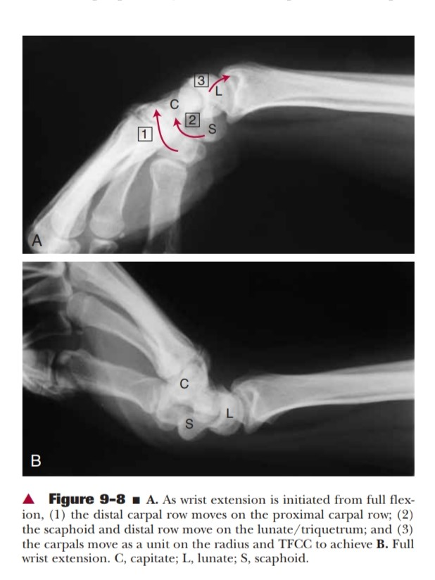
FLEXION/EXTENSION OF THE WRIST-
The motion begins with the wrist in full flexion.
Active extension is initiated at distal carpal rows and metacarpal by the wrist extensor to which they are attached.
The distal carpels glide with relatively fixed proximal bones in the same direction as the motion of the hand.
When the wrist complex reaches neutral (long axis of 3rd metacarpal is lined with the long axis of the forearm).

Slide 13
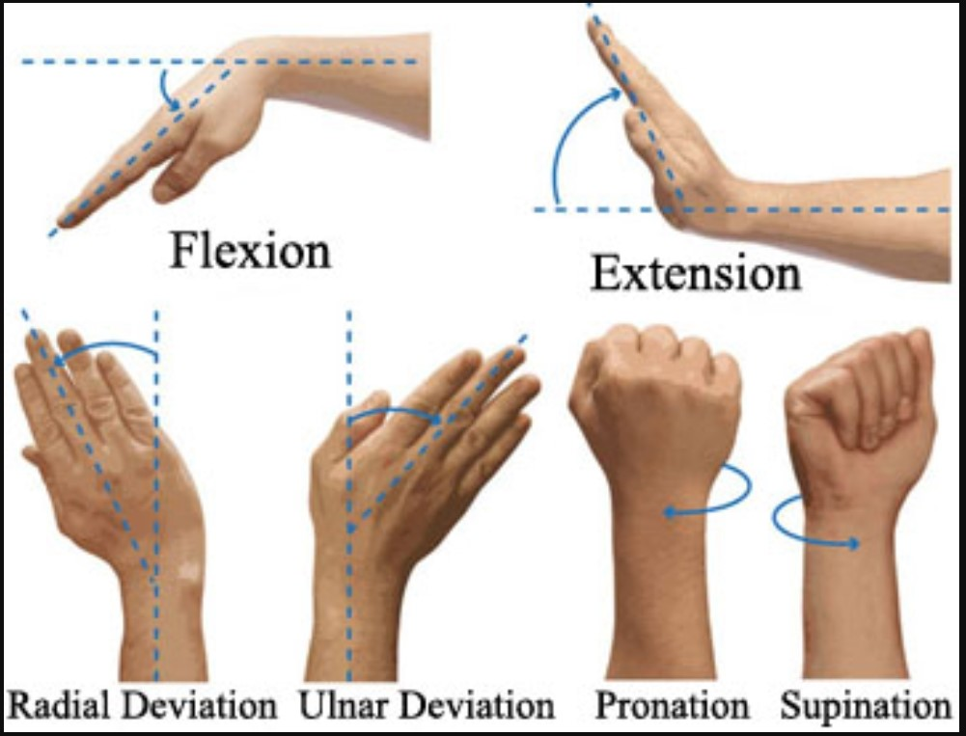
The ligament Spanning the capitate and scaphoid draw the capitates and scaphoid together into a close packed position.
Continued extensors force now moved the combined unit of distal carpal row and scaphoid on the relatively fixed lunate and triquetrum. At approx. 45⁰ hyperextension of the wrist complex, the scapholunate interosseus ligament bring the scaphoid and lunate into close packed position.
This unites all the carpels and causes them to function as a single unit.
Wrist extension is completed as the proximal articular surface of the carpals move as a solid unit on the radius and radioulnar disc.
All ligament become taut as full extension is reached and the entire wrist complexes close packed. Wrist motion from full extension to full flexion occurs in the reverse sequence.

Slide 14
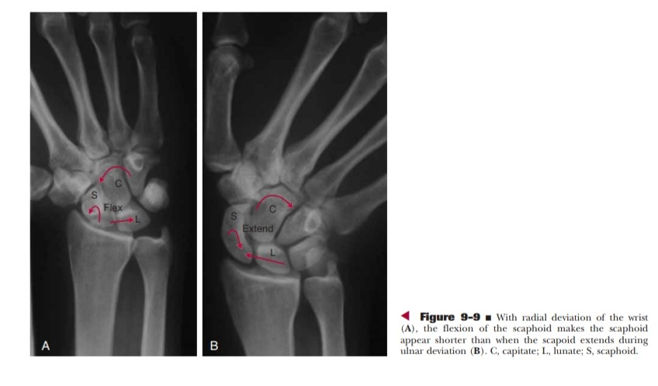
RADIAL/ULNAR DEVIATION
These are even more complex motion than flexion and extension but perhaps the variation is less.
Radial deviation produces not only deviation of the proximal and distal carpal rows radially, but simultaneously flexion of proximal rows and extension of distal carpal rows.

Slide 15
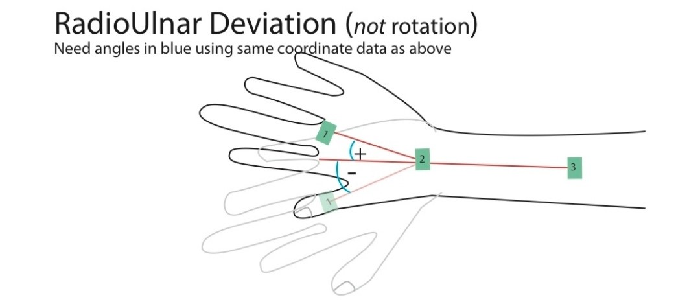
The opposite motion of the proximal and distal carpal occur with ulnar deviation. During these motion the distal rows again moves as a fixed unit but the magnitude of motion between the proximal carpal bones may differ.
The range of radial and ulnar deviation is greatest when the wrist is in neutral position.
When the wrist so extended or flexed the ROM is very little, because in closed packed position the carpals are locked and in lose pack position the bones are splayed.

Slide 16
Thank YOU

