Slide 1




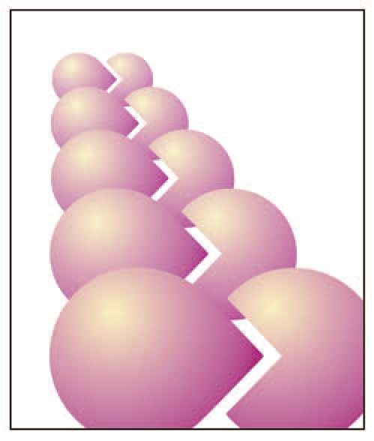

Slide 2
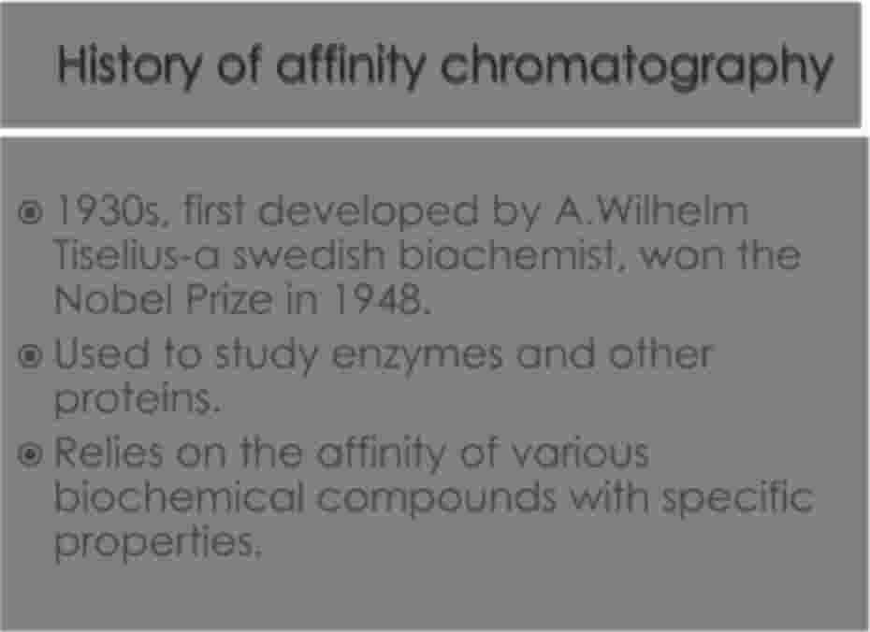


· 1930s, first developed by A.Wilhelm Tiselius-a swedish biochemist, won the Nobel Prize in 1948.
· Used to study enzymes and other proteins.
· Based on the affinity of various biochemical compounds with specific properties.

Slide 3
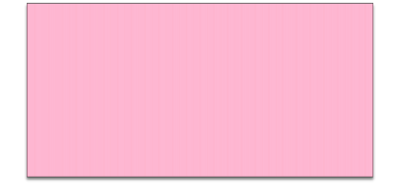

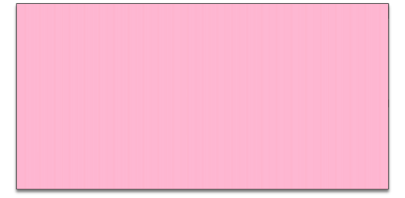
Affinity
Chromatography
Bio-specific
Chemo-specific

Slide 4

· The matrix simply provides a structure to increase
the surface area to which the molecule can bind.
· The matrix must be
to it but still able to
towards the target
activated for the ligand to bind
retain it’s own activation
molecule.

Slide 5

· Amino, hydroxyl, carbonyl and thio groups located
with the matrix serve as ligand binding sites.
· Matrix are made up of agarose and other
polysaccharides
· The matrix also must be able to withstand the
decontamination process of rinsing with sodium hydroxide or urea.

Slide 6

· Cellulose : used for DNA affinity
chromatography.
· Polyacrylamite : it
beads. The beads sufficiently porous,
exist in gel &
form are not
in form
of
so it do not allow
ligand to bind over that.
· Agarose

Slide 7



· It
· It
· It
is having higher separation ability.
is found to be non-biodegradable. has small particle size 40-80
micrometer.
· It can be derivetized.
· Commercially known by spheron beads.

Slide 8






LIGAND
SPECIFIC
LIGAND
GROUP
LIGAND

Slide 9

·
The Ligand binds only to the desired molecule within the
solution
·
The ligand attaches to the matrix which is made up of an inert substance
·
The ligand should only interact with the desired molecule and form a temporary bond
·
The ligand/molecule complex will remain in the column,
eluting everything else off
·
The ligand/molecule complex dissociates by changing the pH

Slide 10

• Antigen
Antibody
• Antibody
Antigen
• Substrate
Enzyme
• DNA
Histon
• Hormone
Binding Protein/Receptor

Slide 11
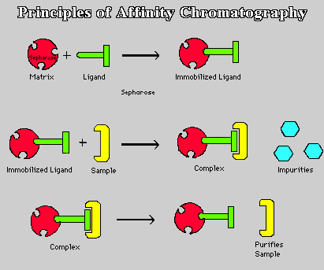

Slide 12


·
1) Inject a sample into an initially equilibrated affinity
chromatography column.
2) Only the substances with affinity for the ligand are
retained in the column.
3) Other substances with no affinity for the ligand are
eluted from the column.
4) The substances retained in the column can be
eluted from the column by changing pH or salt or
organic solvent concentration of the eluent.
Affinity chromatography is widely used as a means of
separation and purification with specific properties.
·
·
·

Slide 13



· Specificity is based on three aspect
affinity
of
Matrix: for ligand attachment.
Spacer arm: used to bind ligand to matrix
Ligand: molecule that binds reversibly to a
target molecule(site of interaction)
specific

Slide 14



· Hi-Trap Heparin HP (High performance)
· Column size: 5 × 1 mm, 1 × 5 mm, 5 × 5
mm
· Average particle diameter : 34μm
· Maximum operating flow rate: 4 ml/min
20 ml/min.

Slide 15



·
At 2-8 °C in an upright position
caps in place.
Thiomersal may be added for
storage.
DO NOT FREEZE
with both
·
long term
·
·
Application areas : purification, isolation
or removal of the following substances:
Anti-thrombin III and other coagulation
factors, lipoproteins, lipases, protein
synthesis factors

Slide 16

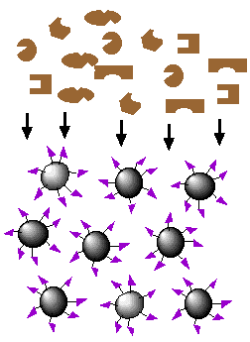
·
:Step-1 Attach ligand to column matrix
·
Binding of the selected ligand to the
matrix requires that a covalent bond be
formed between the two.
This is facilitated by derivatization of the
sugar residues' hydroxyl groups.
·
·
It is important to realize that the substrate
might not be able to reach the ligand
active site if it is hidden deep within the
ligand.
·
Most ligands are attached first to spacer
arms which are then bonded to the
matrix. The ligand-matrix gel is then
loaded into an elution column.

Slide 17

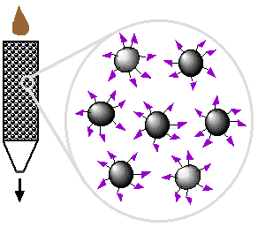
Once the column has been
prepared, the mixture containing
isolate is poured into the elution
column.
Gravity pulls the solution through the gel, because most of the proteins do not bind to the ligand-matrix complex.
When ligand is recognized substrate passes through the gel, it binds to the ligand-matrix complex, halting its passage through the gel.
Some of the impurities flow through the gel due to gravity, but most remain, unbound, in the gel column

Slide 18


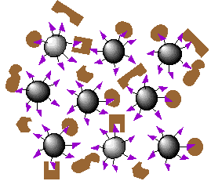
In order to remove these
unbound impurities, a wash
of extreme pH, salt
concentration, or
temperature is run through
the gel.
It is important to use a
strong wash so that all the
impurities are removed.
Once the impurities are
washed-out, the only
remaining part of the protein
mixture should be the
desired isolates.
·
·
·

Slide 19


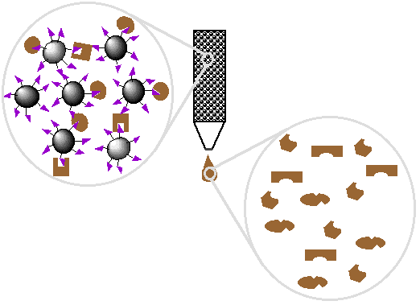
· Finally to collect isolate,
which is still bound to the ligand-matrix in the gel, a stronger second wash is run through the column.

Slide 20





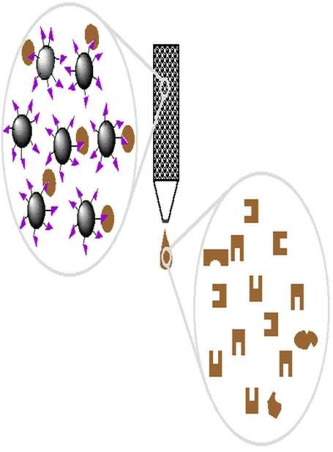
·
This second wash
relies on the reversible binding properties of the ligand, which allows
the bound protein to dissociate from its ligand in the presence of this
stronger wash.

Slide 21


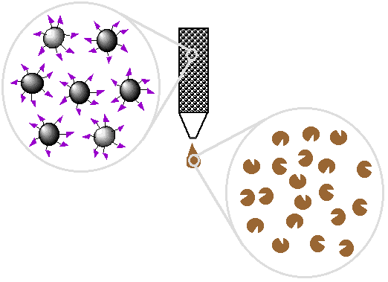
· The protein is then
free to run through the gel and be collected.

Slide 22


· Purify and concentrate a substance from a
mixture into a buffering solution.
· Reduce the amount of a substance in a
mixture.
· Purify and concentrate an enzyme solution.

Slide 23
· Used in Genetic Engineering
- nucleic acid purification
· Production of Vaccines
- antibody purification from blood serum
· And Basic Metabolic Research
- protein or enzyme purification from cell free extracts

Slide 24

Affinity chromatography is widely used in
the pharmaceutical industry to purify and
extract molecules of interest from complex
mixtures.
These molecules tend to be enzymes,
proteins or amino acids, but other
biological species can be selectively
retained.
Once isolated, these biological species can
be selectively amplified to produce larger
quantities, although at large
concentrations.
·
·
·

Slide 25


·
Hyper-lipidemia : here the sample is made
to pass through coloumn containing
antibody & plasma LDL so, it can easily
separated out by iluting with glycine
hydrochloride buffer (pH 3).
Others : Pregnancy test Allergy test Immuno assay Kinetic studies
Qualitative measurment of substrate.
be
·
·
·
·
·
·

Slide 26


1)
2)
3)
4)
Extremely high specificity
High degrees of purity can be obtained
The process is very reproducible
The binding sites of biological molecules
can be simply investigated

Slide 27

1)
2)
3)
4)
5)
6)
Expensive ligands
Leakage of ligand
Degradation of the solid support
Limited lifetime
Non-specific adsorption
Relatively low productivity

