Slide 1
ASSIGNMENT PROBLEM

Slide 2
INTRODUCTION TO ASSIGNMENT PROBLEM
An assignment problem is a particular case of transportation problem.
The objective is to assign a number of resources to an equal number of activities .
So as to minimize total cost or maximize total profit of allocation.
The problem of assignment arises because available resources such as men, machines etc. have varying degrees of efficiency for performing different activities, therefore, cost, profit or loss of performing the different activities is different.

Slide 3
Suppose that we have n jobs to be performed on m machines (one job to one machine).
Our objective is to assign the jobs to the machines at the minimum cost (or maximum profit).
Under the assumption that each machine can perform each job but with varying degree of efficiencies.

Slide 4
ASSIGMENT ALGORITHM (OR) HUNGARIAN METHOD
First check whether the number of rows is equal to number of columns, if it is so, the assignment problem is said to be balanced. Then proceed to step 1. If it is not balanced, then it should be balanced before applying the algorithm.
Step 1:
Subtract the smallest cost element of each row from all the elements in the row of the given cost matrix. See that each row contains atleast one zero.
Step 2:
Subtract the smallest cost element of each column from all the elements in the column of the resulting cost matrix obtained by step 1 and make sure each column contains atleast one zero

Slide 5
Step 3: (Assigning the zeros)
(a) Examine the rows successively until a row with exactly one unmarked zero is found. Make an assignment to this single unmarked zero by encircling it. Cross all other zeros in the column of this encircled zero, as these will not be considered for any future assignment. Continue in this way until all the rows have been examined.
(b) Examine the columns successively until a column with exactly one unmarked zero is found. Make an assignment to this single unmarked zero by encircling it and cross any other zero in its row. Continue until all the columns have been examined.

Slide 6
Step 4: (Apply Optimal Test)
(a) If each row and each column contain exactly one encircled zero, then the current assignment is optimal.
(b) If atleast one row or column is without an assignment (i.e., if there is atleast one row or column is without one encircled zero), then the current assignment is not optimal. Go to step 5. Subtract the smallest cost element of each column from all the elements in the column of the resulting cost matrix obtained by step 1 and make sure each column contains atleast one zero.

Slide 7
Step 5:
Cover all the zeros by drawing a minimum number of straight lines as follows:
(a) Mark the rows that do not have assignment.
(b) Mark the columns (not already marked) that have zeros in marked rows.
(c) Mark the rows (not already marked) that have assignments in marked columns.
(d) Repeat (b) and (c) until no more marking is required.
(e) Draw lines through all unmarked rows and marked columns. If the number of these lines is equal to the order of the matrix then it is an optimum solution otherwise not.

Slide 8
Step 6:
Determine the smallest cost element not covered by the straight lines. Subtract this smallest cost element from all the uncovered elements and add this to all those elements which are lying in the intersection of these straight lines and do not change the remaining elements which lie on the straight lines.
Step 7:
Repeat steps (1) to (6), until an optimum assignment is obtained.

Slide 9
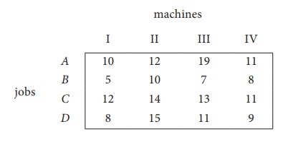
Example 1
Solve the following assignment problem. Cell values represent cost of assigning job A, B, C and D to the machines I II III and IV.

Slide 10
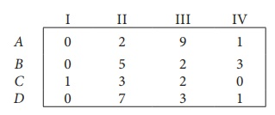
Solution:
Here the number of rows and columns are equal.
The given assignment problem is balanced. Now let us find the solution.
Step I :
Select a smallest element in each row and subtract this from all the elements in its row.

Slide 11
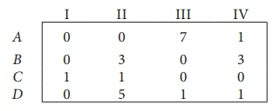
Step II:
Select the smallest element in each column and subtract this from all the elements in its column.
Since each row and column contains atleast one zero, assignments can be made.

Slide 12
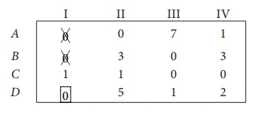
.
Step III :
Examine the rows with exactly one zero. First three rows contain more than one zero. Go to row D . There is exactly one zero . Mark that zero by ₹ (i.e.) job D is assigned to machine I.
Mark other zeros in its column by ⨯.

Slide 13
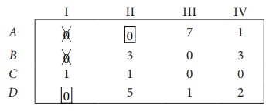
Step IV :
Now examine the columns with exactly one zero. Already there is an assignment in column I. Go to the column II. There is exactly one zero. Mark that zero by . Mark other zeros in its row by × .
Column III contains more than one zero. Therefore proceed to Column IV, there is exactly one zero. Mark that zero by . Mark other zeros in its row by × .

Slide 14
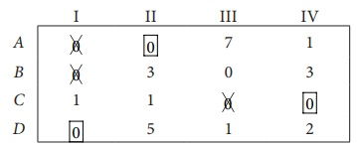
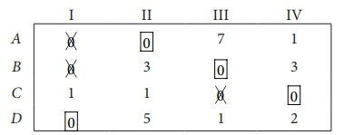
Step V :
Again examine the rows. Row B contains exactly one zero. Mark that zero by .

Slide 15
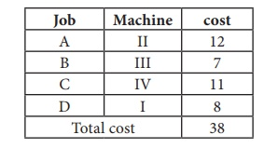
Thus all the four assignments have been made. The optimal assignment schedule and total cost is
The optimal assignment (minimum) cost
= ₹ 38

Slide 16
MCQ QUESTIONS WITH ANSWER
1. If the number of rows and columns in an assignment problem are not equal than it is called problem.
(a) prohibited
(b) infeasible
(c) unbounded
(d) unbalanced
2. The method of solution of assignment problems is called method.
(a) NWCR
(b) VAM
(c) LCM
(d) Hungarian

Slide 17
3. When a maximization assignment problem is converted in minimization problem, the resulting matrix is called
(a) Cost matrix
(b) Profit matrix
(c) Regret matrix
(d) Dummy matrix
4. The extra row or column which is added to balance an assignment problem is called
(a) regret
(b) epsilon
(c) dummy
(d) extra

Slide 18
5. When a particular assignment in the given problem is not possible or restricted as a condition, it is called a problem.
(a) infeasible
(b) degenerate
(c) unbalanced
(d) prohibited
6. If in an assignment problem, number of rows is not equal to number of columns then
(a) Problem is degenerate
(b) Problem is unbalanced
(c) It is a maximization problem
(d) Optimal solution is not possible

Slide 19
7. An assignment problem is considered as a particular case of a transportation problem because
The number of rows equals columns
All xij=0 or 1
All rim conditions are 1
All of the above
8. An optimal assignment requires that the maximum number of lines that can be drawn through squares with zero opportunity cost be equal to the number of
Rows or columns
Rows & columns
Rows + columns – 1
None of the above

Slide 20
9. While solving an assignment problem, an activity is assigned to a resource through a square with zero opportunity cost because the objective is to
Minimize total cost of assignment
Reduce the cost of assignment to zero
Reduce the cost of that particular assignment to zero
All of the above
10. The assignment problem
Requires that only one activity be assigned to each resource
Is a special case of transportation problem
Can be used to maximize resources
All of the above

Slide 21
11. The purpose of dummy row or column in an assignment problem is to
Obtain balance between total activities & total resources
Prevent a solution from becoming degenerate
Provide a means of representing a dummy problem
None of the above
12. An assignment problem can be solved by
Simplex method
Transportation method
Both a & b
None of the above

