Slide 1
AUTOIMMUNITY
Condition in which the body’s own immunologically competent cells or antibodies act against its self-antigens resulting in structural or functional damage.
Paul Ehrlich had first introduced the concept of autoimmunity; he termed this condition as “horror autotoxicus”.

Slide 2
AUTOIMMUNITY
Normally immune system does not react to its own antigens due to a protective mechanism called tolerance.
Any breach in tolerance mechanisms predispose to several autoimmune diseases.

Slide 3
IMMUNOLOGICAL TOLERANCE
State in which an individual is incapable of developing an immune response against his own tissue antigens.
Mediated by two broad mechanisms:
Central tolerance
Peripheral tolerance.

Slide 4
Central tolerance
Refers to the deletion of self-reactive T and B lymphocytes during their maturation in central lymphoid organs (i.e., in the thymus for T cells and in the bone marrow for B cells).
In thymus:
During the T cell development in thymus → any self-antigens are encountered → processed and presented by thymic antigen presenting cells (APCs) in association with self-MHC.
Any developing T cell that expresses a receptor for such self-antigen is negatively selected (i.e. deleted by apoptosis).

Slide 5
Central tolerance
In bone marrow: Self antigens are eliminated by
Receptor editing - process by which many of the B cells reactivate the machinery of antigen receptor gene rearrangement (mainly genes coding for light chains), so that a different (edited) B cell receptor will be produced which no longer recognizes the self-antigen.
Negative selection- If receptor editing fails, they undergo apoptosis.

Slide 6
Peripheral tolerance
Back-up mechanisms that occur in the peripheral tissues to counteract the self-reactive T cells that escape central tolerance.

Slide 7
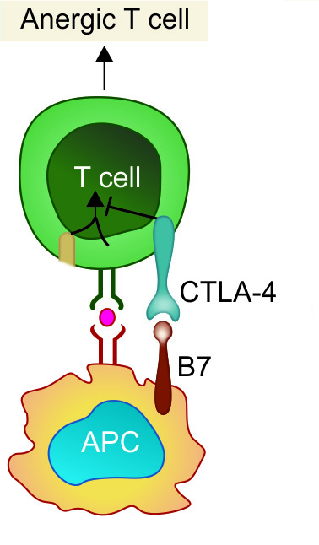
Peripheral tolerance - Mechanisms
Ignorance- Self-reactive T cells might never encounter the self-antigen which they recognize.
Anergy:
Defined as unresponsiveness to antigenic stimulus.
The self-reactive T cells interact with the APCs presenting the self antigen, but the co-stimulatory signal is blocked.
The B7 molecules on APC bind to CTLA-4 molecules on T cells instead of CD28 molecules.

Slide 8
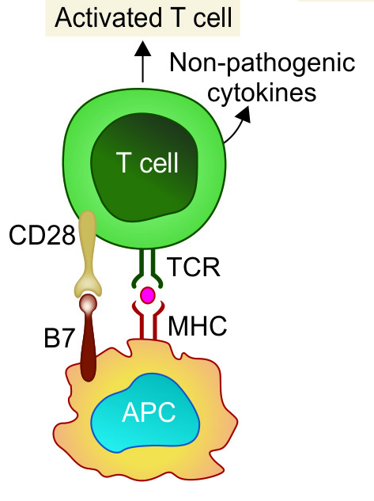
Peripheral tolerance
Phenotypic skewing:
Self-reactive T cells interacting with APCs presented with self-antigens, undergo full activation.
Secrete non-pathogenic cytokines and chemokine receptors profile.

Slide 9
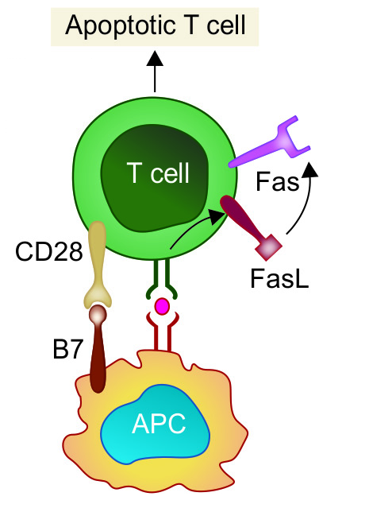
Peripheral tolerance
Apoptosis by AICD:
Activation-induced cell death
Activation of T cells induces upregulation of Fas ligand which subsequently interacts with the death receptor Fas leading to apoptosis.

Slide 10
Peripheral tolerance
Regulatory T cells (T_{reg} cells):
T_{reg} cells can down regulate the self-reactive T cells through secreting certain cytokines (e.g., IL-10 and transforming growth factor β [TGF-β]) or killing by direct cell to cell contact.
Dendritic cells (DCs):
Immature DCs and tolerogenic DCs capture the self-antigen for processing.
Down regulate the expression of molecules of co-stimulatory ligands such as CD40 and B7 molecules or act indirectly by induction of regulatory T cells.
Sequestration of self-antigen: Certain self-antigens can evade immune recognition by sequestration in immunologically privileged sites, e.g. corneal proteins, testicular antigens and antigens from brain.

Slide 11
MECHANISMS OF AUTOIMMUNITY
Breakdown of T-Cell Anergy: In the presence of tissue necrosis and local inflammation express co-stimulatory molecules (B7) .
Multiple sclerosis, rheumatoid arthritis and psoriasis
Failure of AICD- Failure of the auto reactive activated T cells to undergo activation induced cell death (AICD)
SLE (systemic lupus erythematosus)

Slide 12
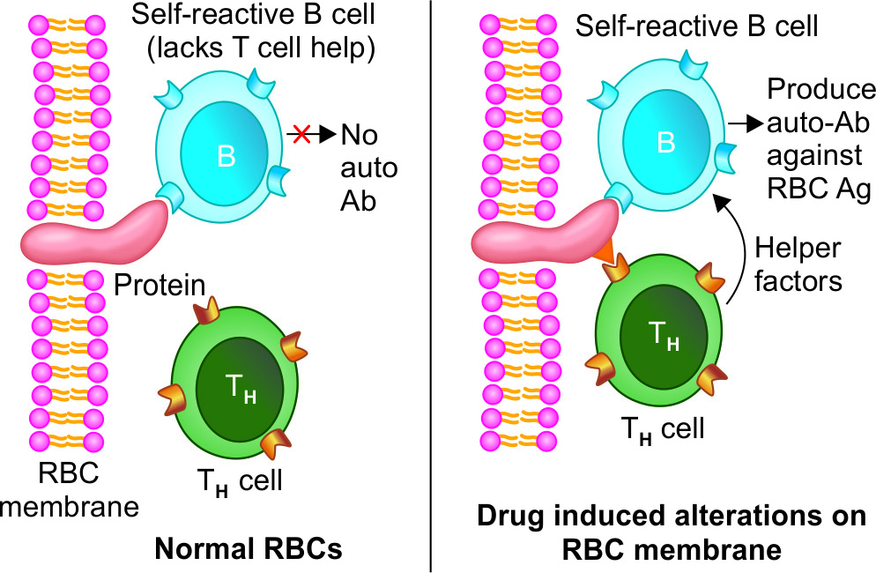
MECHANISMS OF AUTOIMMUNITY
Loss of T_{reg} cells.
Providing T cell help to stimulate self-reacting B cells:
Antibody response to self-antigens occurs only when potentially self-reactive B cells receive help from T cells.

Slide 13
MECHANISMS OF AUTOIMMUNITY
Release of Sequestered Antigens:
Sequestered antigens -never been exposed to the tolerance mechanisms during development of immune system.
Injury to the organs leads to release of such sequestered antigens which are very well capable of mounting an immune response.
Spermatozoa and ocular antigens release can cause post vasectomy orchitis and post-traumatic uveitis.

Slide 14
MECHANISMS OF AUTOIMMUNITY
Molecular Mimicry:
Some microorganisms share antigenic determinants (epitopes) with self-antigens.
Immune response against such microbes would produce antibodies that can cross-react with self-antigen.
Example: Acute rheumatic fever and multiple sclerosis (molecular mimicry involving T-cell epitopes).

Slide 15
MECHANISMS OF AUTOIMMUNITY
Polyclonal Lymphocyte Activation
Polyclonal T cell activation - Superantigens released from microbes (e.g. Staphylococcus aureus), polyclonally activate the T cells directly by binding to antigen non-specific Vβ region of T cell receptors.
Polyclonal B cell activation can be induced by products of various microbes such as Epstein Barr virus, HIV, etc.

Slide 16
MECHANISMS OF AUTOIMMUNITY
Bystander activation:
Nonspecific activation of bystander self-reactive T_{H}1 cells.
Leads to cytokine influx which causes an increased infiltration of various non-specific T cells at the site of infection.

Slide 17
AUTOIMMUNE DISEASES
Single Organ or Cell Type Autoimmune Diseases
Disease |  | Self-antigen present on | Type of immune response & Important features
Autoimmune anemias
 | Autoimmune hemolytic anemia | RBC membrane proteins | Auto-antibodies to RBC antigens triggers complement mediated lysis or antibody-mediated opsonization of the RBCs
 | Drug induced hemolytic anemia | Drugs alter the red cell membrane antigens | Drugs such as penicillin or methyldopa interact with RBCs so that the cells become antigenic
 | Pernicious anemia | Intrinsic factor (a membrane-bound protein on gastric parietal cells) | Auto-antibodies to intrinsic factor block the uptake of vitamin B 12; leads to megaloblastic anemia
Idiopathic Thrombocytopenic Purpura |  | Platelet membrane proteins (glycoproteins IIb-IIIa or Ib-IX) | Auto-antibodies against platelet membrane antigens leads to ↓platelet count

Slide 18
AUTOIMMUNE DISEASES
Single Organ or Cell Type Autoimmune Diseases
Disease | Self-antigen present on | Type of immune response & Important features
Goodpasture syndrome | Renal and lung basement membranes | Auto-antibodies bind to basement-membrane antigens on kidney glomeruli and the alveoli of the lungs followed by complement mediated injury leads to progressive kidney damage and pulmonary haemorrhage
Myasthenia gravis | Acetylcholine receptors | Blocking type of auto-antibody directed against Ach receptors present on motor nerve endings, leads to progressive weakening of the skeletal muscles
Graves’ disease | Thyroid-stimulating hormone (TSH) receptor | Anti TSH- auto-antibody (stimulates thyroid follicles, leads to hyperthyroid state)

Slide 19
AUTOIMMUNE DISEASES
Disease | Self-antigen present on | Type of immune response & Important features
Hashimoto’s thyroiditis | Thyroid proteins and cells | Auto-antibodies and T_{DTH} cells targeted against thyroid antigen leads to suppression of thyroid gland. Seen in middle aged females Hypothyroid state is produced (↓ production of thyroid hormones)
Post-streptococcal glomerulonephritis | Kidney | Streptococcal antigen- antibody complexes are deposited on glomerular basement membrane
Insulin-dependent diabetes mellitus | Beta cells present in islets of Langerhans of pancreas | T_{DTH} cells and auto-antibodies directed against pancreatic beta cells cause ↓ production of insulin

Slide 20
AUTOIMMUNE DISEASES
Single Organ or Cell Type Autoimmune Diseases
Systemic Autoimmune Diseases
Disease | Self-antigen present on | Type of immune response & Important features
Systemic lupus erythematosus | Auto-antibodies are produced against various tissue antigens such as DNA, nuclear protein, RBC and platelet membranes. | Age & sex- Women (20-40 years of age) are commonly affected; female to male ratio is-10:1. Immune complexes (self Ag- auto Ab) are formed; which are deposited in various organs Major symptoms- Fever, butterfly rash over the cheeks, arthritis, pleurisy, and kidney dysfunction

Slide 21
AUTOIMMUNE DISEASES
Single Organ or Cell Type Autoimmune Diseases
Systemic Autoimmune Diseases
Disease | Self-antigen present on | Type of immune response & Important features
Rheumatoid arthritis | Here, a group of auto-antibodies against the host IgG antibodies are produced called RA factor. It is an IgM antibody directed against the Fc region of IgG. ACPA (Anti citrullinated peptide antibodies) are also produced | Age & sex- Women (40-60 years of age) affected Auto-antibodies bind to circulating IgG, forming IgM-IgG complexes that are deposited in the joints and can activate the complement cascade. Major symptoms- Main feature-Arthritis (chronic inflammation of the joints, begins at synovium; most common joints involved are-small joints of the hands, feet and cervical spine) Other features-hematologic, cardiovascular, and respiratory systems are also frequently affected

Slide 22
AUTOIMMUNE DISEASES
Single Organ or Cell Type Autoimmune Diseases
Systemic Autoimmune Diseases
Disease | Self-antigen present on | Type of immune response & Important features
Sjögren syndrome | Ribonucleoprotein (RNP) antigens SS-A (Ro) and SS-B (La) present on salivary gland, lacrimal gland, liver, kidney, thyroid | Auto-antibodies to the RNP antigens SS-A (Ro) and SS-B (La); leads to immune-mediated destruction of the lacrimal and salivary glands resulting in dry eyes (keratoconjunctivitis sicca) and dry mouth (xerostomia)

Slide 23
AUTOIMMUNE DISEASES
Single Organ or Cell Type Autoimmune Diseases
Systemic Autoimmune Diseases
Disease | Self-antigen present on | Type of immune response & Important features
Scleroderma (Systemic Sclerosis) | Nuclear antigens such as DNA topoisomerase and centromere present in heart, lungs, GIT, kidney, etc | Helper T cell (mainly) and auto-antibody mediated. Excessive fibrosis of the skin, throughout the body Two types- 1.Diffuse scleroderma- Auto-antibodies against DNA topoisomerase I (anti-Scl 70) is elevated 2.Limited scleroderma- ↑Anticentromere antibody, characterized by CREST syndrome-calcinosis, Raynaud phenomenon, esophageal dysmotility, sclerodactyly, and telangiectasia

Slide 24
AUTOIMMUNE DISEASES
Single Organ or Cell Type Autoimmune Diseases
Systemic Autoimmune Diseases
Disease | Self-antigen present on | Type of immune response & Important features
Seronegative Spondyloarthropathies | Sacroiliac joints & other vertebrae Several types- Ankylosing spondylitis Reiter Syndrome Psoriatic Arthritis Spondylitis With Inflammatory Bowel Disease Reactive arthritis | Common characteristics- They present as rheumatoid arthritis like features, but differ from it by- Association with HLA-B27 Pathologic changes begin in the ligamentous attachments to the bone rather than in the synovium Involvement of the sacroiliac joints, and/or arthritis in other peripheral joints Absence of RFs (hence the name "seronegative") Auto-Ab and immune complex mediated

Slide 25
AUTOIMMUNE DISEASES
Single Organ or Cell Type Autoimmune Diseases
Systemic Autoimmune Diseases
Disease | Self-antigen present on | Type of immune response & Important features
Multiple sclerosis | Brain (white matter) | Self-reactive T cells produce characteristic inflammatory lesions in brain that destroys the myelin sheath of nerve fibers; leads to numerous neurologic dysfunctions

Slide 26
LABORATORY DIAGNOSIS OF AUTOIMMUNE DISEASES
Autoimmune diseases | Laboratory diagnosis
Autoimmune hemolytic anemias | Coombs test - red cells are incubated with an anti–human IgG antiserum → IgG auto-antibodies are present on the red cells, the cells are agglutinated by the antiserum
Goodpasture syndrome | Biopsies from patients are stained with fluorescent-labeled anti-IgG and anti-C3b reveal linear deposits of IgG and C3b along the basement membranes.

Slide 27
LABORATORY DIAGNOSIS OF AUTOIMMUNE DISEASES
Autoimmune diseases | Laboratory diagnosis
SLE (Systemic lupus erythematosus) | Detection of autoantibodies by indirect immunofluorescence assay (most widely used) and ELISA based techniques. ANA (antinuclear antibody)- Positive in >90% cases (screening test). Anti-double stranded DNA (dsDNA)-Highly specific (Confirmation). Anti-Sm antibodies Lupus band test- Direct immunofluorescence test - detect deposits of immunoglobulins and complement proteins in the patient's skin. LE cell test- No longer used because the LE cells are only found in 50–75% of SLE cases.

Slide 28
LABORATORY DIAGNOSIS OF AUTOIMMUNE DISEASES
Autoimmune diseases | Laboratory diagnosis
Scleroderma | Anti-Scl 70 antibody is raised, detected by indirect immunofluorescence assay
Sjögren’s syndrome | Detection of SS-A (or anti-Ro) and SS-B (or anti-La) antibodies by indirect immunofluorescence assay.

Slide 29
LABORATORY DIAGNOSIS OF AUTOIMMUNE DISEASES
Autoimmune diseases | Laboratory diagnosis
Rheumatoid arthritis | RA factor (by latex agglutination test)- RA factor is an IgM autoantibody directed against Fc portion of IgG, good sensitivity. False positive - seen in other autoimmune diseases. ACPA (Anti-citrullinated peptide antibodies) is an auto-antibody to citrullin protein. It is positive only in 67% of cases; but is highly specific. Rose-Waaler test to detect RA factor is of historical importance, no longer used now.

Slide 30
References
Text Book Of Medical Microbiology by Ananth
Narayan Paniker
Text Book Of Medical Microbiology by D R Arora
Text Book Of Medical Microbiology by A S Sastry
Text Book Of Medical Microbiology by Baweja
Text Book Of Medical Microbiology by Satish Gupte

