Slide 1
Chapter 1: Introduction

Slide 2
Database Management System (DBMS)

Slide 3
University Database Example

Slide 4
Drawbacks of using file systems to store data

Slide 5
Drawbacks of using file systems to store data (Cont.)

Slide 6
Levels of Abstraction

Slide 7
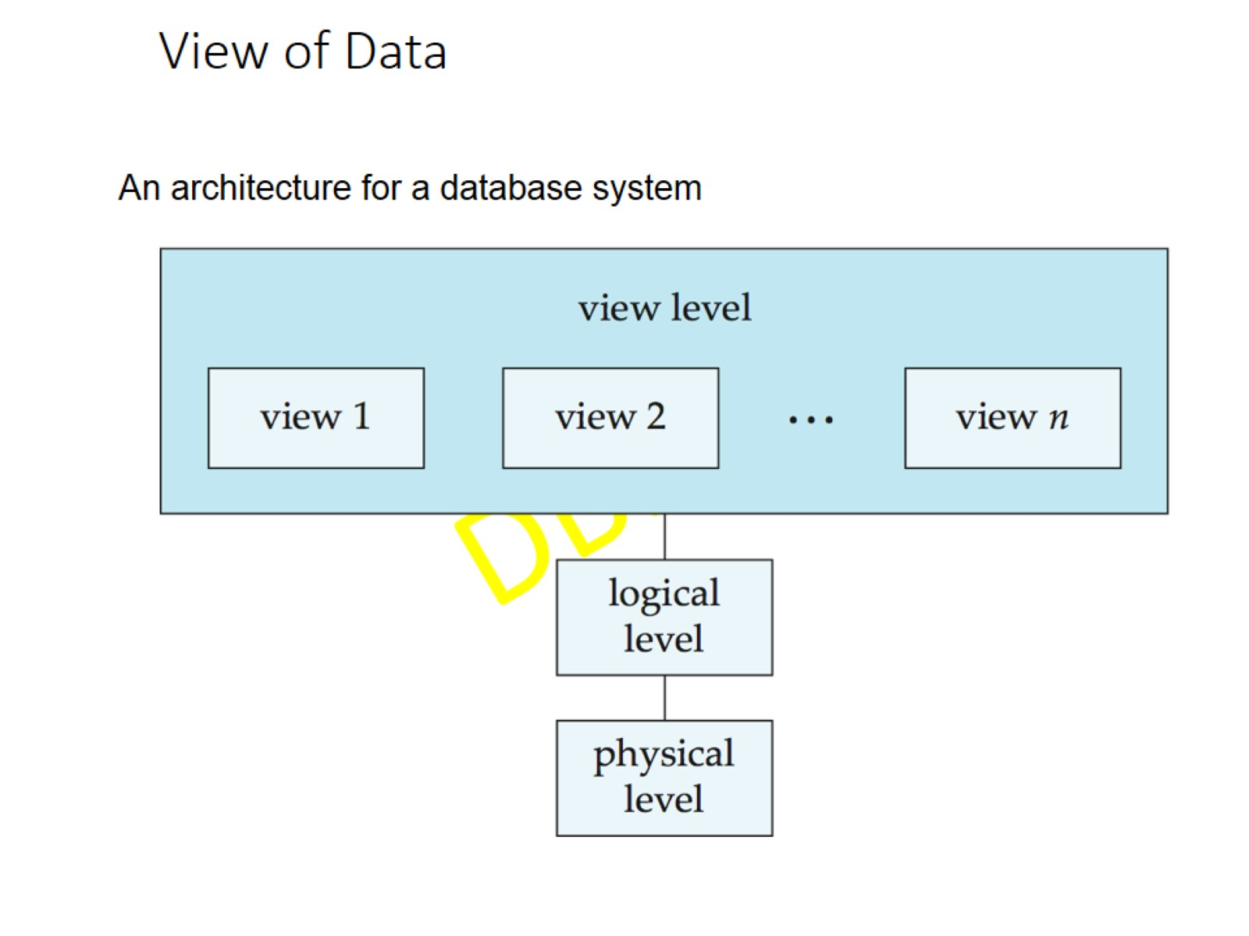
View of Data

Slide 8
Instances and Schemas

Slide 9
Data Models

Slide 10
Relational Model

Slide 11
A Sample Relational Database

Slide 12
Data Definition Language (DDL)

Slide 13
Data Manipulation Language (DML)

Slide 14
SQL

Slide 15
Database Design

Slide 16
Database Design (Cont.)

Slide 17
Design Approaches

Slide 18
Object-Relational Data Models

Slide 19
XML: Extensible Markup Language

Slide 20
Database Engine

Slide 21
Storage Management

Slide 22
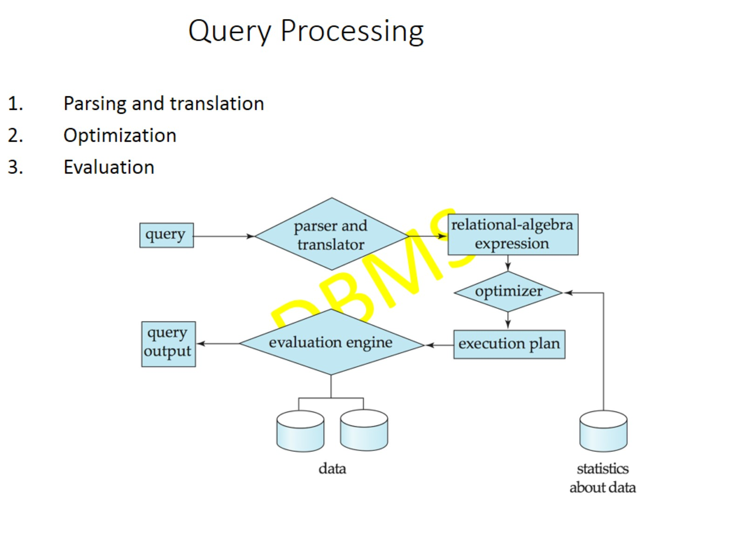
Query Processing

Slide 23
Query Processing (Cont.)

Slide 24
Transaction Management

Slide 25
Database Users and Administrators

Slide 26
Database System Internals

Slide 27
Database Architecture

Slide 28
History of Database Systems

Slide 29
History (cont.)

