Slide 1
Electronics circuits
Chopper amplifier

Slide 2
What is chopper amplifier?
A chopper amplifier is an electric circuit that implements a modulation methodology to minimize both the low-frequency noise signals and DC offset conditions in the op-amp.

Slide 3
How does a chopper amplifier work?
A chopper stabilized amplifier is an electronic circuit that employs a modulation technique to reduce or eliminate dc offset and low-frequency noise in op amps.
The chopping amplifier utilizes switches to chop or modulate the input signal.

Slide 4
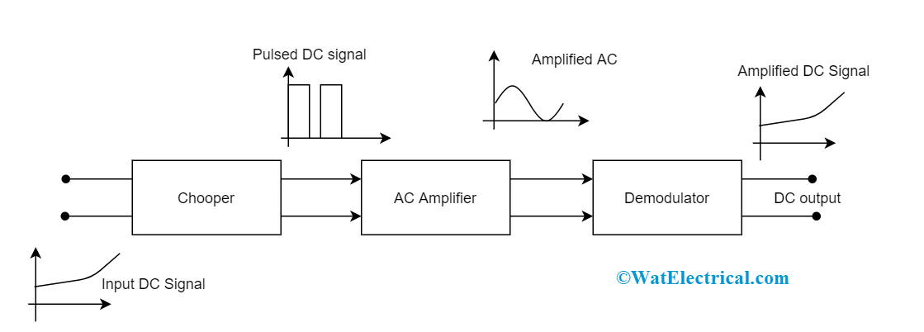
Block Diagram
The DC signal is fed to the first block of the circuit and it transforms it as AC signal. Then in the next block, amplification of the chopped AC signal is done and finally in the demodulator section AC signal is transformed to DC signal.

Slide 5
What are the applications of a chopper amplifier?
There are wide applications of chopper amplifiers and few of those are as follows:
These devices are utilized as battery chargers
Used in battery controlled electric cars
Implemented in railway tractions
Can be used for DC voltage amplification purposes
In brushless DC torque motors, chopper amplifiers are used as drivers and as stepper motors in the actuator devices
Also regulates the speed in DC motors
Operated as variable frequency drivers and class D type of electronic amplifiers
Converted capacitor filters
Used in the applications where a minimal range of voltages are necessary.

Slide 6
Why does it is called a chopper amplifier?
The amplifier circuit samples the analog signal.
So it is known as chopper amplifier. The chopper converts DC or low-frequency signal to high-frequency signal.
An AC amplifier amplifies the modulated high-frequency signal.

Slide 7
What are the advantages of chopper amplifier?
The most important advantage of this approach, as compared to the conventional chopper, consists in the cancellation of the amplifier input offset, low-frequency input noise components, and residual offsets due to input switching spikes, without requiring any low-pass filtering.

