Slide 1
Computer architecture unit 1
Presented By: SANTOSH PRASAD GUPTA

Slide 2
Content:
Introduction
CPU
Computer Registers
Instruction Execution Cycle
Register transfer and micro operation
Bus design
Interrupts in microprocessor
Memory reference instruction

Slide 3
Introduction: Computer Architecture and Computer Organization
Computer Architecture: Computer Architecture is a functional description of requirements and design implementation for the various parts of computer. It deals with functional behavior of computer system. It comes before the computer organization while designing a computer.
Architecture describes what the computer does.
Computer Organization: Computer Organization comes after the decide of Computer Architecture first. Computer Organization is how operational attribute are linked together and contribute to realise the architectural specification. Computer Organization deals with structural relationship.
Organization describes how it does it.

Slide 4
Differences between computer architecture and organization
Srno. | computer architecture | Computer organization
1 | Architecture describes what the computer does. | Organization describes how it does it.
2 | Computer Architecture deals with functional behavior of computer system. | Computer Organization deals with structural relationship.
3 | it deals with high-level design issue. | it deals with low-level design issue.
4 | Architecture indicates its hardware. | Where, Organization indicates its performance.
5 | Computer Architecture is also called as instruction set architecture. | Computer Organization is frequently called as micro architecture.
6 | Computer Architecture comprises logical functions such as instruction sets, registers, data types and addressing modes. | Computer Organization consists of physical units like circuit designs, peripherals and adders.

Slide 5
Central Processing Unit(CPU)
The full form of CPU is Central Processing Unit. Alternatively, it is also known by the name of processor, microprocessor or a computer processor. A CPU is an electronics circuit used in a computer that fetches the input instructions or commands from the memory unit, performs arithmetic and logic operations and stores this processed data back to memory.
A CPU or Central Processing Unit is the heart of a computer and is install in socket specified on a motherboard. Since a CPU performs a lot of calculations at a high speed, it gets heat up quickly.

Slide 6
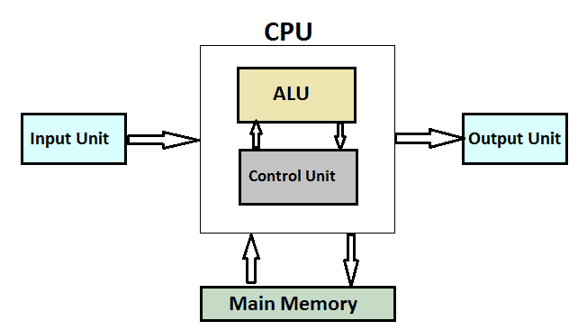
Components of a CPU

Slide 7
Cont…
Control Unit
The Control Unit is an internal part of a CPU that co-ordinates the instructions and data flow between CPU and other component of computer. It is the CU that directs the operations of a central processing unit by sending timing and control signals.
Arithmetic Logic Unit
The ALU is an internal electronic circuitry of a CPU that performs all the arithmetic and logical operations in a computer. The ALU receives three types of inputs.
Control signal from CU ( Control Unit )
Data(operands) to be operated
Status information from operations done previously.
When all the instructions have been operated, the output that consists of data is stored in memory and a status information is stored in internal registers of a CPU.

Slide 8
Cont..
Working of a CPU
All the CPUs regardless of their origin or type performs a basic instruction cycle that consists of three steps named Fetch, decode and Execute.
Fetch
A program consists of a number of instructions. Various programs are stored in memory. During this step, the CPU reads instruction that is to be operated from a particular address in the memory. The program counter of CPU keeps the record of address of the instructions.
Decode
A circuitry called instruction decoder decodes all the instructions fetched from the memory. The instructions are decoded to various signals that control other areas of CPU.
Execute
In the last step, the CPU executes the instruction. For example, it stores a value in the particular register and the instruction pointer then points to other instruction that is stored in next address location.

Slide 9
Computer Registers
Registers are a type of computer memory used to quickly accept, store, and transfer data and instructions that a being used immediately by the CPU. The registers used by the CPU are often termed as Processor registers.
A processor register may hold an instruction, a storage address, or any data (such as bit sequence or individual characters).
The computer needs processor registers for manipulating data and a register for holding a memory address. The register holding the memory location is used to calculate the address of the next instruction after the execution of the current instruction is completed.
Following is the list of some of the most common registers used in a basic computer:

Slide 10
Cont…
Register | Symbol | Number of bits | Function
Data register | DR | 16 | Holds memory operand
Address register | AR | 12 | Holds address for the memory
Accumulator | AC | 16 | Processor register
Instruction register | IR | 16 | Holds instruction code
Program counter | PC | 12 | Holds address of the instruction
Temporary register | TR | 16 | Holds temporary data
Input register | INPR | 8 | Carries input character
Output register | OUTR | 8 | Carries output character

Slide 11
Cont…
The following image shows the register and memory configuration for a basic computer.
11 0
11 0
15 0
15 0 15 0
7 0 7 0
15 0
Memory 4096 word 16 bits per word
PC
AR
IR
TR
DR
OUTR
INPR
AC

Slide 12
Cont….
The Memory unit has a capacity of 4096 words, and each word contains 16 bits.
The Data Register (DR) contains 16 bits which hold the operand read from the memory location.
The Memory Address Register (MAR) contains 12 bits which hold the address for the memory location.
The Program Counter (PC) also contains 12 bits which hold the address of the next instruction to be read from memory after the current instruction is executed.
The Accumulator (AC) register is a general purpose processing register.
The instruction read from memory is placed in the Instruction register (IR).
The Temporary Register (TR) is used for holding the temporary data during the processing.
The Input Registers (IR) holds the input characters given by the user.
The Output Registers (OR) holds the output after processing the input data.

Slide 13
Instruction Execution Cycle
All computers have an instruction execution cycle. A basic instruction execution cycle can be broken down into the following steps:
Fetch cycle
Execute cycle
Although we have been concentrating on the CPU and memory, there are additional components in a computer such as the I/O modules which can interact with the processor. In an improved instruction execution cycle, we can introduce a third cycle known as the interrupt cycle. Figure 2 illustrates how the interrupt cycle fits into the overall cycle.

Slide 14
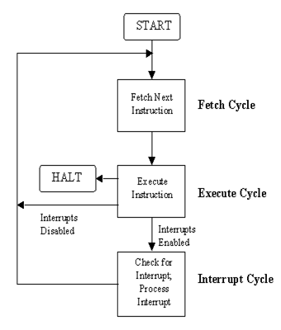
Cont…

Slide 15
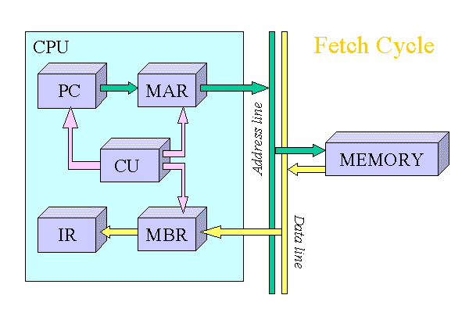
Fetch cycle
To start off the fetch cycle, the address which is stored in the program counter (PC) is transferred to the memory address register (MAR). The CPU then transfers the instruction located at the address stored in the MAR to the memory buffer register (MBR) via the data lines connecting the CPU to memory. This transfer from memory to CPU is coordinated by the control unit (CU). To finish the cycle, the newly fetched instruction is transferred to the instruction register (IR) and unless told otherwise, the CU increments the PC to point to the next address location in memory.

Slide 16
Cont….
The illustrated fetch cycle above can be summarized by the following points:
PC => MAR
MAR => memory => MBR
MBR => IR
PC=PC+1
After the CPU has finished fetching an instruction, the CU checks the contents of the IR and determines which type of execution is to be carried out next. This process is known as the decoding phase. The instruction is now ready for the execution cycle.

Slide 17
Execution cycle
Once an instruction has been loaded into the instruction register (IR), and the control unit (CU) has examined and decoded the fetched instruction and determined the required course of action to take, the execution cycle can commence. Unlike the fetch cycle and the interrupt cycle, both of which have a set instruction sequence, the execute cycle can comprise some complex operations (commonly called opcodes).
The actions within the execution cycle can be categorized into the following four groups:
CPU - Memory: Data may be transferred from memory to the CPU or from the CPU to memory.
CPU - I/O: Data may be transferred from an I/O module to the CPU or from the CPU to an I/O module.
Data Processing: The CPU may perform some arithmetic or logic operation on data via the arithmetic-logic unit (ALU).
Control: An instruction may specify that the sequence of operation may be altered. For example, the program counter (PC) may be updated with a new memory address to reflect that the next instruction fetched, should be read from this new location.
For simplicity reasons, the following examples will deal with two operations that can occur. The [LOAD ACC, memory] and

Slide 18
Conti…
[ADD ACC, memory], both of which could be classified as memory reference instructions. Instructions which can be executed without leaving the CPU are referred to as non-memory reference instructions.
LOAD ACC, memory
This operation loads the accumulator (ACC) with data that is stored in the memory location specified in the instruction. The operation starts off by transferring the address portion of the instruction from the IR to the memory address register (MAR). The CPU then transfers the instruction located at the address stored in the MAR to the memory buffer register (MBR) via the data lines connecting the CPU to memory. This transfer from memory to CPU is coordinated by the CU. To finish the cycle, the newly fetched data is transferred to the ACC.
1 The illustrated LOAD operation (Figure 4) can be summarized in the following points:
2 IR [address portion] => MAR
3 MAR => memory => MBR
4 MBR => ACC

Slide 19
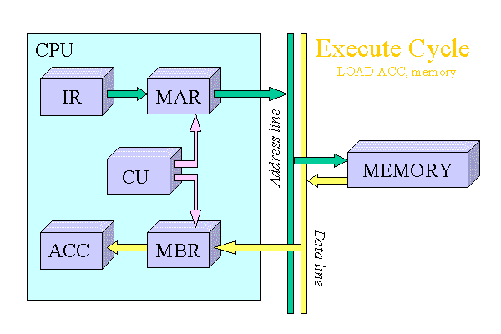
Cont..

Slide 20
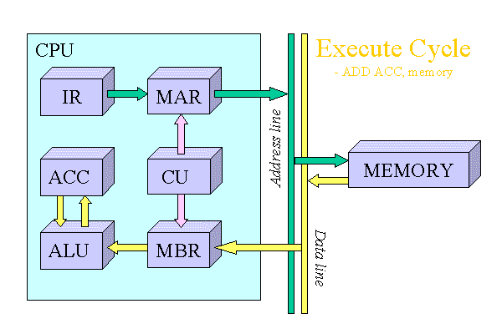
ADD ACC, memory
This operation adds the data stored in the ACC with data that is stored in the memory location specified in the instruction using the ALU. The operation starts off by transferring the address portion of the instruction from the IR to the MAR. The CPU then transfers the instruction located at the address stored in the MAR to the MBR via the data lines connecting the CPU to memory. This transfer from memory to CPU is coordinated by the CU. Next, the ALU adds the data stored in the ACC and the MBR. To finish the cycle, the result of the addition operation is stored in the ACC for future use.
The illustrated ADD operation (Figure 5) can be summarised in the following points:
1 IR [address portion] => MAR
2 MAR => memory => MBR
3 MBR + ACC => ALU
4 ALU => ACC

Slide 21
After the execution cycle completes, if an interrupt is not dedect, the next instruction is fetched and the process starts all over again.
Interrupt Cycle
An interrupt can be described as a mechanism in which an I/O module etc., can break the normal sequential control of the central processing unit (CPU). Table 1 below, summarizes the most common form of interrupts that the CPU can receive.
The main advantage of using interrupts is that the processor can be engaged in executing other instructions while the I/O modules connected to the computer are engaged in other operations.

Slide 22
Cont..
Program | Generated by some condition that occurs as a results of an instruction execution, such as arithmetic overflow, division by zero, attempt to execute am illegal machine instruction, and reference outside a user's allowed memory space.
Timer | Generated by a timer within the processor. This allows the operating system to perform certain functions on a regular basis.
I/O | Generated by an I/O controller, to signal normal completion of an operation or to signal a variety of error conditions.
Hardware failure | Generated by a failure such as power failure or memory parity error.

Slide 23
Cont..
Up until now we have dealt with the instruction execution cycle on the hardware level. When interrupts are introduced, the CPU and the operating system driving the system, is responsible for the suspension of the program
currently being run, as well as restoring that program at the same point before the interrupt was detected. To handle this, an interrupt handler routine is executed. This interrupt handler is usually built into the operating system.
Before the interrupt handler routine can ran, several processes must occur first. A typical sequence of events is illustrated in Figure 6 below. After the completion of the interrupt handler routine, the normal sequencial fetch / execute cycle begins.

Slide 24
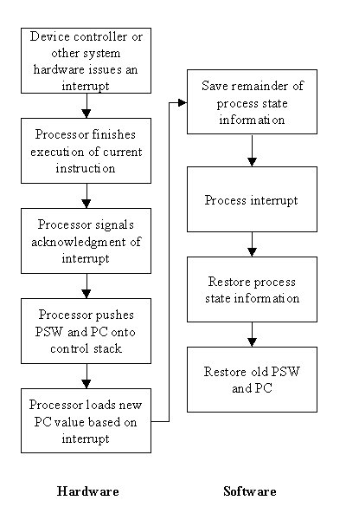
Cont..

Slide 25
Register transfer and micro operation
In symbolic notation, it is used to describe the micro-operations transfer among registers. It is a kind of intermediate representation (IR) that is very close to assembly language, such as that which is used in a compiler. The term “Register Transfer” can perform micro-operations and transfer the result of operation to the same or other register.
Micro-operations : The operation executed on the data store in registers are called micro-operations. They are detailed low-level instructions used in some designs to implement complex machine instructions.
Register Transfer : The information transformed from one register to another register is represented in symbolic form by replacement operator is called Register Transfer.
Replacement Operator : In the statement, R2 <- R1, <- acts as a replacement operator. This statement defines the transfer of content of register R1 into register R2.

Slide 26
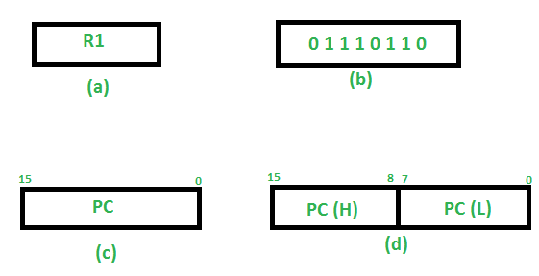
Cont..
There are various methods of RTL –
1 General way of representing a register is by the name of the register inclosed in a rectangular box as shown in (a).
2 Register is numbered in a sequence of 0 to (n-1) as shown in (b).
3 The numbering of bits in a register can be marked on the top of the box as shown in (c).
4. A 16-bit register PC is divided into 2 parts- Bits (0 to 7) are assigned with lower byte of 16-bit address and bits (8 to 15) are assigned with higher bytes of 16-bit address as shown in (d)

Slide 27
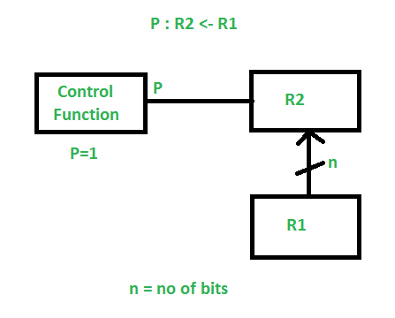
Cont..

Slide 28
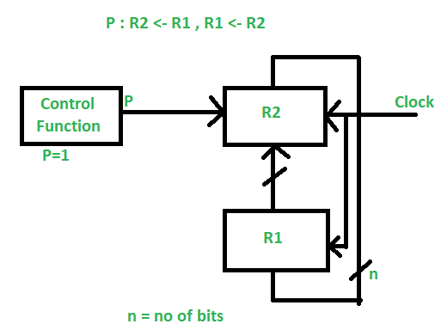
Cont..
It indicates that if P=1, then the content of R1 is transferred to R2. It is a unidirectional operation.
Simultaneous Operations – If 2 or more operations are to occur simultaneously then they are separated with comma (,).
If the control function P=1, then load the content of R1 into R2 and at the same clock load the content of R2 into R1.

Slide 29
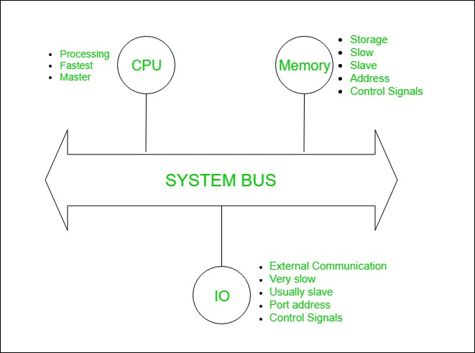
Bus design
System Bus Design
Bus is a communication channel.
Characteristic of bus is shared transmission media.
Limitation of a bus is only one transmission at a time.
A bus which is used to provide the communication between the major components of a computer is called as System bus.

Slide 30
Cont..
System bus contains 3 categories of lines used to provide the communication between the CPU, memory and IO named as:
Address lines (AL)
Data lines (DL)
Control lines (CL)
1. Address Lines:
Used to carry the address to memory ad IO.
Unidirectional.
Based on width of a address bus we can determine the capacity of a main memory
Example:

Slide 31
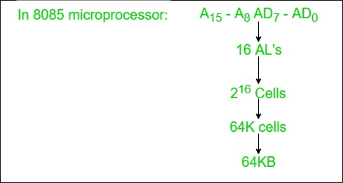
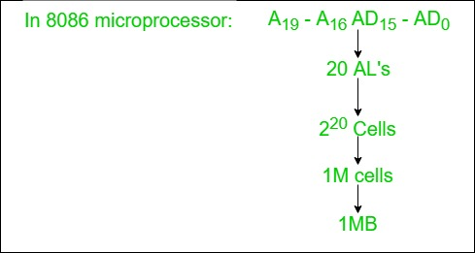
Cont..

Slide 32
2. Data Lines:
Used to carry the binary data between the CPU, memory and IO.
Bidirectional.
Based on the width of a data bus we can determine the word length of a CPU.
Based on the word length we can determine the performance of a CPU.
Example:

Slide 33
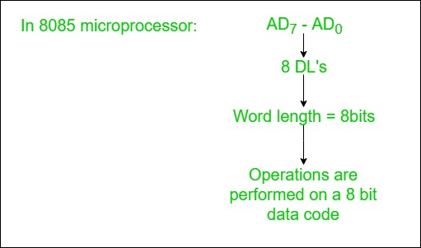
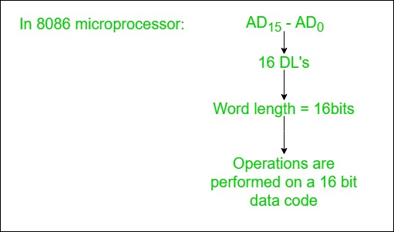
Cont..

Slide 34
3. Control Lines:
Used to carry the control signals and timing signals
Control signals indicates type of operation.
Timing Signals used to synchronize the memory and IO operations with a CPU clock.

Slide 35
Interrupts in microprocessor
An interrupt is a condition that halts the microprocessor temporarily to work on a different task and then return to its previous task. Interrupt is an event or signal that request to attention of CPU. This halt allows peripheral devices to access the microprocessor.
Whenever an interrupt occurs the processor completes the execution of the current instruction and starts the execution of an Interrupt Service Routine (ISR) or Interrupt Handler. ISR is a program that tells the processor what to do when the interrupt occurs. After the execution of ISR, control returns back to the main routine where it was interrupted.

Slide 36
Cont…
In 8086 microprocessor following tasks are performed when microprocessor encounters an interrupt:
The value of flag register is pushed into the stack. It means that first the value of SP (Stack Pointer) is decremented by 2 then the value of flag register is pushed to the memory address of stack segment.
The value of starting memory address of CS (Code Segment) is pushed into the stack.
The value of IP (Instruction Pointer) is pushed into the stack.
IP is loaded from word location (Interrupt type) * 04.
CS is loaded from the next word location.
Interrupt and Trap flag are reset to 0.

Slide 37
Cont…
The different types of interrupts present in 8086 microprocessor are given by:
Hardware Interrupts – Hardware interrupts are those interrupts which are caused by any peripheral device by sending a signal through a specified pin to the microprocessor. There are two hardware interrupts in 8086 microprocessor. They are:
(A) NMI (Non Maskable Interrupt) – It is a single pin non maskable hardware interrupt which cannot be disabled. It is the highest priority interrupt in 8086 microprocessor. After its execution, this interrupt generates a TYPE 2 interrupt. IP is loaded from word location 00008 H and CS is loaded from the word location 0000A H.
(B) INTR (Interrupt Request) – It provides a single interrupt request and is activated by I/O port. This interrupt can be masked or delayed. It is a level triggered interrupt. It can receive any interrupt type, so the value of IP and CS will change on the interrupt type received.

Slide 38
Cont…
Software Interrupts – These are instructions that are inserted within the program to generate interrupts. There are 256 software interrupts in 8086 microprocessor. The instructions are of the format INT type where type ranges from 00 to FF. The starting address ranges from 00000 H to 003FF H. These are 2 byte instructions. IP is loaded from type * 04 H and CS is loaded from the next address give by (type * 04) + 02 H. Some important software interrupts are:
(A) TYPE 0 corresponds to division by zero(0).
(B) TYPE 1 is used for single step execution for debugging of program.
(C) TYPE 2 represents NMI and is used in power failure conditions.
(D) TYPE 3 represents a break-point interrupt.
(E) TYPE 4 is the overflow interrupt.

Slide 39
Memory reference instruction
The basic computer has 16-bit instruction register (IR) which can denote either memory reference or register reference or input-output instruction.
Memory Reference – These instructions refer to memory address as an operand. The other operand is always accumulator. Specifies 12-bit address, 3-bit opcode (other than 111) and 1-bit addressing mode for direct and indirect addressing.
Example – IR register contains = 0001XXXXXXXXXXXX, i.e. ADD after fetching and decoding of instruction we find out that it is a memory reference instruction for ADD operation.
Hence, DR ← M[AR] AC ← AC + DR, SC ← 0

