Slide 1
Consumer Surplus
Dr. Pooja Singh Assistant Professor, Department of Economics, School of Arts ,Humanities And Social Sciences, Chhatrapati Shahu Ji Maharaj University, Kanpur

Slide 2
Consumer Surplus
Consumer Surplus
Consumer surplus is an economic measurement of consumer benefits.
A consumer surplus happens when the price that consumers pay for a product or service is less than the price they are willing to pay.
It's a measure of the additional benefit that consumers receive because they're paying less for something than what they were willing to pay.

Slide 3
Consumer Surplus
Assumptions-
Marginal utility of money for the consumer is assumed to be the same throughout the process of exchange.
Commodity does not have substitutes.
In the market as the given point of time there are no differences of income, tastes, preferences and fashions among the consumers.

Slide 4
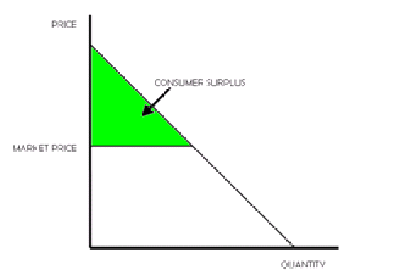
Consumer Surplus
Units of Coffee | Marginal Utility (Price Willing to Pay) | Market Price | Consumer’s Surplus
1st | 20 | 5 | 15
2st | 15 | 5 | 10
3st | 10 | 5 | 5
4st | 5 | 5 | 0

Slide 5
References
Dwivedi D N, Managerial Economics, Vikas Publishing House Pvt. Ltd, 2006

