Slide 1
ELECTROPHORESIS
Zone
1. Paper
2. Gel
Moving Boundary
3. Capillary
Iso electric
https://microbenotes.com/agarose-gel-electrophoresis/

Slide 2
THEORY OF ELECROPHORESIS
INTRODUCTION:
Electrophoresis is a physical method of analysis which
involves separation of the compounds that are capable of
acquiring electric charge in conducting electrodes.
DEFINITION:
• migration of the charged particle through a solution under the influence of an external electrical field.
• Ions that are suspended between two electrodes tends to trave₃l towards the electrodes that bears opposite charges.

Slide 3
TYPES OF ELECTROPHORESIS
Zone Electrophoresis
a) Paper Electrophoresis
b) Gel Electrophoresis
c) Thin Layer Electrophoresis
d) Cellulose acetate Electrophoresis
1
migration of the charged particle on the supporting media
2)
Moving Boundary
a) Capillary Electrophoresis
b) Isotachophoresis
c) Isoelectric Focussing
d) Immuno Electrophoresis
Electrophoresis
charged species migrate in a free moving solution without supporting medium
4

Slide 4
TYPES OF ELECTROPHORESIS
Zone Electrophoresis
Paper E
Gel E
Moving Boundary Electrophoresis
Iso tacho-phoresis
Cellulose Acetate E
Capillary E
Isoelectric
Focussing
Immuno E

Slide 5
PRINCIPLE
Any charged ion or molecule migrates when placed in an electric field.
The rate of migration depend upon its net charge, size, shape and the applied electric current.
• It can be represented by following equation: 𝑣 = 𝐸𝑞 ⁄ 𝐹
where, v = velocity of migration of the molecule
E = electric field (in volts/cm)
q = net electric charge on the molecule.
F = frictional co-efficient (depends upon the mass and shape of the molecule).
• The movement of charged particle in an electric field is expressed in terms of electrophoretic mobility denoted by ‘µ’,
where 𝜇 = 𝑣 𝐸 or 𝜇 = 𝑞 𝐹
• For molecules with similar conformation, 𝐹 varies with size but not with shape. Thus electrophoretic mobility (µ) of a molecule is directly proportional to the charge density (charge/mass ratio).

Slide 6
ZONE ELECTROPHORESIS
▪ It involves the migration of the charged particle on the supporting media.
Paper, Cellulose acetate membrane, Starch Gel, Poly acrylamide.
▪ Components separated are distributed into discrete zone on the support media.
▪ Supporting media is saturated with buffer solution, small volume of the sample is applied as narrow band.
▪ On application of PD at the ends of a strip,
its electrophoretic mobility.
components
migrates
at
a
rate
determined
by
ADVANTAGES:
○ Useful in biochemical investigations.
○ Small quantity of sample can be analysed.
○ Cost is low and easy maintenance.
DISADVANTAGES:
○ Unsuitable for accurate mobility and isoelectric point determination.
5
○ Due to the presence of supporting medium, technical complications such as capillary
flow, electro osmosis, adsorption and molecular sieving are introduced.

Slide 7
Saturation of the medium with the buffer.
Sample application.
Electrophoretic separation.
Removal of the supporting media.
○ Electrophoretic chamber.
○ Electrodes.
○ Diffusion barriers.
○ Supporting/ Stabilizing media.
(inert to sample and to any developing reagents).
6

Slide 8
PAPER
ELECTROPHORESIS
1.
Horizontal paper Electrophoresis
2.
Vertical paper Electrophoresis
7

Slide 9
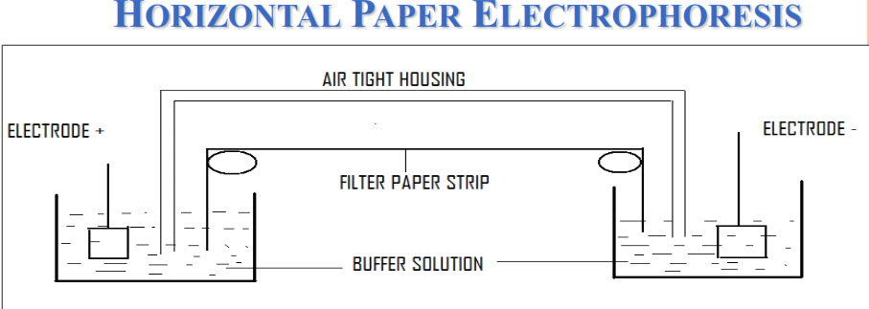
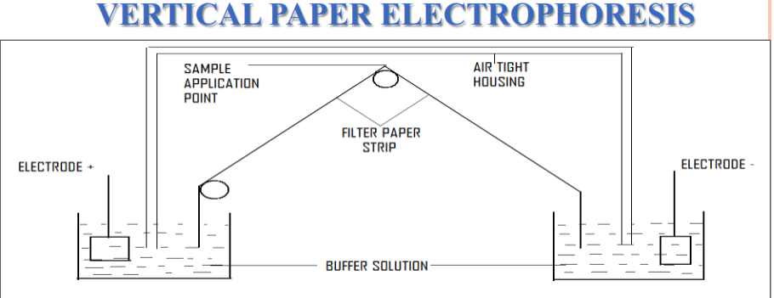

Slide 10
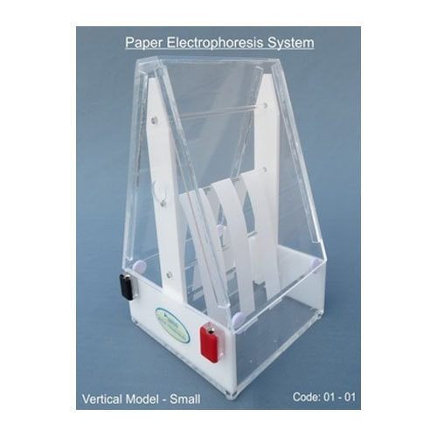

Slide 11
Filter paper: Paper of good quality should contain at least 95% α-cellulose and should have only a very slight adsorption capacity.
Apparatus: The equipment required for electrophoresis consists basically of two items, a POWER PACK and an ELECTROPHORETIC CELL.
Power pack provides a
stabilized direct current & has controls for both voltage & current out put, which have an out put of 0 to 500V and 0 to 150mA are available.
The Electrophoretic cell contains the electrodes, buffer reservoirs, a support for paper and a supporting transparent insulating cover. The electrodes are usually made of platinum.
The two arrangements of the filter strips are commonly used.
The horizontal & vertical arrangements.

Slide 12
Sample application: The sample may be applied as a spot (about 0.5cm
in diameter)
or as a narrow uniform streak. Special devices are available commercially for this purpose. The sample can be applied before the paper has been equilibrated with buffer (or) after it. Procedure: Apply sample
Equilibrate the paper with the buffer.
Switch on current

Slide 13
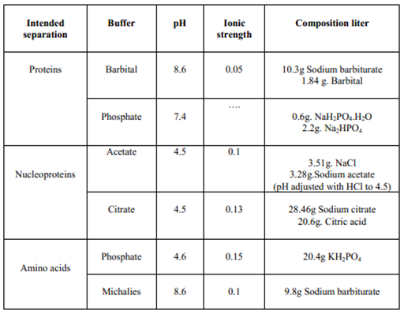
Commonly used buffers are

Slide 14
Detection & Quantitative assay: To identify the unknown electrophorogram, compare the Unknown electogram with standard electrogram under standard conditions.
Individual compounds are usually identified by physical properties by the following methods. Fluorescence: a) Staining with “Ethidium bromide” and subsequent visualization of the
electrophoreticgram under UV light makes DNA & RNA fluoresce and thus facilitates their detection.
b) Flourescamine staining is utilized for detecting amino acids, amino acid derivatives, peptides & proteins.
c) DANSYL chloride may be used in place of fluorescamine.
ii) UV absorption: Proteins, Peptides & nucleic acids absorb in the range of 260 to 280nm, by this property these can be detect.
iii) Staining:

Slide 15
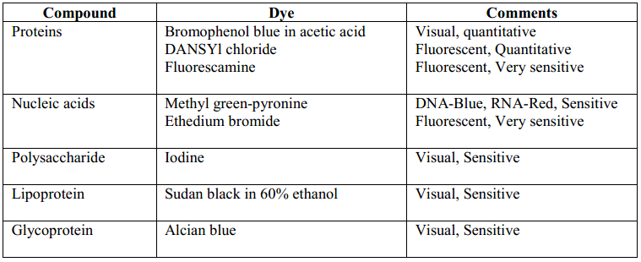

Slide 16
iv) Detection of Enzymes in situ: If the component to be separated is an enzyme. Special techniques may be used to detect it.
The paper strip, which have separated enzyme, is impregnated with the substrate for the enzyme desired to be separated.
The paper strip is now placed in a suitable buffer along with electrophoretogram. The color bands will appear which indicates the position of enzyme.
v) Quantitative estimation: The color density of the zone may be multiplied with the area of the zone and the resulting value would be a rough estimate of the concentration of the component.
Applications: Serum analysis for diagnostic purpose is routinely carried about by paper electrophoresis.
Muscle proteins, egg white proteins, milk proteins & snake, insect venom analysis done by this technique.

Slide 17
○ Filter paper such as Whatmann no1
wide have been used to good effect.
and
no
3mm
in
strip
of
3
or
5cm
○ Separation takes place
in
12
to
14hrs.
ADVANTAGES:
○ It is economical.
○ Easy to use.
DISADVANTAGES:
○ Certain compounds such
as proteins,
hydrophilic molecules cannot be
resolved due to the adsorptive and ionogenic properties of paper which
results in tailing and distortion of component bands.
9
○ Electro osmosis.

Slide 18
GEL ELECTROPHORESIS
• Technique used for the separation of Deoxyribonucleic acid, Ribonucleic acid or protein molecules according to their size and electrical charge using an electric current applied to a gel matrix.
• What is a gel?
Gel is a cross linked polymer whose composition and porosity is chosen based on the specific weight and porosity of the target molecules.
• Types of gels used: Polyacrylamide gel, Agarose gel.
Gel Electrophoresis
1-D
SDS-PAGE
Isoelectric focusing
2 D
Separates proteins by isoelectric point in the first dimension and by mass in the second dimension.
Native PAGE

Slide 19
1-D GEL ELECTROPHORESIS : PROCEDURE
The samples are treated with SDS (sodium dodecyl sulfate), an anionic detergent which denatures the protein by breaking the disulfide bonds and gives negative charge to each protein in proportion to its mass.
Without SDS, different proteins with similar molecular weights would migrate differently due to differences in folding, as differences in folding patterns would cause some proteins to better fit through the gel matrix than others. SDS linearizes the proteins so that they may be separated strictly by molecular weight.
The SDS binds to the protein in a ratio of approximately 1.4 g SDS per 1.0 g giving an approximately uniform mass : charge ratio for most proteins, so that the distance of migration through the gel can be assumed to be directly related to only the size of the protein.
Proteins may be further treated with reducing agent, such as dithiothreitol (DTT) or TRP (Tributyl phosphine) to break any reformed disulfide bonds and then alkylated with iodoacetamide to prevent reformation of disulfide bonds.
A tracking dye like bromophenol blue may be added to the protein solution to track the progress of the protein solution through the gel during the electrophoretic run.

Slide 20
POLYACRYLAMIDE GEL
• The gel used for SDS-PAGE is made of acrylamide which form cross-linked polymers of polyacrylamide.
• Standard gels are typically composed of two layers, one top-most layer called the stacking gel and a lower layer called separating or resolving gel.
• The stacking layer contains a low percentage of acrylamide and has low pH , while the acrylamide concentration of the separating gel varies according to the samples to be run and has higher pH.
• The difference in pH and acrylamide concentration at the stacking and separating gel provides better resolution and sharper bands in the separating gel.
• This gel material can also withstand high voltage gradients, is amenable to various staining and destaining procedures, and can be digested to extract separated fractions or dried for autoradiography and permanent recording.

Slide 21
STACKING & RESOLVING GELS
• Stacking gel:
The stacking gel is a large pore PAG (4%). This gel is prepared with Tris/HCl buffer pH 6.8 of about 2.0 pH units lower than that of electrophoresis buffer (Tris/Glycine).
This gel is cast over the resolving gel. The height of the stacking gel region is always maintained more than double the height and the volume of the sample to be applied.
• Resolving gel:
The resolving gel is a small pore PAG (3 -30% acrylamide monomer) typically made using a pH 8.8 Tris/HCl buffer.
In the resolving gel, macromolecules separate according to their size. Resolving gels have an optimal range of separation that is based on the % of monomer present in the polymerization reaction.

Slide 22
2-D GEL ELECTROPHORESIS
• Two-dimensional gel electrophoresis, abbreviated as 2-DE or 2-D electrophoresis, form of gel electrophoresis used to analyze proteins.
Mixtures of proteins are separated by two properties in two dimensions on 2D gels.
• 2-DE was first introduced by O'Farrell and Klose in 1975.
• 2-D electrophoresis begins with 1-D electrophoresis but then separates the molecules by a second property in a direction 90 degrees from the first.
In 1-D electrophoresis, proteins (or other molecules) are separated in one dimension, so that all the proteins/molecules will lie along a lane but that the molecules are spread out across a 2-D gel. Because it is unlikely that two molecules will be similar in two distinct properties, molecules are more effectively separated in 2-D E than in 1-D electrophoresis.
• The 2D E proteins are separated BY using isoelectric pointand protein mass.
• Common techniques of 2-DE:
IPG(immobilized pH gradient) IEF SDS-PAGE

Slide 23
COMPONENTS OF SDS-PAGE:
The components of an SDS PAGE gel electrophoresis system are the following:
A Slab holder for vertical or horizontal gels (thin, flat sheets of many individual lanes)
Polyacrylamide or agarose gels (cm x cm x mm); these are poured for each analysis
Gel is amended with SDS to dissociate & charge proteins.
High voltage power supply (0.1-6 kV)
A detection technique (dye staining, fluorescence, or autoradiography to image separated bands)
SDS-PAGE stands for Sodium Dodecyl Sulfate Poly-Acrylamide Gel Electrophoresis. Sodium- Dodecyl Sulfate, (“SDS”), is an anionic detergent. It is composed of a hydrophilic group with a net negative charge and a long hydrophobic chain with neutral charge.
SAMPLE PREPARATION:
Samples may be any material containing proteins or nucleic acids. These may be biologically derived, for example from prokaryotic or eukaryotic cells, tissues, viruses, environmental samples, or purified proteins.

Slide 24
In the case of solid tissues or cells, these are often first broken down mechanically using a blender (for larger sample volumes), using a homogenizer (smaller volumes), by sonicator or by using cycling of high pressure, and a combination of biochemical and mechanical techniques – including various types of filtration and centrifugation – may be used to separate different cell compartments and organelles prior to electrophoresis.
Synthetic biomolecules such as oligonucleotides may also be used as analytes.
The sample to analyze is optionally mixed with a chemical denaturant if so desired, usually SDS for proteins or urea for nucleic acids.
SDS denatures secondary and non–disulfide–linked tertiary structures, and additionally applies a negative charge to each protein in proportion to its mass. Urea breaks the hydrogen bonds between the base pairs of the nucleic acid, causing the constituent strands to separate. Heating the samples to at least 60 °C further promotes denaturation.
In addition to SDS, proteins may optionally be briefly heated to near boiling in the presence of a reducing agent, such as dithiothreitol (DTT) or 2-mercaptoethanol (beta- mercaptoethanol/BME), which further denatures the proteins by reducing disulfide linkages, thus overcoming some forms of tertiary protein folding, and breaking up quaternary protein structure (oligomeric subunits). This is known as reducing SDS-PAGE.
A tracking dye may be added to the solution. This typically has a higher electrophoretic mobility than the analytes to allow the experimenter to track the progress of the solution through the gel during the electrophoretic run.

Slide 25
Sample preparation for SDS-PAGE electrophoresis
• PREPARATION OF ACRYLAMIDE GELS:
The gels typically consist of acrylamide, bisacrylamide, the optional denaturant (SDS or urea), and a buffer with an adjusted pH. The solution may be degassed under a vacuum to prevent the formation of air bubbles during polymerization. Alternatively, butanol may be added to the resolving gel (for proteins) after it is poured, as butanol removes bubbles and makes the surface smooth.
A source of free radicals and a stabilizer, such as ammonium persulfate and TEMED (tetramethyl ethylene diamine) are added to initiate polymerization. The polymerization reaction creates a gel because of the added bisacrylamide, which can form cross-links between two acrylamide molecules. The ratio of bisacrylamide to acrylamide can be varied for special purposes, but is generally about 1 part in 35.

Slide 26
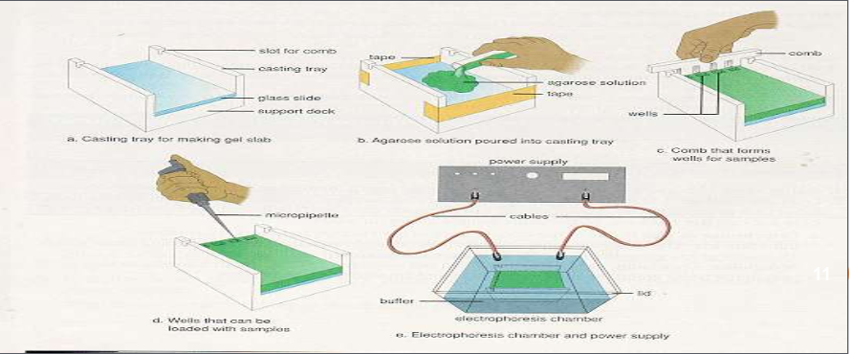
GEL
ELECTROPHORESIS
▪ Separation is brought about through molecular sieving technique, based on the molecular
size of the substances. Gel material acts as a "molecular sieve”.
▪ Gel is a colloid in a solid form (99% is water).
▪ It is important that the support media is electrically neutral.
▪ Different
types
of
gels
which
can
be
used are; Agar and
Agarose
gel, Starch, Sephadex, Polyacrylamide gels.
▪  A porous gel acts as a sieve by retarding obstructing the movement of macromolecules migrate freely.
or, in some cases, by completely
while allowing smaller molecules to

Slide 27
GEL
○
Agar is a mixture of poly saccharides extracted from sea weeds.
Agarose is a highly purified uncharged polysaccharide derived from agar.
Agarose is chemically basic disaccharide repeating units of 3,6-anhydro-L-galactose.
○
○
○
Agarose dissolves when added to boiling liquid. It remains in a liquid state until the temperature is
lowered to about 40° C at which point it gels.
The pore size may be predetermined by adjusting the concentration of agarose in the gel.
○
○
Agarose gels are fragile. They are actually hydrocolloids, and they are held together by the
formation of weak hydrogen and hydrophobic bonds.
The pores of an agarose gel are large, agarose is used to separate nucleic acids, large proteins and protein complexes.
○
macromolecules
such
as
ADVANTAGES:
➢ Easy to prepare and small concentration of agar is required.
➢ Resolution is superior to that of filter paper.
➢ Large quantities of proteins can be separated and recovered.
➢ Adsorption of negatively charged protein molecule is negligible.
➢ It adsorbs proteins relatively less when compared to other medium.
➢ Sharp zones are obtained due to less adsorption.
➢ Recovery of protein is good, good method for preparative purpose.
13

Slide 28
DISADVANTAGES:
➢
➢
➢
Electro osmosis is high.
Resolution is less compared to polyacrylamide gels.
Different sources and batches of agar tend
often necessary.
to
give
different
results
and
purification
is
APPLICATION:
➢ Widely used in Immuno electrophoresis.
14

Slide 29
POLYACRYLAMIDE GEL ELECTROPHORESIS
(PAGE)
It is prepared by polymerizing acryl amide monomers in the
presence
of
methylene-bis-acrylamide
to
cross link
the
monomers.
•
•
Structure of acrylamide (CH2=CH-CO-NH2)
Polyacrylamide gel structure held together by covalent cross-links.
Polyacrylamide gels are tougher than agarose gels.
It is thermostable, transparent, strong and relatively chemically
inert.
Gels are uncharged and are prepared in a variety of pore sizes.
Proteins are separated on the basis of charge to mass ratio and molecular size, a phenomenon called Molecular sieving.
•
•
•
ADVANTAGES:
▪
▪
▪
Gels are stable over wide range of pH and temperature.
Gels of different pore size can be formed.
Simple and separation speed is good comparatively.
15

Slide 30
PAGE can be classified according
conditions into:
○ NATIVE-PAGE:
  Native gels are run in non-denaturing conditions, so that the analyte's natural structure is maintained.
 Separation is based upon charge, size, and shape
macromolecules.
of
 Useful
for
separation
or
purification
of
mixture
of
proteins.
 This was the original mode of electrophoresis.
○ DENATURED-PAGE OR SDS-PAGE:
 Separation is based upon the molecular weight
proteins.
of
16
 The common method for determining MW of proteins.
 Very useful for checking purity of protein samples.

Slide 32
PAGE-PROCEDURE
The gel of different pore sizes is cast into a column inside a vertical tube, often with large pore gel at the top and small pore gel at the bottom.
○
○
Microgram quantity of the sample is placed over the top of the gel column and covered
by a buffer solution having such a pH so as to change sample components into anions.
○
The foot of the gel column is made to dip in the same buffer in the bottom reservoir.
○
Cathode and anode are kept above and below the column to impose an electric field
through the column.
○
Macromolecular anions move towards the anode down the gel column.
○
There is no external solvent space, all the migratory particles have to pass through the
gel pores.
○
Rate of migration depends on the charge to mass ratio.
○
Different sample components get separated into discrete migratory bands along the gel
17
column on the basis of electrophoretic mobility and gel filtration effect.

Slide 33
PAGE
PROCEDURE
SLAB PAGE
Polyacrylamide
(PAGE)
Gel
Electrophoresis
a)
The
gel
is
poured
vertically
between two glass plates.
b.) Protein bands are separated on th₁e₈ basis of relative molecular weight and visualized with stains.

Slide 34
SLAB PAGE
○
The Polyacrylamide gel is cast as thin rectangular slab inside a plastic frame and this slab is
placed vertically on a buffer solution taken in a reservoir.
○
Several samples dissolved in dense sucrose solution or glycerol are placed in separate
wells cut in to the upper edge of the slab and are covered by the same buffer solution.
Cathode and anode are above and below to produce electric field effect. Different
components migrate simultaneously down parallel lanes in the slab and get separated into
bands.
VISUALIZATION
○
After the electrophoresis is complete, the molecules in the gel can be stained to make them
visible.
○
Ethidium bromide, silver, or coomassie blue dye may be used for this process.
○
If the analyte molecules fluoresce under ultraviolet light, a photograph can be taken of the
gel under ultraviolet lighting conditions. If the molecules to be separated contain radioac₁t₉ivity
added for visibility, an autoradiogram can be recorded of the gel.

Slide 35
SDS-POLYACRYLAMIDE
GEL
ELECTROPHORESIS (SDS-PAGE)
▪
SDS-PAGE,
sodium
dodecyl
sulfate polyacrylamide
gel
electrophoresis,
is a
technique widely used in biochemistry, forensics, genetics and molecular biology to
separate proteins according to their electrophoretic mobility.
▪
▪
▪
When a detergent SDS added to PAGE the combined procedure is termed as SDS PAGE.
SDS coats protein molecules giving all proteins a constant charge-mass ratio.
Due to masking of charges of proteins by the large negative charge on SDS binding
with them, the proteins migrate along the gel in order of increasing sizes or
molecular weights.
▪
SDS is an anionic detergent which denatures secondary and non–disulfide–linked tertiary
structures by wrapping around the polypeptide backbone. In so doing, SDS confers a net
negative charge to the polypeptide in proportion to its length.
Molecules in solution with SDS have a net negative charge within a wide pH range.
▪
▪
▪
A polypeptide chain binds amounts of SDS in proportion to its relative molecular
mass.20
The negative charges on SDS destroy most of the complex structure of proteins, and are
strongly attracted toward an anode in an electric field.

Slide 36
SODIUM DODECYL SULFATE
(SDS-PAGE)
Native
protein
is unfolded by heating
in the
Native protein
Heat
+ Reductant
+ SDS
₋ ₋
- ⁻ ⁻ - ^{C}
^{N -} ₋ - ⁻ ⁻
Denatured protein with bound SDS
○
presence of β-mercaptoethanol and
SDS.
○
SDS
binds to the protein so that
it
stays in
solution and denatures.
○
Large polypeptides
bind
more
SDS
than
small
polypeptides, so proteins
end up with
negative charge in relation to their size.
○
When treated
with
SDS and
a
reducing
agent,
the
polypeptides
become
rods
of
-
-
-
-
-
negative charges with equal “charge
or charge per unit length.
densities"
-
○
Thus, we
their mass.
can separate the proteins
based
on

Slide 37
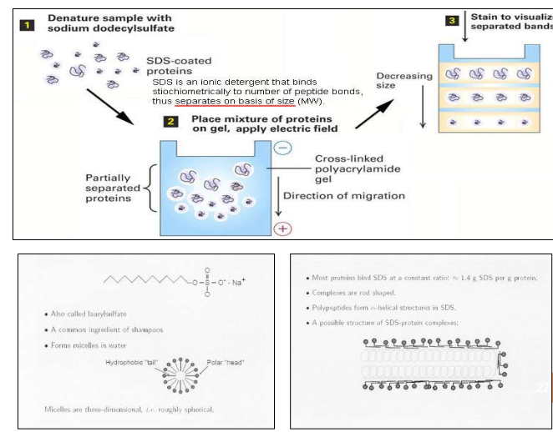

Slide 38
STARCH
○ A suspension of granular starch should be boiled in a buffer to give a
clear colloidal suspension.
○ The suspension on cooling sets as a semisolid gel due to intertwining of the branched chains of amylopectin.
○ In order to avoid swelling and shrinking petroleum jelly is used.
ADVANTAGES:
o High resolving power and sharp zones are obtained.
o The
components
resolved
can be
recovered
in
reasonable
yield
especially proteins.
o Can be used for analytical as well as preparative electrophoresis.
DISADVANTAGES:
o Electro osmotic effect.
o Variation in pore size from batch to batch.
23

Slide 39
VERTICAL
AND HORIZONTAL
GEL
ELECTROPHORESIS
Methods for application of
sample:
a)
Sample is mixed with the
gel.
By soaking a bit of filter
b)
paper
in
sample
and
pressing it
Detection
into the gel.
by staining or
c)
by Direct gravimetry or by
UV absorption, etc.
24

Slide 40
PULSED-FIELD GEL ELECTROPHORESIS
▪
Pulsed field gel electrophoresis is a technique used for the separation of large
DNA molecules by applying to a gel
direction.
matrix an electric field that periodically changes
▪
While in general small fragments can find their way through the gel matrix more easily than
large DNA fragments, a threshold length exists above 30–50 kb where all large fragments will
run at the same rate, and appear in a gel as a single large diffuse band. However, with
periodic changing of field direction, the various lengths of DNA react to the change at
differing rates. Over the course of time with the consistent changing of directions, each band
will begin to separate more and more even at very large lengths. Thus separation of very large
DNA pieces using PFGE is made possible.
The voltage is periodically switched among three directions; one that runs through the
central axis of the gel and two that run at an angle of 60 degrees either side. The pulse
times are equal for each direction resulting in a net forward migration of the DNA.
This procedure takes longer than normal gel electrophoresis due to the size of the fragments
being resolved and the fact that the DNA does not move in a straight line through the gel.
▪
▪
25

Slide 41
APPLICATIONS:
PFGE may be used for genotyping or genetic fingerprinting . It is commonly ²⁶
considered a gold standard in epidemiological studies of pathogenic organisms.

Slide 42
MOVING BOUNDARY ELECTROPHORESIS
PRINCIPLE:
The moving boundary method allows the charged species to migrate in a free moving
solution without the supporting medium.
INSTRUMENTATION:
o Consists of a U shaped glass cell of rectangular cross section, with electrodes placed on
the one each of the limbs of the cell.
o Sample solution is introduced at the bottom or through the side arm, and the apparatus is
placed in a constant temp. bath at 40º C.
o Detection is done by measuring refractive index throughout the solution.(Schlieren optical
system).
29

Slide 43
ADVANTAGES:
○ Biologically active fractions can be recovered without the use of denaturing
agents.
○ A reference method for measuring electrophoretic
mobilities.
○ Minute
concentrations
of
the
sample
can
be
detected.(0.05mg/ml
by
Interferometric optical system).
DISADVANTAGES:
○ Costlier.
○ Elaborate optical system
are required.
APPLICATION:
○ To study homogenecity of a macromolecular
system.
30
○ Analysis of complex biological mixtures.

Slide 44
CAPILLARY ELECTROPHORESIS
The principle behind electrophoresis is that charged molecules will migrate toward the opposite
pole and separate from each other based on physical characteristics.
Capillary electrophoresis has grown to become a collection of a range of separation techniques
which involve the application of high voltages across buffer filled capillaries to achieve
separations .
Capillary electrophoresis, then, is the technique of performing electrophoresis in buffer-
filled, narrow-bore capillaries, normally from 25 to 100 mm in internal diameter (ID).
A high voltage (typically 10-30 kV) is applied.
Capillaries are typically of 50 µm inner diameter and 0.5 to 1 m in length.
Due to electroosmotic flow, all sample components migrate towards the negative electrode.
The capillary can also be filled with a gel, which eliminates the electroosmotic flow. Separation is
•
•
•
•
•
•
•
accomplished
as
in
conventional
gel
electrophoresis
but
the capillary
allows
higher
resolution, greater sensitivity, and on-line detection.
The capillary is filled with electrolyte solution which conducts current through the inside of the
capillary. The ends of the capillary are dipped into reservoirs filled with the electrolyte.
Electrodes (platinum) are inserted into the electrolyte reservoirs to complete the electrical circ3u1it.
•
•

Slide 45
Sample application is done by either
a)High voltage injection-potential is applied causing the sample to enter capillary by combination of ionic attraction and electroosmotic flow.
b)Pressure injection-pressure difference is used to drive the sample into capillary by applying vaccum.
• When PD is applied net migration occurs in the direction of cathode.
• Even substance with net negative charge migrate in the direction of cathode due to the phenomenon called as Electro Osmotic Flow.
faster, speed is sum of EOF and Electrophoretic mobility. Negatively charged molecules lag behind.
•
Neutral molecule moves at the same speed as the EOF. Positively charged species m³o²ve

Slide 46
ELECTROOSMOTIC FLOW
The surface of the silicate glass capillary contains negatively-charged functional
groups that attract positively-charged counterions. The positively-charged ions migrate towards the negative electrode and carry solvent molecules in the same direction. This overall solvent movement is called electroosmotic flow. During a separation, uncharged molecules move at the same velocity as the electroosmotic
flow
(with
very
little
separation).
move slower.
Positively-charged
ions
move
faster
and
negatively-charged
ions
33

Slide 47
•
A small volume of sample is moved into one end of the capillary. The capillary passes
through a detector, usually a UV absorbance detector, at the opposite end of the capillary.
•
Application of a voltage causes movement of sample ions towards their appropriate
electrode usually passing through the detector.
•
A plot of detector response with time is generated which is termed an electropherogram.
34

Slide 48
ISOELECTRIC FOCSING
PRINCIPLE:
➢
All proteins have an isoelectric point pH .
When electrophoresis is run in a solution buffered at constant pH , proteins having a net charge will
migrate towards the opposite electrode so long as the current flows.
The use of pH gradient across the supporting medium causes each protein to migrate to an area of
specific pH.The pH of the protein equals the pH of the gradient, thus resulting in sharp well defined
protein bands.
A procedure to determine the isoelectric point (PI) of proteins thus, a mixture of proteins can be
electrophorised through a solution having a stable pH gradient in from the anode to the
cathode and a each protein will migrate to the position in the pH gradient according to its
isoelectric point. This is called isoelectric focusing.
Protein migrate into the point where its net charge is zero – isoelectric pH.
Protein is positively charged in solutions at pH below its PI and will migrate towards the cathode.
Protein is negatively charged in solution at pH above its PI will migrate towards the anode.
They will be in the Zwitter ion form with no net charge so the further movement will cease.
➢
➢
➢
➢
➢
➢
➢
➢
Ampholytes
(amphoteric electrolytes)- low molecular mass
(600-900D) ooligomers with aliphatic
points. Ampholytes help maintain the
amino and carboxylic acid groups with a range of isoelectric
pH gradiennt in the presence of high voltage.
Can also use gels with
immobilized
pH gradients - made
of acrylamide
derivatives
40
that are
➢
covalently linked to ampholytes.

Slide 49
METHOD
pH gradient is established in gel by addition of ampholytes which increases the pH from anode to cathode.
A protein mixture is placed in a well on the gel.
With an applied electric field, proteins enter the gel migrates until each reaches its pH equivalent to its (PI).
Each species of proteins is therby focussed into a narrow band about its PI.
The Anode of the column is connected to a reservoir containing an acidic solution like phosphoric acid and
Cathode is connected to a reservoir containing alkaline solution like sodium hydroxide.
On opening the two reservoir valves the two solutions are allowed to diffuse into the column from their
respective ends , setting up a PH gradient between the acidic anode and the alkaline cathode.
The valves are then closed and the current is switched on , causing the carrier ampholytes to migrate until they reach
the PH regions where they have no net charge. They will then remain stationary at these points.
•
•
•
•
•
•
•
Ampholytes
polyacrylamide
Cathode
(-) electrode solution
Anode
(+)
electrode
41

Slide 50
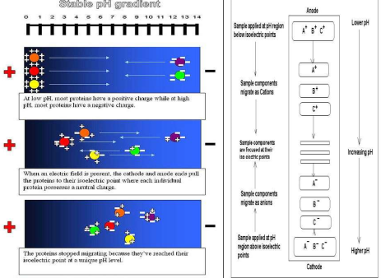

Slide 51
ADVANTAGES:
1) As spreading of bands is minimized due to application of the applied
the PH gradient , high resolution can be achieved.
field
and
2) Proteins that differ by as little as 0.001 PH units can be separated.
DISADVANTAGES:
1)
Because carrier ampholytes are generally used in high concentration, a high
voltage (upto 2000v ) is necessary . As a result the electrophoretic
be cooled which sometimes makes it difficult.
matrix
must
APPLICATIONS:
1) For separating proteins and peptides.
43
2) For research in enzymology , immunology, cytology and taxonomy.

Slide 52
TWO-DIMENSIONAL GEL ELECTROPHORESIS
(2-D ELECTROPHORESIS )
▪ In the first dimension, proteins are resolved in according to their isoelectric
points (PI) using immobilized pH gradient electrophoresis (IPGE), isoelectric
focusing
(IEF),
or
non-equilibrium
pH
gradient
electrophoresis.
(Horizontal
seperation)
▪ In the second dimension, proteins are separated according
to
their
approximate
molecular weight using SDS-PAGE.
(Vertical
seperation).
44

Slide 53
APPLICATIONS OF ELECTROPHORESIS
DNA Sequencing
Medical Research
Protein research/purification
Agricultural testing
1.
2.
3.
4.
5.
Separation of organic acid,
acids, insulin.
In food industry
It is employed in biochemical
alkaloids, carbohydrates, amino acids, alcohols, phenols, nucleic
6.
7.
and clinical fields i.e. in the study of protein mixtures such as blood
serum, haemoglobins and in the study of antigen- antibody interactions.
Electrophoresis in combination with autoradiography is used to study the binding of
proteins.
Used for analysis of terpenoids , steroids and antibiotics.
8.
iron
to
serum
9.
10. For testing purity of thyroid hormones by zone electrophoresis.
11. Paper chromato-electrophoresis is used to separate free Insulin from plasma proteins.
12. It is used for diagnosis of various diseases of kidney , liver and CVS.
13. It is also used for separation of Scopolamine and Ephedrine using buffer at PH 4.2.
14. Electrophoresis is also used for separation of carbohydrates and vitamins.
45
15. Quantitative separation of all fractions of cellular entities, antibiotics, RBC, Enzymes etc is possible.

