Slide 1
Radioimmunoassay (RIA)
Dr. Munish Rastogi
Associate Professor & Director
SHS, CSJMU

Slide 2
History
The method Radioimmunoassay (RIA) was developed by Solomon Berson and Rosalyn Sussman Yalow.
It was developed at the Veterans Administration Hospital, located in Bronx.
This method was considered a revolutionary advancement in medical science.
Rosalyn Sussman Yalow was awarded the Nobel Prize in Physiology or Medicine in 1977 for this discovery.
She became the second woman ever to receive this Nobel Prize.
In her Nobel acceptance speech, she stated:
"The world cannot afford the loss of the talents of half its people if we are to solve the many problems which beset us.”
She shared the Nobel Prize with:
Roger Guillemin
Andrew Schally
8. Their award was based on their research on peptide hormone production in the brain.

Slide 3
Introduction
A radioimmunoassay (RIA) is an immunoassay that uses radiolabeled molecules in a stepwise formation of immune complexes.
A RIA is a very sensitive in vitro assay technique used to measure concentrations of substances, usually measuring antigen concentrations (for example, hormone levels in blood) by use of antibodies.
The RIA technique is extremely sensitive and extremely specific, and although it requires specialized equipment, it remains among the least expensive methods to perform such measurements.
It requires special precautions and licensing, since radioactive substances are used.
In contrast, an immunoradiometric assay (IRMA) is an immunoassay that uses radiolabeled molecules but in an immediate rather than stepwise way.
A radioallergosorbent test (RAST) is an example of radioimmunoassay.
It is used to detect the causative allergen for an allergy.

Slide 4
Principle
Antigens and antibodies bind specifically to form the Ag-Ab complex. The antigen can be labeled or conjugated with radioisotopes. The unlabeled antigens from the sample compete with radiolabeled antigens to bind on paratopes of specific antibodies. The unlabeled antigens replace labeled antigens that are already linked with the antibodies. The unlabeled antigens when bind with antibodies, increases the amount of free radiolabeled antigens in the solution. Hence the concentration of free labeled antigens is directly proportional to the bound unlabeled antigens.

Slide 5
Radioimmunoassay (RIA) Procedure
Specific antibodies of known concentration are fixed in the microtitre well.
A known amount of hot antigens is then added to the well
Washed carefully to remove any unbound antigens
At this point, the radioactivity of the well will be maximum.
Unlabeled antigens are then added to the well
The unlabeled antigens will bind to the antibodies and there will be free labeled antigens in the well.
Again washed carefully to remove the free labeled antigens.
Radioactivity of wells is then measured by gamma-counter.

Slide 6
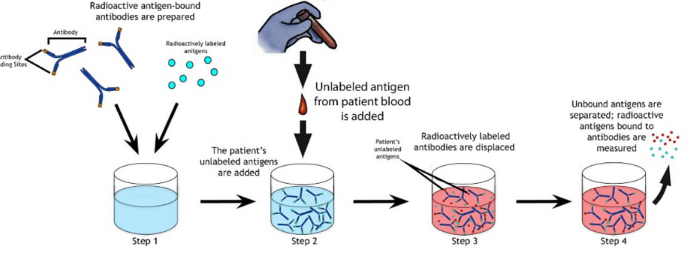

Slide 7
Applications
It was first used for the detection of peptide hormones.
Detection of different viral antigens
Detection of many hormones and drugs
Detection of Hepatitis B surface antigens
Detection of mycotoxins
Detection of the early stage of cancer

Slide 8
Advantages
High specificity
High sensitivity
Can detect a very small amount (nanograms) of antigen or antibodies.

