Slide 1
IMMUNOGLOBULIN
Dr. munish Rastogi
Director & associate professor
(head of microbiology dept.)
School of health sciences
c.s.j.m. university kanpur

Slide 2
INTRODUCTION
Immunoglobulins (Igs), also known as antibodies, are Y-shaped glycoprotein molecules produced by plasma cells (activated B cells) that play a critical role in the immune system by identifying and neutralizing pathogens like bacteria and viruses.
Antigen binding proteins present on the B-cell membrane and secreted by plasma cells.
Secreted antibodies circulate in the blood, where they serve as the effectors of humoral immunity, complement system.
They are found in blood, lymph, and other body fluids and are essential for humoral immunity, which defends the body against pathogens such as bacteria, viruses, and toxins.

Slide 3
Conti…..
Through these functions, immunoglobulins form a vital component of the immune response, protecting the body from infections and contributing to long-term immunity.
Immunoglobulins constitute 20-25 per cent of total serum proteins. Based on physicochemical and anti genic differences, five classes of immunoglobulins have been recognised: IgG, IgA, lgM, ,IgD and IgE.

Slide 4
Definition of Immunoglobulin
Immunoglobulins, commonly referred to as antibodies, are a group of specialized glycoproteins produced by B-lymphocytes, also known as plasma cells, in response to the presence of foreign substances called antigens.
These antigens can include bacteria, viruses, toxins, and other harmful microorganisms. Immunoglobulins are a vital component of the humoral immune system, which protects the body by recognizing, binding, and neutralizing these harmful invaders.
Structurally, immunoglobulins are composed of two heavy chains and two light chains, forming a Y-shaped molecule with variable regions that determine antigen specificity and constant regions that mediate effector functions like complement activation and interaction with immune cells.

Slide 5
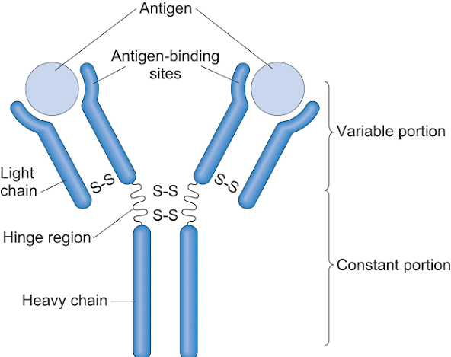
Structure of Immunoglobulin
Immunoglobulins (Igs) are Y-shaped glycoproteins that serve as antibodies in the immune system. They are composed of four polypeptide chains: two identical heavy (H) chains and two identical light (L) chains, which are held together by disulfide bonds and non-covalent interactions. This quaternary structure gives the antibody both stability and flexibility, enabling it to recognize and bind a wide variety of antigens.
Heavy Chains (H chains):
Each immunoglobulin has two identical heavy chains.
The heavy chain consists of one variable region (VH) and three or four constant regions (CH1, CH2, CH3, sometimes CH4 depending on class).
The type of heavy chain determines the class of the antibody (IgG, IgA, IgM, IgE, or IgD).
Light Chains (L chains):
Each antibody contains two identical light chains, which can be either kappa (κ) or lambda (λ).
Each light chain has a variable region (VL) and a constant region (CL).
Light chains pair with heavy chains to form the antigen-binding sites.

Slide 6
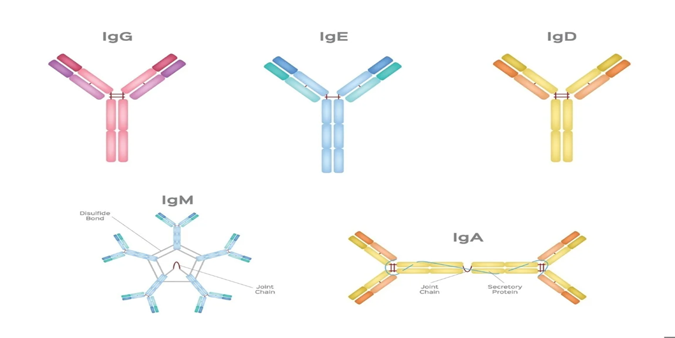
Classification of Immunoglobulins
Immunoglobulins (Igs), commonly called antibodies, are glycoproteins produced by B lymphocytes that play essential roles in immune defense. They are classified into five major classes based on the type of heavy chain they contain, their structural characteristics, location, and biological functions. Each class has specialized roles in protecting the body from pathogens, maintaining immune homeostasis, and providing both immediate and long-term immunity.
Type of Immunoglobulins
IgG (Immunoglobulin G)
IgA (Immunoglobulin A)
IgM (Immunoglobulin M)
IgE (Immunoglobulin E)
IgD (Immunoglobulin D)

Slide 7
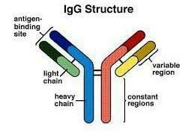
Immunoglobulin G
Immunoglobulin G (IgG) is the most abundant antibody in human serum, constituting approximately 70–75% of total immunoglobulins. It is a monomeric glycoprotein that plays a central role in humoral immunity, providing both long-term protection against infections and passive immunity to the newborn. IgG is produced by plasma cells, which are differentiated B lymphocytes, in response to antigenic stimulation. Its high specificity and versatility make it the most important antibody in secondary immune responses.
Structure of IgG
IgG is a Y-shaped molecule consisting of four polypeptide chains: two identical heavy chains (γ) and two identical light chains (κ or λ). These chains are linked by disulfide bonds and stabilized by non-covalent interactions, forming a quaternary structure. The IgG molecule has distinct functional regions.

Slide 8
Conti…..
Subclasses of IgG
Human IgG is further divided into four subclasses (IgG1, IgG2, IgG3, and IgG4) based on slight differences in the heavy chain structure:
IgG1
IgG2
IgG3
IgG4

Slide 9
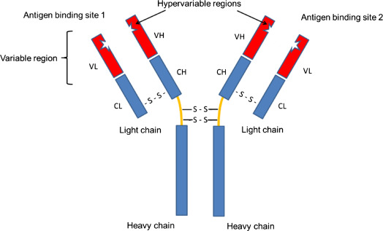
Immunoglobulin A
Immunoglobulin A is the second most abundant class of immunoglobulin constitute about 10% to 13% of all serum immunoglobulins. The normal serum level is 0.6 to 4.2 mg per mL.
It has a half-life of 6 to 8 days. IgA is found in two forms in the body—in serum, where it occurs principally as monomer (160 kDa, 7S) and on secretory surfaces, where it exists as a dimeric molecule (385 kDa, 11S).
The dimeric form is known as secretory IgA (sIgA) and is found in association of J chain and with secretory component; the latter is involved in the transport of IgA to the secretory surfaces.
Furthermore, selective IgA deficiency appears to be a significant risk factor for recurrent chest infections, particularly in asthmatic patients.

Slide 10

Conti…..
Secretory component is non-covalently associated with the IgA molecules in the sIgA complex. sIgA is the main Ig in the secretions such as milk, saliva and tears and in the secretions of respiratory, intestinal and genital tracts. It protects mucous membranes from attack by bacteria and viruses.
There are two subclasses of IgA; IgA1 and IgA2 distinguished by their distribution and arrangement of disulfide bonds.
IgA is the predominant form found in serum, where as IgA1 and IgA2 isotypes are present in roughly equal amounts in IgA.
Immunoglobulin A is the component of the secondary humoral response. The principal antigens that elicit an IgA response are microorganisms in the gut or on the airways.
IgA cannot cross the placental barrier, but however, sIgA can be passed to the neonate through milk. IgA does not fix complement, but can activate the alternative complement pathway. It promotes phagocytosis and intracellular killing of microorganisms.

Slide 11
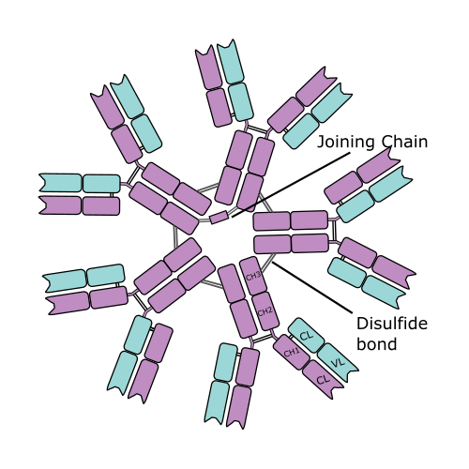
Immunoglobulin M
Immunoglobulin M constitutes 5% to 8% of serum Ig with a normal level of 0.5 to 2 mg per mL. It has a half-life of about 5 days. It is a heavy molecule (19S; molecular weight 900,000 to 1,000,000, hence called the millionaire molecule). It has a pentameric structure comprising five identical four chain units.
it has 10 identical binding sites . The ‘mu’ heavy chains has five domains, VH plus 4 C regions (Cμ1, Cμ2, Cμ3, Cμ4) and lacks a hinge region. The pentameric structure is stabilized by disulfide bonding between adjacent Cμ3 domains and by the presence of Joinez (J) chain.
Though theoretically 10 antigen-binding sites are there, only five antigen-binding sites react with antigen probably due to steric hindrance.
Immunoglobulin M is the principal component of primary immune response. Because of its large size (970 kDa, 19S), it is located mainly in the bloodstream.

Slide 12
Conti…..
As it is not transported across the placenta, the presence of IgM in the fetus indicates intrauterine infection and its detection is useful to the diagnosis of congenital infections such as syphilis, rubella, human immunodeficiency virus (HIV) infection and toxoplasmosis.
IgM antibodies are relatively short lived, disappears earlier than IgG. Hence, their demonstration in serum indicates recent infection. Treatment of serum with 0.12 M 2-mercaptoethanol selectively destroys IgM without affecting IgG antibodies.
The isohemagglutinins (anti-A, anti-B) and many other natural antibodies to microorganisms are IgM. Antibodies to typhoid O antigen (endotoxin) and Wassermann reaction (WR) antibodies in syphilis are also of this class. It is efficient in both opsonization and complement fixation

Slide 13
Immunoglobulin D
Immunoglobulin D structurally resembles IgG. The concentration is about 0.03 mg per mL of serum.
It has a half-life of about 3 days. IgD acts as an antigen receptor, when present on the surface of certain B lymphocyte.
Two subclasses of IgD are IgD1 and IgD2.
IgD is primarily known for its role as a B-cell antigen receptor (BCR) on the surface of B cells.
It is thought to participate in various B-cell processes, including maturation, maintenance of peripheral tolerance, activation, and potentially even silencing.

Slide 14
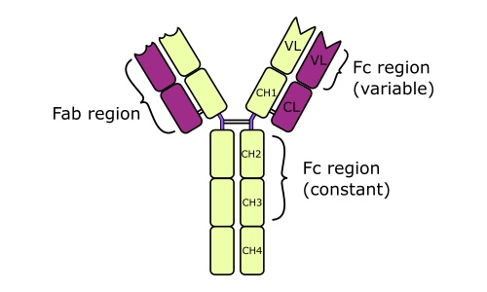
Immunoglobulin E
Immunoglobulin E is 8S molecule (molecular weight is about 190,000) with a half-life of 2 days. Normal serum contains only traces.
It exhibits unique properties such as heat lability and affinity towards surface of mast cells.
The Fc region of IgE binds to the receptor for the antigen on the surface of mast cell and basophil. The resulting antigen-antibody complex triggers immediate (type 1) hypersensitivity reaction by releasing the mediators.
Serum IgE increased in anaphylactic reaction and helminthic infection. IgE is also known as reagin.

Slide 15
Conti…..
In response to pathogens, IgE antibodies bound to mast cells through high-affinity receptors undergo cross-linking upon antigen binding.
This cross-linking triggers mast cell degranulation, releasing inflammatory mediators that recruit eosinophils to the site of infection.
The eosinophil-mediated killing of the pathogen can then occur through mechanisms resembling antibody-dependent cell-mediated cytotoxicity (ADCC).
Clinically, however, IgE levels rise dramatically in type I hypersensitivity reactions, including allergic diseases like bronchopulmonary aspergillosis and parasitic infections such as schistosomiasis.

