Slide 1
Indifference Curve, Budget Line And Consumer Equilibrium
Dr. Pooja Singh Assistant Professor, Department of Economics, School of Arts ,Humanities And Social Sciences, Chhatrapati Shahu Ji Maharaj University, Kanpur

Slide 2
Indifference Curve
Indifference Curve And Budget Line
Based on Ordinal Approach
Explains behaviour of consumer in terms of his preferences.
Indifference curve may be defined as locus of points, each representing a different combination of two substitute goods, which yield the same utility or level of satisfaction to the consumer.

Slide 3
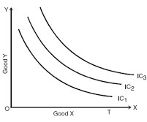
Indifference Curve And Budget Line
Indifference curve is derived from indifference schedule.
Combination | Units of Y | Units of X | Total Utility
A | 25 | 3 | U
B | 15 | 6 | U
C | 8 | 9 | U
D | 4 | 12 | U
E | 2 | 15 | U
Indifference Curve
Indifference Map

Slide 4
Properties Of Indifference Curve
Indifference Curve And Budget Line
Negatively sloping
Neither intersect nor be tangent with one another
Higher the indifference curve represent a higher level of satisfaction.
Convex to origin

Slide 5
Budget Line
Indifference Curve And Budget Line
A budget line shows all possible combination of two commodities that could be pursued with a given amount of income.
straight line that slope downwards
The budget line, also known as the budget constrain
The equation of the budget line equation can be represented as follows:
M = Px × Qx + Py × Qy
Where,
Px = cost of product X.
Qx = the quantity of product X.
Py = cost of product Y.
Qy = quantity of product Y.
M = consumer’s income.

Slide 6
Indifference Curve And Budget Line
 | Budget schedule
Combination | Cream biscuit (@ ₹10 per packet) | Plain biscuit (@ ₹5 per packet) | Budget allocation
A | 0 | 10 | 10 × 0 + 5 × 10 = 50
B | 1 | 8 | 10 × 1 + 5 × 8 = 50
C | 2 | 6 | 10 × 2 + 5 × 6 = 50
D | 3 | 4 | 10 × 3 + 5 × 4 = 50
E | 4 | 2 | 10 × 4 + 5 × 2 = 50
F | 5 | 0 | 10 × 5 + 5 × 0 = 50

Slide 7
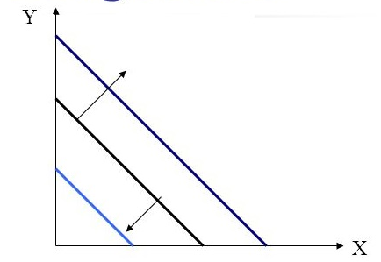
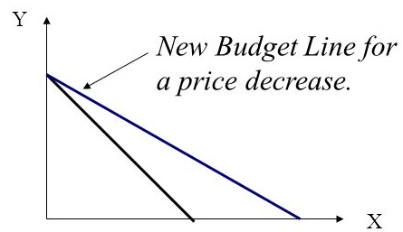
Change in budget line
Indifference Curve And Budget Line
1. Change in income
2. Change in price-
Increase lead to parallel outward shift
Decrease lead to parallel inward shift
A decrease in price of goods X rotate the line counter clockwise.
Increase in price of goods X rotate the line clockwise.

Slide 8
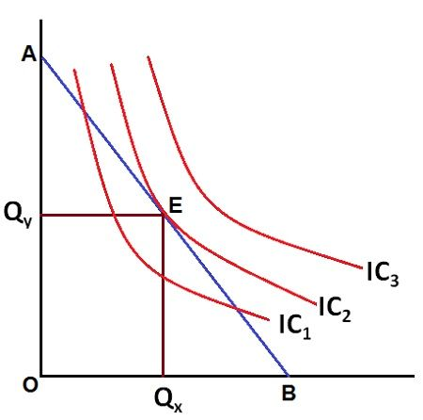
Consumer Equilibrium
Rational consumer choose the highest indifference curve given the budget constraint
At the point of tangency, the slope of indifference curve and budget line are equal is the Consumer Equilibrium

Slide 9
References
Dwivedi D N, Managerial Economics, Vikas Publishing House Pvt. Ltd, 2006

