Slide 2
Lecture 1: Black-body radiation
Instructor:
Bhoomika Yadav

Slide 3
Newton's corpuscular theory:
Newton's corpuscular theory was based on postulates as follows:
1.Newton proposed that a source of light emits many minute, elastic, rigid and massless particles called corpuscles.
2. These particles travel through a transparent medium at very high speed in all direction along a straight line.
Explained phenomenon's: Reflection, refraction,etc.
Unexplained phenomenon's:
Newton's corpuscular theory fails to explain simultaneous phenomenon of partial reflection and refraction on the surface of transparent medium such as glass or water.
The corpuscular theory fails to explain optical phenomena such as interference, diffraction, polarization etc.
Spectrum of H atom.

Slide 4
“Hot” objects ,T > 0 K emits electromagnetic waves.
A red “Hot” incandescent lamp is said to be hot as it emits em waves specially in IR region.
Thermal Radiation:
An ordinary object can emit and absorb an electromagnetic radiation.
Particles constituting an object are in constant motion.
These particles while interacting with em waves exchange energy with it.
At equilibrium, the rate of energy absorbed is equal to the energy emitted by the body.
At different temperature the frequency spectrum is different.

Slide 5
A black body is a perfect absorber as well as perfect emitter.
Fig.1. Perfect black body
Fig.2. Experimental set up to study black body spectrum
Image source:wikipedia

Slide 6
V
Retarding potential
Fig.4. The extinction violtage,V^{O} s depends upon frequency of light. When retarding potential is V=o. The photoelectric current is the same for the light of a given intensity regardless of its frequency.
Fig.3. photoelectric current is proportional to ,light intensity L
for all retarding voltages. The extinction voltage V^{O}
is the same for all intensities of light of a given frequency, ν
Fig courtsy: Beiser, R.T. Lagemann, BOOKS: Concepts of Modern Physics, Phys. Teach. 6 (1968) 43–43. https://doi.org/10.1119/1.2352394.

Slide 7
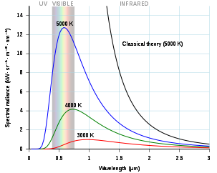
T_{max.}
ν
Fig.5. The maximum photoelectron energy
as a frequency of the incident light
Fig 6. spectral distribution vs. wavelength
Image source:online

Slide 8
Lecture 2
Black-body radiation
Instructor:
Bhoomika Yadav

Slide 9
Wien's displacement law: shows how the spectrum of black-body radiation at any temperature is related to the spectrum at any other temperature. If the shape of spectrum at one temperature is known then the shape at any other temperature can be known. Spectral intensity can be expressed as a function of frequency or wavelength.
The wavelength at which the intensity per unit wavelength of the radiation produced by a black body has a local maximum or peak is a function only of the temperature:
Stefan–Boltzmann law:
E=σT⁴

Slide 10
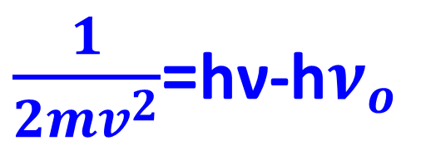
The quantum theory of light
Planck's law of black-body radiation
$\frac{1}{2mv^{2}}$=hν-h$ν_{o}$
E
E(ν,T) is the spectral radiance of the body
h=Planck’s constant,
c= light velocity, T= absolute temperature,
$k_{B}$= Boltzmann constant

Slide 11
Applications:
Human-body emission
When Wein's Law is applied to human-body emission, a peak wavelength of
As a result, human thermal imaging systems are most sensitive in the 7–14 micrometer range.
Temperature relation between a planet and its star
Effective temperature of Earth
Cosmology

Slide 12
Lecture 4
Light–matter interaction
Photoelectric effect
Bhoomika Yadav

Slide 13
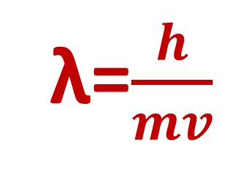
De-Broglie hypothesis: wave particle duality
λ=$\frac{h}{mv}$
Photon: smallest unit/quanta of energy.
Energy of photon, E=hν=hc/λ
where h=Planck’s constant, c=light velocity, λ is wavelength of light
Properties of photons:
Photons travels at a speed of light (c=3$×1$0⁸ m/s) in vacuum.
The rest mass m₀ of photon is zero i.e. photon never exist in rest.

Slide 14
3. The kinetic mass m0 of photon = E/ m₀c²
The momentum of photon, p =$\frac{ E}{C}$ = $\frac{h}{λ}$
Photons are electrically neutral.
The energy of photon depends upon frequency of photon; so photons energy do not change when photon travels from one medium to another.
As the wavelength of photon changes in different media, the velocity of photon too changes in varying media.
Photons may show diffraction under given conditions.
Photons are not deviated by either magnetic or electric fields.

Slide 15
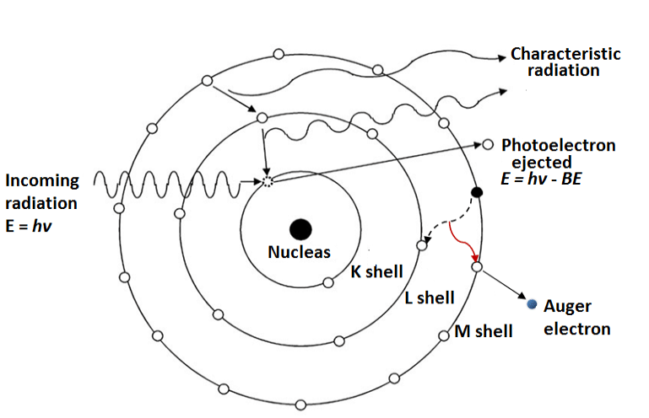
Fig.1. Photoelectric effect
C. Mahuvava, F.C.P. Du Plessis, Monte Carlo evaluation of the dose perturbation effect of hip prostheses for megavoltage photon radiotherapy, Phys. Medica. 31 (2015) S7. https://doi.org/10.1016/j.ejmp.2015.07.108.

Slide 16
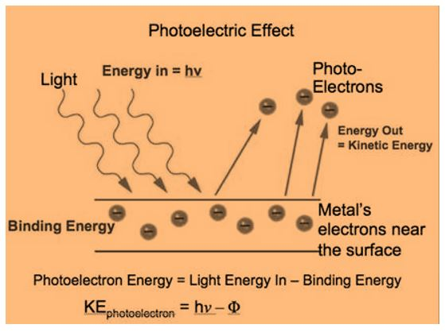
Photoelectric effect: emission of photon by an electron;
Dual nature of waves confirmed
Assignment 1: Do all questions from Arthur Beiser
Due date: 21 Oct. 21
Fig.2. Schematic of Photoelectric effect
Image source:online

Slide 17
Lecture 5
Light–matter interaction
Compton effect
Bhoomika Yadav

Slide 18
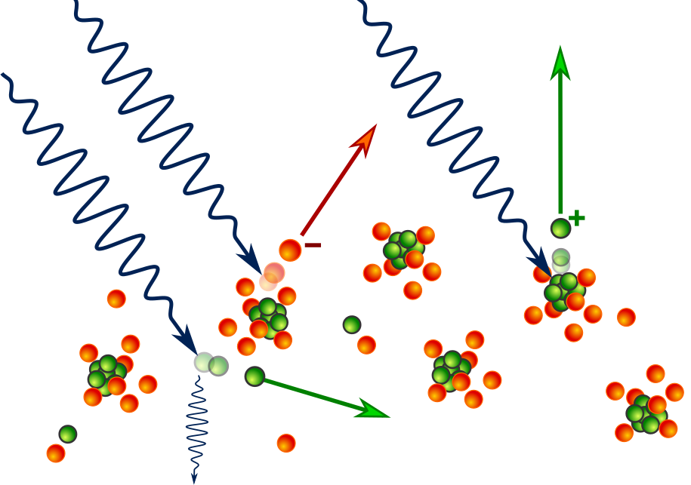
Fig. 1 Compton effect
Image source:wikipedia

Slide 19
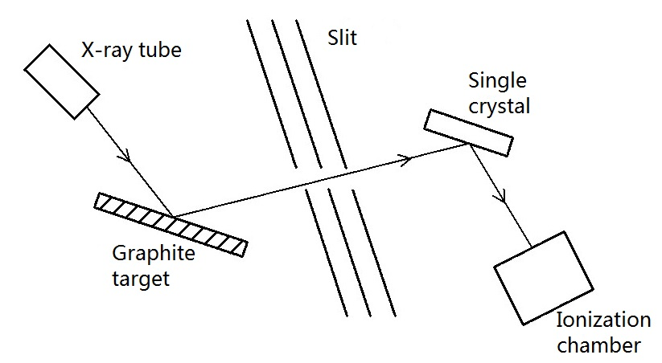
Fig. 2: Schematic diagram of Compton's experiment.
Compton scattering occurs in the graphite target on the left. The slit passes X-ray photons scattered at a selected angle. The energy of a scattered photon is measured using Bragg scattering in the crystal on the right in conjunction with ionization chamber; the chamber could measure total energy deposited over time, not the energy of single scattered photons

Slide 20
The rest energy m_{o}c² of an electrocn an positron is 0.51 eV,hence pair production requires a photon energy of at least 1.02 MeV.Any additional photon energy becomes kinetic enrgy of the electron and positron.Any additional photon energy becomes kinetic energy of the electron and positron.The corresponding maximum photon wavelength is 1.2 pm. Electromagnetic waves with such wavelength are called gamma rays,γ rays and are found in nature as one of the emissions fro radioactive nuclei and in cosmic rays.

Slide 21
Lecture 6
Light–matter interaction
Pair production
Bhoomika Yadav

Slide 22
Fig.1 In the process of pair production, a photon of sufficient energy materializes into an electron and positron
Fig courtsy: Beiser, R.T. Lagemann, BOOKS: Concepts of Modern Physics, Phys. Teach. 6 (1968) 43–43. https://doi.org/10.1119/1.2352394.

Slide 23
Question 1: Show that pair production cannot occur in empty space
Question 2: An electron and a positron are moving side by side in the +x direction at a 0.500c when they annihilate each other.The photons are produced that nove along the x axis.(a) Do both photons move in the +x direction (b) what is the energy of each photon.

Slide 24
Lecture 7
Light–matter interaction
Pair annhilation
Bhoomika Yadav

Slide 25
Pair annhilation
The inverse of pair production occurs when a positron is near an electron and the two come together under the influence of their opposite electric charge.Both particles vanish simultaneously, with the lost mass becoming energy in the form of two gamma ray photons
e⁺ + e⁻ = γ + γ
The total mass of the positron and electron is equivalent to 1.02 eV and each photon has an energy,hν of 0.51 MeV plus half the kinetic energy of the particle relative to their centre of mass. Thje directions of the photons are such as to conserve both energy and linear momentum and no nucleus or other particle is needed for this pair annihilation to take place.

Slide 26
Pair annihilation and pair production Assignment:
All questions from Concepts of Modern Physics: Aurther Beiser

Slide 27
Lecture 8
Uncertainty Principle
We cannot know the future because we cannot know the present
Bhoomika Yadav

Slide 28
Fig 1 (a) A narrow de-Broglie wave group. The postion of the particle can be precisely determined,but the wavelength (and hence the particle’s momentum) can not be established because there are not enough waves to measure accurately.
(a) A wide wave group. Now the wavelength can be precisely determined but not the position of the particle.

Slide 29
Uncertainty Principle:
J.sec.
J
θ
E
t
For canonically conjugate quantities
Assignment: 2 All questions from Arthur Beiser
Due date: 12 Nov. 21
Unit: J.sec.

Slide 30
Lecture 9
Davission-Garmer experiment
Wave nature of material particle confirmed
Bhoomika Yadav

Slide 31
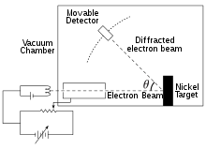
Davission-Garmer experiment
Fig. 1 Experimental setup
Cont..
Image source:wikipedia

