Slide 1
Logistic Regression

Slide 2
What is logistic regression?

Slide 3
Logistic regression applications

Slide 4
When is logistic regression suitable

Slide 5
Question
Which of the following sentences are TRUE about Logistic Regression?
Logistic regression is analogous to linear regression but takes a categorical/discrete target field instead of a numeric one.
Logistic Regression measures the probability of a case belonging to a specific class.
Logistic Regression can be used to understand the impact of a feature on a dependent variable.

Slide 6
Email: Spam / Not Spam?
Online Transactions: Fraudulent (Yes / No)?
Tumor: Malignant / Benign ?
0: “Negative Class” (e.g., benign tumor)
1: “Positive Class” (e.g., malignant tumor)

Slide 7
(Yes) 1
Malignant ?
(No) 0
Tumor Size
Tumor Size
Threshold classifier output at 0.5:
If , predict “y = 1”
If , predict “y = 0”

Slide 8
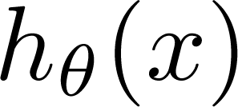
Classification: y = 0 or 1
can be > 1 or < 0
Logistic Regression:

Slide 9
Hypothesis Representation
Logistic
Regression

Slide 10
Logistic Regression Model
Want
1
0.5
Sigmoid function
Logistic function
0

Slide 11
Interpretation of Hypothesis Output
= estimated probability that y = 1 on input x
Example: If
Tell patient that 70% chance of tumor being malignant
“probability that y = 1, given x,
parameterized by ”

Slide 12
Decision boundary
Logistic
Regression

Slide 13
Logistic regression
1
z
Suppose predict “ “ if
predict “ “ if

Slide 14
Logistic Regression Model
Want
1
0.5
Sigmoid function
Logistic function
0

Slide 15
Logistic regression
1
z
Suppose predict “ “ if
predict “ “ if

Slide 16
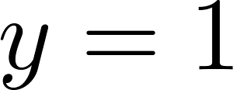
Decision Boundary
x₂
3
2
1
1
2
3
x₁
Predict “ “ if

Slide 17
Non-linear decision boundaries
x₂
1
x₁
-1
1
-1
Predict “ “ if
x₂
x₁

Slide 18
Cost function
Logistic
Regression

Slide 19
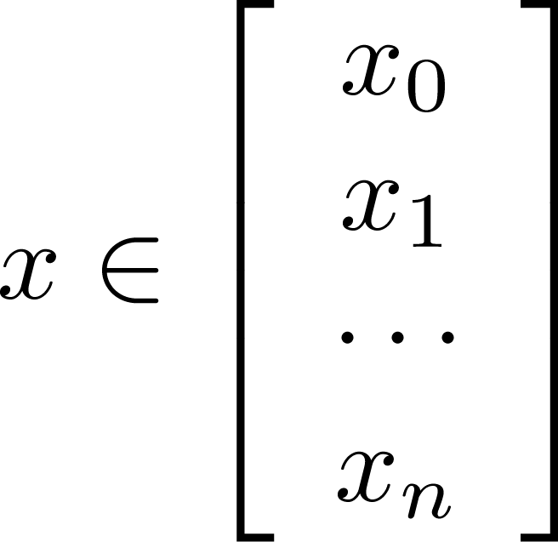
Training set:
m examples
How to choose parameters ?

Slide 20
Cost function
Linear regression:
“non-convex”
“convex”

Slide 21
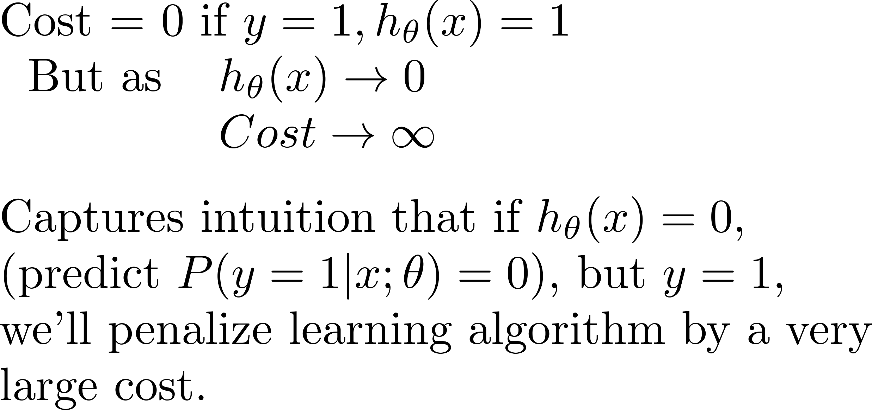
Logistic regression cost function
If y = 1
0
1

Slide 22
Logistic regression cost function
If y = 0
0
1

Slide 24
Simplified cost function and gradient descent
Logistic
Regression

Slide 25
Logistic regression cost function

Slide 26
Logistic regression cost function

Slide 27
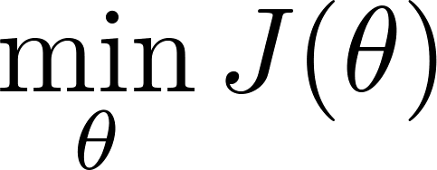
Logistic regression cost function
To fit parameters :
To make a prediction given new :
Output

Slide 28
Gradient Descent
Want :
Repeat
(simultaneously update all )

Slide 29
Gradient Descent
Want :
Repeat
(simultaneously update all )
Algorithm looks identical to linear regression!

Slide 32
The problem of overfitting
Regularization

Slide 33
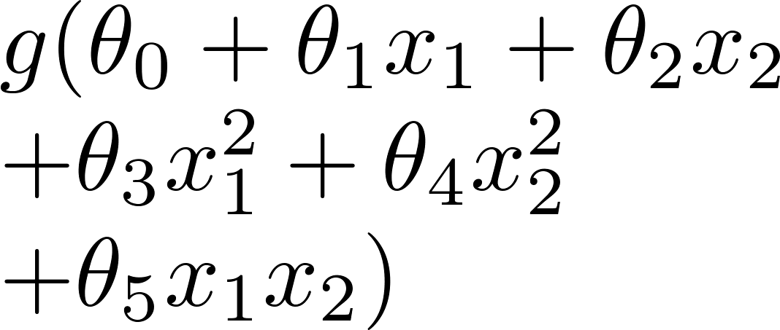
Example: Logistic regression
x₂
x₂
x₂
x₁
x₁
x₁
( = sigmoid function)

Slide 34
Addressing overfitting:
Options:
Reduce number of features.
Manually select which features to keep.
Regularization.
Keep all the features, but reduce magnitude/values of parameters .
Works well when we have a lot of features, each of which contributes a bit to predicting .

Slide 35
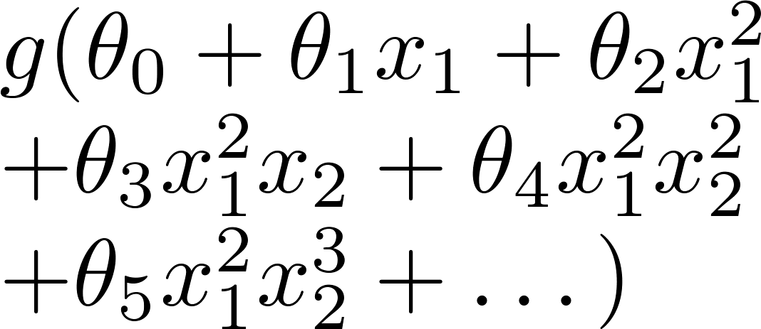
Regularized logistic regression.
x₂
x₁
Cost function:

Slide 36
Gradient descent
Repeat

Slide 37
Multi-class classification: One-vs-all
Logistic
Regression

Slide 38
Multiclass classification
Email foldering/tagging: Work, Friends, Family, Hobby
Medical diagrams: Not ill, Cold, Flu
Weather: Sunny, Cloudy, Rain, Snow

Slide 39
Binary classification:
Multi-class classification:
x₂
x₂
x₁
x₁

Slide 40
x₂
One-vs-all (one-vs-rest):
x₁
x₂
x₂
x₁
x₁
Class 1:
Class 2:
Class 3:
x₂
x₁

Slide 41
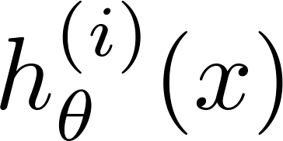
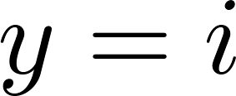
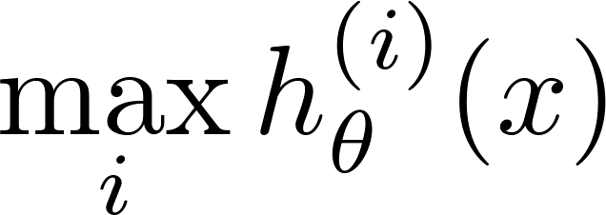
One-vs-all
Train a logistic regression classifier for each class to predict the probability that .
On a new input , to make a prediction, pick the class that maximizes

