Slide 1
Myco bacterium tuberculosis

Slide 2
General Features of Mycobacteria
Acid fastness due to
Mycolic acids in the cell wall & Integrity of the cell wall
Guanine plus cytosine (G+C) content of DNA of Mycobacterium is 61–71 mol % (exception M.leprae G+C content 54 to 57 mol %)
Weakly gram-positive, Obligate aerobes
Non-motile, non-sporing, noncapsulated straight or slightly curved rod-shaped, sometimes show branching filamentous forms

Slide 3
Classification
M. tuberculosis complex - tuberculosis in man
M. leprae (Hansen’s bacilli) - leprosy
Nontuberculous mycobacteria (NTM) –
Saprophytes (M.phlei) or
Commensals (M.smegmatis)
occasionally cause opportunistic human infection

Slide 4
MYCOBACTERIUM TUBERCULOSIS COMPLEX
Causes tuberculosis and includes:
M. tuberculosis (human tubercle bacillus)
M. bovis (bovine tubercle bacillus)
M. caprae (closely related to M. Bovis)
M. africanum (isolated from a few West African cases)
M. microti (‘vole’ bacillus, rare and less virulent)
M. pinnipedii (infects seals in the Southern hemisphere and recently isolated from humans)
M. canetti (a rare isolate from East African cases, that produces unusual smooth colonies on solid media)

Slide 5
Antigenic Structure
Cell wall (insoluble) antigens
Peptidoglycan layer – maintains shape & rigidity
Arabinogalactan layer - survival of M.tuberculosis within macrophages
Mycolic acid layer - principal constituent, confers very low permeability, acid fastness and reduces the entry of most antibiotics
Outermost layer - lipids, glycolipids & mycosides

Slide 6
Antigenic Structure
Proteins (e.g. porins, transport proteins) - found throughout various layers
Plasma membrane - helps in attachment to host cell and is also a target antigen used for diagnosis
Cytoplasmic (soluble) antigens: These include antigen 5, antigen 6, antigen 60
- Used in serodiagnosis of tuberculosis.

Slide 7
Pathogenesis
Source of Infection
Human cases of pulmonary tuberculosis
Bovine source (unpasteurized infected milk)
Mode of Transmission
Inhalational mode: Droplet nuclei, generated while coughing, sneezing, or speaking
- Tiny dry droplets (<5–10 μm size) remain suspended for several hours & are easily inhaled
Other modes – Inoculation & Ingestion

Slide 8
Risk Factors favouring transmission
Sputum positive patients with Bacillary load at least 10,000 bacilli/mL
Cavitary lesions in lung - more bacillary load
Overcrowding in poorly ventilated rooms
Low cell-mediated immunity – HIV
Other comorbid conditions - Post-silicosis, postransplantation, hemodialysis, diabetes, IV drug abuse, smoking, etc.
Age: Late adolescence and early adulthood
Sex: women at 25–34 years, men in older ages

Slide 9
Sequence of Pathogenic Events
Droplet nuclei inhaled →Majority trapped in upper airways and expelled out & usually <10% reach the alveoli
Adhesion to macrophages - lipoarabinomannan (LAM) binds to complement receptors and mannose receptors → internalization
Phagocytosis by macrophages - enhanced by complement (C3b) mediated opsonization of bacilli
Survival inside the macrophages - cell wall LAM impairs phagosome-lysosome fusion →replicate inside the macrophage → macrophage ruptures & releases bacilli

Slide 10
Host Immune Response
Cell-mediated Immune Response
critical to contain the infection
Macrophages present mycobacterial antigens to TH (T helper) cells → activation of TH1 & TH2
Activation of TH1 cells → release of IL-2 and IFN γ
Macrophage-activating response
Tissue damaging Response
- Balance between the m decides outcome

Slide 11
Macrophage-activating response
IFN γ activates macrophages
Tubercles: a favorable sign
Hard tubercles: initially hard - central zone containing activated macrophages (epithelioid and giant cells) and a peripheral zone of lymphocytes and fibroblasts
Soft tubercles - central part undergoes caseous necrosis
Bacilli inhibited within this necrotic environment because of low oxygen tension and low pH → lesion heals

Slide 12
Tissue-damaging response
Minority of cases, associated with risk factors -macrophage-activating response is weak & bacilli more virulent
Mycobacterial growth inhibited only by an intensified delayed hypersensitivity reaction → lung tissue destruction
Spread of caseous necrosis
1. Direct draining into the airways → discharged with cough
2. Lymphatic spread → reseeding into same or opposite lung → disseminate to other organs.
3. Hematogenous spread to various organs

Slide 13
Humoral Immune Response
TH2 release → IL-4, IL-5 → activate B-cells →antibodies.
M. tuberculosis being obligate intracellular organism, humoral immunity plays a minor role
Anti-LAM antibodies play a role in preventing dissemination of tuberculosis in children.

Slide 14
Clinical Manifestations
Pulmonary Tuberculosis (PTB)
- 80% of all cases of tuberculosis
Extrapulmonary Tuberculosis (EPTB)
15–20% of all cases of TB
Results from hematogenous dissemination.

Slide 15
Primary v/s Secondary Pulmonary TB
Features | Primary PTB | Post-primary/secondary PTB
Results due to | Initial exogenous infection with tubercle bacilli | i) Exogenous reinfection ii) Endogenous- reactivation of latent primary lesion
Age group affected | Children | Adults
Parts of lungs commonly affected | Sub pleural lesion affecting, upper part of lower lobe and lower part of upper lobe | Apical and posterior segments of the upper lobes (high oxygen tension)

Slide 16
Primary vs Secondary Pulmonary TB
Features | Primary PTB | Post-primary/secondary PTB
Lesions formed at the initial sites | Fibrotic nodular lesions (Ghon focus) | Calcified nodules (Assmann focus) Early hematogenous seedling in apex of lungs - Simon’s focus
Lymph node | Ghon focus with associated hilar lymphadenopathy is common (called as primary complex) | Lymph node involvement is unusual

Slide 17
Primary vs Secondary Pulmonary TB
Features | Primary PTB | Post-primary/secondary PTB
Clinical feature | It may be asymptomatic or may present with fever, productive cough (with or without hemoptysis) and occasionally chest pain, night sweating, weight loss | Lesions undergoing necrosis and tissue destruction, leading to cavity formation. Symptoms are similar, but more pronounced.

Slide 18
Primary vs Secondary Pulmonary TB
Features | Primary PTB | Post-primary/secondary PTB
Fate | Lesions heal spontaneously. Primary complex becomes calcified (Ranke complex) | Bronchogenic spread to the same or opposite lung form satellite lesions → caseating pneumonia Hematogenous spread to various parts of the body and granuloma formation. Rarely, heals spontaneously

Slide 19
Extrapulmonary Tuberculosis
Tuberculous lymphadenitis – MC form (35% of all EPTB)
- Posterior cervical and supraclavicular lymph nodes - painless swelling in neck region without warmth or color change
Pleural tuberculosis – (20%) - pleural effusion
Tuberculosis of the upper airways - larynx, pharynx, and epiglottis
Genitourinary tuberculosis: Renal tuberculosis
Genital tuberculosis – Females: fallopian tubes & endometrium → infertility. Males: epididymis

Slide 20
Extrapulmonary Tuberculosis
Skeletal tuberculosis - Weight-bearing joints (spine, hips & knees)
- Complications - collapse of vertebral bodies → kyphosis & paravertebral ‘cold’ abscess
Tuberculosis of CNS – children, Tuberculous meningitis & tuberculoma are
Tuberculous pericarditis - direct extension from adjacent lymph nodes or following hematogenous spread

Slide 21
Extrapulmonary Tuberculosis
Gastrointestinal tuberculosis - Terminal ileum and caecum
- Due to swallowing of sputum with direct seeding, hematogenous spread, or ingestion of cow’s milk contaminated with M. bovis
Tuberculous skin lesions:
Scrofuloderma – skin involvement by direct extension from underlying tuberculous lymphadenitis
Lupus vulgaris: Apple jelly nodules are formed over face
Miliary or disseminated tuberculosis: Hematogenous spread →yellowish 1–2 mm size granulomatous lesions resembling millet seeds in various organs

Slide 22
Epidemiology
One-third world population infected asymptomatically with M.tuberculosis → 5–10% develop clinical disease
2016 (WHO) - 10.4 million new cases of TB occurred with 1.7million deaths
Over 95% of TB deaths in low and middle-income countries
Seven countries account for 64% of the total TB burden - India (25% of total TB cases and 33% of total TB deaths), Indonesia, China, Philippines, Pakistan, Nigeria, and South Africa.
TB is the ninth leading cause of death worldwide

Slide 23
Laboratory Diagnosis
Specimen Collection
PTB: Sputum –
Spot sample & early morning sample, at least 2–5 mL & preferably mucopurulent

Slide 24
Extrapulmonary specimens
Sterile site specimens collected aseptically
Optimum specimens | CSF, spinal, pericardial, synovial, ascitic, blood and bone marrow, pleural biopsy, tissues (collected in sterile saline)
Suboptimal specimens (organism load is less) | Pleural fluid (20–50 mL is collected and centrifuged), Blood (indicated only for disseminated TB and HIV-TB coinfection)

Slide 25
Extrapulmonary specimens
Specimens containing normal flora
Swabs | Only recommended swabs- - Laryngeal swabs: Collected early morning in empty stomach - Swab from discharging sinus
Urine | Three early morning specimens collected (500 mL/ specimen, centrifuged) on different days
Stool | For disseminated TB in HIV infected patients and infants

Slide 26
Extrapulmonary specimens
Specimens containing normal flora
Other Resp specimens | Bronchial secretions (2–5 mL) Bronchoalveolar lavage (20–50 mL) Transbronchial and other biopsies
Gastric Lavage | Recommended for children (tend to swallow sputum), or ICU patients (aspiration)Early morning lavage should be collected and processed early (<4 hours)

Slide 27
Digestion, Decontamination and Concentration
Digestion - to liquefy the thick pus cells and homogenization
Decontamination - to inhibit the normal flora
Concentration - to increase the yield
Petroff’s method - 4% sodium hydroxide → centrifuged → neutralized with 8% HCl
NALC (N-acetyl-L-cysteine) + 2% NaOH: NALC liquefies sputum and NaOH kills normal flora
Superior & more compatible with automated culture systems

Slide 28
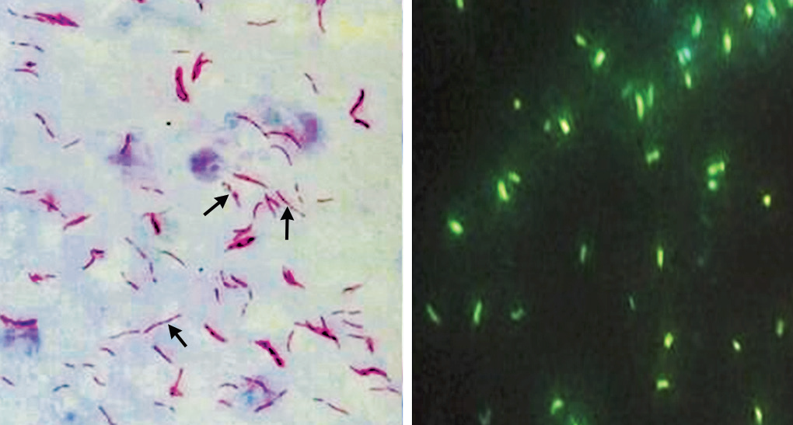
Direct Microscopy
Acid Fast Staining Ziehl-Neelsen (ZN) technique
Interpretation
Negative result: ≥100 OIFs, 10–15 min
Positive result: long slender, beaded, less uniformly stained red colored bacilli (AFB)

Slide 29
Direct Microscopy
Microscopy provides only presumptive diagnosis
Advantages: rapid, easy to perform & cheaper
Disadvantages:
Less sensitive than culture, Detection limit 10,000 bacilli/mL of sputum
Cannot determine viability of bacilli
Difficult to differentiate from saprophytic mycobacteria
Acid alcohol – M.tuberculosis (acid & alcohol fast);M.smegmatis (only acid fast but not alcohol fast)

Slide 30
RNTCP guidelines for grading of sputum smear
No. of bacilli seen | Grading | No. of OIF to be screened
>10/OIF | 3+ | 20
1-10/OIF | 2+ | 50
10-99/100 OIF | 1+ | 100
1-9/100 OIF | Scanty | 100
No AFB in 100 OIF | Nil | 100

Slide 31
RNTCP guidelines for grading of sputum smear
RNTCP grading is useful for:
Monitoring the treatment response of the patients
Assessing the severity of disease
Assessing the infectiousness of the patient: Higher the grade more is the infectiousness. Smear negative patients (<10,000 bacilli/mL of sputum) are less infectious

Slide 32
Culture Methods
Advantages:
More sensitive (detection limit of 10–100 viable bacilli)
Indicates viability
Drug susceptibility testing can be performed
Conventional Solid Media (Lowenstein Jensen Medium)
Most widelyused and recommended by RNTCP
Composition : coagulated hen’s eggs, mineral salt solution, asparagine and malachite green (as a selective agent)
Incubation: 6–8 weeks

Slide 33
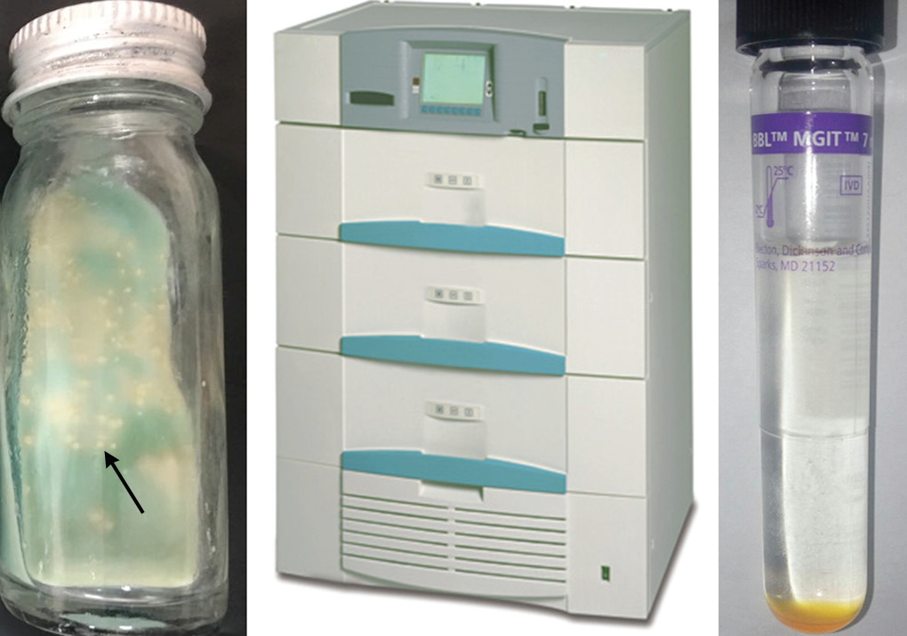
Colonies on LJ Medium
M.tuberculosis - typical rough, tough and buff colored colonies
M.bovis - Smooth, moist and white colored colonies which break up easily when touched

Slide 34
Automated Liquid Culture
Monitor growth continuously and offer a faster turnaround time
99% of positive growth gets detected within 3–4 weeks
Middlebrook 7H9 medium supplemented with:
OADC enrichment growth media (oleic acid, albumin, dextrose and catalase) - promote the growth M. tuberculosis and
PANTA antibiotic mixture (polymyxin B, amphotericin B, nalidixic acid, trimethoprim, and azlocillin) to inhibit other organisms

Slide 35
Automated systems
BACTEC MGIT (Mycobacteria growth indicator tube):
Detects growth of mycobacteria
Drug susceptibility testing
Principle: O2 sensitive fluorescent compound in the broth quenches emissions from the fluorescent compound →quenching effect is lost if organisms grow & use O2

Slide 36
Automated systems
VersaTek system:
Detects change in pressure in headspace due to production of CO2 by M.tuberculosis
Drug susceptibility testing against first line anti-tubercular drugs
BacT/ALERT:
- Colorimetric detection of pH change due to CO2 liberated by M. tuberculosis.

Slide 37
Culture Identification
Growth subjected to acid fast stain. Further testing if found AFB positive
MPT 64 antigen detection by rapid immunochromatographic test
Biochemical tests - niacin test, nitrate reduction and pyrazinamidase test - almost obsolete now
Rabbit pathogenicity test - M. bovis is pathogenic to rabbit, whereas M. tuberculosis is not pathogenic. Obsolete now

Slide 38
Serology
Serological methods (both antigen and antibody detection methods) are NOT recommended
Low sensitivity
Cross reactivity with other mycobacteria
Variable antibody response against different epitopes
WHO has banned the use of serological tests

Slide 39
Upcoming Methods for TB Diagnosis
TrueNat (Molbios) - Chip Based Real Time PCR (TrueNat)
Automated battery operated device; can be used at primary health center level
Unit 1 (sample preparation device) - DNA extraction Then
Unit 2 (analyzer) - extracted DNA is added to the chip (coated with the probes) and loaded for amplification
Disadvantages: very expensive, cannot further speciate MTB complex and tests one sample at a time

Slide 40
Other Methods for TB Diagnosis
TB-LAMP (Loop-mediated isothermal amplification):
Alternative to smear microscopy for identification (WHO)
Does not detect drug resistance
Next generation GeneXpert (Xpert Ultra):
Ultra cartridge with larger chamber for DNA amplification to accommodate larger amount of sputum
Two additional molecular targets to detect TB
More sensitive and specific with detection limit of 16 bacilli/mL compared to 131 bacilli/mL of first generation GeneXpert

Slide 41
Other Methods for TB Diagnosis
Breath biomarkers such as volatile organic compounds
LAM (lipoarabinomannan) antigen detection - urine and sputum
InterGam Rapid Immuno Suspension Assay – IFN γ from extrapulmonary sites
Automated microscopy and image detection
Non-commercial culture and drug-susceptibility testing
Microscopic observation of drug susceptibility
Colorimetric redox indicator (CRI) methods

Slide 42
Diagnosis of Latent Tuberculosis –
Tuberculin Test
By demonstration of type IV hypersensitivity reaction against the tubercle bacilli antigens
Discovered by Von Pirquet in 1907
Antigens used in tuberculin test:
OT (Old tuberculin antigen) - Crude preparation, not used now
PPD (Purified protein derivative antigen) - purified preparation of the active tuberculoprotein
PPD-RT-23 with Tween 80 PPD – Recommended by WHO

Slide 43
Tuberculin Test
Dosage: One TU is equal to 0.01 mL of OT or 0.00002 mg of PPD
Procedure:
Mantoux test: Injected intradermally into flexor surface of forearm
Heaf and Tine multiple puncture tests - not in use

Slide 44
Tuberculin Test
Reading: after 48–72 hours. width of the induration
≥10 mm: Positive (tuberculin reactors)
6–9 mm: Equivocal/doubtful reaction
<5 mm: Negative reaction.
Interpretation of result:
- Adults: Positive only indicates present or past exposure with tubercle bacilli . only used as an epidemiologicalmarker
- Children: positive test indicates active infection and used as diagnostic marker

Slide 45
Tuberculin Test
False-positive:
BCG vaccination (after 8–14 weeks)
Nontuberculous mycobacteria infection.
False-negative:
- Early or advanced TB, miliary TB, decreased immunity (HIV-infected people)
Two-step testing: In adults, repeat test 1–2 weeks after the first test - booster effect → strong positive reaction (>20 mm)

Slide 46
Diagnosis of Latent Tuberculosis – IGRA
Interferon Gamma Release Assay (IGRA)
- Highly specific M. tuberculosis antigens - CFP10 & ESAT6
Procedure: an in vitro test
Patient’s Sensitized T lymphocytes exposed to ESAT-6/CFP-10 antigens → release of high level of IFNγ from the T lymphocytes
QuantiFERON-TB Gold assay – commercially available ELISA format
Advantage: highly specific; no false positive

Slide 47
Extensively Drug-resistant Tuberculosis (XDR-TB)
 Definition: MDR-TB cases also resistant to:
Fluoroquinolones (ofloxacin/levofloxacin) and
At least one injectable aminoglycosides (kanamycin, amikacin or capreomycin).
 Epidemiology: 6.2% of MD -TB cases are XDR
India - exact incidence unknown
MDR-TB treatment failure cases (2–6%) may be presumed to be XD -TB cases
 Treatment of XD -TB is extremely difficult

Slide 48
Prophylaxis Against Tuberculosis
Bacillus Calmette Guerin Vaccine (BCG)
BCG strain: Live-attenuated M. Bovis - Danish 1331 strain
Lyophilized form form – preferred as it is more stable
Administration of BCG
Dose and strength: 0.1 mL containing 0.1 mg TU
Site: above the insertion of left deltoid
Route: intradermal

Slide 49
BCG
Protection
Efficacy: variable efficacy of 0–80%
Duration of immunity - 15–20 years
Definite protection to infants and young children against tuberculous meningitis and disseminated tuberculosis
Complications following BCG
Most common – ulceration, regional lymphadenitis
Rare - keloid or lupus lesion, osteomyelitis non-fatal meningitis, progressive tuberculosis and "BCGitis”

Slide 50
BCG
Contraindications to BCG include:
- HIV-positive child, Child borne to AFB positive mother
- Child with low immunity
- Generalized eczema, Pregnancy
Other uses of BCG are:
- Induces non-specific stimulation of the immune system- leprosy and leukemia
- Adjunctive therapy in malignancies - bladder carcinoma

Slide 51
Chemoprophylaxis
Shortcomings of Chemoprophylaxis
Expensive & side effects of the drugs
Risk of developing tuberculosis is minimal in tuberculin reactors
INH prophylaxis restricted to
Adults with HIV who are unlikely to have active TB
Children with HIV who have no TB symptoms and who are unlikely to have active TB
All children with HIV who have successfully completed treatment for TB

Slide 52
refrences

