Slide 1
The Decision Control Structure
Department of Computer Application
Presented By: SANTOSH PRASAD

Slide 2
Decision Control Statement
a decision control instruction can be implemented in C using: (a) The if statement (b)The if-else statement (c)The conditional operators.

Slide 3
The if Statement
Like most languages, C uses the keyword if to implement the decision control instruction. The general form of if statement looks like this:
if ( this condition is true ) execute this statement ;
Here is a simple program, which demonstrates the use of if and the relational operators.

Slide 4
/* Demonstration of if statement */
main( )
{
int num ;
printf ( "Enter a number less than 10 " ) ;
scanf ( "%d", &num ) ;
if ( num <= 10 )
printf ( “hello!" ) ;
}

Slide 5
On execution of this program, if you type a number less than or equal to 10, you get a message on the screen through printf( ). If you type some other number the program doesn’t do anything.
The following flowchart would help you understand the flow of control in the program.

Slide 6
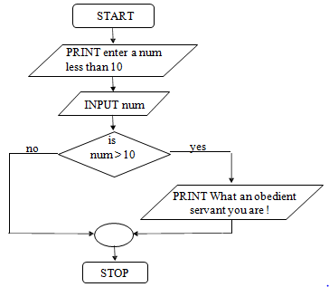
Control flow Diagram of if Statement

Slide 7
The if-else Statement
The if statement by itself will execute a single statement, or a group of statements, when the expression following if evaluates to true. It does nothing when the expression evaluates to false.
Example:- In a company an employee is paid as under:

Slide 8
If his basic salary is less than Rs. 1500, then HRA = 10% of basic salary and DA = 90% of basic salary. If his salary is either equal to or above Rs. 1500, then HRA = Rs. 500 and DA = 98% of basic salary. If the employee's salary is input through the keyboard write a program to find his gross salary.

Slide 9
/* Calculation of gross salary */ main( )
{
float bs, gs, da, hra ;
printf ( "Enter basic salary " ) ;
scanf ( "%f", &bs ) ;
if ( bs < 1500 )
{
hra = bs * 10 / 100 ; da = bs * 90 / 100 ;
}
else
{
hra = 500 ;
da = bs * 98 / 100 ;
}
gs = bs + hra + da ;
printf ( "gross salary = Rs. %f", gs ) ;
}

Slide 10
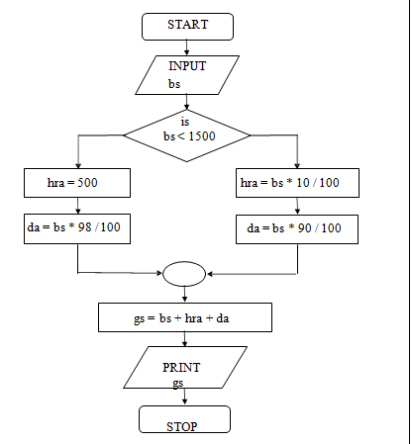

Slide 11
Nested if-elses
It is perfectly all right if we write an entire if-else construct within either the body of the if statement or the body of an else statement. This is called ‘nesting’of ifs.
This is shown in the following program.

Slide 12
/* A quick demo of nested if-else */
main( )
{
int i ;
printf ( "Enter either 1 or 2 " ) ; scanf ( "%d", &i ) ;
if ( i == 1 )
printf ( "You would go to heaven !" ) ;
else
{
if ( i == 2 )
printf ( "Hell was created with you in mind" ) ;
else
printf ( "How about mother earth !" ) ;
}
}
In the above program an if-else occurs within the else block of the
first if statement. Similarly, in some other program an if-else may
occur in the if block as well. There is no limit on how deeply the ifs
and the elses can be nested.

Slide 13
The marks obtained by a student in 5 different subjects are input through the keyboard. The student gets a division as per the following rules:
Percentage above or equal to 60 – First
division Percentage between 50 and 59
- Second division Percentage between
40 and 49 - Third division Percentage
less than 40 - Fail
Write a program to calculate the division obtained by the student.

Slide 14
/* Method – I */ main( )
{
int m1, m2, m3, m4, m5, per ;
printf ( "Enter marks in five subjects " ) ;
scanf ( "%d %d %d %d %d", &m1
, &m2, &m3, &m4, &m5 ) ;
per = ( m1 + m2 + m3 + m4 + m5 ) / 5 ;
if ( per >= 60 )
printf ( "First division ") ;
else
{
if ( per >= 50 )
printf ( "Second division" ) ;
else
{
if ( per >= 40 )
printf ( "Third division" ) ;
else
printf ( "Fail" ) ;
}
}
}

Slide 15
THANK U

