Slide 1
Path of approach & Path of recess

Slide 2
Path of approach + path of recess
If gear-1 is driving gear
Point of engagement
M
+
+
C₁
P
C₂
L
Path of approach
Path of recess
Addendum circle of gear-1
Addendum circle of gear-2
Point of disengagement

Slide 3
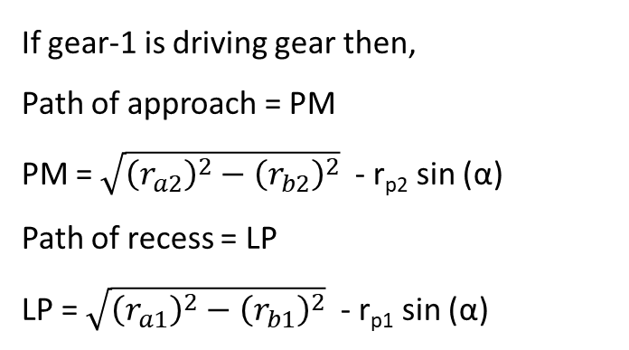
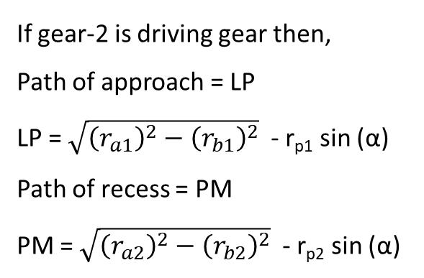
Path of Approach and Path of recess
If gear-2 is driving gear then,
Path of approach = LP
LP = $\sqrt{{\left(r_{a1}\right)}^{2}−{\left(r_{b1}\right)}^{2}}$ - r_{p1} sin (α)
Path of recess = PM
PM = $\sqrt{{\left(r_{a2}\right)}^{2}−{\left(r_{b2}\right)}^{2}}$ - r_{p2} sin (α)
If gear-1 is driving gear then,
Path of approach = PM
PM = $\sqrt{{\left(r_{a2}\right)}^{2}−{\left(r_{b2}\right)}^{2}}$ - r_{p2} sin (α)
Path of recess = LP
LP = $\sqrt{{\left(r_{a1}\right)}^{2}−{\left(r_{b1}\right)}^{2}}$ - r_{p1} sin (α)

Slide 4
Path of contact

Slide 5
Path of contact
Draw addendum circle for gear-1 and gear -2
M
+
+
C₁
P
C₂
L
Addendum circle of gear-1
Addendum circle of gear-2
LM is known as path of contact.

Slide 6
Path of contact
Draw addendum circle for gear-1 and gear -2
Q
M
r_{b1}
α
+
r_{p1}
+
C₁
P
α
C₂
L
r_{b2}
R
Addendum circle of gear-1
Addendum circle of gear-2
LM is known as path of contact.

Slide 7
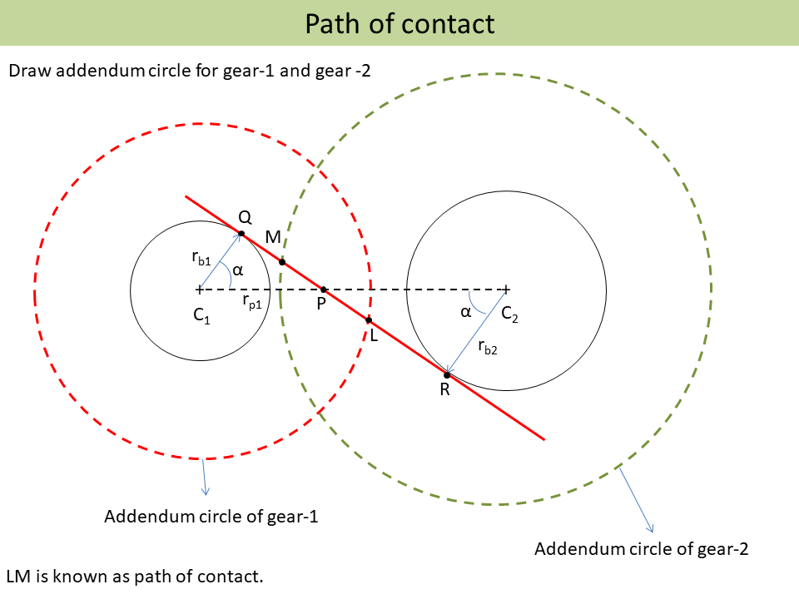

Path of contact
Path of contact LM:
LM = LP + PM
Calculate LP:
LP = LQ – PQ
$$LQ= \sqrt{{C_{1}L}^{2}−{C_{1}Q}^{2}}$$
$$LQ= \sqrt{{\left(r_{a1}\right)}^{2}−{\left(r_{b1}\right)}^{2}}$$
$r_{a1}$ = addendum circle radius of gear-1
$r_{b1}$ = base circle radius of gear-1
PQ = C₁ P sin (α)
PQ = r_{p1} sin (α)
LP = $\sqrt{{\left(r_{a1}\right)}^{2}−{\left(r_{b1}\right)}^{2}}$ - r_{p1} sin (α)
Similarly
PM = MR – PR
MR = $\sqrt{{C_{2}M}^{2}−{C_{2}R}^{2}}$ = $\sqrt{{\left(r_{a2}\right)}^{2}−{\left(r_{b2}\right)}^{2}}$
PR = C₂ P sin (α) = r_{p2} sin (α)
PM = $\sqrt{{\left(r_{a2}\right)}^{2}−{\left(r_{b2}\right)}^{2}}$ - r_{p2} sin (α)
Path of contact LM
= $\sqrt{{\left(r_{a1}\right)}^{2}−{\left(r_{b1}\right)}^{2}}$ + $\sqrt{{\left(r_{a2}\right)}^{2}−{\left(r_{b2}\right)}^{2}}$
- (r_{p1} + r_{p2} ) sin (α)

