Slide 1
Semiconductor Fundamentals and Devices Unit-3(EIC-302) (Atul Kr. Agnihotri )

Slide 2
Power Amplifiers

Slide 3
BASICS
Power amplifiers get the necessary energy for amplification of input signals from the AC wall outlet to which they are plugged into.
If you had a perfect amplifier, all of the energy the amplifier took from the AC outlet would be converted to useful output (to the speakers)

Slide 4
Power is not really something that can be “amplified”. Voltage and current can be amplified.
The term “power amplifier” although technically incorrect has become understood to mean an amplifier that is intended to drive a load (such as a speaker, a motor, etc).

Slide 5
Functional blocks of an amplifier
All power amplifiers have:
1.A Power supply
2.An input stage
3.An output stage

Slide 6
1.Power Supply
The primary purpose of a power supply in a power amplifier is to take the 120 V AC power from the outlet and convert it to a DC voltage.
The very best of amplifiers have two totally independent power supplies, one for each channel (they do share a common AC power cord though).

Slide 7
2. Input Stage
The general purpose of the input stage of a power amplifier (sometimes called the "front end") is to receive and prepare the input signals for "amplification" by the output stage.
Two types:
1.Balanced Input
2.Single Ended Input

Slide 8
2. Input Stage
Balanced inputs are much preferred over single ended inputs when interconnection cables are long and/or subject to noisy electrical environments because they provide very good noise rejection.
The input stage also contains things like input level controls.

Slide 9
3.Output Stage
The portion which actually converts the weak input signal into a much more powerful "replica" which is capable of driving high power to a speaker.
This portion of the amplifier typically uses a number of "power transistors" (or MOSFETs) and is also responsible for generating the most heat in the unit.
The output stage of an amplifier interfaces to the speakers.

Slide 10
Amplifier Classes
The Class of an amplifier refers to the design of the circuitry within the amp.
For audio amplifiers, the Class of amp refers to the output stage of the amp.

Slide 12
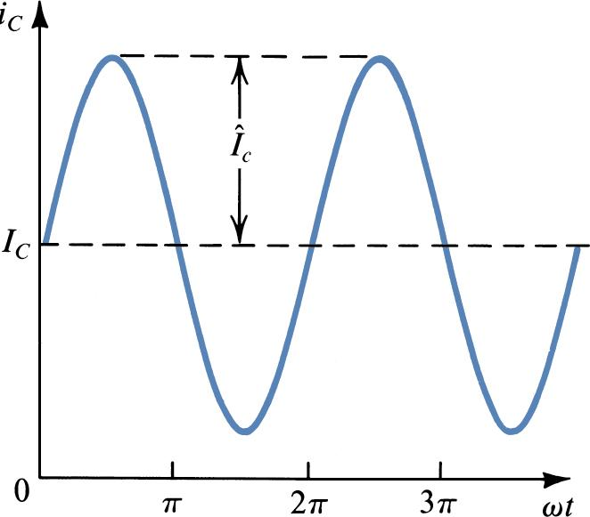
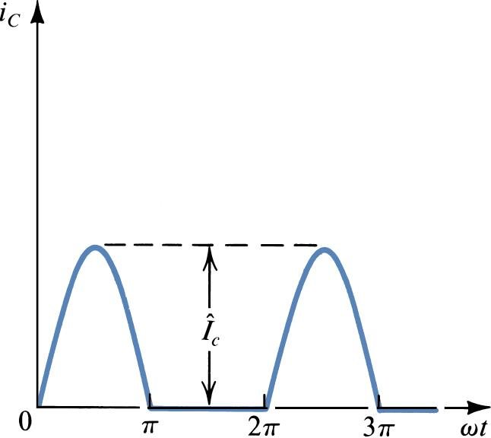
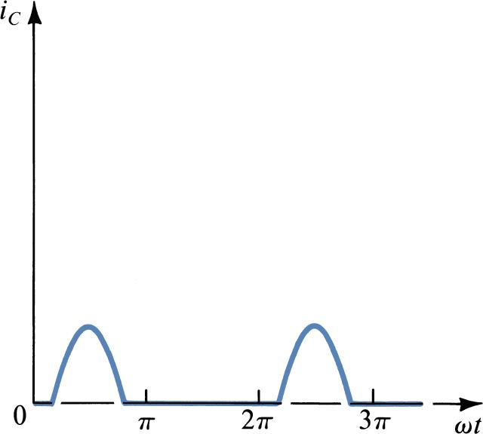
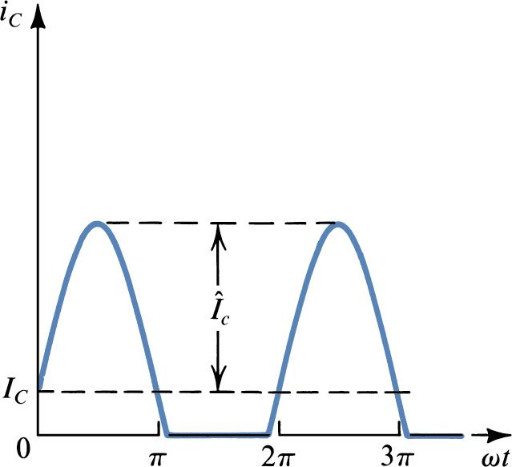
Classes
Collector current waveforms for transistors operating in (a) class A, (b) class B, (c) class AB, and (d) class C amplifier stages.

Slide 13
Figure 1 - The Sinewave Cycle
Class-A: Output device(s) conduct through 360 degrees of input cycle (never switch off) - A single output device is possible. The device conducts for the entire waveform in Figure 1
Class-B: Output devices conduct for 180 degrees (1/2 of input cycle) - for audio, two output devices in "push-pull" must be used (see Class-AB)
Class-AB: Halfway (or partway) between the above two examples (181 to 200 degrees typical) - also requires push-pull operation for audio. The conduction for each output device is shown in Figure 1.

Slide 14
Figure 1 - The Sinewave Cycle
Class-C: Output device(s) conduct for less than 180 degrees (100 to 150 degrees typical) - Radio Frequencies only - cannot be used for audio! This is the sound heard when one of the output devices goes open circuit in an audio amp! See Figure 1, showing the time the output device conducts

Slide 16
Class A Output Stage
Class A output stage is a simple linear current amplifier.
It is also very inefficient, typical maximum efficiency between 10 and 20 %.
Only suitable for low power applications.
High power requires much better efficiency.

Slide 17
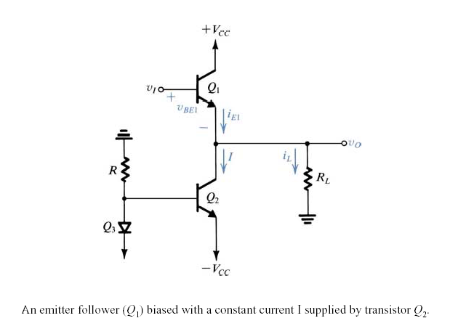

Slide 18
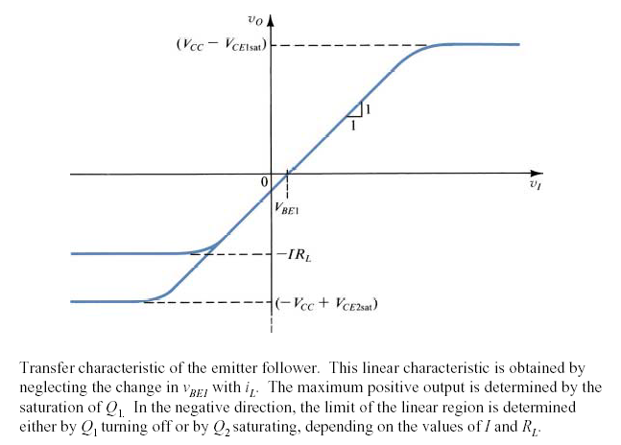
Transfer Characteristics

Slide 19
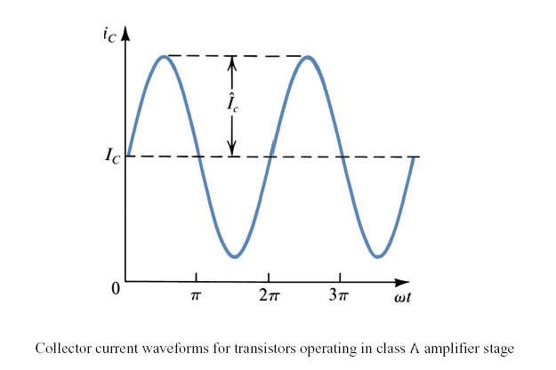

Slide 20
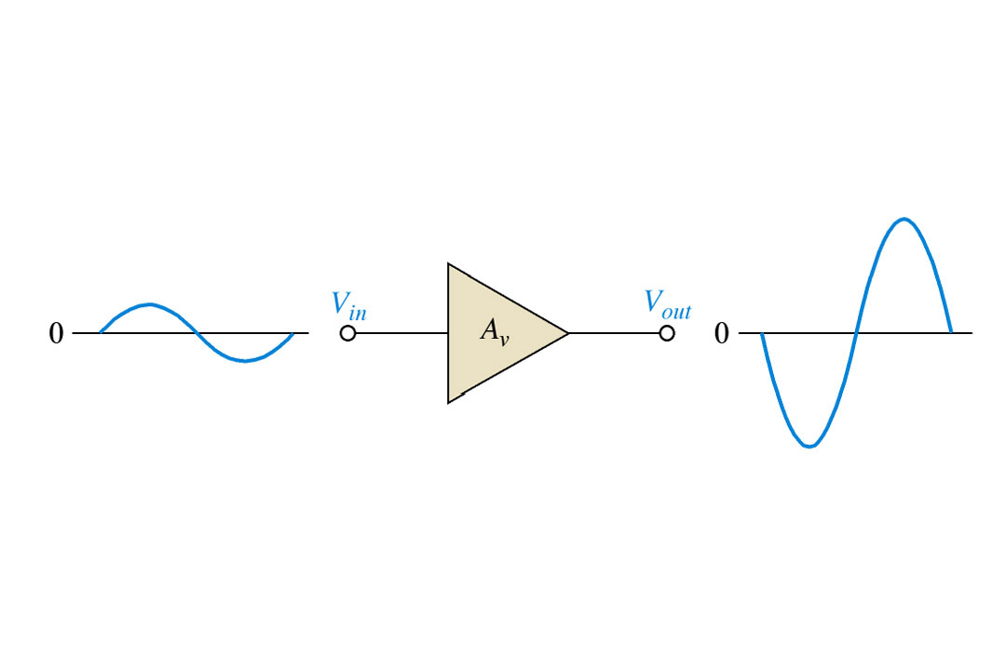
Basic class A amplifier operation. Output is shown 180∞ out of phase with the input (inverted).

Slide 21
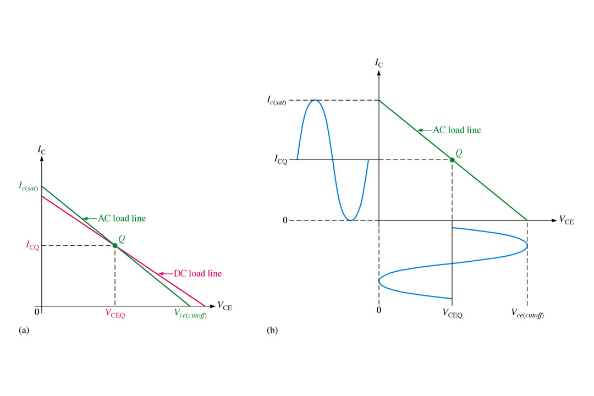
Maximum class A output occurs when the Q-point is centered on the ac load line.

Slide 22
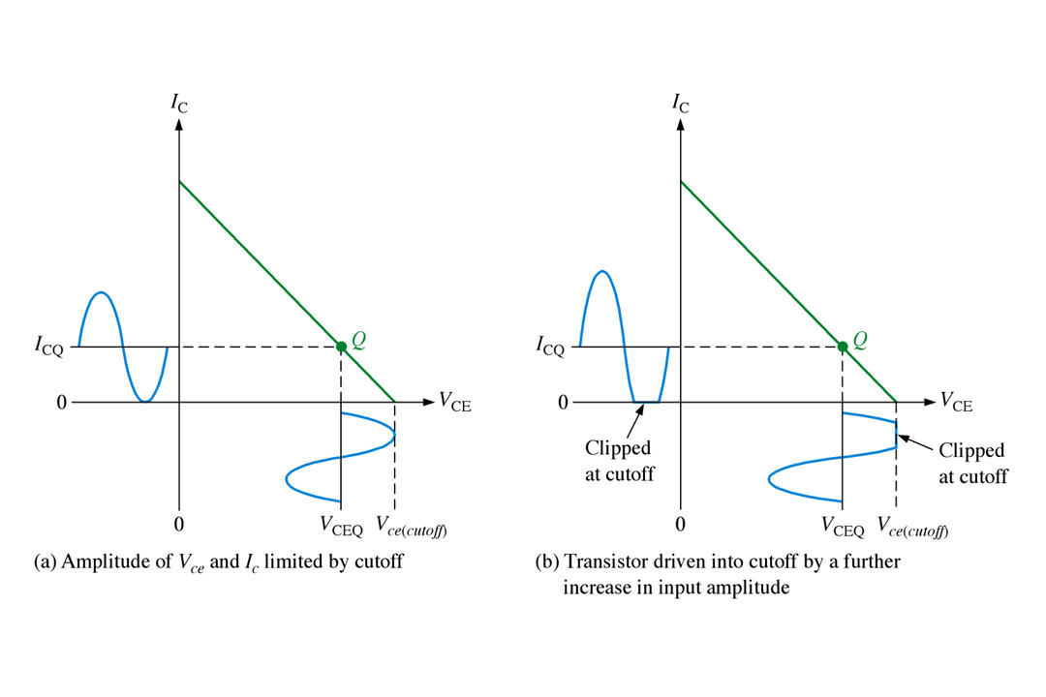
Q-point closer to cutoff.

Slide 23
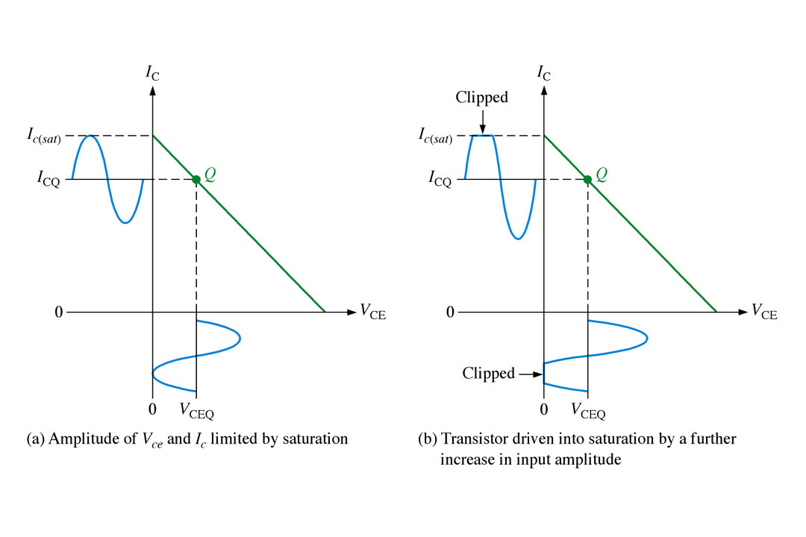
Q-point closer to saturation.

Slide 24
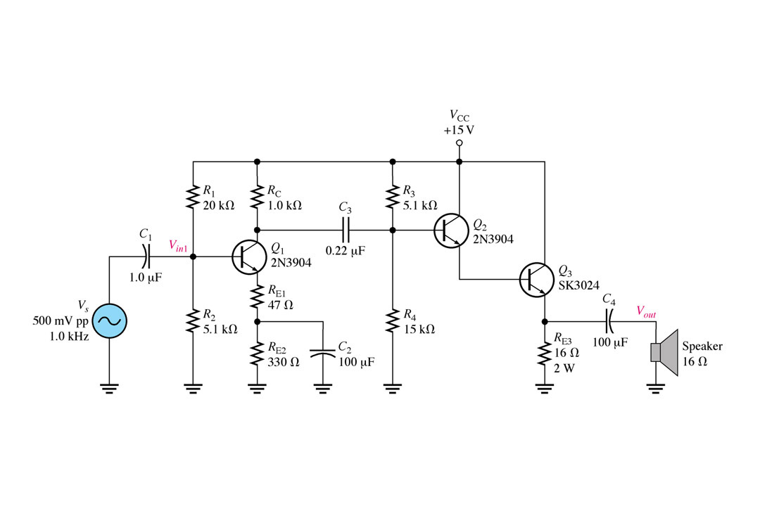
FIGURE

Slide 25
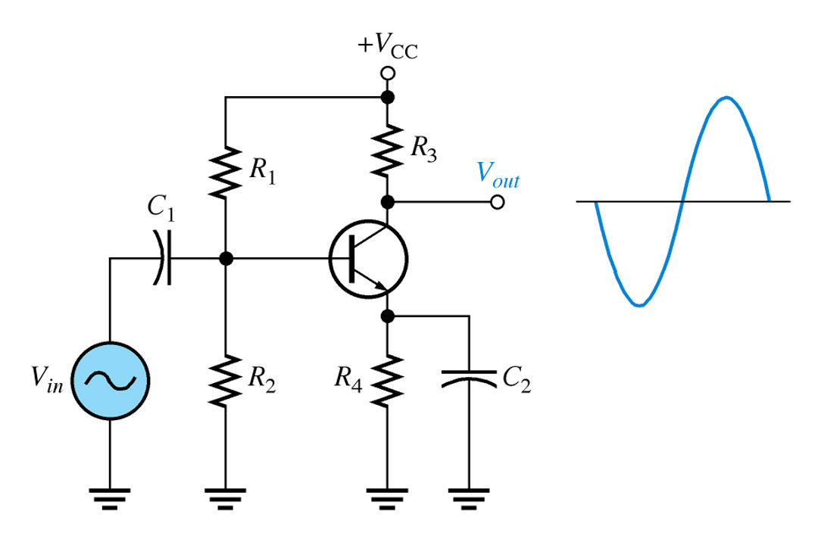
FIGURE 9-30 Class A power amplifier with correct output voltage swing.

Slide 26
Why is class A so inefficient ?
Single transistor can only conduct in one direction.
D.C. bias current is needed to cope with negative going signals.
75 % (or more) of the supplied power is dissipated by d.c.
Solution : eliminate the bias current.

Slide 27
Class A
Class A amplifiers have very low distortion (lowest distortion occurs when the volume is low)
They are very inefficient and are rarely used for high power designs.
The distortion is low because the transistors in the amp are biased such that they are half "on" when the amp is idling

Slide 28
Class A
As a result of being half on at idle, a lot of power is dissipated in the devices even when the amp has no music playing!
Class A amps are often used for "signal" level circuits (where power requirements are small) because they maintain low distortion.

Slide 29
Class-A Benefits
The first is circuit simplicity.
The signal is subjected to comparatively little amplification, resulting in an open loop gain which is generally fairly low.
This means that very little overall feedback is used, so stability and phase should be excellent over the audio frequencies.
Do not require any frequency compensation.

Slide 30
Class-A Benefits
No cross over distortion
No switching distortion
Lower harmonic distortion in the voltage amplifier
Lower harmonic distortion in the current amplifier
No signal dependent distortion from the power supply
Constant and low output impedance
Simpler design

Slide 33
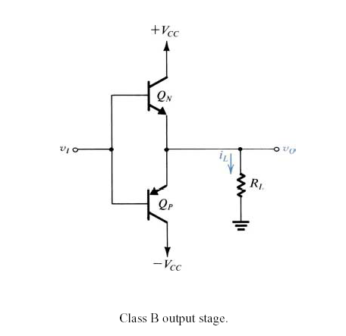
Circuit Operation

Slide 34
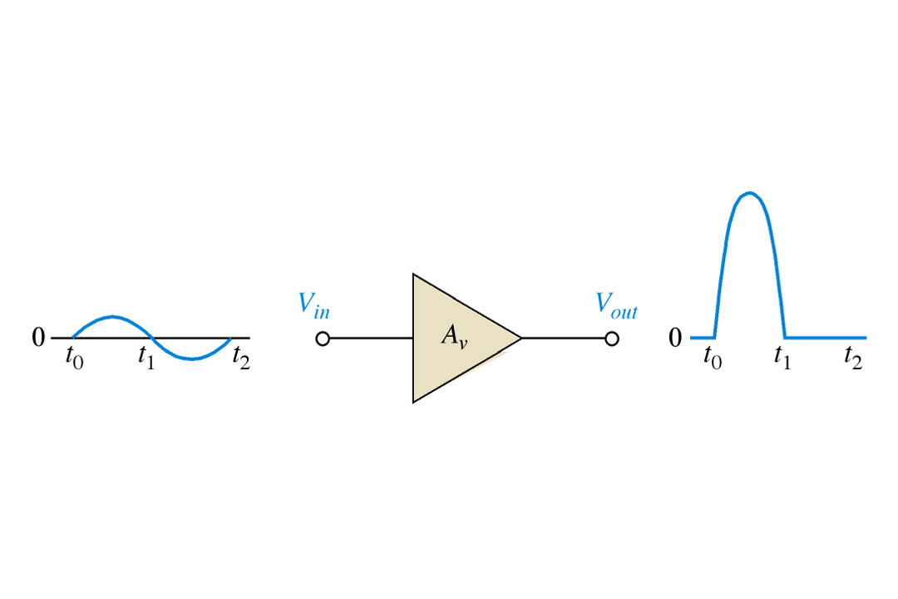
Basic class B amplifier operation (noninverting).

Slide 35
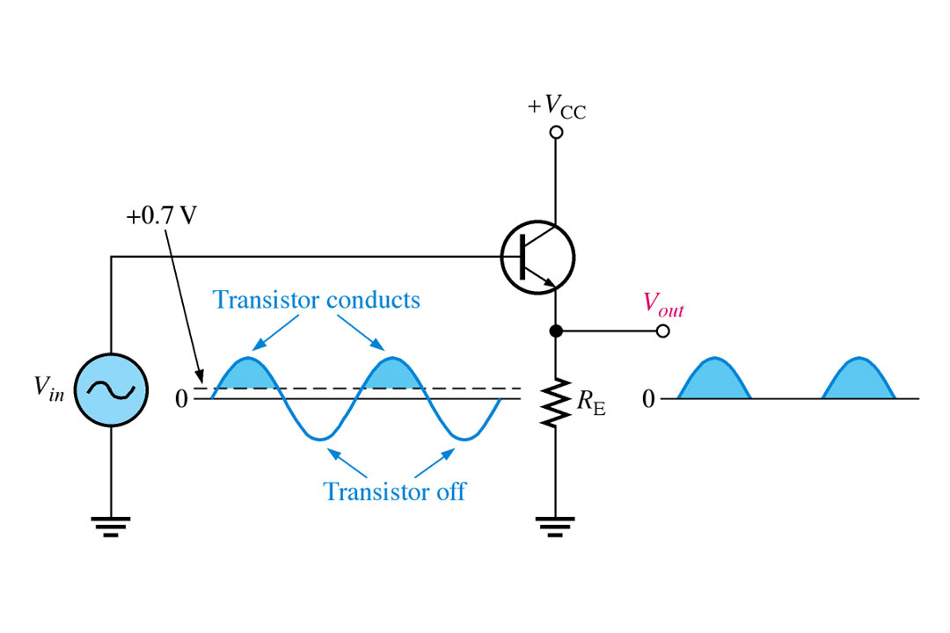
Common-collector class B amplifier.

Slide 36
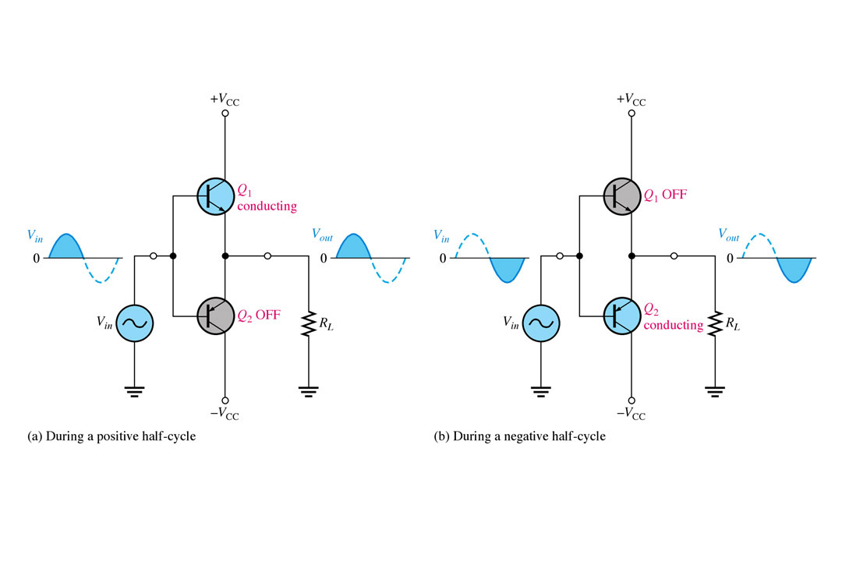
Class B push-pull ac operation.

Slide 37
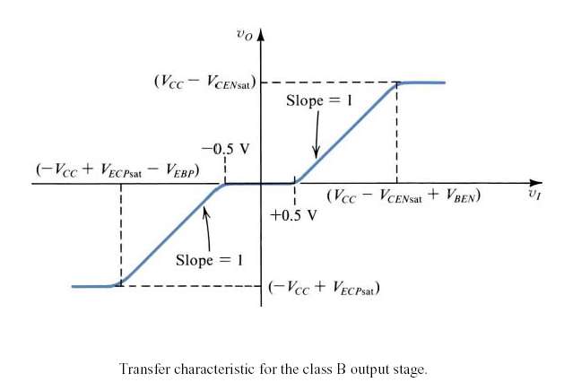
Transfer Characteristics

Slide 38
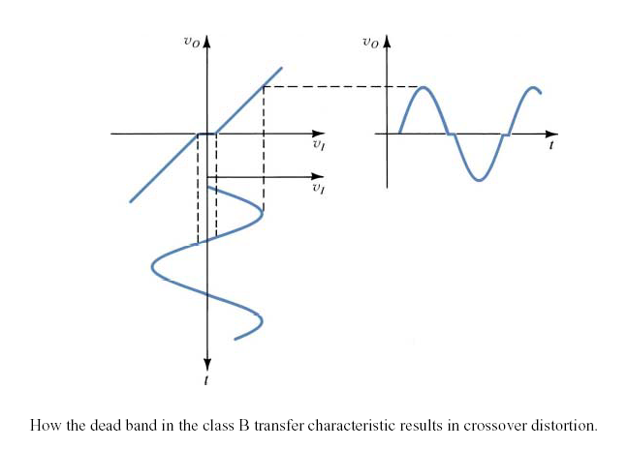
Crossover Distortion

Slide 39
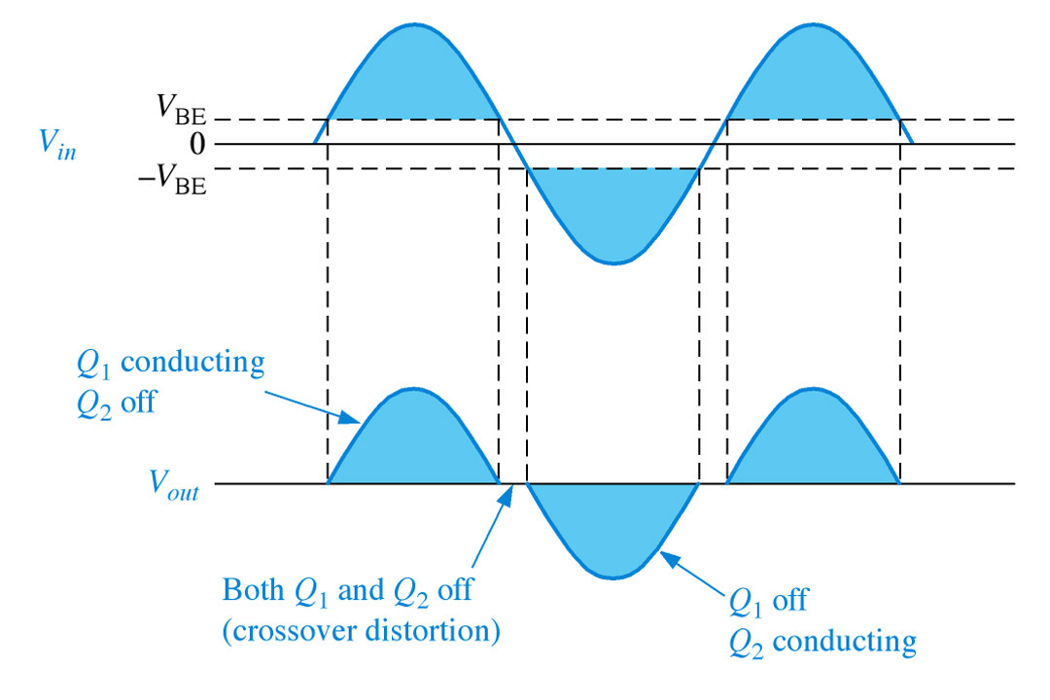
Illustration of crossover distortion in a class B push-pull amplifier. The transistors conduct only during the portions of the input indicated by the shaded areas.

Slide 40
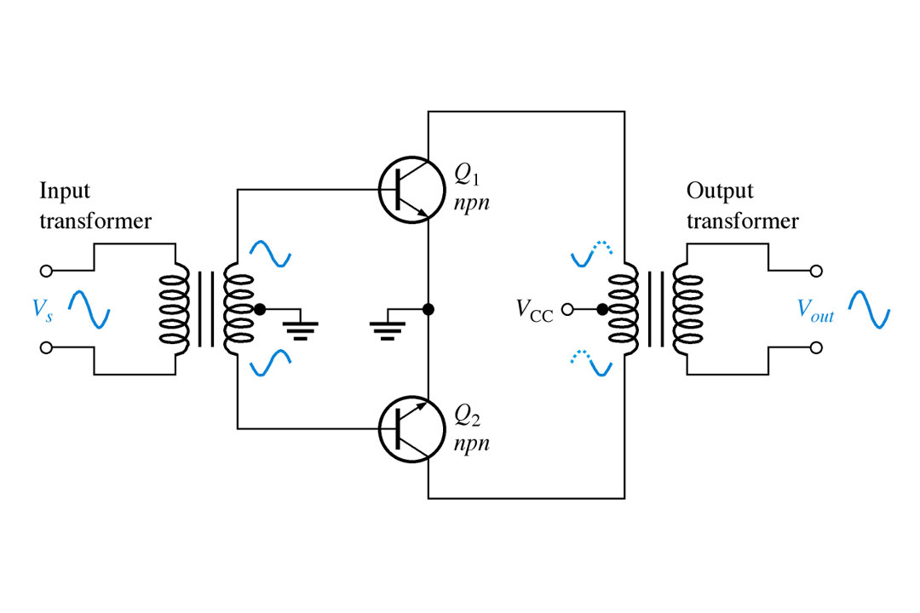
Transformer coupled push-pull amplifiers. Q₁ conducts during the positive half-cycle; Q₂ conducts during the negative half-cycle. The two halves are combined by the output transformer.

Slide 41
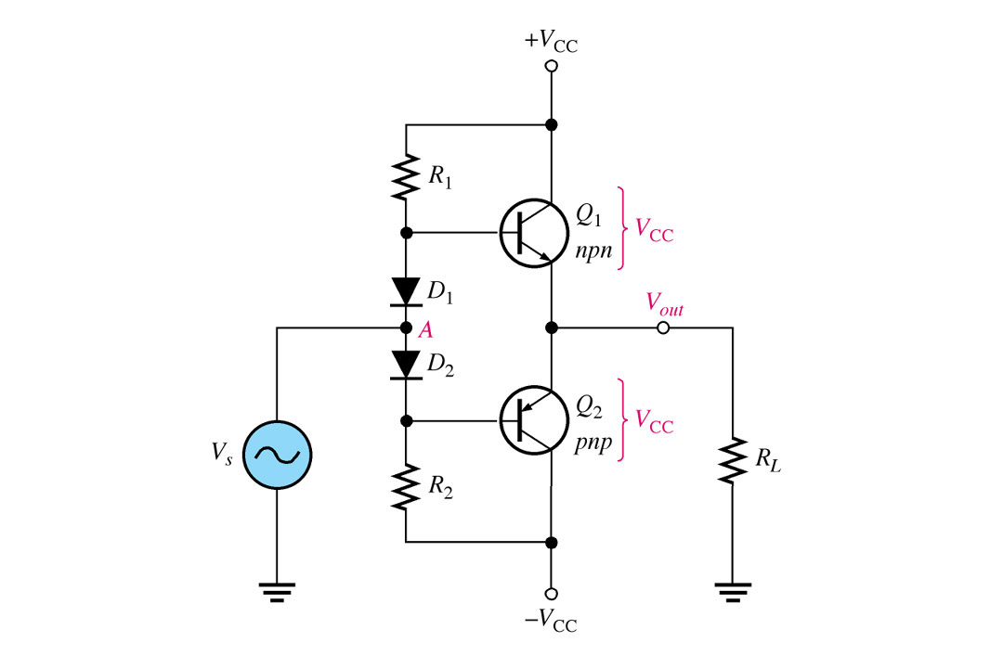
Biasing the push-pull amplifier to eliminate crossover distortion.

Slide 42
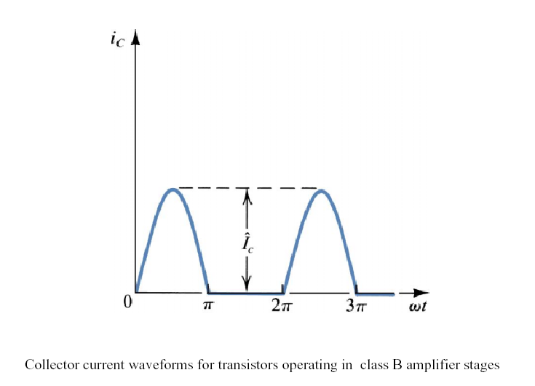

Slide 43
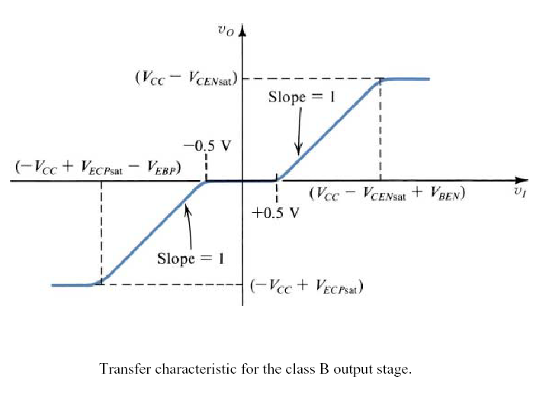

Slide 44
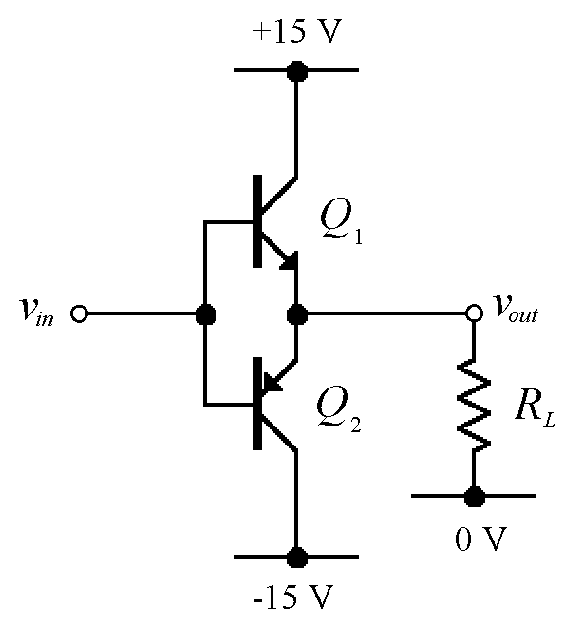
Class B Output Stage
Q₁ and Q₂ form two unbiased emitter followers
Q₁ only conducts when the input is positive
Q₂ only conducts when the input is negative
Conduction angle is, therefore, 180°
When the input is zero, neither conducts
i.e. the quiescent power dissipation is zero

Slide 45
Class B Current Waveforms
I_{out}
time
I_{C1}
time
I_{C2}
time

Slide 46
Efficiency / Power Dissipation
Peak efficiency of the class B output stage is 78.5 %, much higher than class A.
Unlike class A, power dissipation varies with output amplitude.
Remember, there are two output devices so the power dissipation is shared between them.

Slide 47
Cross-Over Distortion
A small base-emitter voltage is needed to turn on a transistor
Q₁ actually only conducts when v_{in} > 0.7 V
Q₂ actually only conducts when v_{in} < -0.7 V
When 0.7 > v_{in} > -0.7, nothing conducts and the output is zero.
i.e. the input-output relationship is not at all linear.

Slide 48
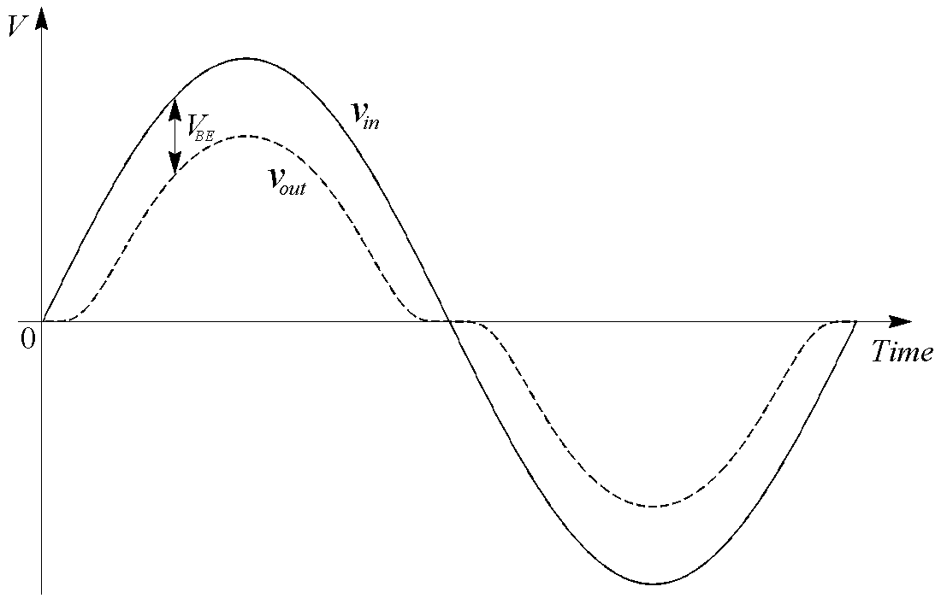
Effect of Cross-Over Distortion

Slide 49
Class B
A class B output stage can be far more efficient than a class A stage (78.5 % maximum efficiency compared with 25 %).
It also requires twice as many output transistors…
…and it isn’t very linear; cross-over distortion can be significant.

Slide 50
Class B
Class B amplifiers are used in low cost designs or designs where sound quality is not that important.
Class B amplifiers are significantly more efficient than class A amps.
They suffer from bad distortion when the signal level is low (the distortion in this region of operation is called "crossover distortion").

Slide 51
Class B
Class B is used most often where economy of design is needed.
Before the advent of IC amplifiers, class B amplifiers were common in clock radio circuits, pocket transistor radios, or other applications where quality of sound is not that critical.

Slide 53
Class AB
Class AB is probably the most common amplifier class currently used in home stereo and similar amplifiers.
Class AB amps combine the good points of class A and B amps.
They have the improved efficiency of class B amps and distortion performance that is a lot closer to that of a class A amp.

Slide 54
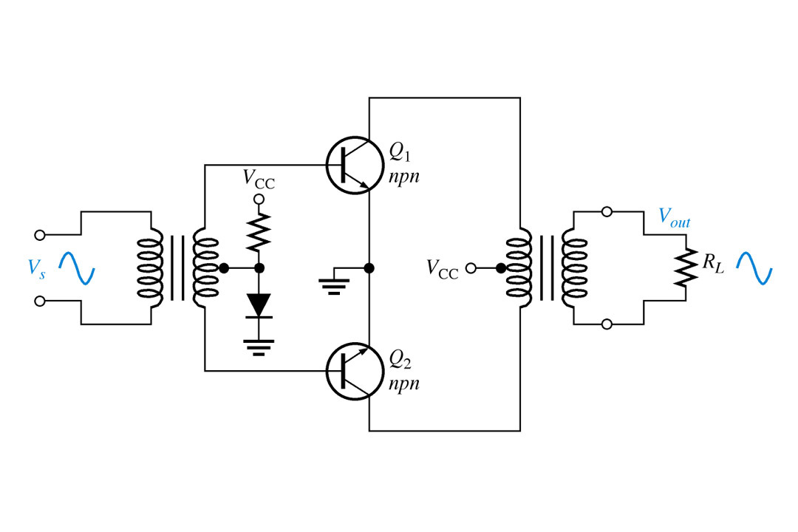
Eliminating crossover distortion in a transformer-coupled push-pull amplifier. The diode compensates for the base-emitter drop of the transistors and produces class AB operation.

Slide 55
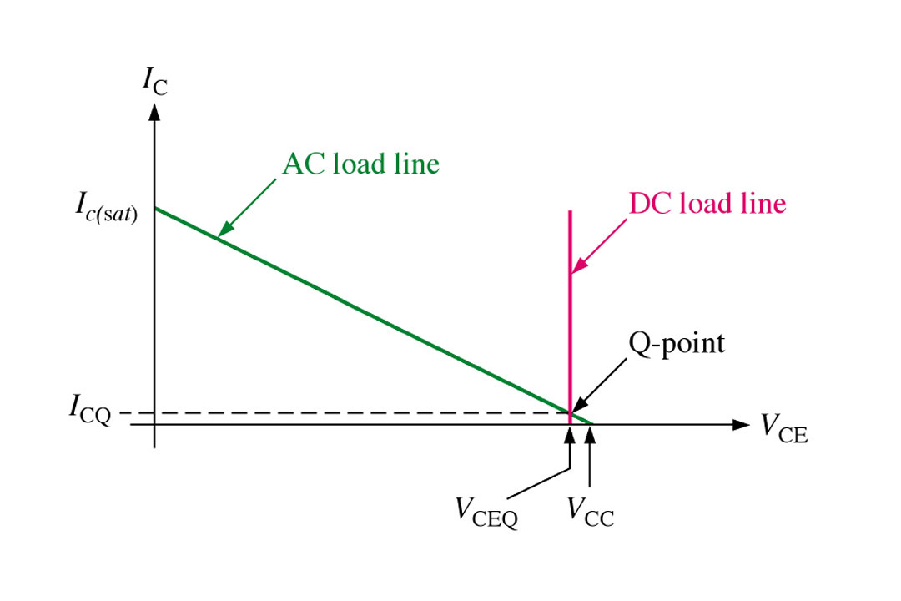
Load lines for a complementary symmetry push-pull amplifier. Only the load lines for the npn transistor are shown.

Slide 56
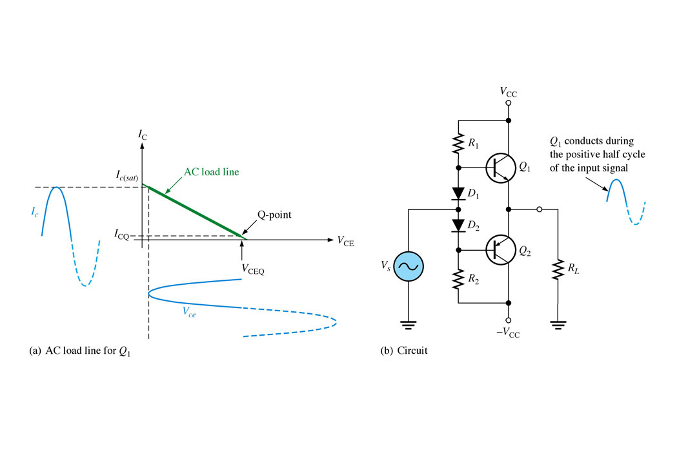

Slide 57
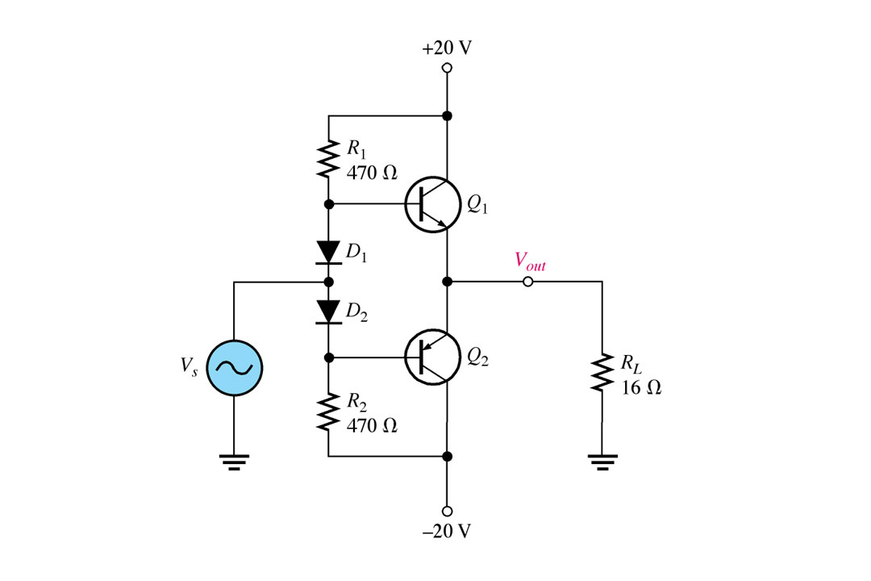

Slide 58
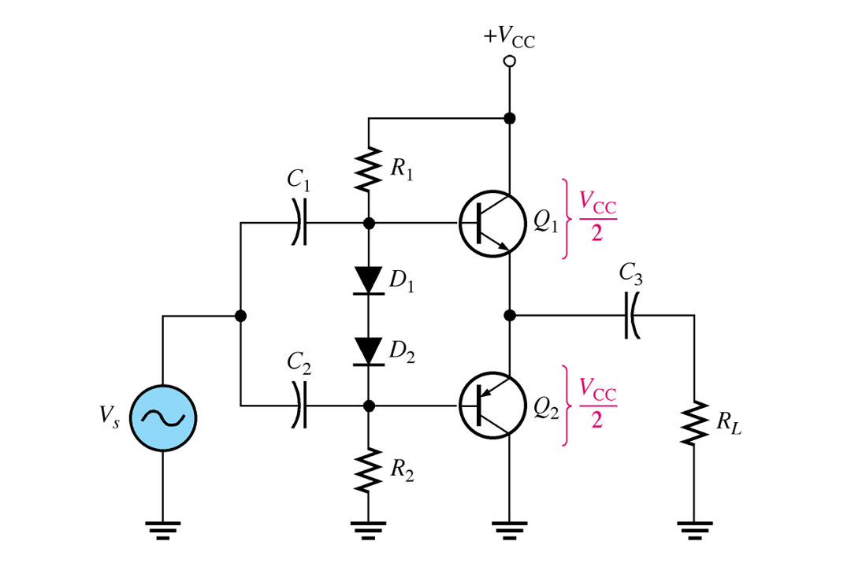
Single-ended push-pull amplifier.

Slide 59
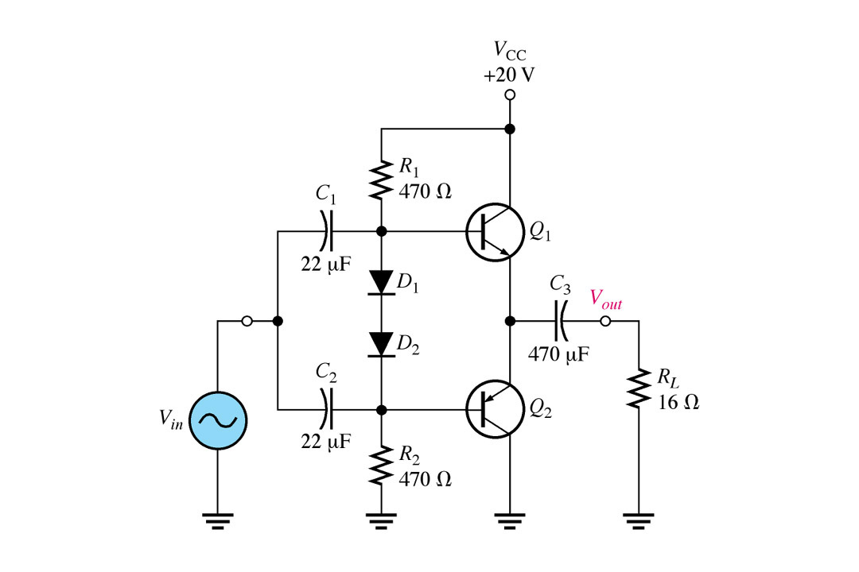

Slide 60
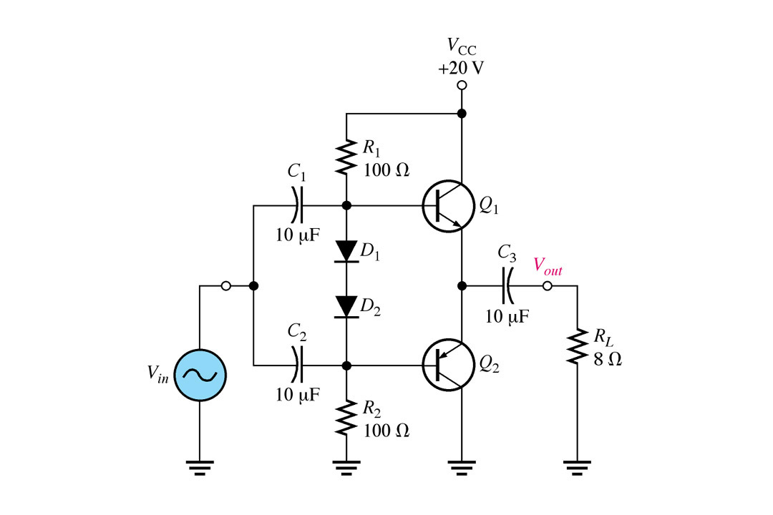

Slide 61
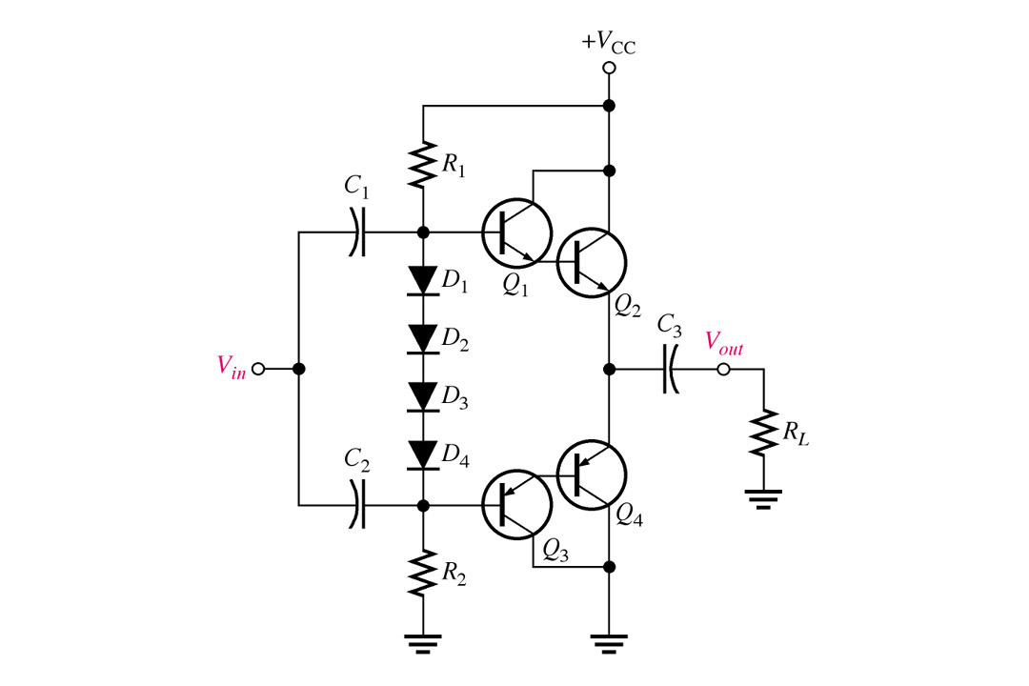
A Darlington class AB push-pull amplifier.

Slide 62
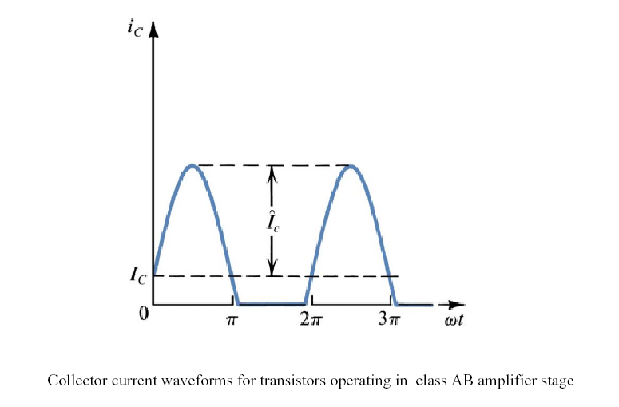

Slide 63
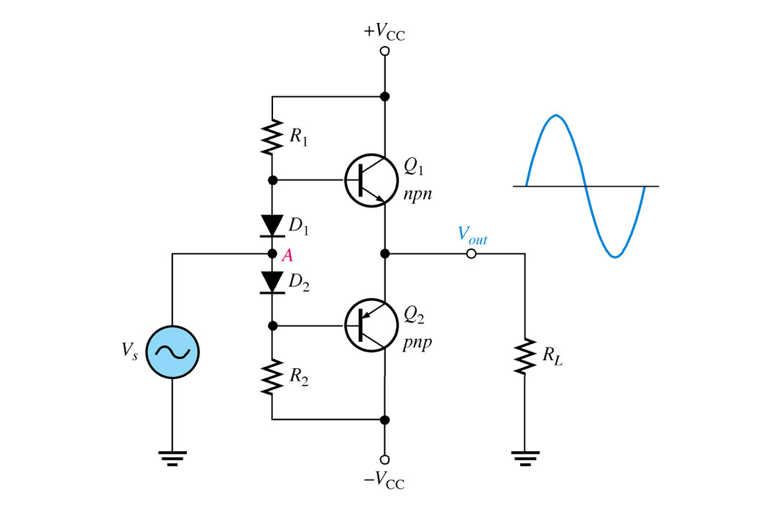
FIGURE A Class AB push-pull amplifier with correct output voltage.

Slide 64
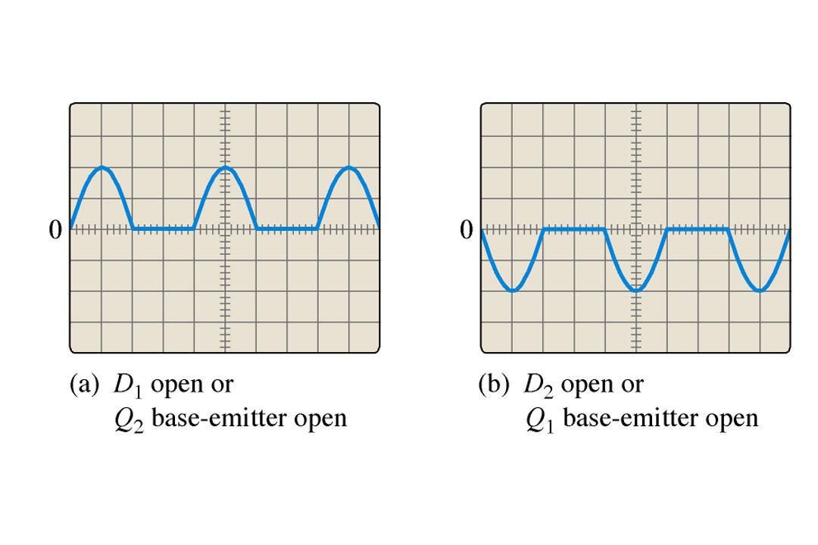
FIGURE Incorrect output waveforms for the amplifier in Figure.

Slide 65
Class AB
With such amplifiers, distortion is worst when the signal is low, and generally lowest when the signal is just reaching the point of clipping.
Class AB amps use pairs of transistors, both of them being biased slightly ON so that the crossover distortion (associated with Class B amps) is largely eliminated.

Slide 66
Class C
Class C amps are never used for audio circuits.
They are commonly used in RF circuits.
Class C amplifiers operate the output transistor in a state that results in tremendous distortion (it would be totally unsuitable for audio reproduction).

Slide 67
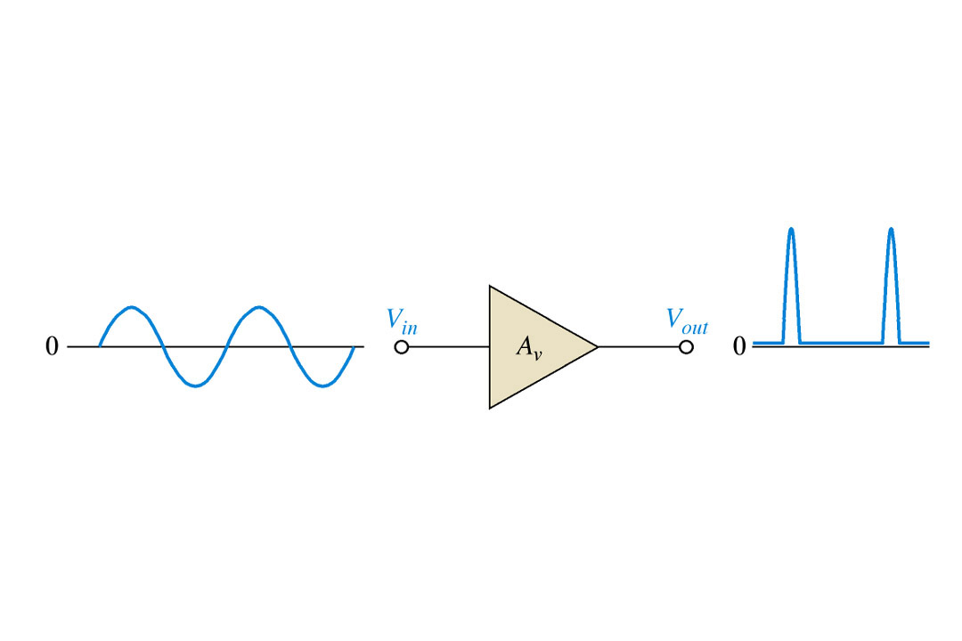
FIGURE Basic class C amplifier operation (non inverting).

Slide 68
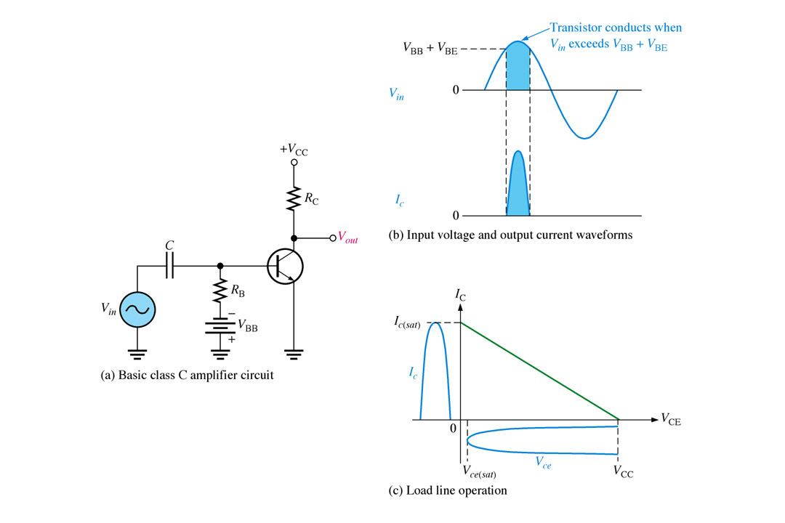
FIGURE Basic class C operation.

Slide 69
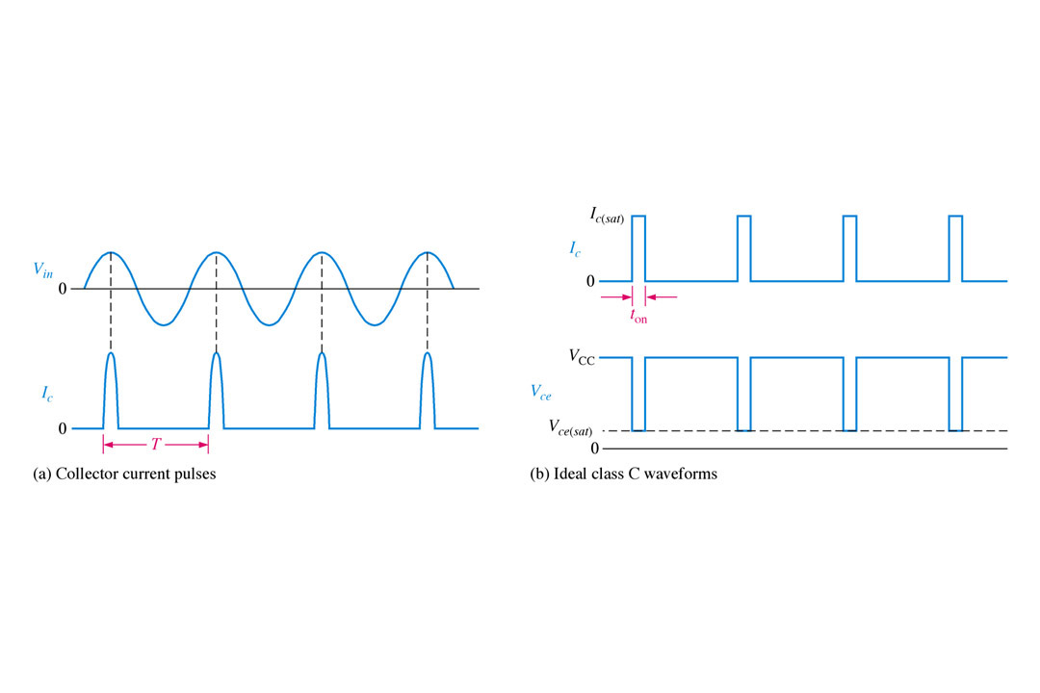
FIGURE Class C waveforms.

Slide 70
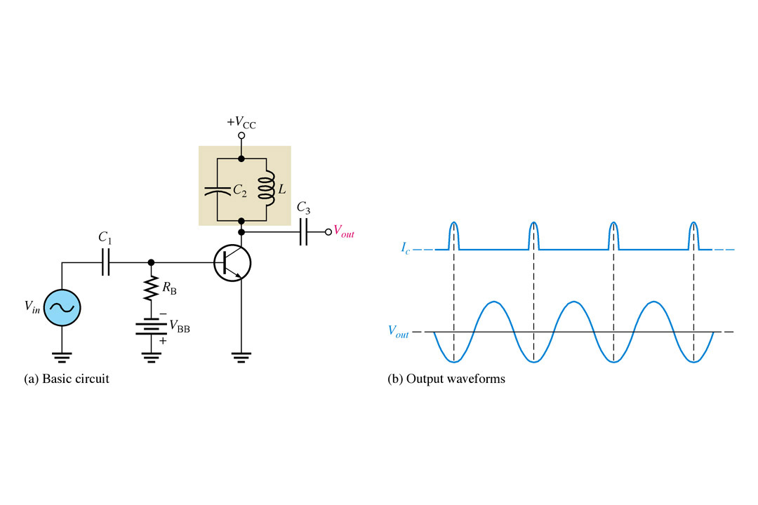
FIGURE Tuned class C amplifier.

Slide 71
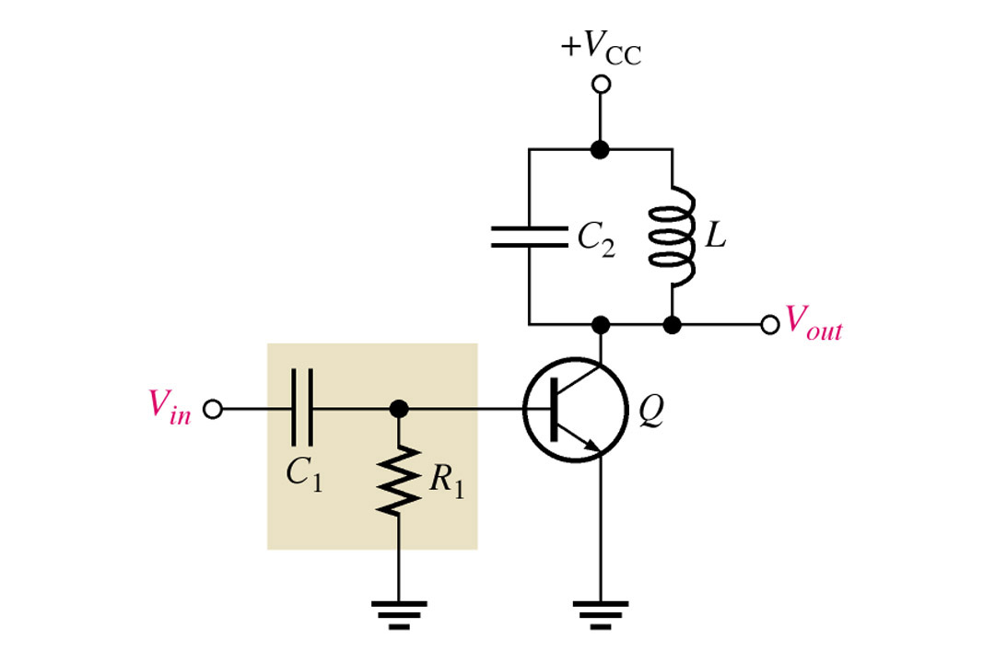
FIGURE Tuned class C amplifier with clamper bias.

Slide 72
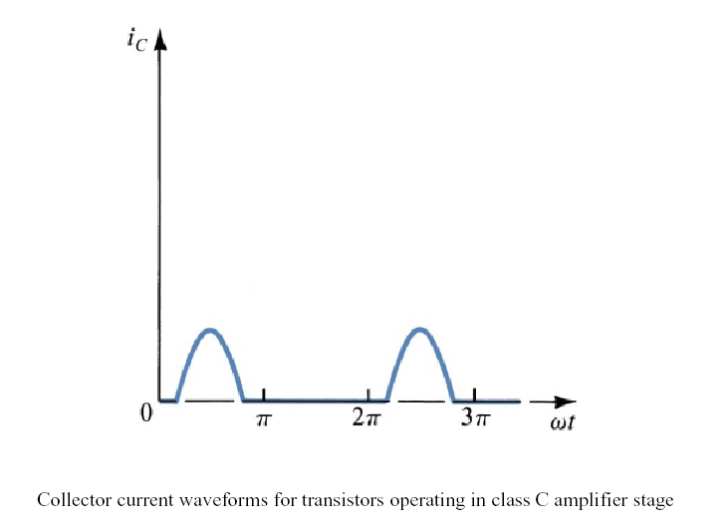

Slide 73
Class C
However, the RF circuits where Class C amps are used, employ filtering so that the final signal is completely acceptable.
Class C amps are quite efficient.

